Slide 1
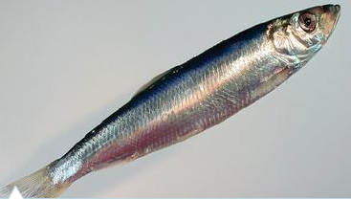
XSAM course
Forecasting
Sondre Aanes
IMR, Bergen
15 - 17/1-2017

Slide 2
The least developed piece…

Slide 3
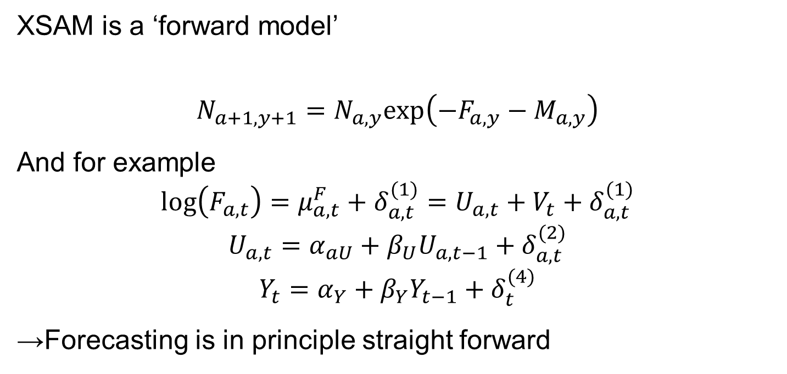
Forecasting using XSAM
XSAM is a ‘forward model’
$$N_{a+1,y+1}=N_{a,y}exp\left(−F_{a,y}−M_{a,y}\right)$$
And for example
$$log\left(F_{a,t}\right)=μ_{a,t}^{F}+δ_{a,t}^{(1)}=U_{a,t}+V_{t}+δ_{a,t}^{(1)}$$
$$U_{a,t}=α_{aU}+β_{U}U_{a,t−1}+δ_{a,t}^{(2)}$$
$$Y_{t}=α_{Y}+β_{Y}Y_{t−1}+δ_{t}^{(4)}$$
→Forecasting is in principle straight forward

Slide 4
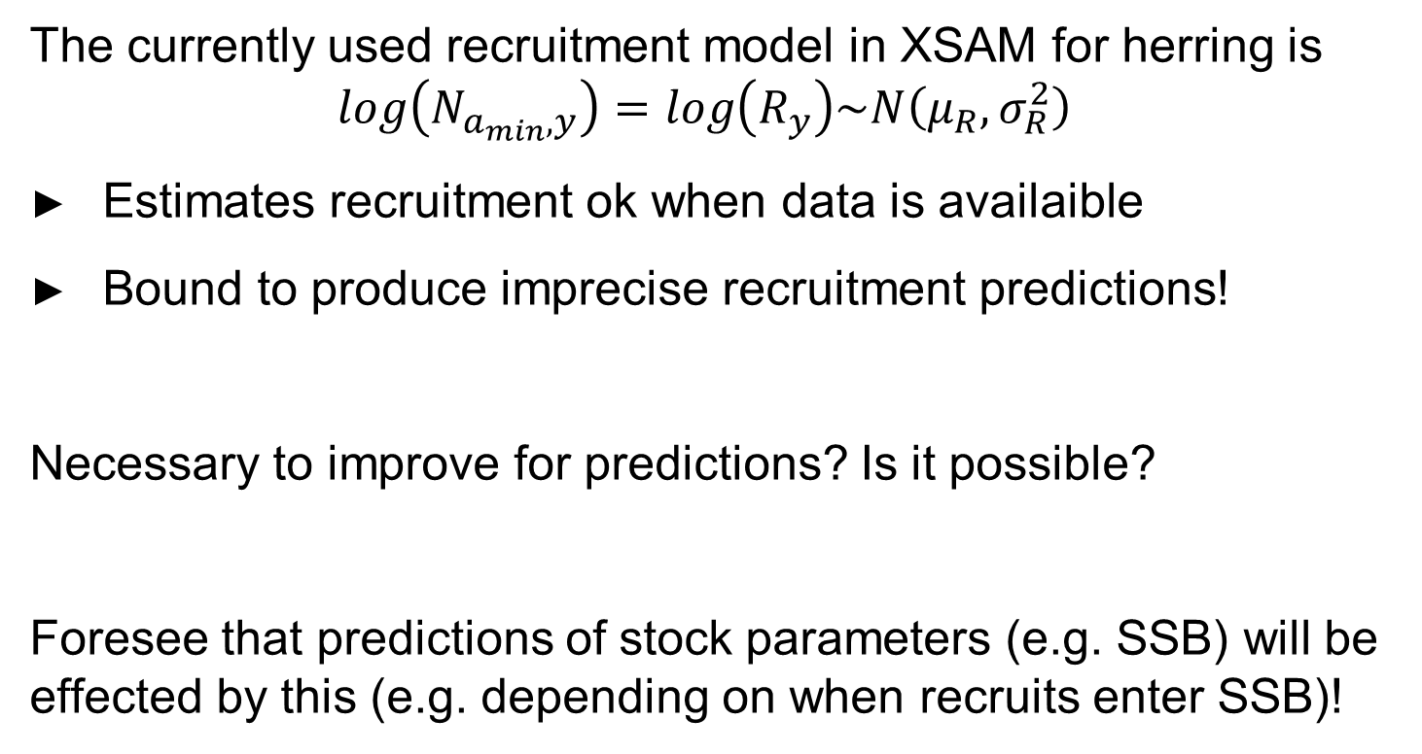
Recruitment
The currently used recruitment model in XSAM for herring is
$$log\left(N_{a_{min},y}\right)=log\left(R_{y}\right)\sim N\left(μ_{R},σ_{R}^{2}\right)$$
Estimates recruitment ok when data is availaible
Bound to produce imprecise recruitment predictions!
Necessary to improve for predictions? Is it possible?
Foresee that predictions of stock parameters (e.g. SSB) will be effected by this (e.g. depending on when recruits enter SSB)!

Slide 5
Uncertainty in forecasts
Variability is caused by
Variability in stochastic processes
Uncertainty in parameters and initial values
Variability in predictions are found by simulations:
Simulate parameters (joint distribution avilable from TMB)
Simulate processes (defined by the model)
Repeating this a large number of times (n>1000) provides the sample distribution of predictions!

Slide 6
Forecasting
Two cases are implemented:
Use the model to project catches (no information about future catches is used other than the dynamics captured by the model)
Constraining F according to TAC (use selection pattern from 1., but adjust to TAC) given by managementplan for NSS herring.
Implement the mangement plan to set TAC using point estimates of SSB as input and F averaged over ages 5-10

Slide 7
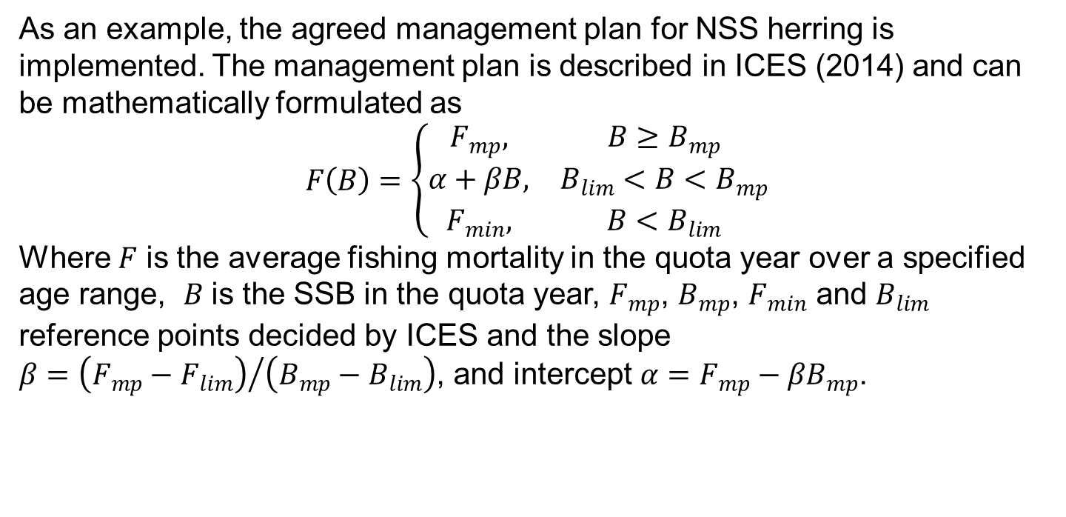
Implemented HCR
As an example, the agreed management plan for NSS herring is implemented. The management plan is described in ICES (2014) and can be mathematically formulated as
$$F\left(B\right)=\left\{\begin{matrix}F_{mp}, & B≥B_{mp} \\ α+βB, & B_{lim}<B<B_{mp} \\ F_{min}, & B<B_{lim}\end{matrix}\right.$$
Where $F$ is the average fishing mortality in the quota year over a specified age range, $B$ is the SSB in the quota year, $F_{mp}$, $B_{mp}$, $F_{min}$ and $B_{lim}$ reference points decided by ICES and the slope $β={\left(F_{mp}−F_{lim}\right)}/{\left(B_{mp}−B_{lim}\right)}$, and intercept $α=F_{mp}−βB_{mp}$.

Slide 8
NSS Herring Mangementplan
F_{mp}=0.125
F_{min}=0.05
B_{mp}=5000
B_{lim}=2500

Slide 9
Follow example ‘XSAM_herring_forecast.R’
Key R functions are:
‘ProjectPoP’
‘DoXSAMForecast’: a wrapper for ProjectPoP adapted to herring type HCR

