Slide 1
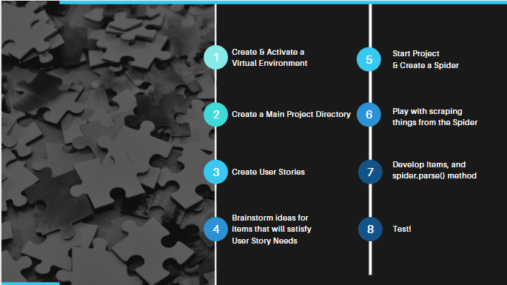

Slide 2


For more accessible code,
create a virtual environment

Slide 3

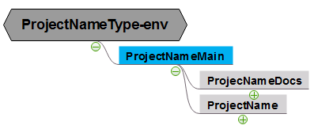

Slide 4
Understand the purpose of the project to create User Stories

Slide 5
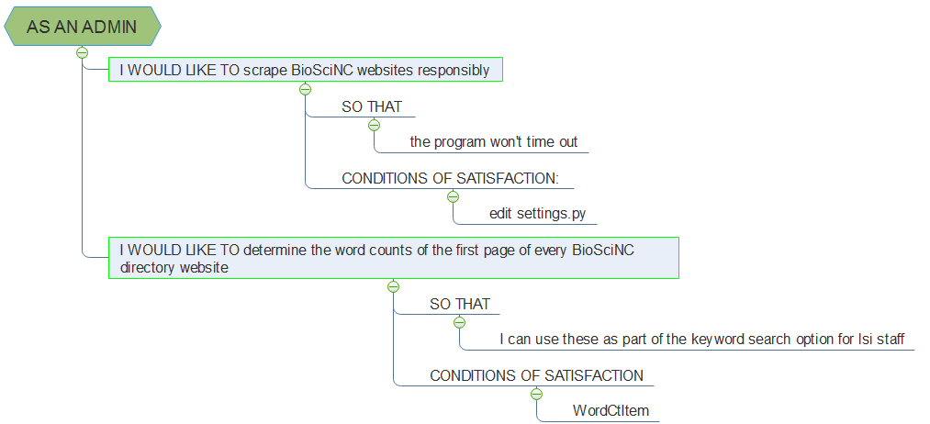

------------
------------------------------------
-----------
s

Slide 6
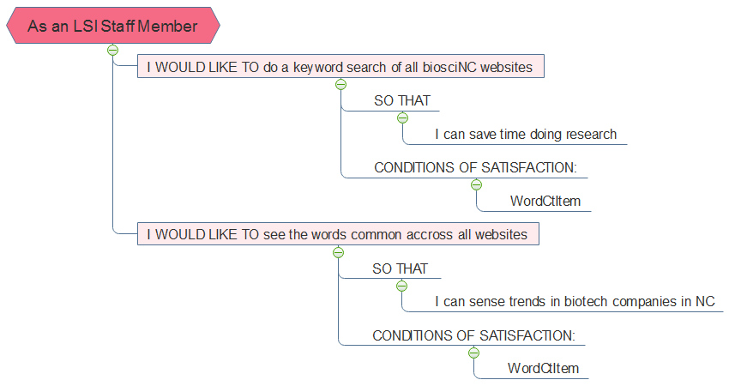
-------------
of a specified contact type
of a specified contact type
-------------

Slide 7
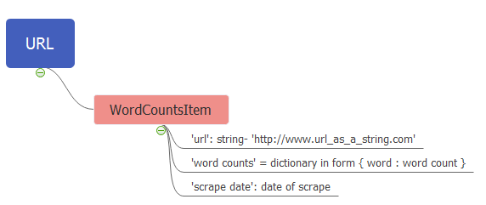
Scrapy uses objects called items, which are dictionary-like

Slide 8


Slide 10
Need to do more research

Slide 11
They are called spiders because they crawl the web!

Slide 12
Scrapy has built in selectors to parse data
Or you can use other parsing and scraping methods. I used Python’s BeautifulSoup because it was the only way I could figure out how to produce all of the visual text within the body

