Slide 1


Reuse functional Selenium tests for performance testing activities using K8s cluster as a performance testing platform
Realised by
Mariem Zouari

Slide 2
Plan
General context
Architecture and Technologies
Implementation and Results
Conclusion

Slide 3

General Context
Project context
While these two forms of testing serve two distinct purposes in the software development lifecycle, they also feed into each other and can be used in tandem to ensure the software performance.
Notes:
There are mainly two types of software testing.
The goal of functional testing is to ensure your API does what it is supposed to do and returns the data it’s expected to return.
Performance testing witch is a non functional test is about creating production level load simulations within the software .
While these two forms of testing serve two distinct purposes in the software development lifecycle, they also feed into each other and can be used in together to ensure the software performance.

Slide 4

General Context
Problematic
JMeter is not a real browser, so the reported response times do not include page rendering.
Notes:
Jmeter is the load tool that I am required to use in my project. however JMeter is not a real browser, so the reported response times do not include page rendering.
Selenium functional tests can automate the collection of the client-side performances.
Thus while the JMeter Load Test will put enough load on the system, the JMeter WebDriver plan will get the response times and other behavior from an end-user point of view.

Slide 5

General Context
Proposed solution
Selenium functional tests can automate the collection of the client-side performances.
Thus while the JMeter Load Test will put enough load on the system, the JMeter WebDriver plan will get the response times and other behavior from an end-user point of view.

Slide 6
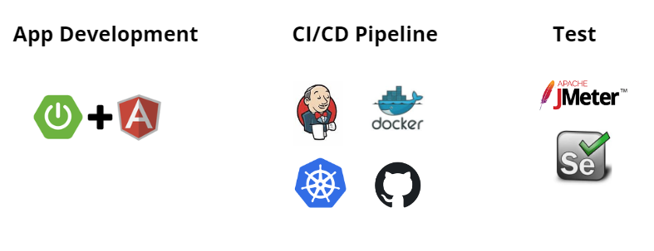
Used Technologies and Architecture (1/4)
Used Technologies

Slide 7
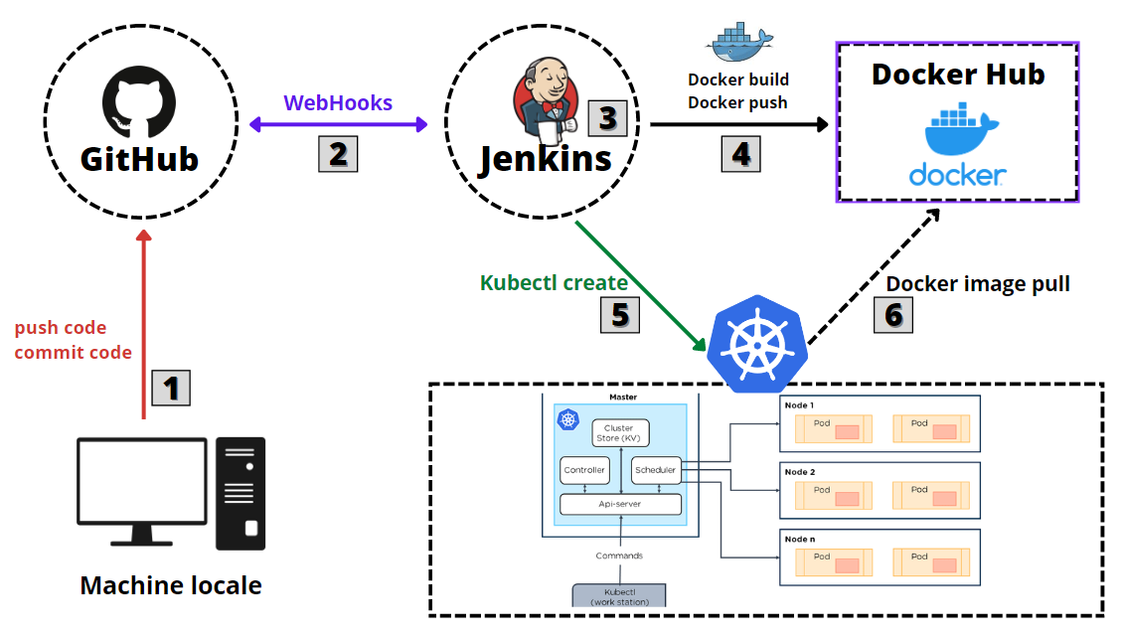
Used Technologies and Architecture (1/4)
CI/CD Pipeline : Deploy the App
Notes:
This figure details the CI/CD pipeline implemented to deploy the app
The developer must first commit and push changes to the git repository.
Jenkins then detects these changes through the webhooks, it launches the CI/CD pipeline
1- the Build to generate the artifacts.(Frontend / Backend)
2-Create the Docker images from the provided Dockerfile and then push them to Docker HUB
3-Deploy the application on our Kubernetes cluster.
In order to create and update instances of the application, Kubernetes needs to pull the apps docker images from docker Hub.

Slide 8
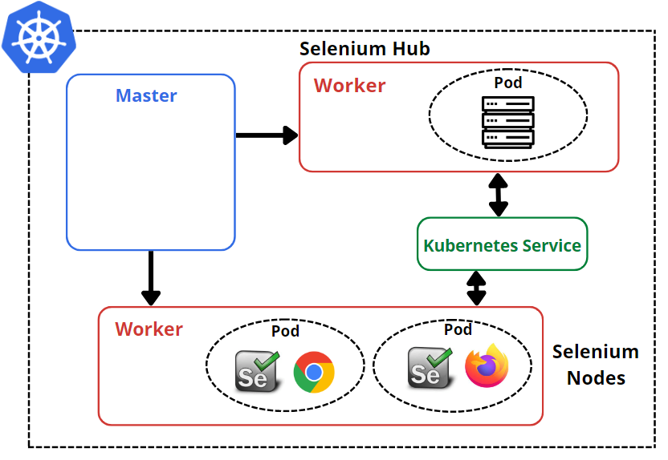
Used Technologies and Architecture (1/4)
Selenium Grid Architecture
Selenium Grid is a smart proxy server that makes it easy to run tests in parallel on multiple machines. This is done by routing commands to remote web browser instances.
Notes:
Selenium Grid is a smart proxy server that makes it easy to run tests in parallel on multiple machines. This is done by routing commands to remote web browser instances.
The two major components of the Selenium Grid architecture are:
-Hub :takes instructions from the client and executes them remotely on the various nodes in parallel
-Node It receives requests from the hub in the form of JSON test commands and executes them using WebDriver
I chose to deploy it on kubernetes to make the selenium nodes easily scalable.

Slide 9
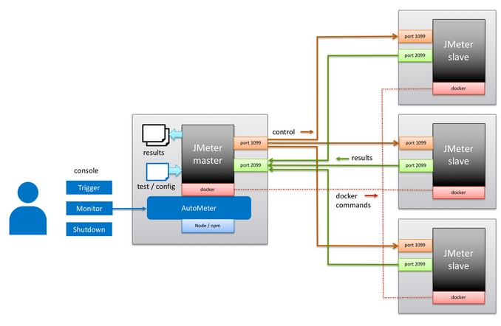
Used Technologies and Architecture (1/4)
Jmeter Distributed Architecture
Distributed Testing in JMeter helps to scale-up the capacity of JMeter to generate the desired number of thread (users) to perform the Load Test. The distributed testing follows the master-slave architecture.
Notes:
Distributed Testing in JMeter helps to scale-up the capacity of JMeter to generate the desired number of thread (users) to perform the Load Test. The distributed testing follows the master-slave architecture.
-The jmeter master controls the test execution
-The slaves follow the instruction initiated by the master machine and sends the requests to the target server.
this architecture is also deployed on the kubernetes cluster

Slide 10
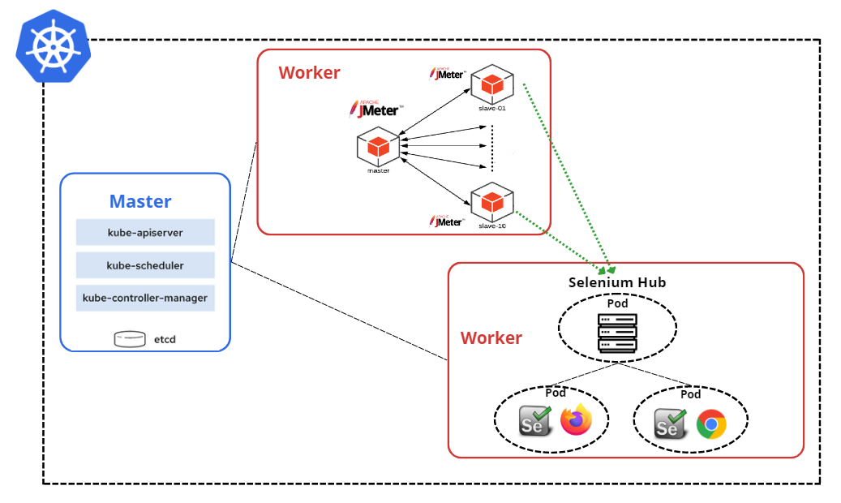
Used Technologies and Architecture (1/4)
Complete Test Process
Notes:
this figure shows us the complete test process.
at first the jmeter master pod will detect all the existing slave pods to trigger the test execution in each one of them.
in order to run the selenium scripts the jmeter slave pods will send them to selenium hub pod.this pod will send the test commands to selenium nodes where they will be executed.

Slide 11
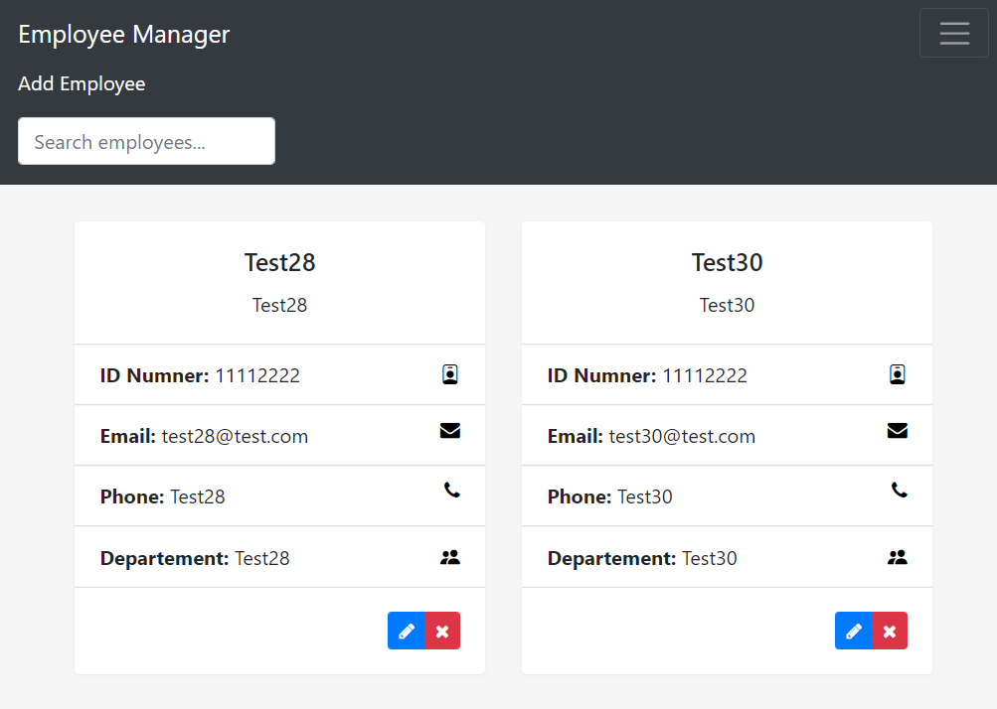
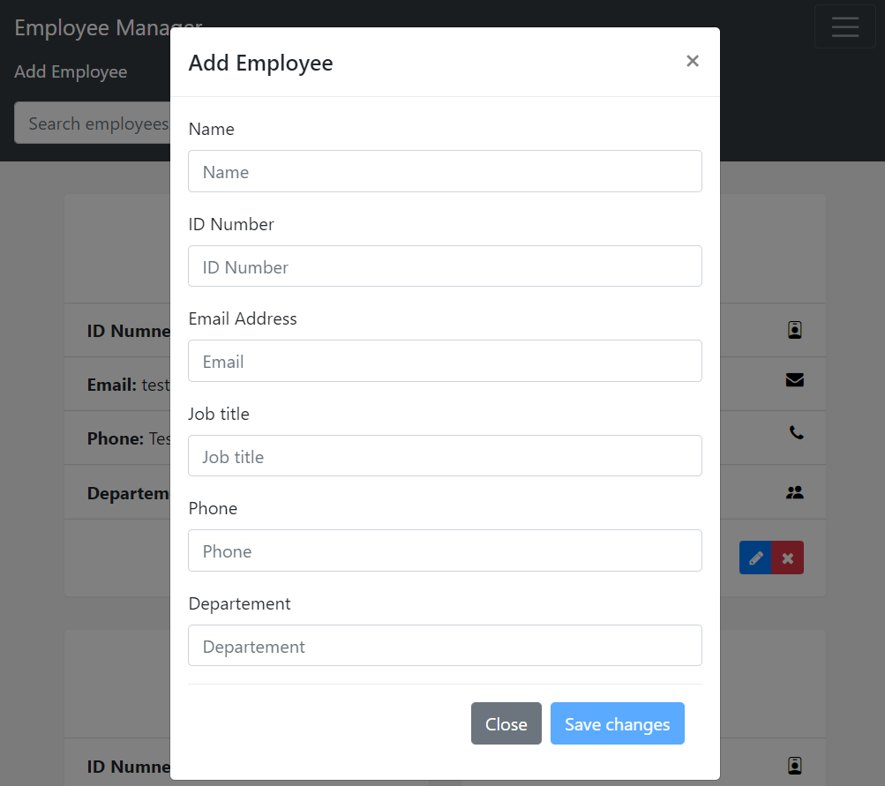
Implementation & results
Develop the reference application
Notes:
those my application home page and and the form used to add an employee
as stated before angular spring boot

Slide 12
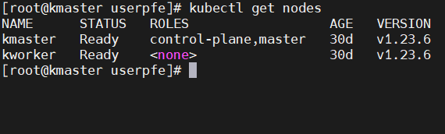
Implementation & results
Setup the environment
Rôle | Hostname | Adresse IP | SE | RAM | CPU
Master | Kmaster | 10.66.12.45 | CentOS 7 | 2 GB | 2
Worker | Kworker | 10.66.12.46 | CentOS 7 | 2 GB | 2

Slide 13
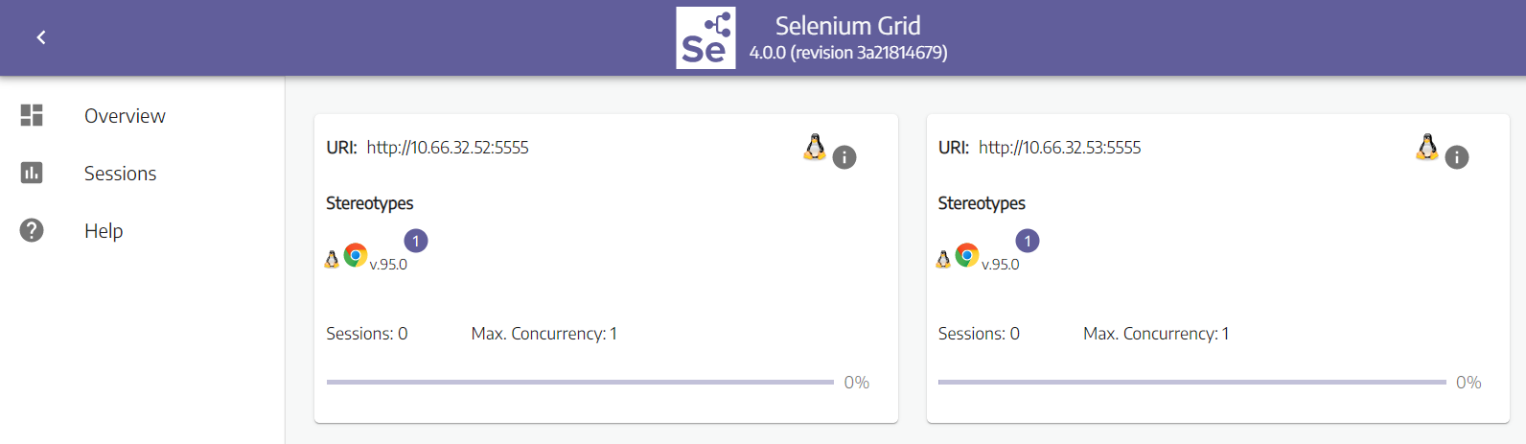
Implementation & results
Deploy Selenium Grid

Slide 14
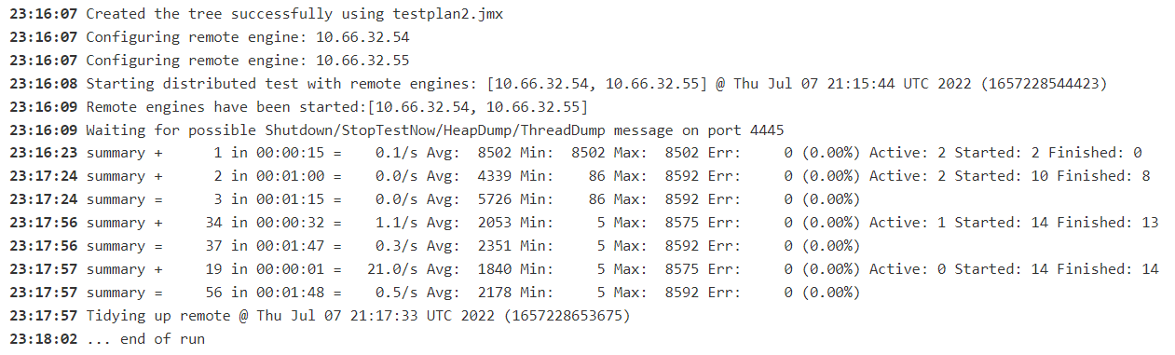
Implementation & results
Execute the test and generate result file
Notes:
we can see in the screenshot that there are two jmeter slaves pods those are their ip @

Slide 15
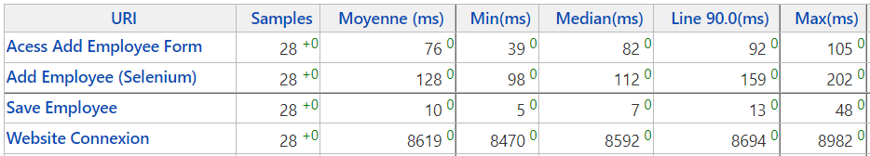
Implementation & results
Test Results
Notes:
we can use the jtl file that we had at the end of our test to generate performance reports using the jenkins performance plugin.
this table show the results that i got :
we can clearly see that the response times are much higher in the tests that integrate Selenium. This result is expected because integrating Selenium allows us to measure the response times from the end-user point of view.

Slide 16
Conclusion
Although functional and performance testing are two forms of testing that serve two distinct purposes in the software development lifecycle, we can reuse our functional test scripts such as selenium in performance testing activities to understand software performance from the end-user's perspective in a real browser

