Slide 1

SpaceTag
Challenge: DATA TREASURE HUNTING

Slide 2

Challenge
NASA has released a huge amount of data on data.nasa.gov, but it is poorly tagged with keywords (if at all)
Difficult to search, even harder to find connections between datasets
Other governmental agencies have also released open data, but there is no direct way to connect it with NASA’s data
SpaceTag

Slide 3
Solution
Metadata for ~70 datasets provided in challenge starter kit
Pulled complete metadata from data.nasa.gov/data.json, plus data.json from other gov’t agencies
Derived new and meaningful keywords for all datasets
Interactive visualization of keywords and datasets
SpaceTag

Slide 4
The Result
Keywords tagged for 26000 datasets, including 16600 from NASA
188812 keywords tagged
12152 unique keywords
Tagged keywords for data from 7 other agencies and 12 states
Connected 3000 NASA datasets to other open data via new keywords
SpaceTag

Slide 5
Before/after
Before
Most common keywords: “Project”, “Complete”
NASA Datasets tagged with “space”: 1
Non-NASA datasets tagged with “space”: 5
After
Most common keywords: “Phase I”, “Phase II”, “NASA”, “International Earth Science Information Network”
SpaceTag

Slide 6
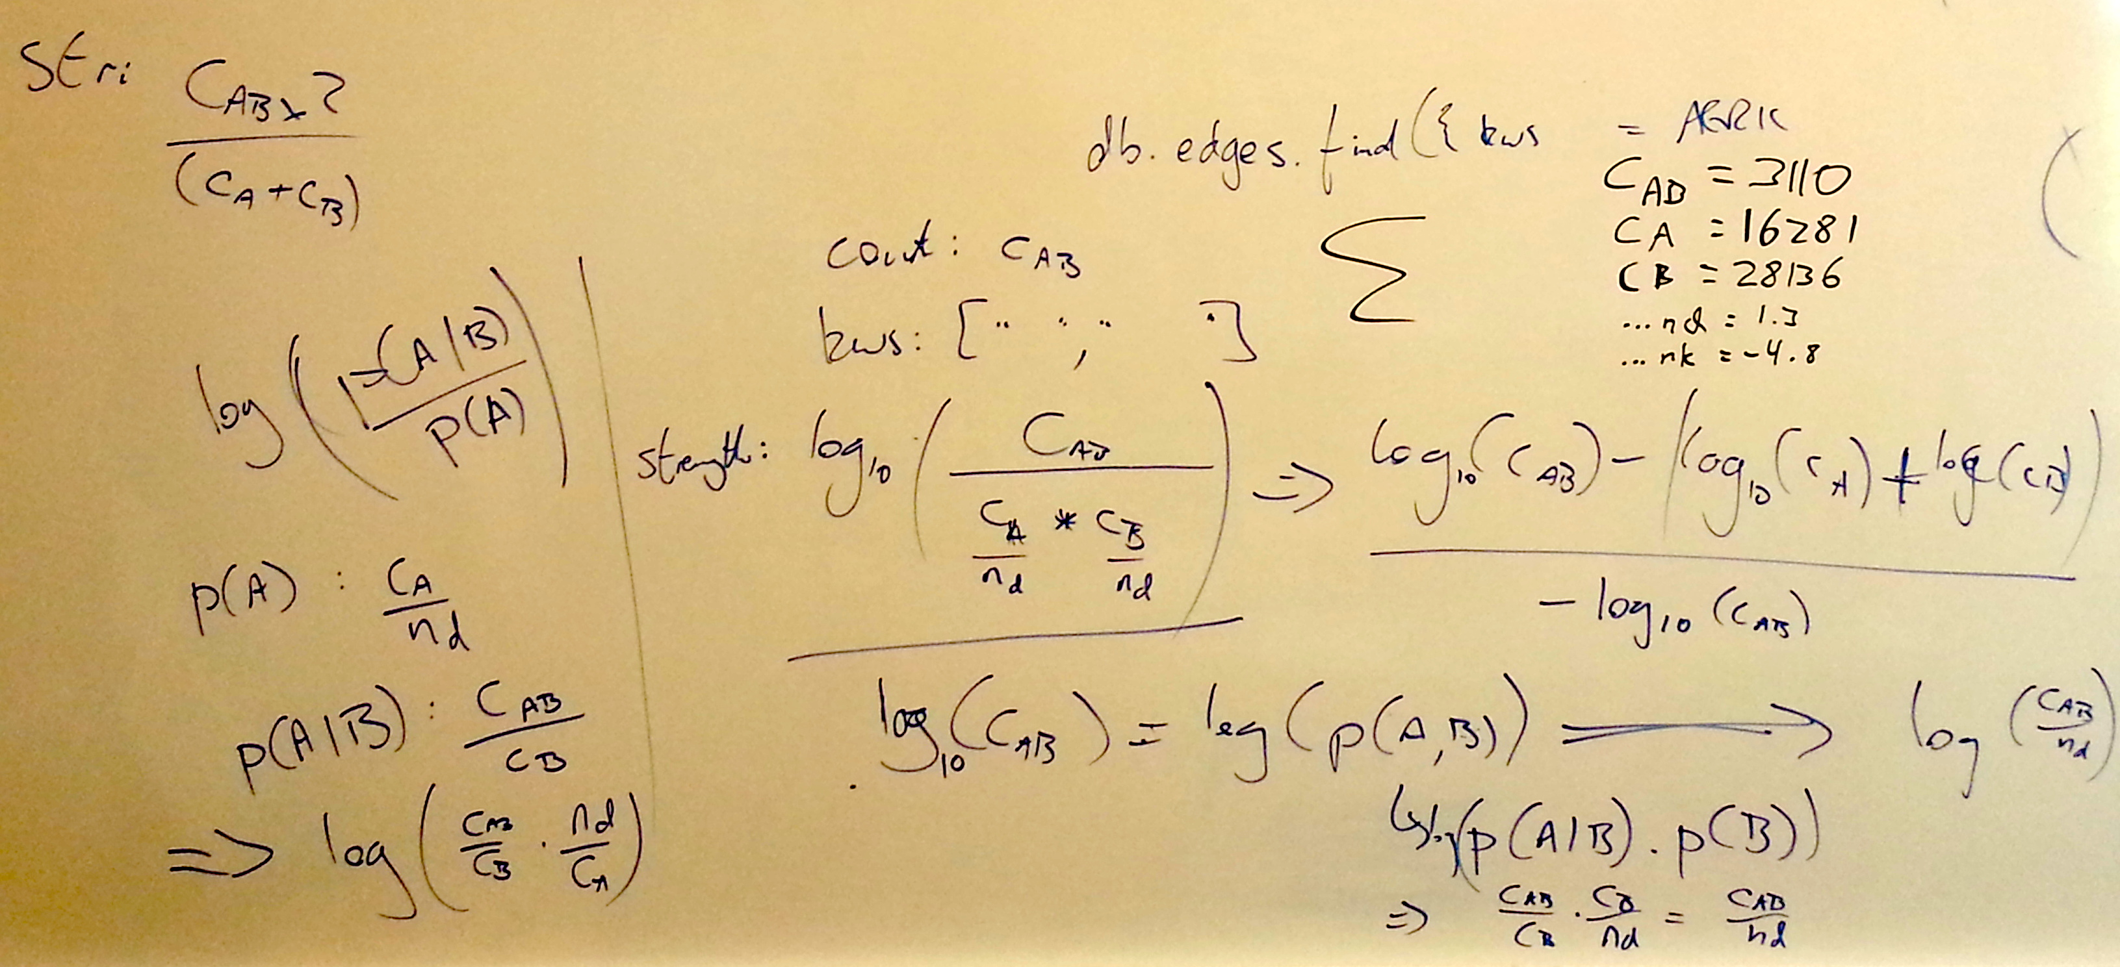
Methods
Lots of math!
SpaceTag

Slide 7
Impact
Deriving knowledge and new conclusions by utilizing existing and open data is one of the greatest challenges in recent years for government, science and business
Building an intelligent and automated application to derive keywords for open data will ensure that datasets are searchable and connected both within and across agencies
The interactive visualization of “constellations” of keywords will lead to new and possibly much more meaningful results derived from the same data
SpaceTag

Slide 8
Creativity
Creative visualization of the data from www.data.nasa.gov in shape of constellations in space, which will illustrate the relations between key words and related tags from the same area of interest
SpaceTag

Slide 9
Product
Finished product
Will be available for general use on a public domain
UI/UX improvements are possible
SpaceTag

Slide 10
Sustainability
Open Source and Free
Automated keyword extraction and updates ensure that data stays fresh
SpaceTag

