Slide 1
Dr.com客户端数据包分析
XiyouLinux小组-田伟

Slide 2
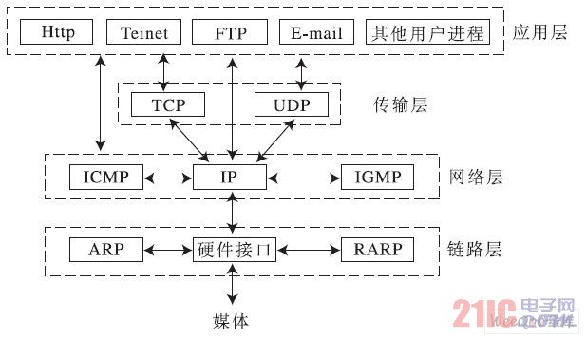
TCP/IP协议栈

Slide 3
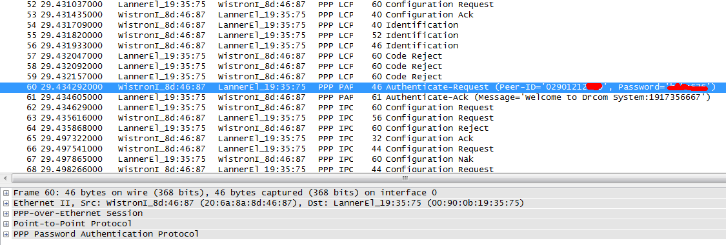
Wireshark-Drcom

Slide 4
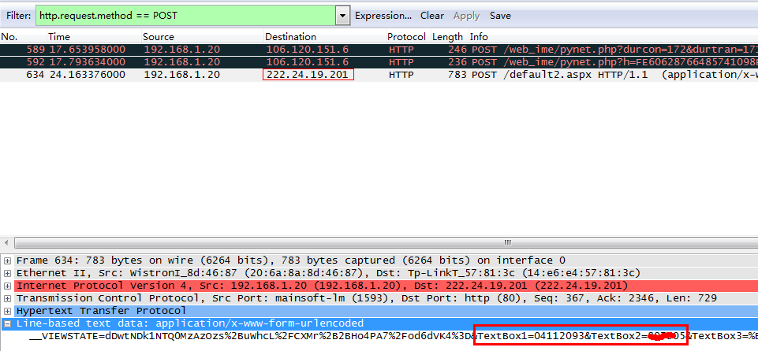
Wireshark-西邮教务系统

Slide 5
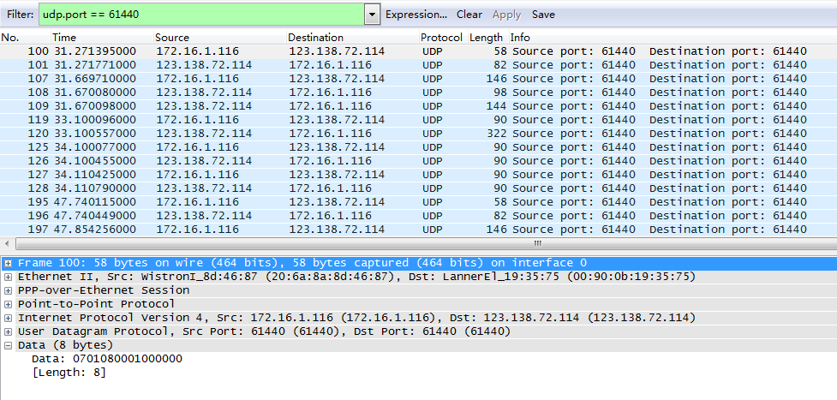
Wireshark抓包分析

Slide 6
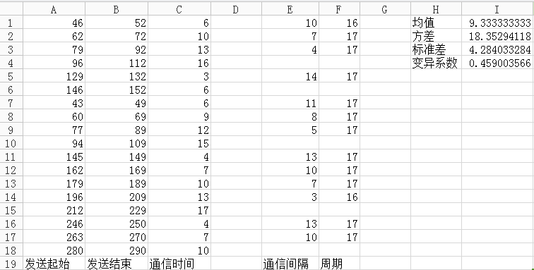
通信时间周期分析

Slide 7
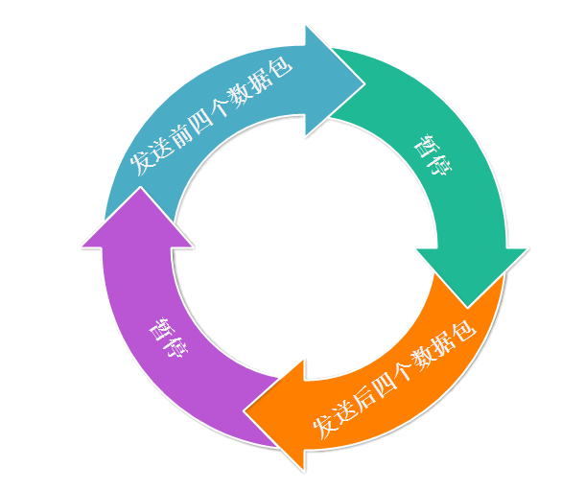
通信模型
暂停时间
阻塞时跳转位置

Slide 8
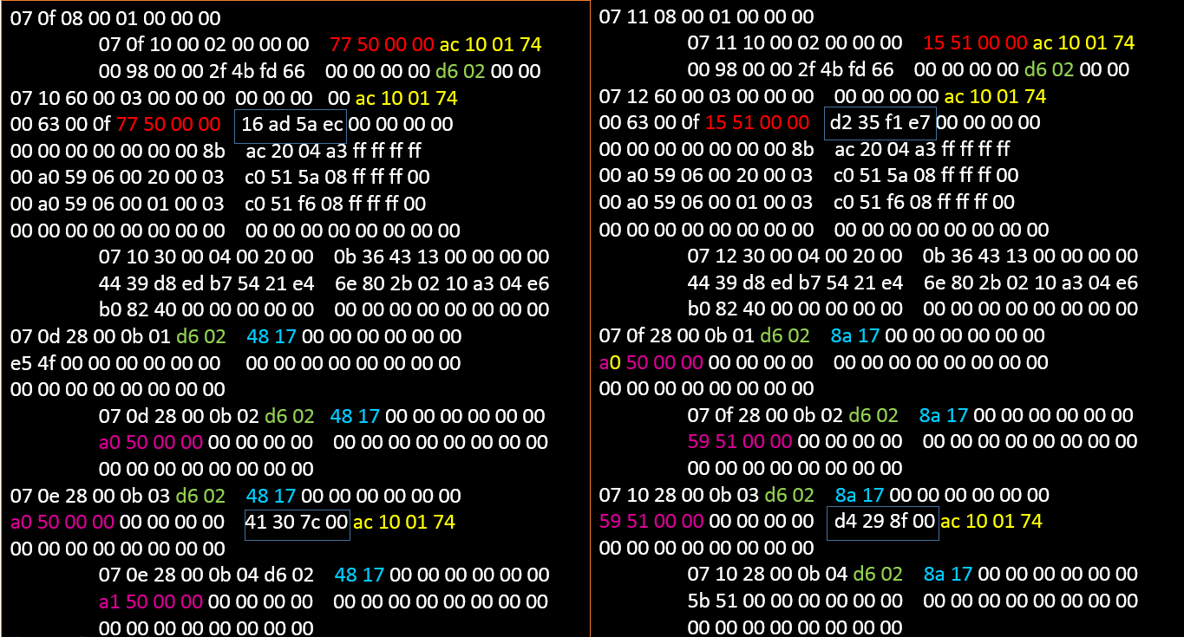
数据包对比

Slide 9
Drcom数据包
07
ID
长度
序列
00 00
07
ID
长度
序列
00 00
code0
code1
00
98
00
00
2f
4b
fd
66
00
00
00
00
d6 02
00
00
07
ID
长度
序列
00 00
00
00
00
00
code1
状态
00
0f
code0
校验和
00
00
00
00
……(64)
接受数据(48)

Slide 10
Drcom数据包
07
ID
长度
序列
d6 02
随机数
00
00
00
00
00
00
key
00
00
00
00
00
00
00
00
00
00
00
00
00
00
00
00
00
00
00
00
07
ID
长度
序列
d6 02
随机数
00
00
00
00
00
00
key1
00
00
00
00
00
00
00
00
00
00
00
00
00
00
00
00
00
00
00
00
07
ID
长度
序列
d6 02
随机数
00
00
00
00
00
00
key1
00
00
00
00
校验和
code1
00
00
00
00
00
00
00
00
07
ID
长度
序列
d6 02
随机数
00
00
00
00
00
00
key
00
00
00
00
00
00
00
00
00
00
00
00
00
00
00
00
00
00
00
00

Slide 11
Drcom数据结构
07
ID
长度
序列
d6 02
随机数
00
00
00
00
00
00
key1
00
00
00
00
校验和
code1
00
00
00
00
00
00
00
00
typedef struct{
char bSignture;
char bPacketID;
short wLength;
short wSeq;
short wCurrentVer;
short wRand;
short wReserved0;
int dwReserved0;
int dwKey0;
int dwKey1;
int dwChecksum;
int dwCode1;
int dwReserved1;
int dwReserved2;
}
07
ID
长度
序列
00 00
struct packet{
char bSignture;
char bPacketID;
short wLength;
short wSeq;
short wReserved;
}

Slide 12
Drcom数据校验码——login数据包
07
ID
长度
序列
00 00
00
00
00
00
code1
状态
00
0f
code0
校验和
00
00
00
00
……(64)
07 02 60 00 03 00 00 00 00 00 00 00 ac 10 07 e1
00 62 00 0f ae 61 5b 01 28 e8 d7 42 00 00 00 00
00 00 00 00 00 00 00 8b ac 20 04 a3 ff ff ff ff
00 a0 59 06 00 20 00 03 c0 51 5a 08 ff ff ff 00
00 a0 59 06 00 01 00 03 c0 51 f6 08 ff ff ff 00
00 00 00 00 00 00 00 00 00 00 00 00 00 00 00 00

Slide 13
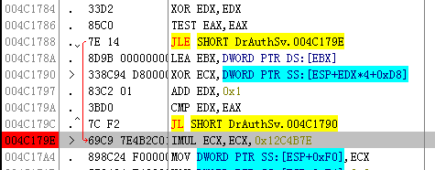
校验方法
c3.dwChecksum = 0x1312FC7;
c3.dwUnk1 = 0x7E;
ptr_int = (int *)&c3;
dwChecksum = 0;
for(n = 0; n < 96/4; n++)
dwChecksum ^= *(ptr_int + n);
c3.dwChecksum = dwChecksum * 0x12C4B7E;
c3.dwUnk1 = 0;

Slide 14
Drcom数据校验码——activate数据包
07
ID
长度
序列
d6 02
随机数
00
00
00
00
00
00
key1
00
00
00
00
校验和
code1
00
00
00
00
00
00
00
00
07 0e 28 00 0b 03 dc 02 dd 0c 00 00 00 00 00 00
a0 65 5b 01 00 00 00 00 f3 de 00 00 ac 10 07 e1
00 00 00 00 00 00 00 00

Slide 15
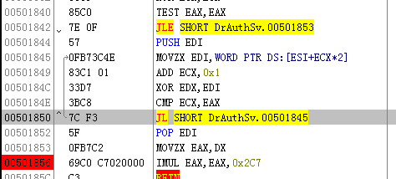
校验方法
ptr_short = (short *)&up;
for(n = 0; n < 40/2; n++)
dwChecksum ^= *(ptr_short + n);
dwChecksum &= 0xFFFF;
up.dwChecksum = dwChecksum * 0x2C7;

Slide 16
数据包接收
阻塞 OR 非阻塞模式?
数据包接收超时
Linux
fcntl() //可用于设置套接字为非阻塞
select() //可用于设置接收超时时间
Windows
ioctlsocket() //控制套接口的模式
select() //设置接收超时时间

Slide 17
Thanks！
本模板由小田设计提供
来自：www.iloveppt.org
部分数据来源于MengXP代码
Thanks to MengXP

