Slide 1
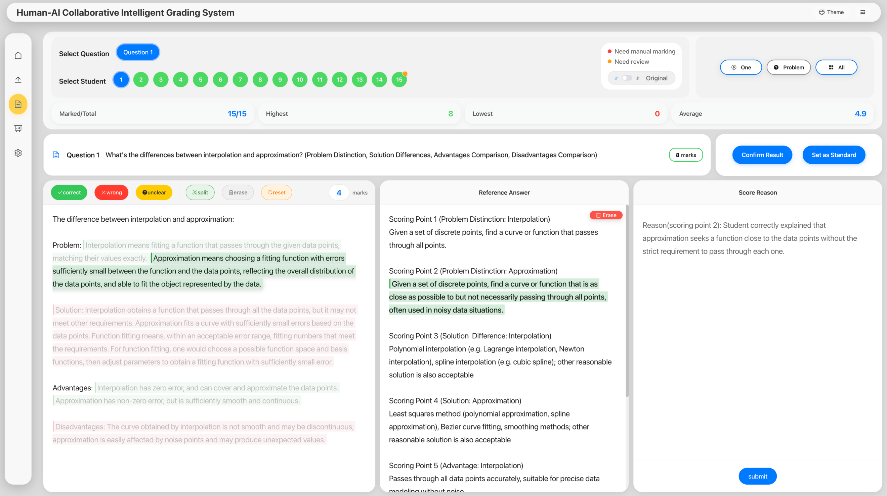


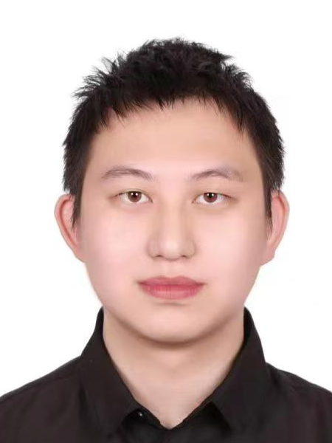


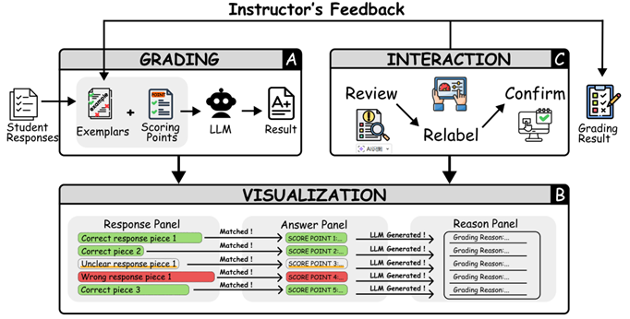
VeriGrader:
Open-ended Structured Question Assessment
with Human-LLM Collaboration
Fengyan Lin^{1,2}
Yanna Lin³
Kai Cao^{1,2}
Zikun Deng^{1,2,*}
Yi Cai^{1,2}
¹ School of Software Engineering, South China University of Technology
² Key Laboratory of Big Data and Intelligent Robot (SCUT), Ministry of Education
³ Cheriton School of Computer Science, University of Waterloo
Notes:
Hi, everyone! I’m Fengyan Lin from South China University of Technology.
Today, I’m glad to introduce our paper “Open-ended Structured Question Assessment with Human-LLM Collaboration”

Slide 2
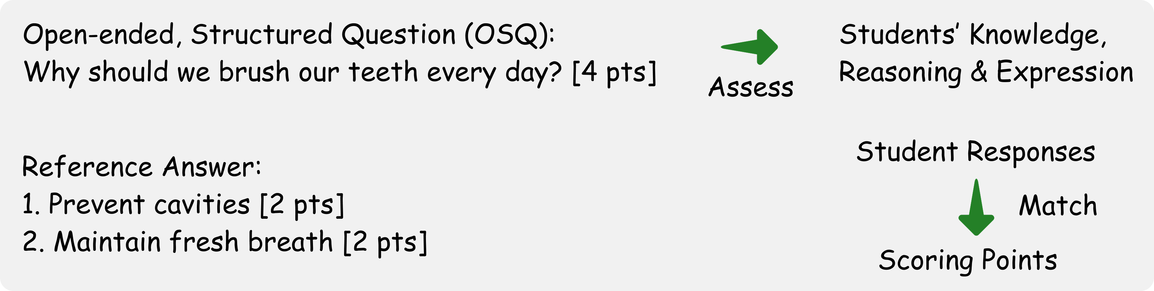
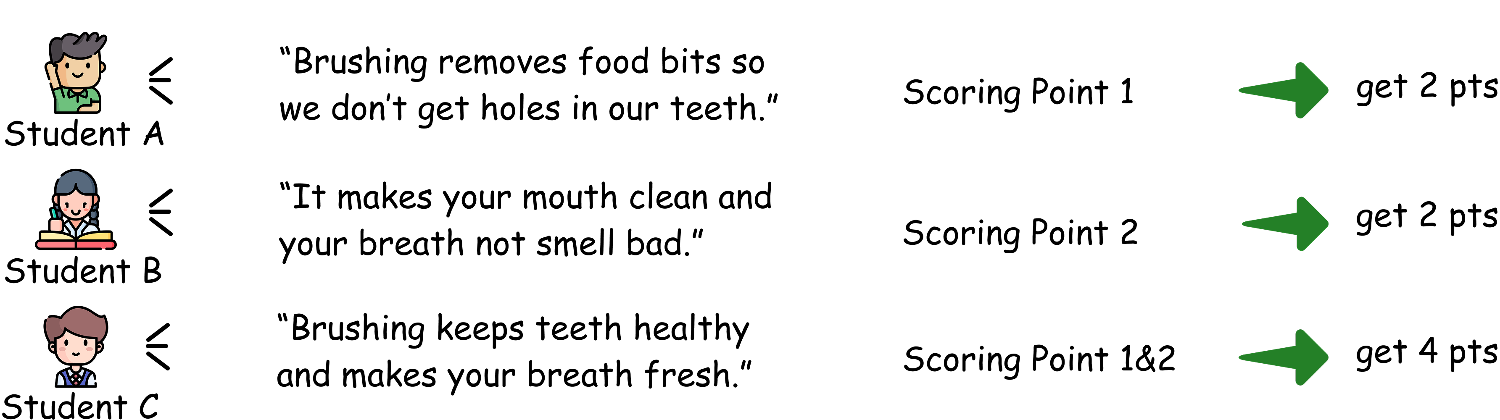
Understanding OSQs
Notes:
Open-ended structured questions, or OSQs, are widely used in education because they assess not only students’ knowledge, but also their reasoning and expression abilities.
For example, consider this question: “Why should we brush our teeth every day?”
To answer this question, students are expected to understand the functions of tooth brushing，namely cavity prevention and fresh breath，and articulate these ideas in a well-organized manner.
<CLICK>
The score of each response depends on the number of scoring points it matches.
Student A‘s response emphasizes cavity prevention,
while Student B’s response emphasizes fresh breath.
Each addresses only part of the expected content, so they each get 2 point.
Whereas Student C’s response is more complete and cover all scoring point, so he gets the full point.

Slide 3
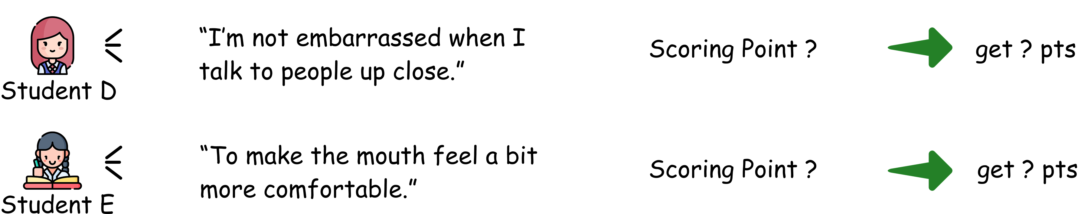
Understanding OSQs
Fine-grained grading is challenged by diverse, ambiguous, and unstructured responses.
Notes:
However, <CLICK>
performing such fine-grained, scoring point–level grading manually is highly challenging due to the diverse, ambiguous, and freely structured responses of the students.
For example, responses like those from Student D and E can be difficult to clearly align with specific scoring point.

Slide 4
Challenges
To propose accurate, comprehensive and consistent assessment, we need to address:
1. Diverse Student Expressions & Semantic Ambiguity
Same idea expressed in many different ways
Variations in wording, structure, and length
Responses can be vague, implicit, or partially correct
Difficult to determine alignment with scoring points
2. Fine-grained Matching Requirement
Need to identify response segments
Match them to predefined scoring points
3. Consistency & efficiency at Scale
Maintain consistent judgments across responses
High workload in large-scale grading scenarios
Notes:
As a result, instructors must carefully examine each response and evaluate it against the predefined scoring points to ensure accurate, comprehensive and consistent assessment,
making the grading process both time-consuming and cognitively demanding.
So, to achieve this kind of assessment, there are several key challenges we need to address.
First, we need to handle diverse and ambiguous student responses;
second, we need fine-grained matching between responses and scoring points;
and finally, we need to ensure consistent and efficient grading at scale.

Slide 5
Existing work
Fully automated grading
Human-LLM collaborative grading
Notes:
Existing work can be roughly divided into the following two major categories.

Slide 6
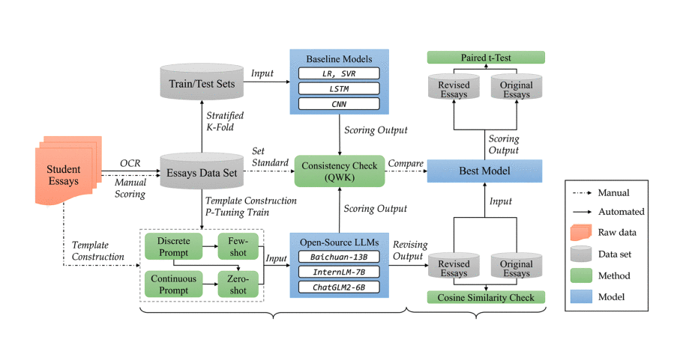
Existing work
Fully automated grading
Human-LLM collaborative grading
Song et al. (2024)
lacks interpretability and transparency, still requires human supervision.
Notes:
Fully automated grading has improved accuracy and reached human-level performance in some tasks through various technologies, but it lacks interpretability and transparency, and may introduce bias and fairness issues, so it still requires human supervision.

Slide 7
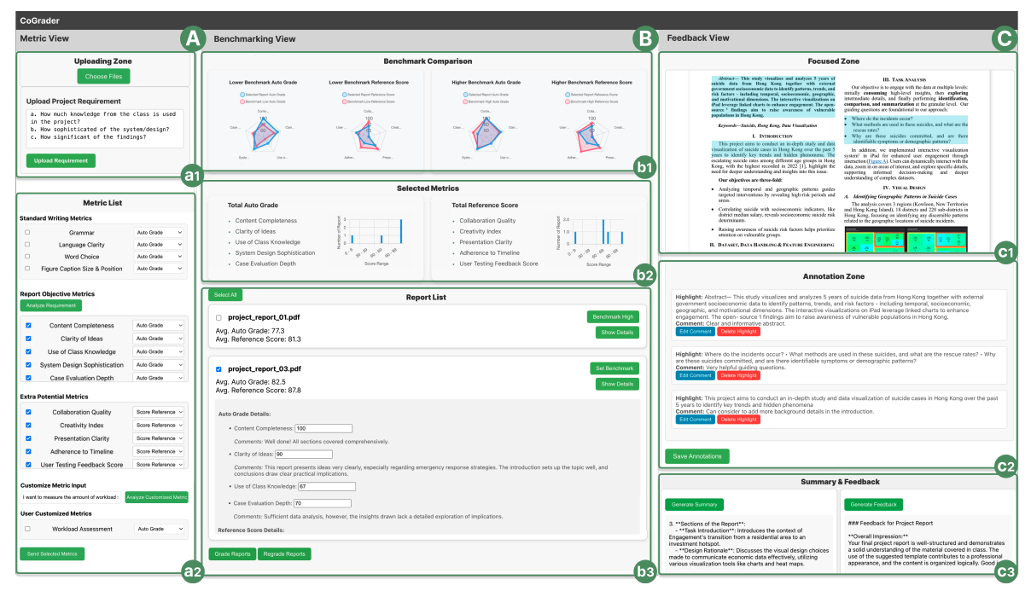
Existing work
Fully automated LLM grading
Human-LLM collaborative grading
Song et al. (2024)
Chen et al. (2025)
limited to overall-level tasks, and lack fine-grained scoring point-level support
Notes:
To address these issues, recent work has started to involve humans in the loop.
Some systems enabled closer integration and two-way collaborative grading between humans and LLMs,
to enhance transparency and instructor‘s participation,
but existing works are still limited to overall-level tasks, and lack fine-grained scoring point-level support required for OSQ.

Slide 8
Our work
1. Fine-grained
We support fine-grained, point-level analysis by identifying response segments and aligning them with scoring points, making the grading process more interpretable.
2. Interaction
We enable interactive inspection and correction, allowing instructors to review matched segments and revise grading results when needed.
3. Scale
We support scalable human-AI collaboration by incorporating instructor feedback to guide the system across large-scale grading tasks.
Propose a human-AI collaborative system that combines point-level analysis with interactive and scalable grading workflows.
Notes:
These limitations are not only algorithmic, but also related to interaction and workflow design.
To address these, our work focuses on these three key aspects: fined-grained, interaction and scale.
Finally, we propose a human-AI collaborative system that combines point-level analysis with interactive and scalable grading workflows.

Slide 9
Preliminary Interviews
Participants:
3 high school instructors, 1 teaching assistant (TA) and 1 academic affairs administrator (ADM)
Result:
1. Ensure fairness, accuracy, interpretability, and scoring point-level grading.
2. Support handling diverse and ambiguous student expressions while reducing the heavy workload of repeated double-checking for consistency.
3. Provide interface support that reduces cognitive load and enables effective human intervention.
Notes:
To better understand real needs, we conducted preliminary interviews.
To sum up, instructors want point-level automated grading that improving efficiency while preserving their judgment and control.

Slide 10
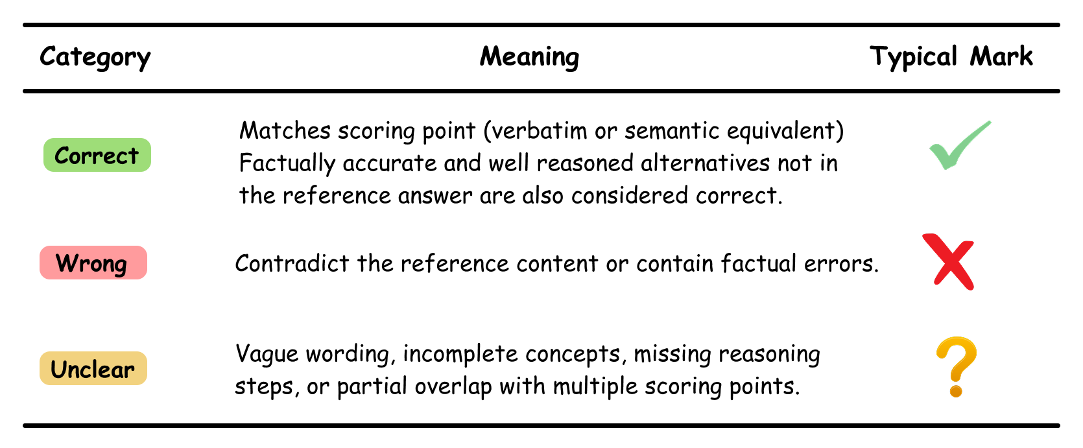
Empirical Analysis
We analyzed 141 graded exam papers containing open-ended structured questions (OSQs)
Notes:
Based on these findings, we identified key design requirements for our system.
We analyzed 141 graded exam papers to understand how instructors actually grade OSQs.
We found that grading is centered around scoring points. After identifying relevant response segments, instructors further classify them into three categories: correct, wrong, or unclear.
Importantly, grading is not just matching keywords, it involves semantic judgment before assigning scores.
These observations above later motivates our system design.

Slide 11
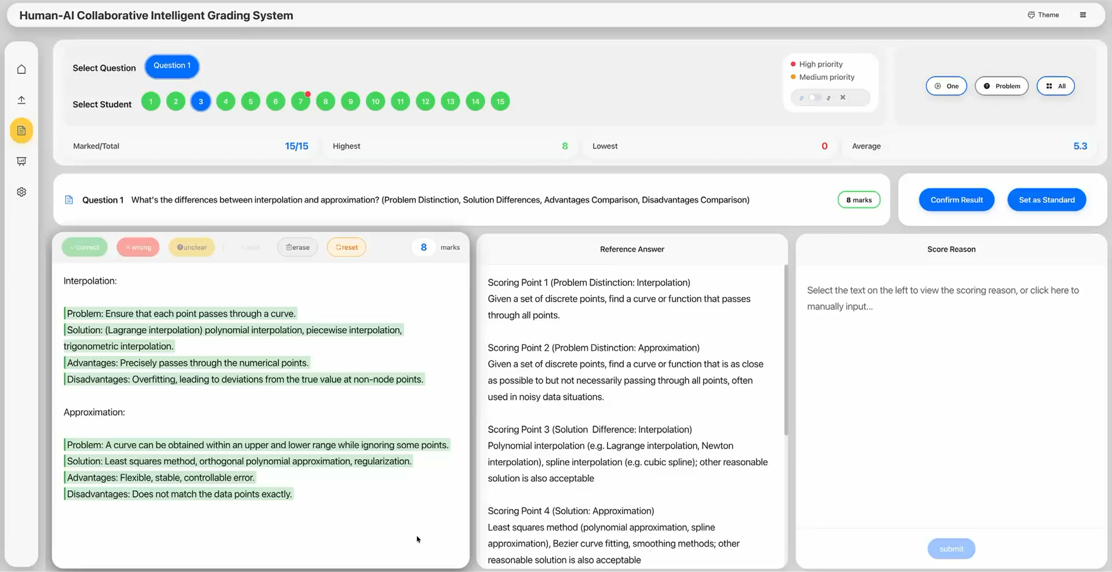
VeriGrader Interface
Notes:
Built upon these design considerations, we design VeriGrader.
Here is the interface.
<PLAY>
The interface comprises two views: a navigation view and a grading view.
The response panel is the primary workspace, rendering response pieces with category highlights.
The answer panel presents the reference answer and highlights scoring point aligned to the selected response piece,
while the reason panel displays an editable, LLM-generated grading reason for the current selection.

Slide 12
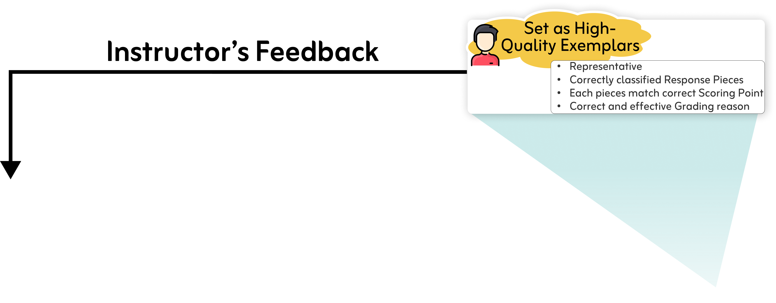
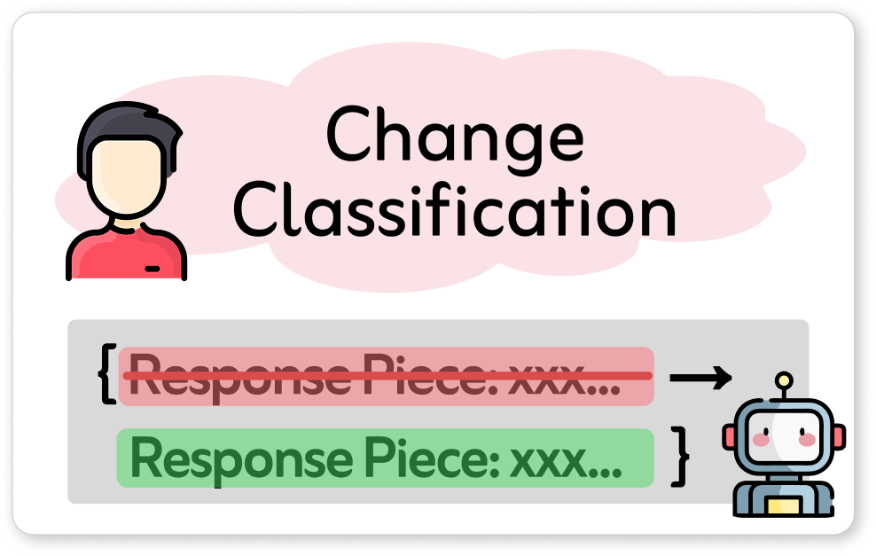
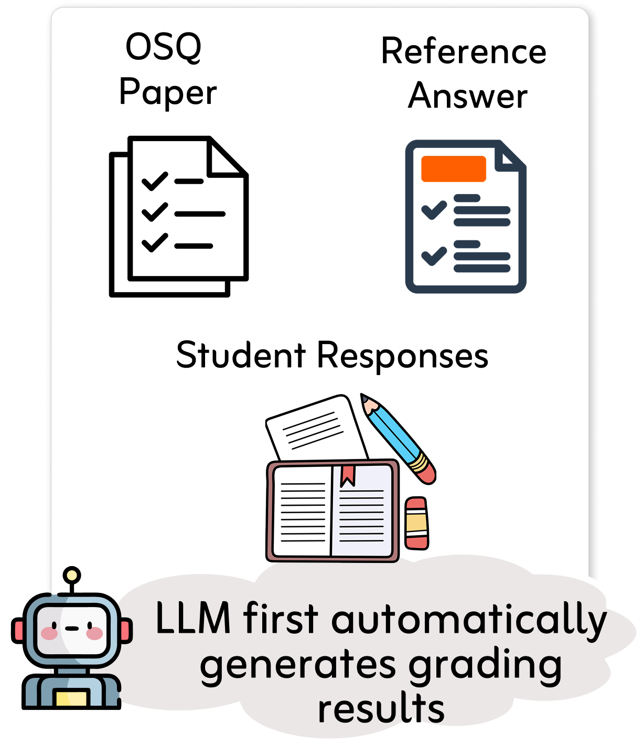
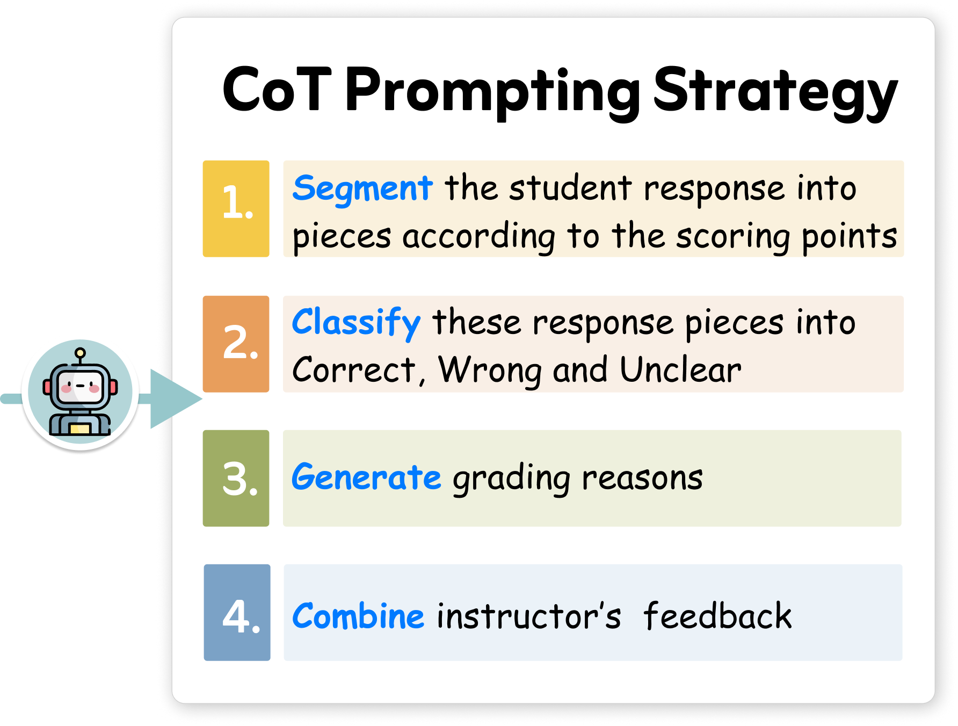
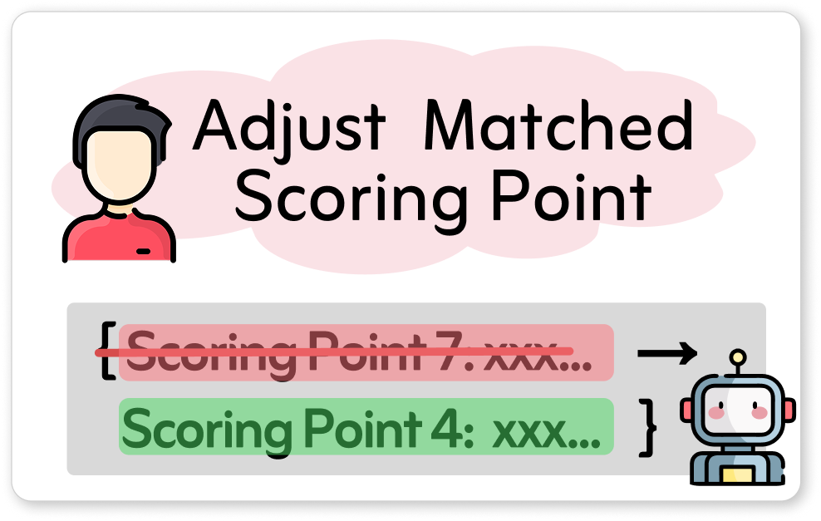
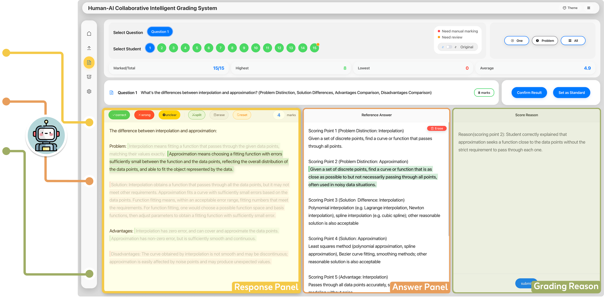
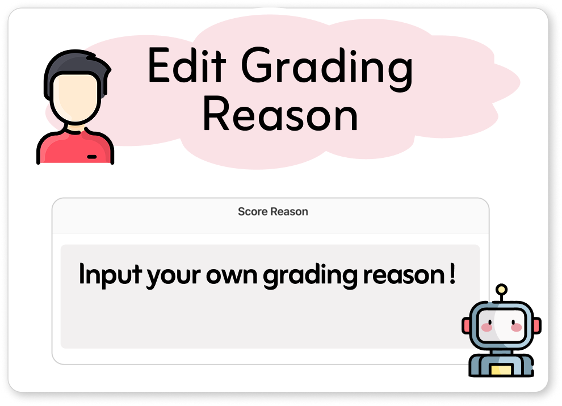
Collaborative Workflow
System proposes → Instructor verifies → System learns and improves → Instructor verifies...
Notes:
VeriGrader follows an iterative workflow: <CLICK>
the LLM first automatically generates grading results, <CLICK>
Particularly, we develop a chain-of-thought prompting strategy that enables the LLM to perform fine-grained, scoring point–level, interpretable, and human-like grading at scale. <CLICK>
then these results are presented to instructors through an interactive interface.
Instructors review and interact with the response pieces, relabel them as needed, <CLICK>
such as change wrong classification <CLICK>
or wrong scoring points mapping, <CLICK>
even edit the grading reason, and finally confirm them.
Importantly, this isn’t a one-way process. <CLICK>
The confirmed grading results can be fed back into the system,
used as few-shot exemplars to improve the LLM in subsequent rounds. <CLICK>
So overall, this forms a “closed human-in-the-loop” : System proposes → Instructor verifies → System learns and improves.
After several rounds of iterations, the system may perform as well as instructor.
Next, I will introduce some usage scenarios to help you better understand Verigrader.

Slide 13
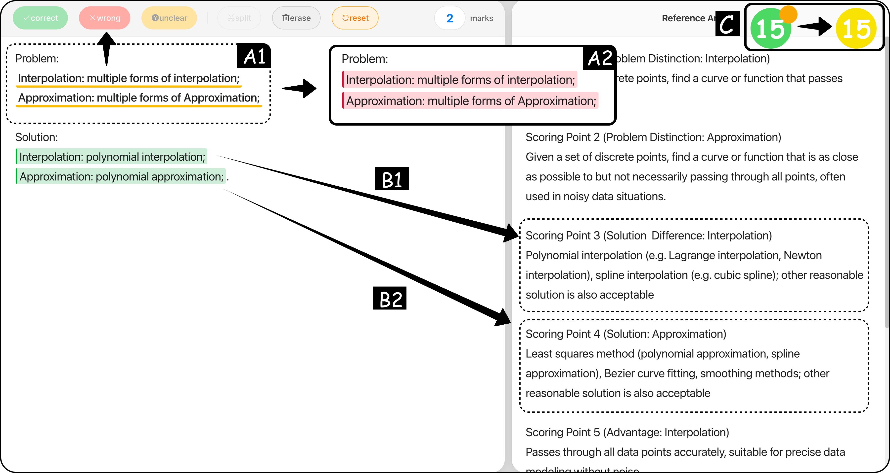
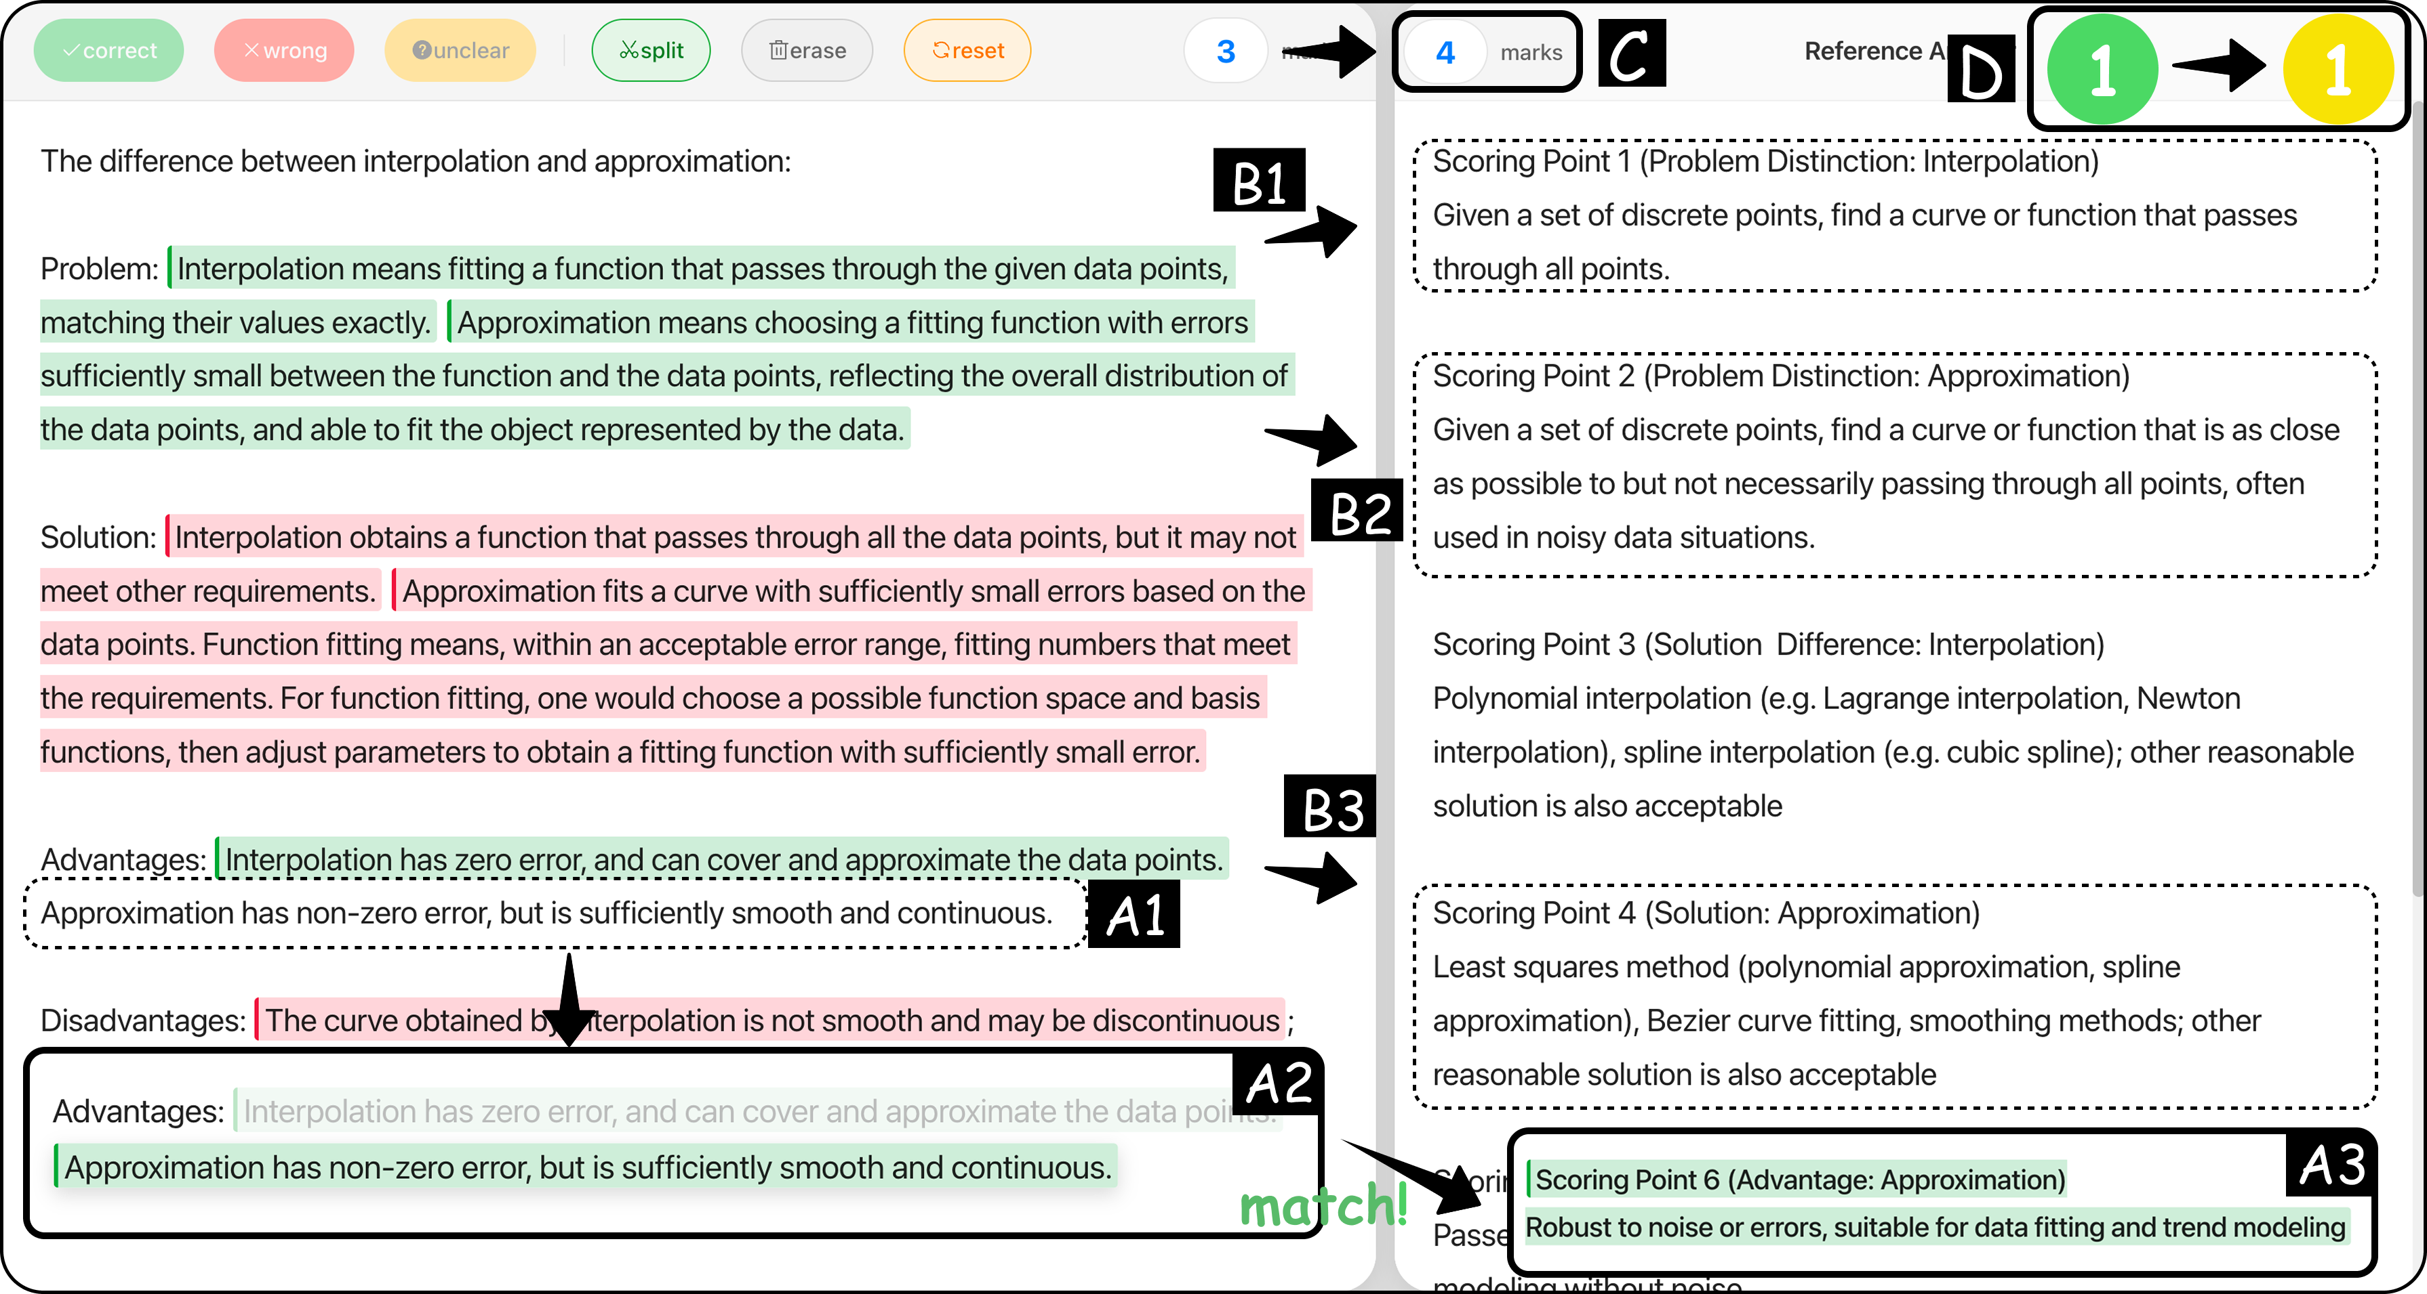
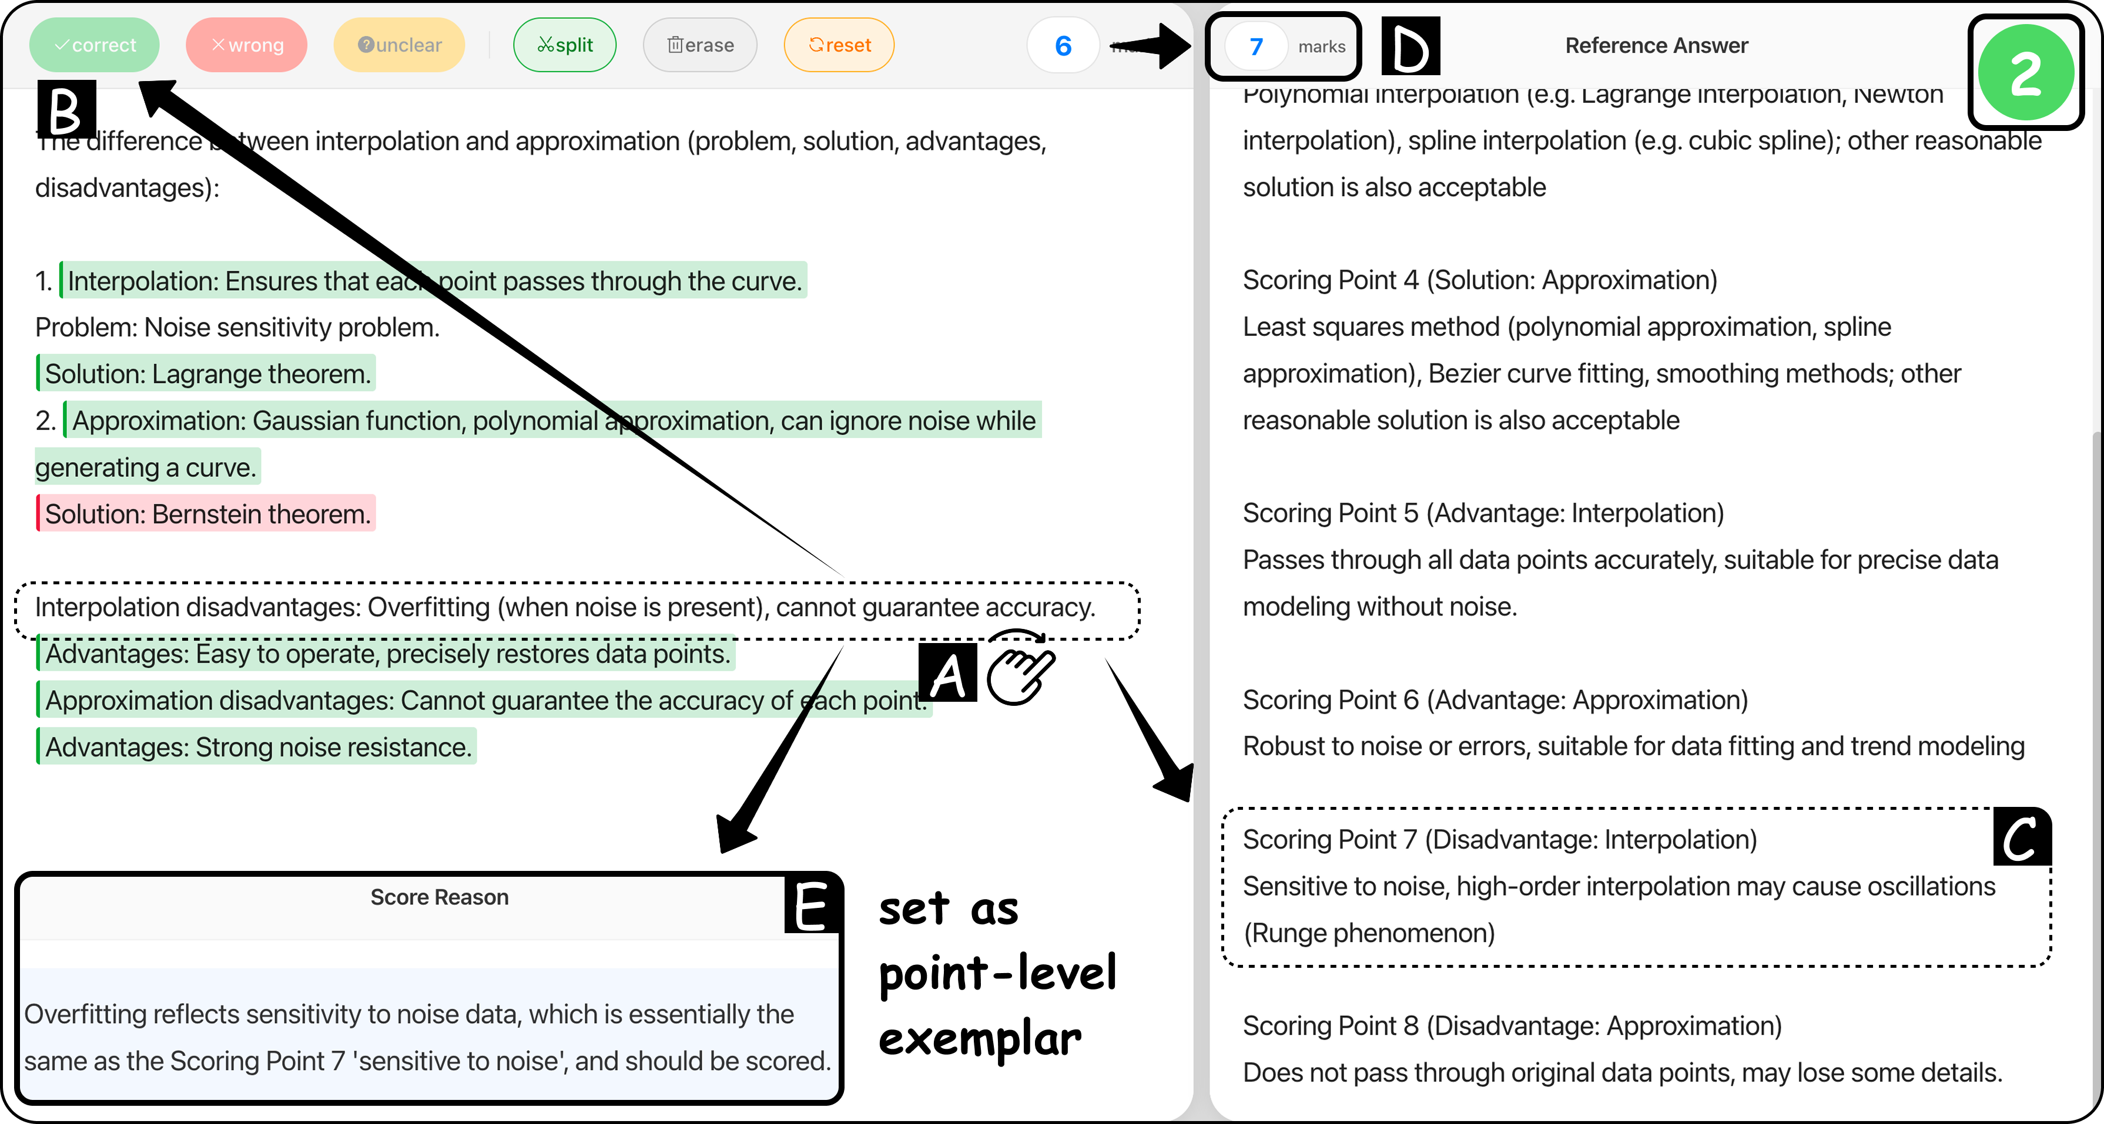
Usage Scenario
Scenario 1
Scenario 2
Scenario 3
Resolving unclear response piece
Adding a missing scoring point
Setting a point-level exemplar
Notes:
We demonstrated 3 scenarios using VeriGrader in our paper.

Slide 14
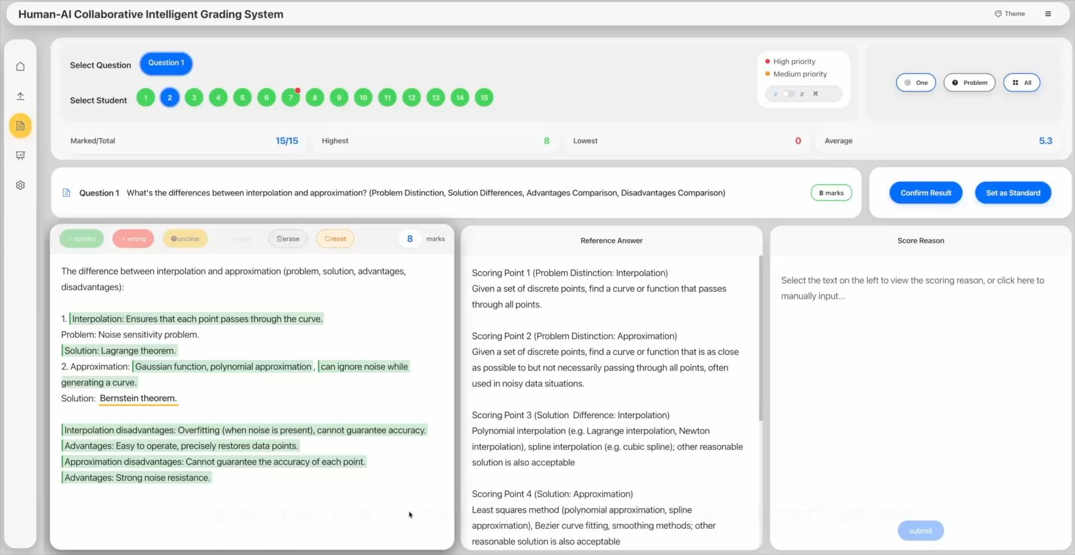
Scenario 1: Resolving unclear response piece
Notes:
1. Resolving unclear response piece
<PLAY>

Slide 15
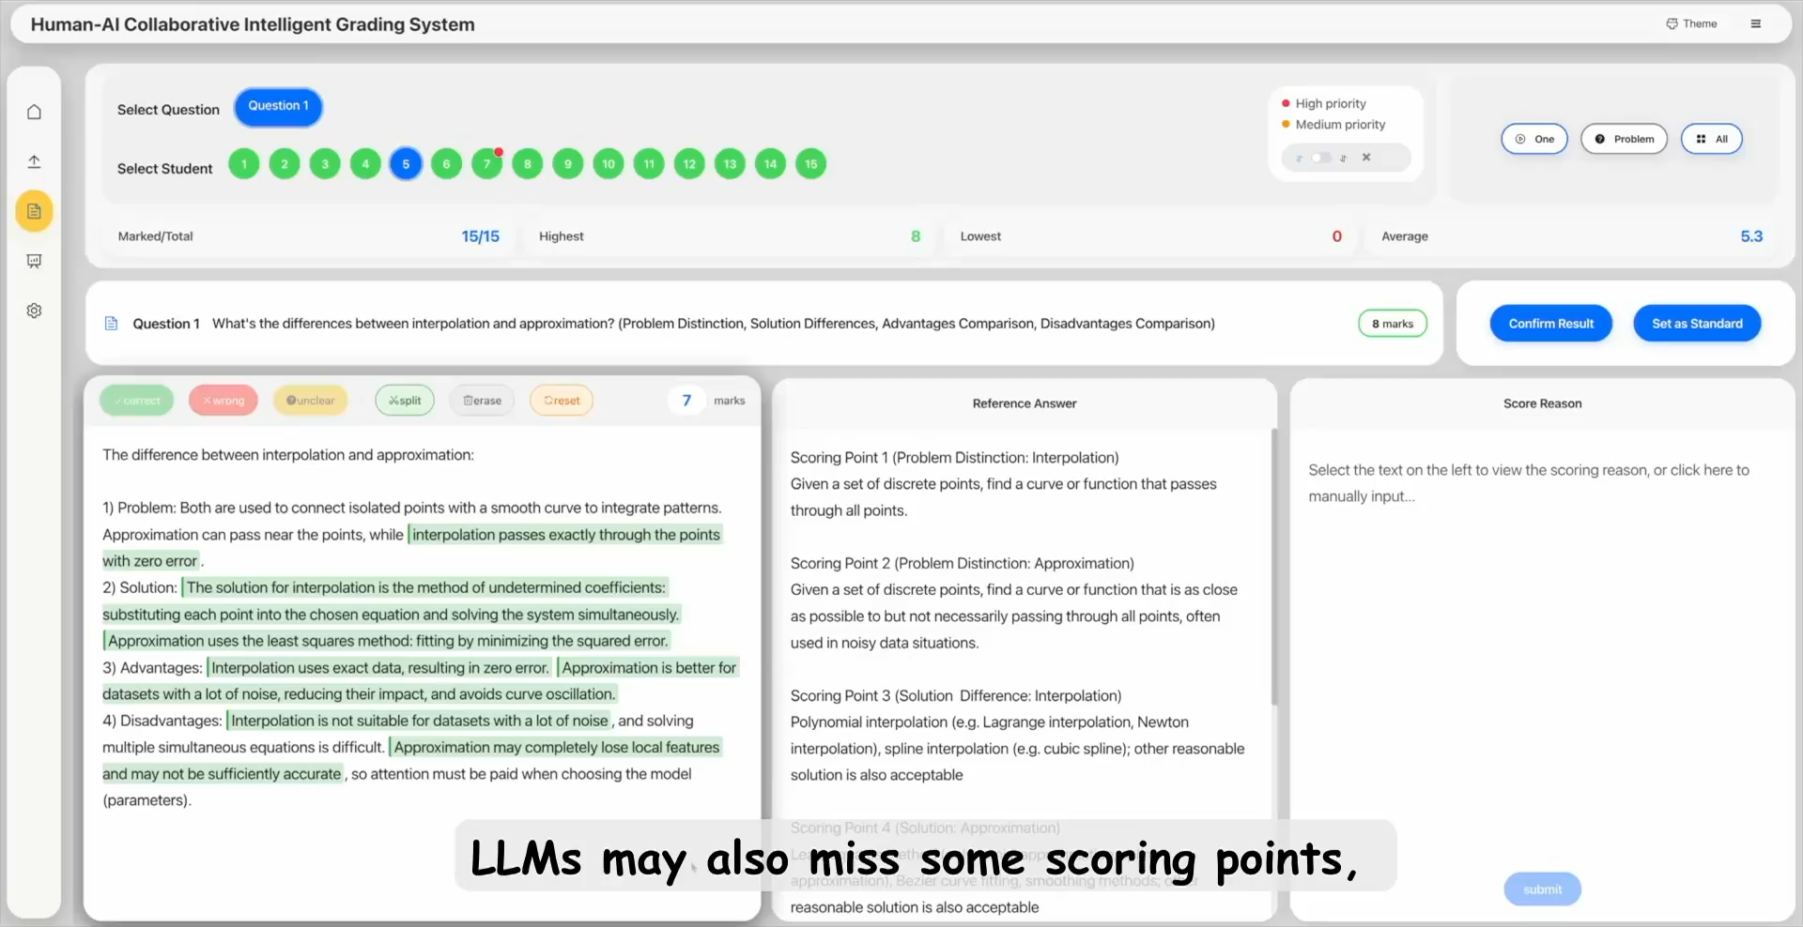
Scenario 2: Adding a missing scoring point
Notes:
2. Adding a missing scoring point
<PLAY>

Slide 16
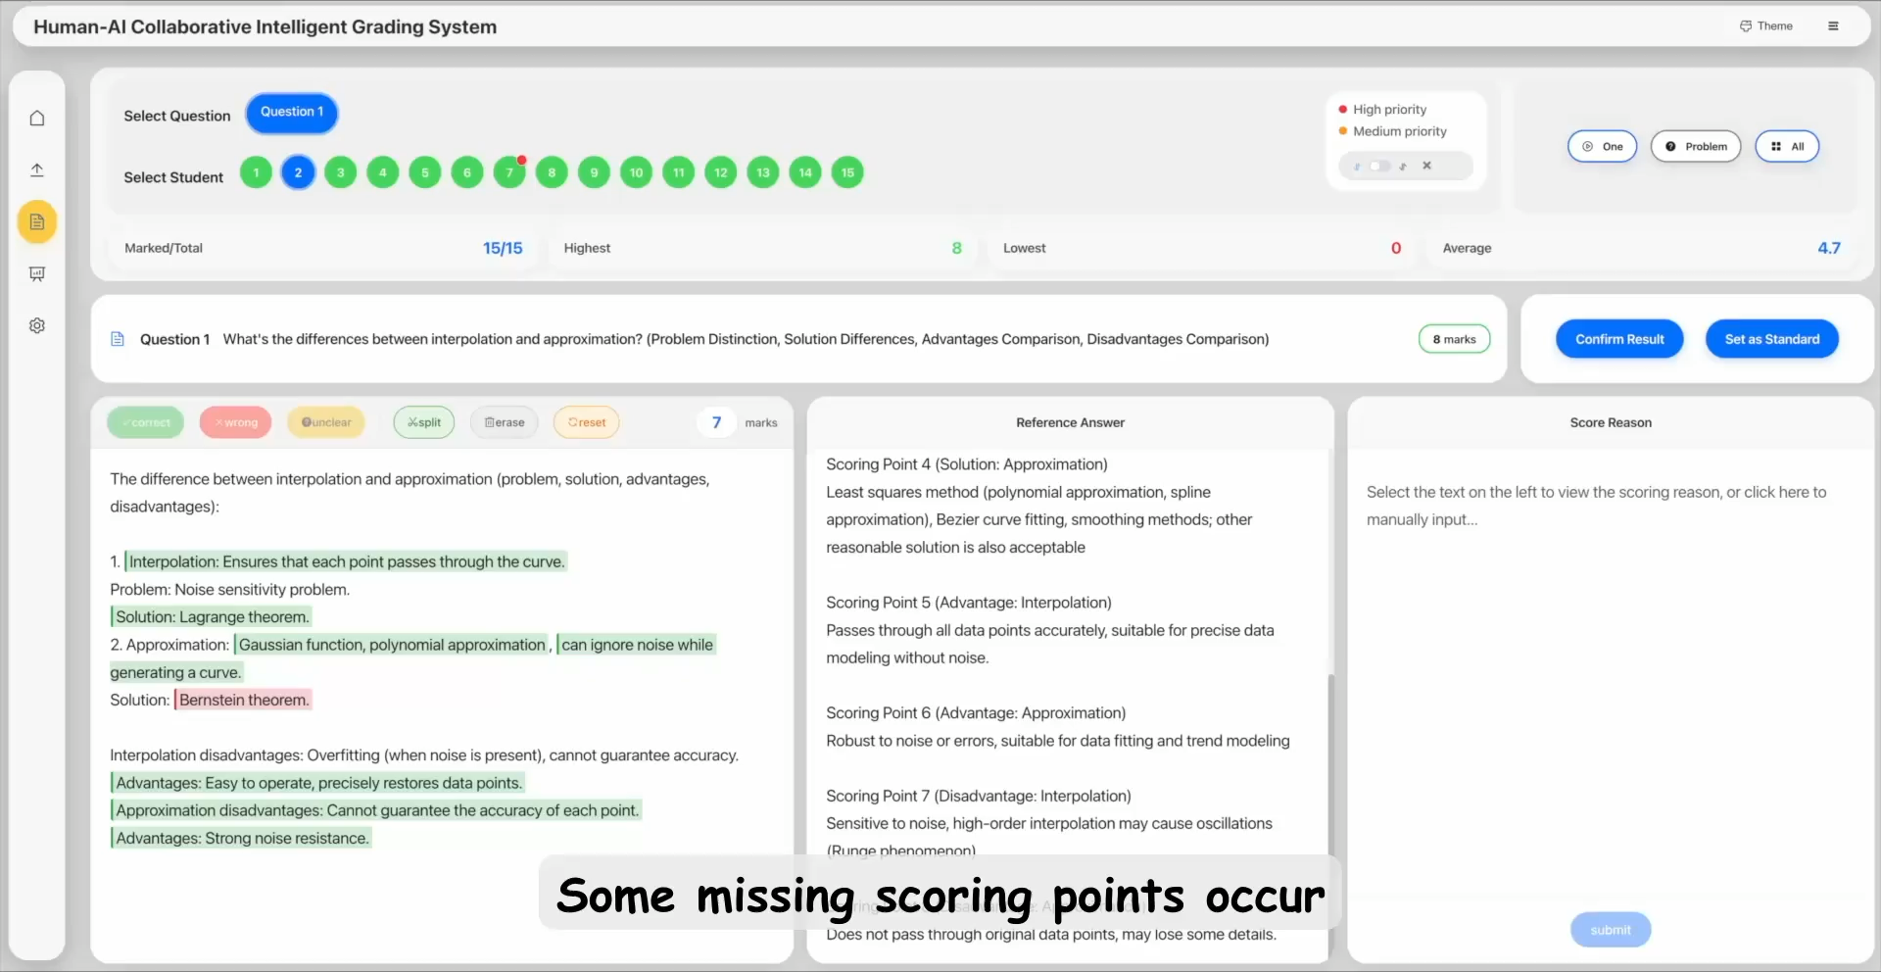
Scenario 3: Setting a point-level exemplar
Notes:
3. Setting a point-level exemplar
<PLAY>

Slide 17
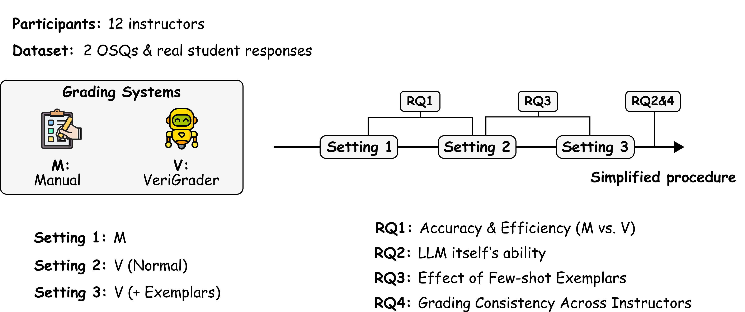
User Study
Notes:
We conducted a user study with 12 instructors using real student responses.
We built a system to simulate manual grading, for comparison with VeriGrader.
Based on these two systems, instructors graded two OSQs under our settings.
By comparing the results under different settings, we explored four research questions.
For detailed insights, please refer to the paper.

Slide 18
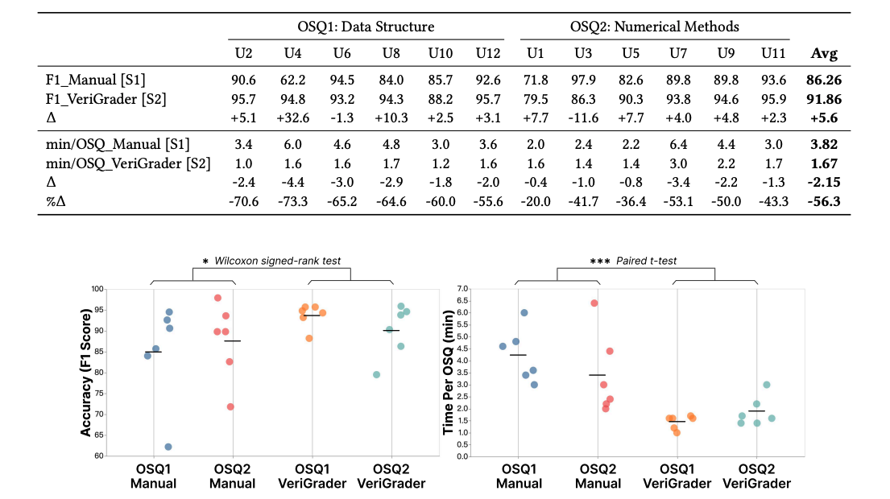
RQ1: Accuracy & Efficiency (M vs. V)
VeriGrader reduced grading time by 56.3%
while simultaneously improving grading accuracy by 5.6%.
Notes:
Overall, VeriGrader outperformed the manual baseline in both efficiency and accuracy.

Slide 19
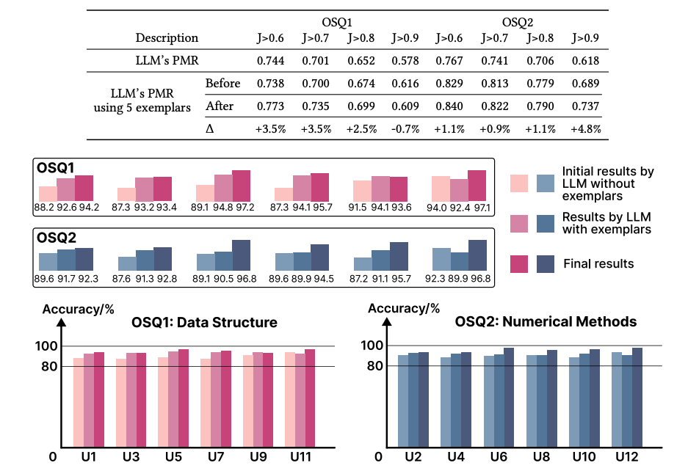
RQ2&3: LLM itself’s ability and the effect of few-shot exemplars
The LLM alone achieved 89% grading accuracy, demonstrating strong standalone capability.
Introducing few-shot exemplars consistently improved grading accuracy.
Notes:
We also find that the LLM itself achieves high accuracy using the prompting technique.
And introducing few-shot exemplars consistently improved grading accuracy.

Slide 20
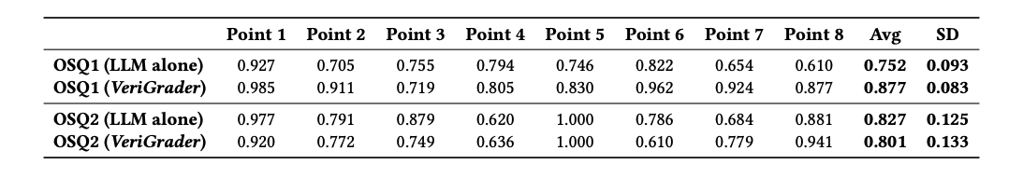
RQ4: Grading Consistency across instructors
VeriGrader reduces grading variability across instructors, enabling more consistent and fair assessments.
Notes:
Additionally, we conducted some statistical tests,
and the results show that VeriGrader fosters consistent grading practices across instructors.

Slide 21
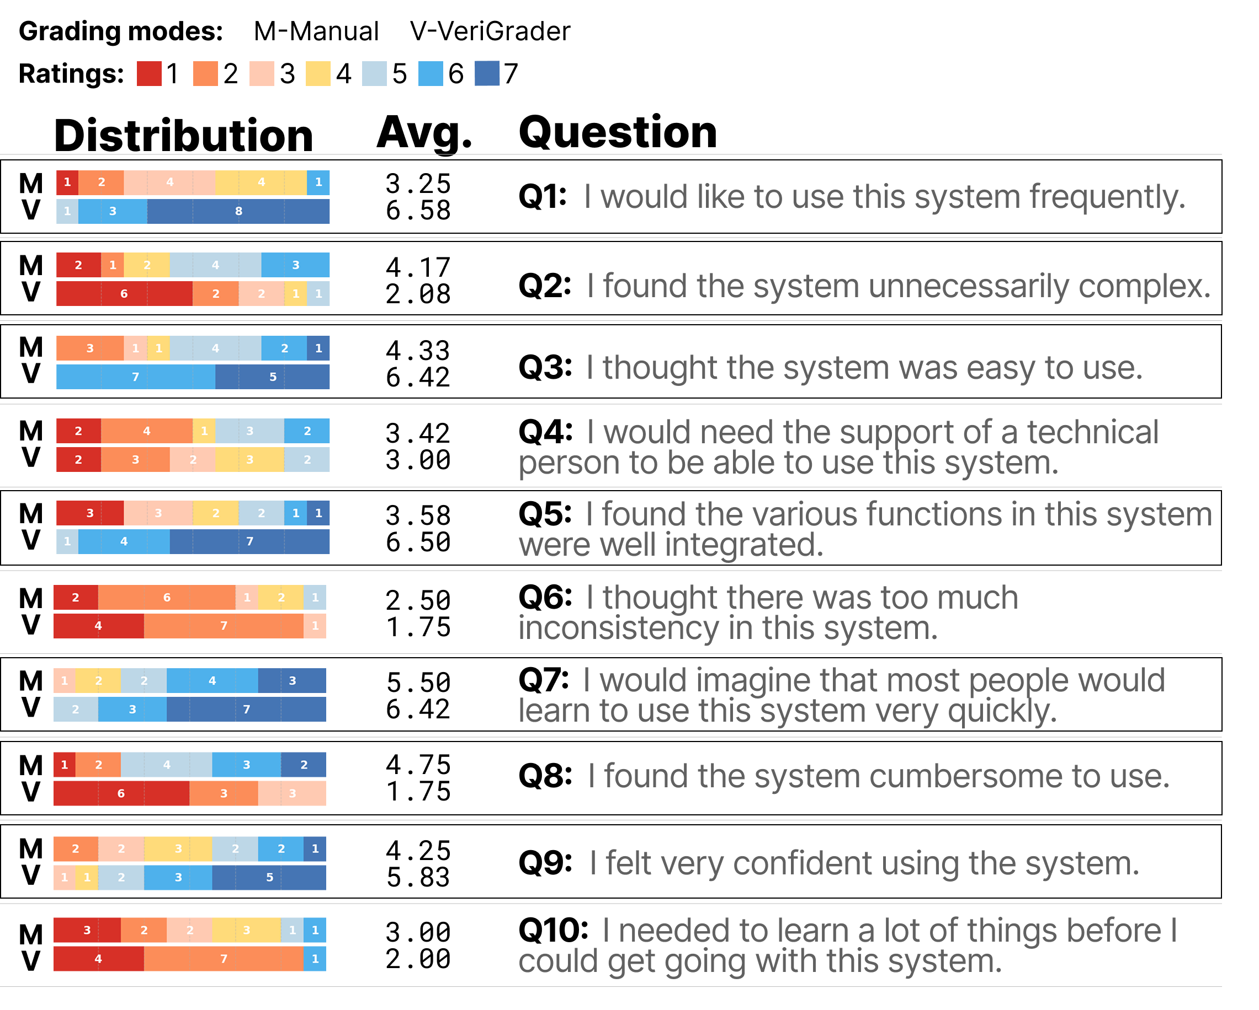
User’s Feedback
Participants reported high usability and positive experience.
Notes:
Participants reported high usability and positive experience.

Slide 22
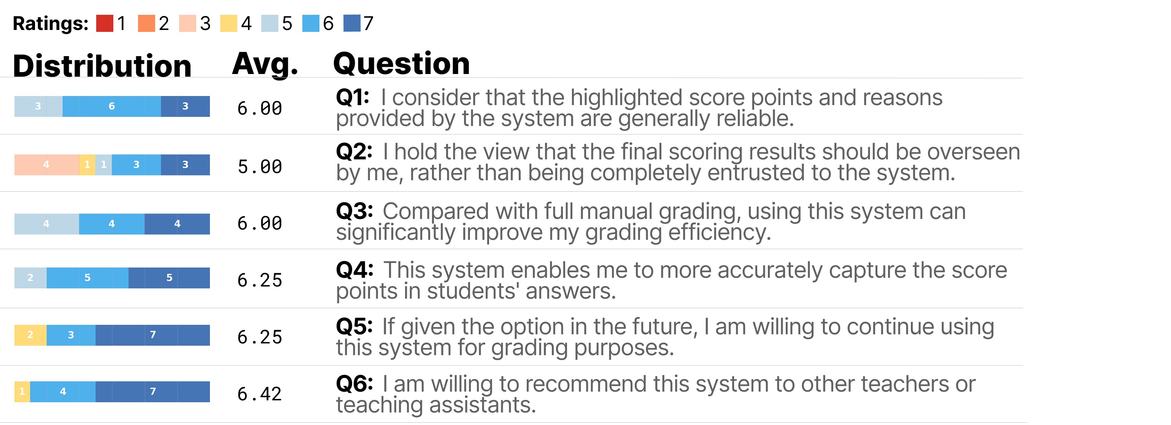
User’s Feedback
Appreciate VeriGrader’s transparency, controllability, and efficiency in grading.
Notes:
Particularly appreciated VeriGrader‘s transparency, controllability, and efficiency in grading.

Slide 23

Acknowledge
The work was supported by the Guangdong Basic and Applied Basic Research Foundation (2025A1515010162), the National Natural Science Foundation of China (62402184), the Guangdong Provincial Fund for Basic and Applied Basic Research—Regional Joint Fund Project (Key Project) (2023B1515120078), the Guangdong Provincial Natural Science Foundation for Outstanding Youth Team Project (2024B1515040010), the Science and Technology Planning Project of Guangdong Province (2025B0101120003), and the Natural Sciences and Engineering Research Council of Canada (NSERC) Discovery Grant (RGPIN-2020-03966).
Notes:
Last, we would like to thank the funding agencies for their generous support.

Slide 24
Conclusion
Contributions:
  Conduct stakeholder interviews and analyze 141 graded exam papers to distill grading practices and derive human–AI collaboration requirements for OSQ assessment.
  Develop VeriGrader, the first instructor–LLM collaborative OSQ grading system, which automates segmentation, scoring mapping, and semantic judgment while preserving instructor agency.
  Validate VeriGrader in real-world educational settings, showing improvements in efficiency, accuracy, consistency, and instructor control, and highlighting its potential for transparent AI in high-stakes assessment.
  Future work:
  Support multimodal assessment capabilities represents including diagrams, formulas.
  Extend VeriGrader into multiple-instructors workflow.
  Explore a unified grading system can handle a wider range of question types.
Notes:
In summary, we present VeriGrader, A system supporting instructor-LLM collaborative OSQ grading.
It frees instructors from tedious manual response segmentation, scoring point mapping, and semantic judgment, while retaining their agency to inspect, correct grading results, and guide LLMs, thus achieving credible, reliable, consistent, and efficient OSQ grading.

Slide 25
VeriGrader:
Open-ended Structured Question Assessment
with Human-LLM Collaboration
Fengyan Lin^{1,2}
Yanna Lin³
Kai Cao^{1,2}
Zikun Deng^{1,2,*}
Yi Cai^{1,2}
¹ School of Software Engineering, South China University of Technology
² Key Laboratory of Big Data and Intelligent Robot (SCUT), Ministry of Education
³ Cheriton School of Computer Science, University of Waterloo

