Slide 1
GPT Scholar
Yijing Jia, Shuqi Wang,
Hsuan-Chu Shih, Zhaoyun Xu
Notes:
Today, I am here to present our project - GPT Scholar.

Slide 2
Problem Statement
Fake / False information
ChatGPT can write convincing fake research-paper abstracts that scientists are often unable to spot them (Gao et al., 2022).
Trust and transparency could be challenging if ChatGPT is used to write scientific research studies(Dwivedi et al., 2023).
Background
Existing solutions emphasize the significance of subject expertise in identifying and eliminating incorrect information (Terence Day, 2023; Seong-Gon Kim, 2023).
Innovation
Instead
We propose potential solutions for enhancing the model and rectifying inaccuracies, primarily by modifying the dataset's composition and limiting the tool's functionality.
Notes:
ChatGPT has been widely used to provide seemingly professional responses for problem-solving.
However, the concern arises when some of these responses turn out to be fabricated.
This poses a significant risk, especially if researchers unknowingly base their work on such content, potentially undermining their scientific studies.
Instead of relying solely on subject expertise to identify and eliminate incorrect information, we have designed GPT Scholar, which we think goes beyond the first one.

Slide 3
Responsibility
Academic Research
Society
Impact & Advantage
More powerful tools for researchers to do research
Reduce plagiarism
Notes:
In conclusion, some people advocate for other methods to regulate academic problems caused by chatGPT through education, rules, while we provide a real prototype to improve the model and solve the problem to some extent.
The product will empower researchers to advance knowledge with accuracy.

Slide 4
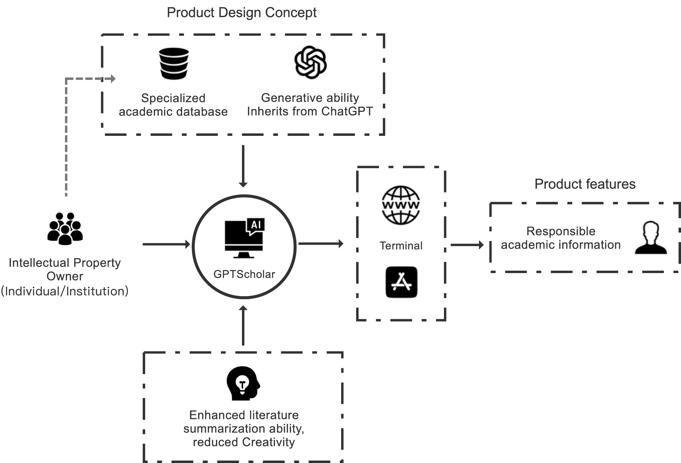
Solution
Notes:
GPT Scholar offers four essential functions for researchers: Literature Review and Research Survey, Academic Consulting and Guidance, Data Analysis and Statistics, and Academic Standards and Ethical Support.
The implementation of these functions is guided by crucial design principles. We modify the dataset's composition and limit the tool's functionality to enhance the model and rectify inaccuracies.
First, GPT Scholar builds upon chatGPT‘s language understanding and generation capabilities and we also undergoes extensive training using academic datasets.
Regular model training is conducted based on the frequency of new content in academic articles, ensuring up-to-date knowledge.
Supervised learning and manual review of outputs guarantee the authenticity and accuracy of GPT Scholar's responses.

Slide 5
Thank you

