Slide 1
Modeling US Bluefin tuna spatial density using VAST Katie Lankowicz

Slide 2
Model inputs and structure
Data filters
Trips targeting BFT
Landed ME-VA
Charter or private boats
< 24 hours effort
June through October
1993 through 2021
Has valid spatial information
Fish categorized as either <59 in (small) or >73 in (large)
Model structure
Response variable is CPUE (catch / hours fishing)
Spatial, temporal, and spatio-temporal effects
Year has fixed effect but correlation between years follows AR1 process
Spatial variation interpolated on a grid generated from 200 knots, anisotropy allowed
Density covariates: SST, SLP, NAO (daily for basin), AMO (monthly for basin), depth, prey field (made with a separate VAST model based on observer data)
Cubic spline model similar to GAM
Currently no catchability covariates

Slide 3
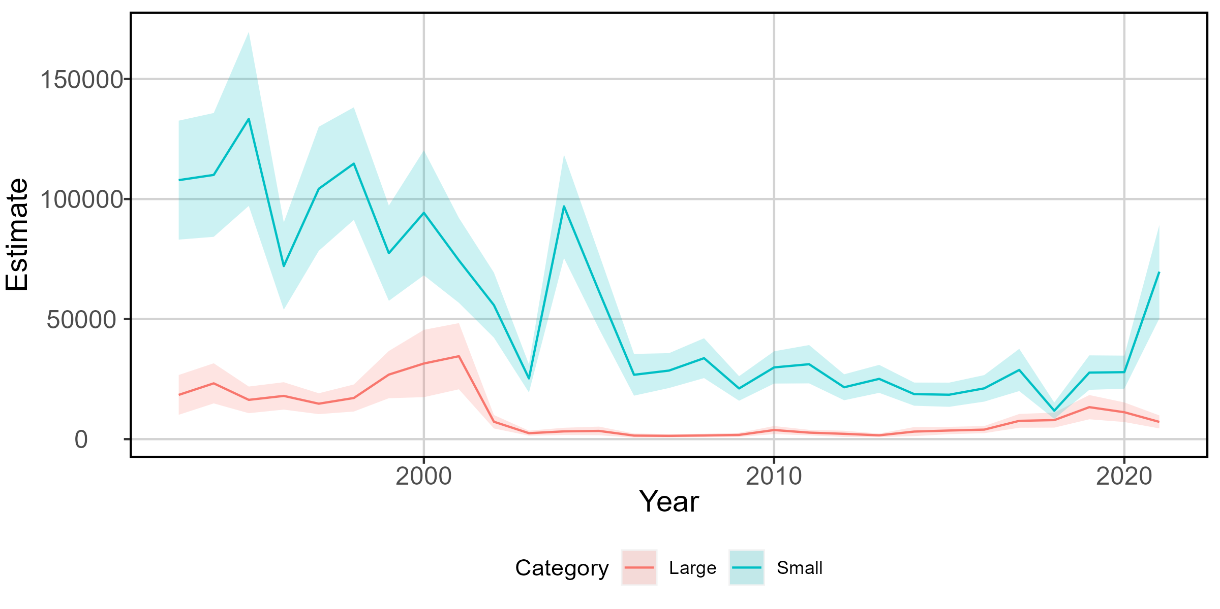
Fig 1. VAST-estimated index of abundance for large (red) and small (blue) BFT based on US
catch data, 1993-2021.

Slide 4
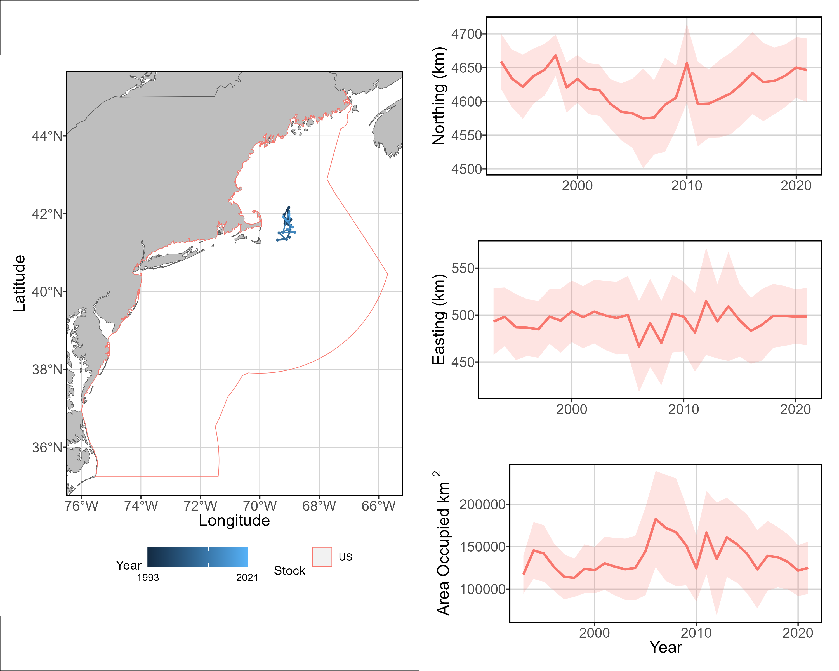
b
a
Fig 2. a) VAST-estimated measures
of stock center of gravity for
large BFT, b) shifts in northing
within the model spatial
domain, c) shifts in easting
within the model spatial
domain, and d) changes in area
utilized by the large size class.
c
d

Slide 5
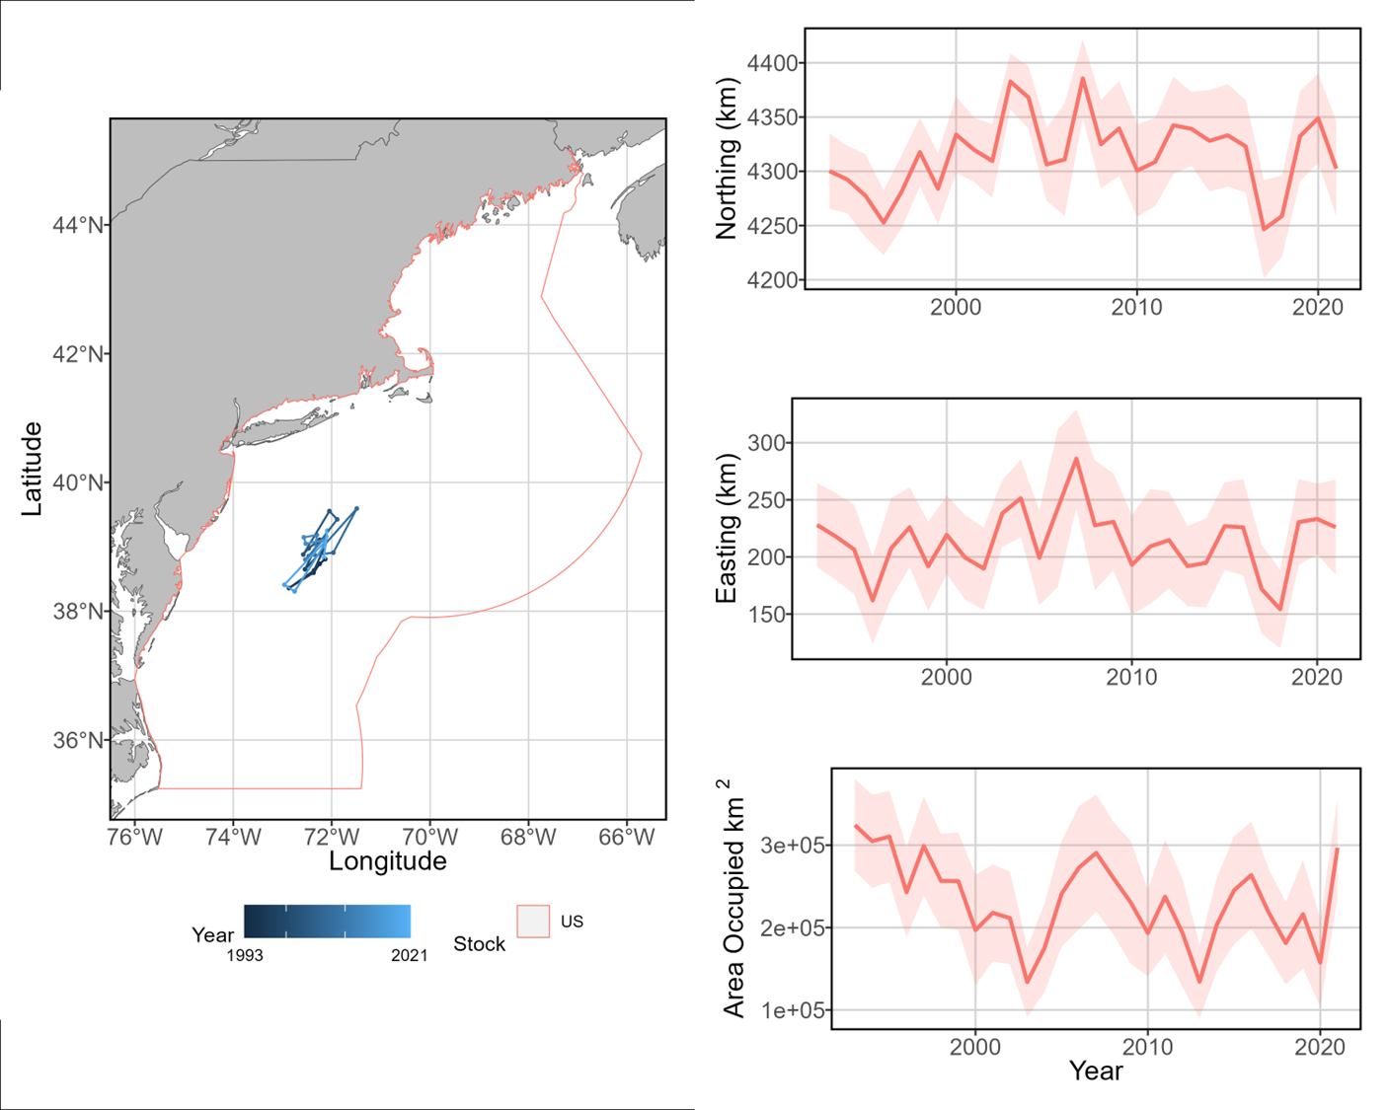
b
a
Fig 3. a) VAST-estimated measures
of stock center of gravity for
small BFT, b) shifts in northing
within the model spatial
domain, c) shifts in easting
within the model spatial
domain, and d) changes in area
utilized by the small size class.
c
d

