Slide 1
Data and Modeling Decisions: Joint US-CA BFT Index

Slide 2
Goals
Apply spatial-temporal models to develop improved indices of abundance for the western BFT stock

Slide 3
Approach
Vector Autoregressive Spatio-Temporal Model (VAST)
Designed to estimate spatial variation in density of one or more categories in one or more time steps
Notes:
Objectives: map spatial density, generate indices of abundance, identify effects of climate covariates, identify shifts in spatial dynamics

Slide 4
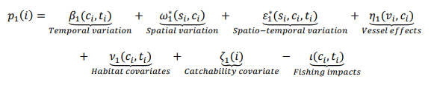
VAST Basics
Predictor 1: Model encounter probability at every spatial location and time step for each category
Predictor 2: Model positive catch rate (abundance) at every spatial location and time step for each category, based on the calculated encounter probability
Notes:
Spatial delta-generalized linear mixed model for multiple categories

Slide 5
VAST Needs
Defined spatial and temporal domains:
spatially-explicit bounded areas to extrapolate spatial density at each time step
Observations:
either count or biomass information for each category at multiple spatio-temporal locations
Effort estimate:
typically area swept estimates for net-based surveys, but can be creative for surveys with undefined areas of influence.
used to scale abundance to area

Slide 6
Data inclusion decisions

Slide 7
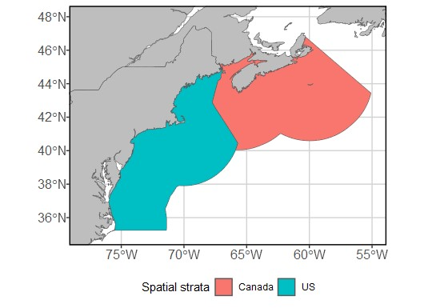
Model domains
Spatial domain
Whole area: EEZ waters of US and Canada
Split into spatial strata by country
Temporal domain
Annual time steps
Data availability constrains domain to 1996-2022

Slide 8
Data available – US
Large Pelagics Survey 1980-2022
Rod and reel recreational fishery only
About 160,000 trip-level reports
Reporting procedure changed in 2002; fewer reported 0-catch instances prior
Trip-level abundance (released + kept) per defined size category, but no actual biological information
Effort measures
Fishing hours, number of anglers/ lines/ hooks
Targeting
Trips can report up to 9 species/ BFT size categories as “targeted”

Slide 9
Size classes – US
Size class | SFL.in | SFL.cm | CFL.in | CFL.cm | PCFL.in | PCFL.cm | RWT.lbs | RWT.kg | Previous index
Young school | < 26 | < 66 | < 27 | < 69 | < 20 | < 51 | < 14 | < 6.4 | No
School | 26 - 44 | 66 - 114 | 27 - 47 | 69 - 119 | 20 - 35 | 51 - 89 | 14 - 66 | 6.4 - 29.9 | Small
Large school | 45 - 56 | 115 - 144 | 47 - 59 | 119 - 150 | 35 - 44 | 89 - 112 | 66 - 135 | 29.9 - 61.2 | Small
Small medium | 57 - 69 | 145 - 177 | 59 - 73 | 150 - 185 | 44 - 54 | 112 - 137 | 135 - 235 | 61.2 - 106.6 | No
Large medium | 70 - 76 | 178 - 195 | 73 - 81 | 185 - 205 | 54 - 60 | 137 - 152 | 235 - 310 | 106.6 - 140.6 | Large
Giant | > 76 | > 195 | > 81 | > 205 | > 60 | > 152 | > 310 | > 140.6 | Large
Notes:
I cannot provide information on the distribution of fish within size categories, as I have no direct biological data.
Note that young school and small-medium fish are not covered by any previous index, nor are they covered in VAST indices if we keep this sizing structure.

Slide 10
Data filtering – US standards
Trips must occur 1996 – 2022
Trips must target Small (66-144cm SFL) or Large BFT (>177cm)
Trips must be taken on private, charter, or headboats
Tuna must be landed in VA-ME
Trips must begin by June 1 and end by Oct 31
Trips must be between 1 and 24 hours of fishing time
Trips must contain valid spatial information
Few observations removed for missing or invalid information

Slide 11
Data available – Canada
SWNS Survey 1996-2022
Rod and reel, tended line, and harpoon commercial trips
About 45,300 trip-level reports
Reporting procedure changed in 2002; fewer reported 0-catch instances prior
Biological information (rounded weight) for landed fish
Sosthene developed modeling procedure to assign and validate location/ effort information when missing (necessary, otherwise would discard much of data)
Effort measures
Fishing hours, number of lines
Targeting
Trips do not include targeting information. All trips that reported non-BFT bycatch discarded prior to analysis.

Slide 12
Size classes – Canada
Size class | RWT.lbs | RWT.kg
Small | < 600 | < 272
Medium | 600 - 798 | 272 – 362
Large | > 798 | > 362

Slide 13
Data filtering – Canadian standards
Trips must occur 1996 – 2022
Trips must target BFT: no bycatch of bigeye, yellowfin, or albacore
Trips must use rod and reel, harpoon, or tended line as gear
Trips must begin by July 1 and end by Dec 15
Trip length must not exceed 7 days at sea
Trips must catch 12 or fewer BFT in total
Trips must contain valid spatial information
Few observations removed for missing or invalid information
Notes:
Differences: no bycatch, extra gears, months included, trip length cap, and catch cap.

Slide 14
Data filtering decisions: Current
Trips must occur 1996 – 2022
Trips must target BFT (either explicitly or by having no bycatch)
Trips must use rod and reel, harpoon, or tended line as gear
Trips must begin by June 1 and end by Dec 15
Fishing effort must be between 1 and 24 hours
Trips must catch 12 or fewer BFT in total
Trips must contain valid spatial and effort information
Will use US size categories (66-144 cm SFL, >177cm SFL)
Will necessitate separate US-only model for small index

Slide 15
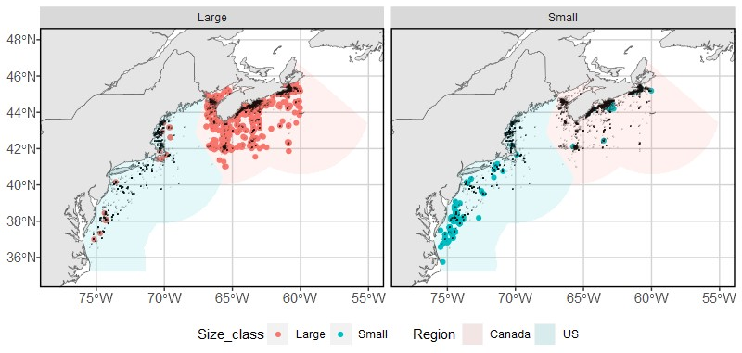
Data coverage

Slide 16
Data inclusion decisions: Current
Domains:
NEUS and SWNS waters within American and Canadian EEZs, split into country-based strata
1996-2022, annual time step
Observations:
Count of fish within small (66-144cm SFL) and large (>177cm SFL) size categories at each sampling spatio-temporal location
Too few “small” fish caught in Canadian data, would require splitting models by size class and restricting “small” model to US only
Effort:
Fishing hours

Slide 17
Model structuring decisions

Slide 18
Density covariates
Scaled, tested for collinearity prior to inclusion
SST (OISST)
Water depth (GEBCO 15 arc-second bathymetry)
Basin-wide climate indices: daily NAO index, monthly AMO index
US ONLY: prey field from observations of herring, mackerel, menhaden
Cubic spline additive model for both predictors
Response variable ~ cs(Density Covariate 1) + … + cs(Density Covariate n)
Looking to add
SSHA
Canadian prey field, cannot include prey as covariate while data are missing

Slide 19
Vessel effects
Similar to catchability covariates, specifies random variation in catchability among levels of a grouping variable
Can help distinguish effects of unmeasured differences in gear operations from covariation in species densities
Will use country-gear combination as grouping variable
Can conduct simple leave-one-out sensitivity analysis to determine relative usefulness of Canadian harpoon and TL data

Slide 20
Spatial smoothing and resolution
Model spatial domain represented as “2D mesh” built on SPDE approximation to Gaussian Markov random field
Geometric anisotropy included as fixed effect
K-means clustering used to position 200 knots within domain to minimize average distance between knots and sampling locations
Spatial variables at each sampling location assumed to be equivalent to nearby knot
Number of knots can be altered, but selecting number of knots after viewing results can lead to questionable cherry-picking

Slide 21
Spatial, temporal, spatio-temporal effects
Model selection process to justify the use of spatial and spatiotemporal random effects in both linear predictors
Intercept defined as fixed effect, ensures independence between years
Lognormal-Poisson distribution for random effects in first linear predictor and alternative “Poisson-link delta-model” distribution for the second
Temporal correlation estimated for spatiotemporal variation in both linear predictors using an AR1 process
Prevents development of unrealistic “hot spots”

Slide 22
Output examples

Slide 23
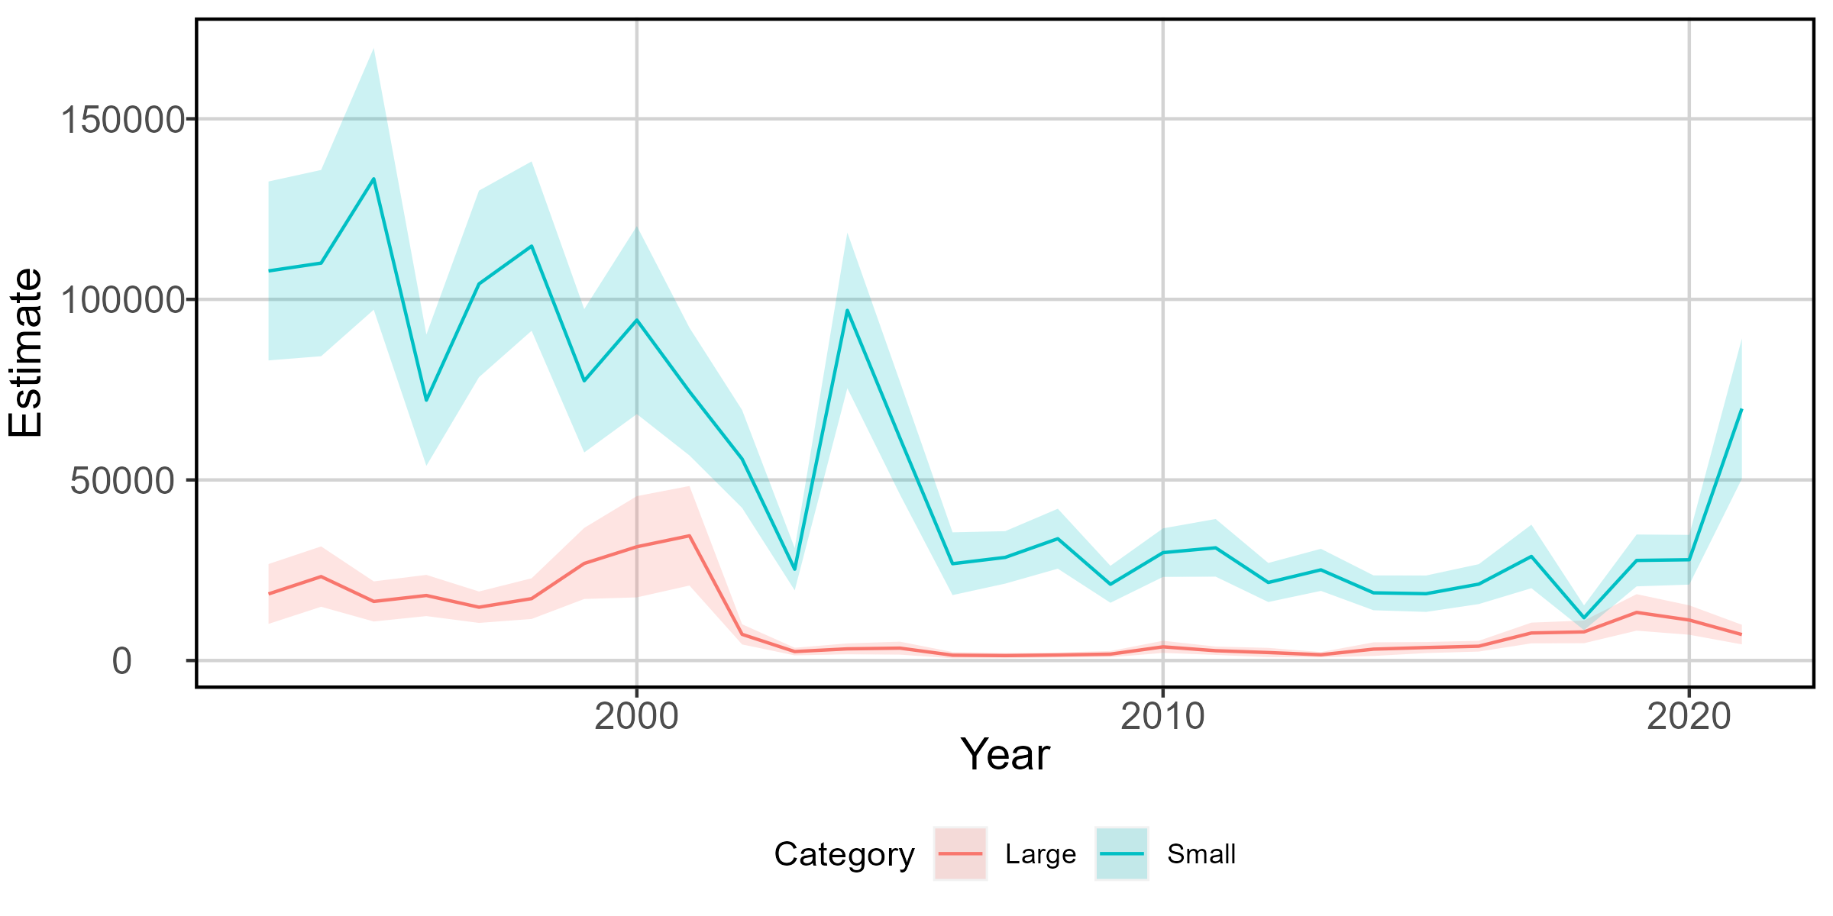
US ONLY Indices of abundance
MODEL TESTING: DO NOT USE
Fig 1. VAST-estimated index of abundance for large (red) and small (blue) BFT based on US
catch data, 1993-2021.

Slide 24
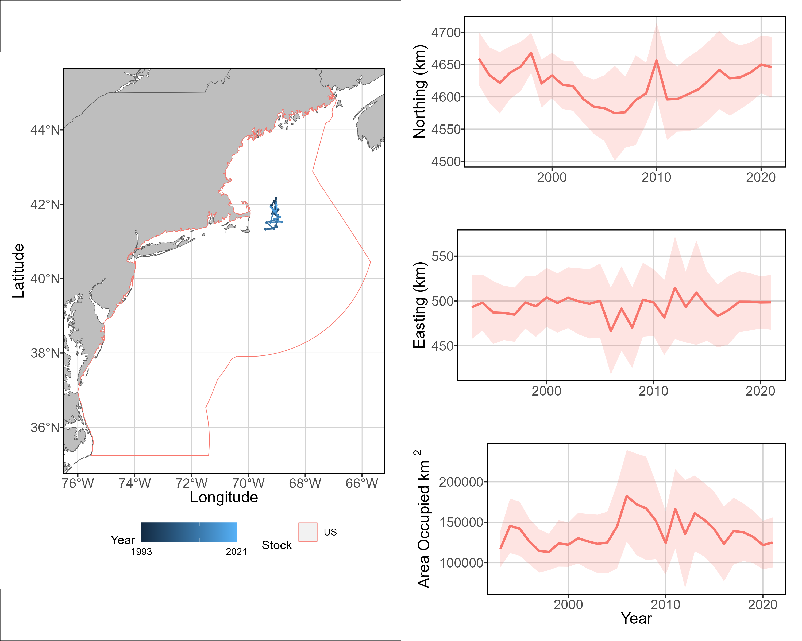
US ONLY spatial dynamics – large size class
b
a
a) VAST-estimated measures
of stock center of gravity for
large BFT
b) shifts in northing
within the model spatial
domain
c) shifts in easting
within the model spatial
domain
d) changes in area
utilized by the large size class.
c
MODEL TESTING: DO NOT USE
d

Slide 25
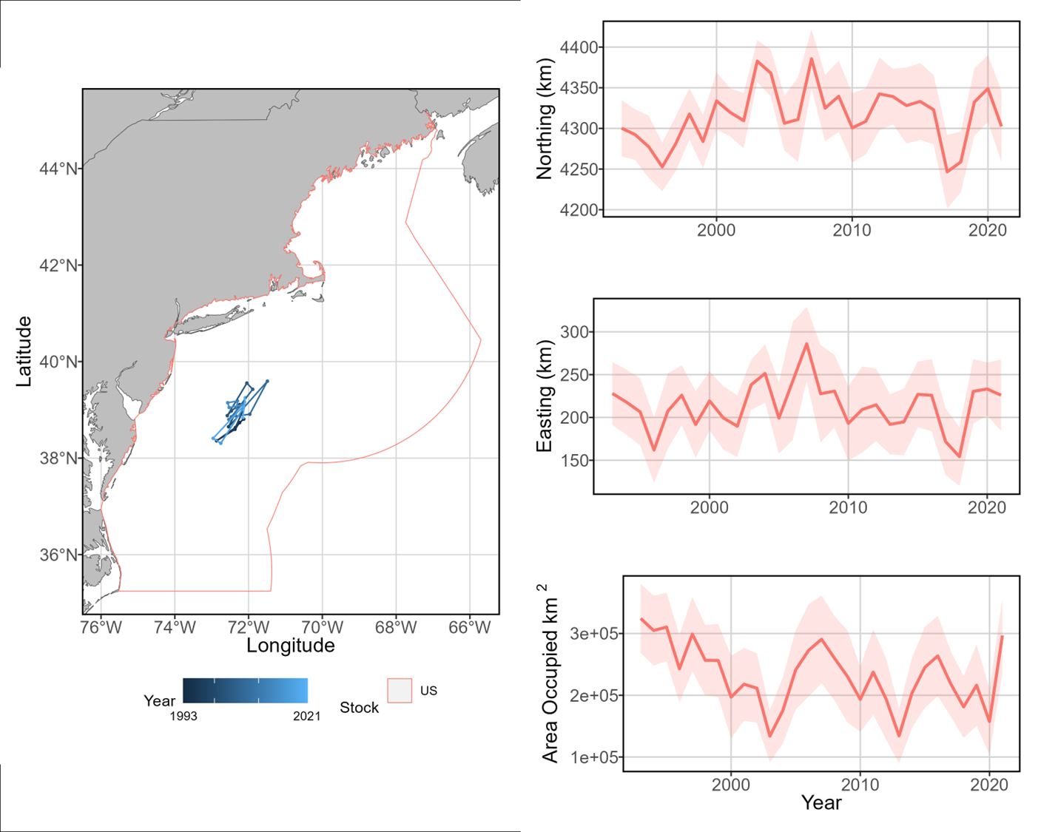
US ONLY spatial dynamics – small size class
b
a
a) VAST-estimated measures
of stock center of gravity for
small BFT
b) shifts in northing
within the model spatial
domain
c) shifts in easting
within the model spatial
domain
d) changes in area
utilized by the small size class.
c
MODEL TESTING: DO NOT USE
d

Slide 26
Other potential output
Partial effects of density covariates
Similar to GAM smoother output, shows partial effect of each density covariate on both linear predictors for all categories
Range edges at various spatial density quantiles for each year

Slide 27
Questions, Comments

