Slide 1
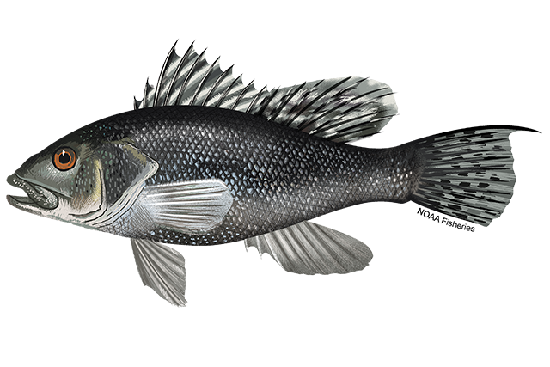
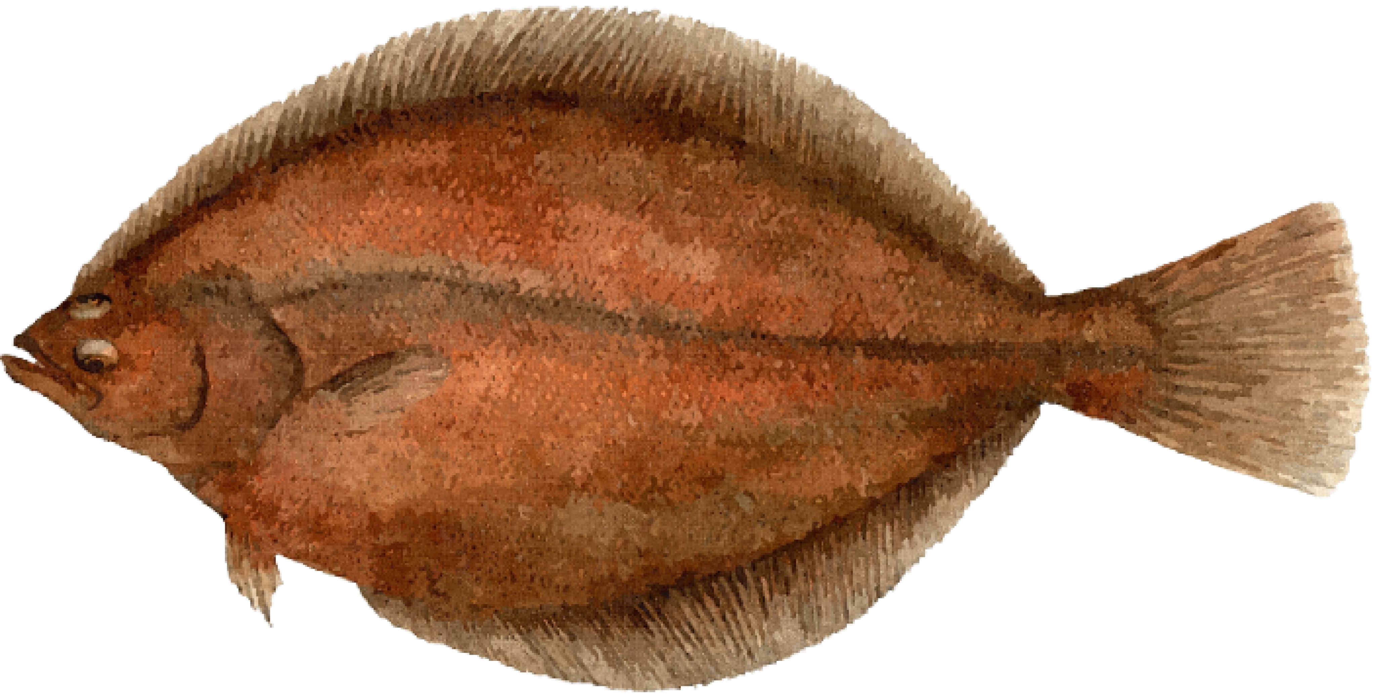
Black Sea Bass
(Centropristis striata)
American Plaice
(Hippoglossoides platessoides)

Slide 2
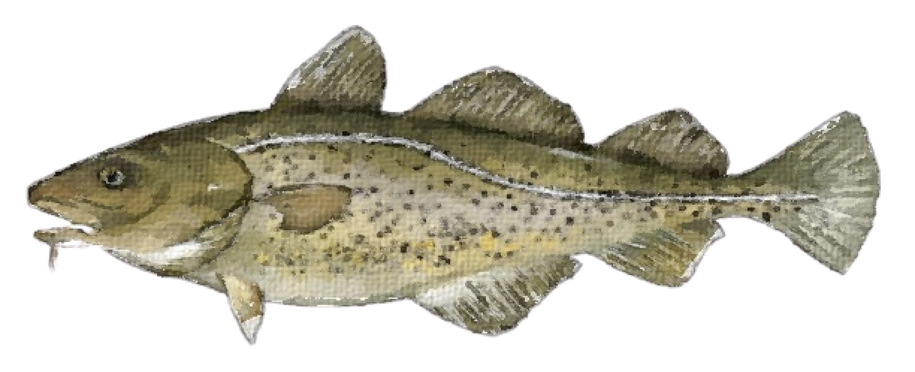
Atlantic Cod
(Gadus morhua)
Fish
(fancy name)

Slide 3



Slide 4



Slide 5


