Slide 1

Team 5 -Akash Jagtap -Jerin Rajan -Nitin Prince Reuben

Slide 2

Kubernetes is a Greek word which means “helmsman” or the pilot of a ship.
It is an open source project that was started by Google and derived from Borg, which is used inside Google — for several years now — for container management, automating deployment and scaling. Currently, it is hosted by Cloud Native Computing Foundation(CNCF).

Slide 3
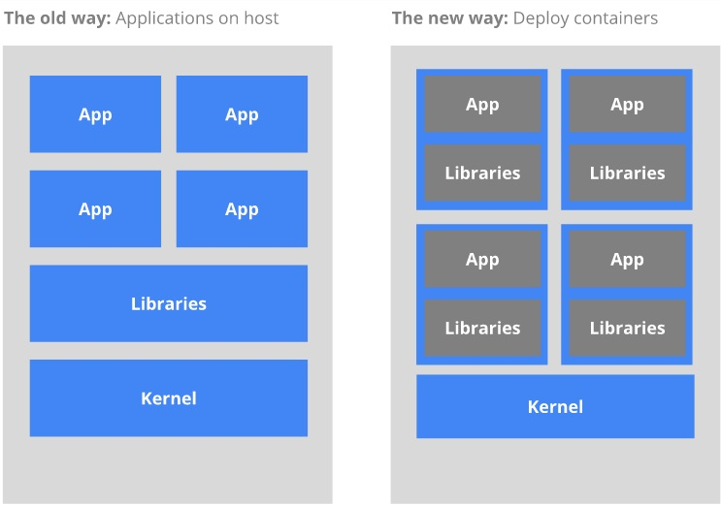

Slide 4
Features Of Kubernetes
Does not limit the types of application supported
Load Balancing
Rolling update or rollback
Auto – scalability
Using pods for grouping container
API management

Slide 5
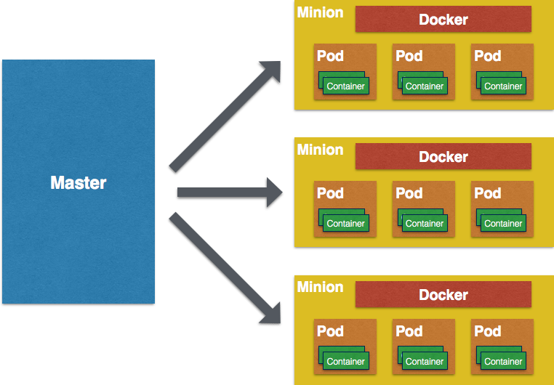
Architecture

Slide 6
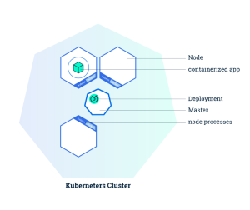
Kubernetes Cluster

Slide 7
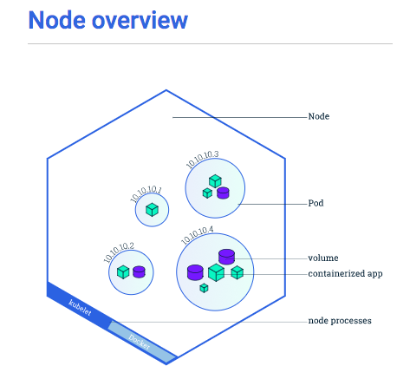

Slide 8
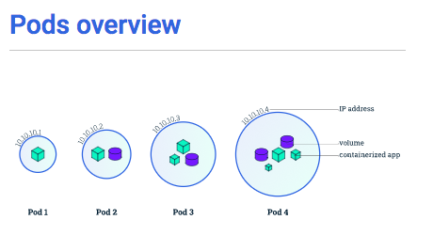

Slide 9
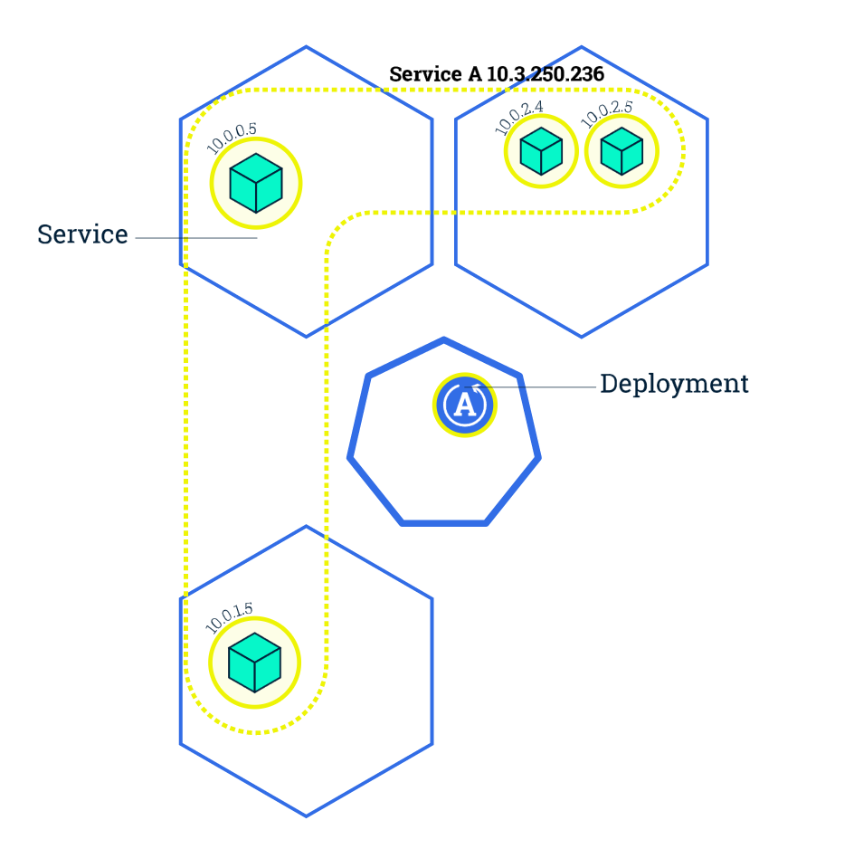
Services

Slide 10
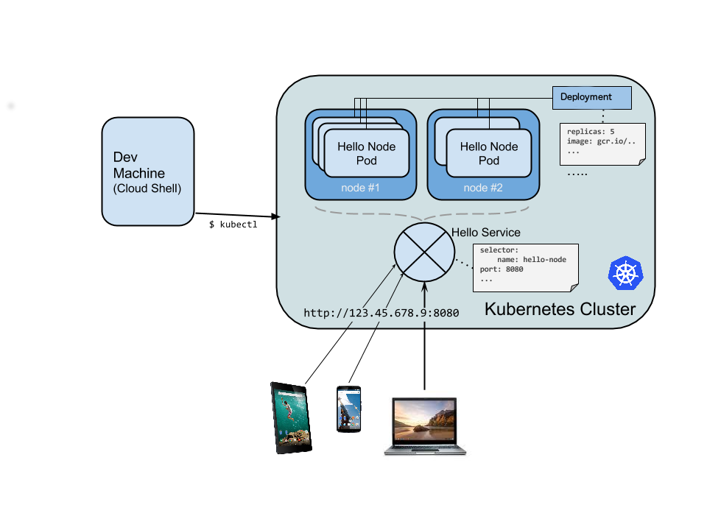
How Kubernetes works?

Slide 11

Docker Swarn

Slide 12
Docker Swarm
Comprises of:
Manager nodes: Control orchestration, cluster management, and the distribution of tasks
Worker nodes: The sole purpose of workers is to run containers and services as assigned by a manager node
Services: A service describes how you’d like an individual container to distribute itself across your nodes. To create a service, specify the exact information as in an ordinary ‘docker run’, plus new parameters (i.e., # of container replicas)
Tasks: Single containers place work within these “slots” according to the Swarm manager

Slide 13
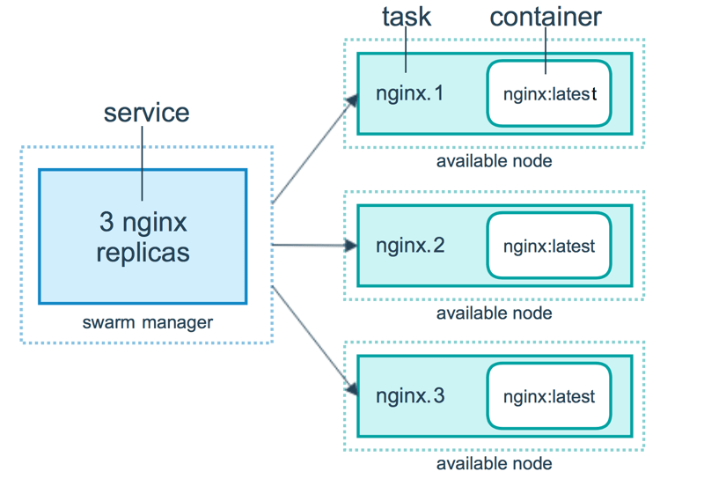
Docker Swarm

Slide 14
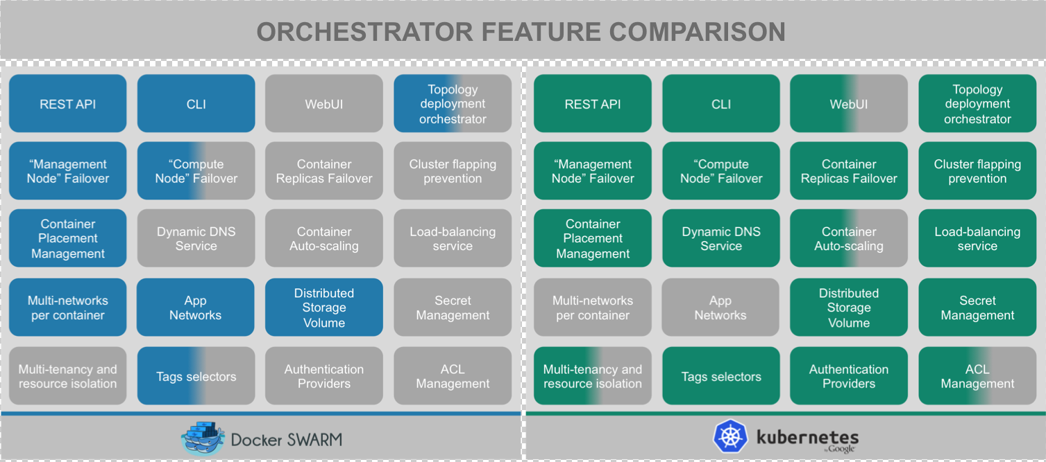
Docker Swarm vs Kubernetes
Docker Swarm | Kubernetes
Lack auto-scaling | Has auto-scaling
Lack secret management | Provides secret management
Lacks resource management | Provides resource management

Slide 15
Why Microservices !!
Software systems become more complex as their scale
scope
Volume
user interactions
Sometimes system that grow in size beyond the boundaries initially define pose a particular problems when it comes to changing them

Slide 16
What is Microservices
Microservice architecture are used to achieve faster delivery and greater safety as the scale of their systems increase
Microservices are goal-oriented
Microservices are focused on replaceability
This idea that driving toward replacement of components rather than maintaining existing components get to the very heart of what makes the microservices approach special

Slide 17
Microservices
More specifically, the real value of microservices is realized when we focus on two key aspects - speed and safety
The Speed of Change - The desire for speed is a desire for immediate change and ultimately a desire for adaptability
At Scale - Systems that can work at scale don’t break when under pressure; instead they incorporate built-in mechanisms to increase capacity in a safe way
In Harmony - Organizations that succeed with microservice architecture are able to maintain their system stability while increasing their change velocity. In other words, they created a harmony of speed and safety that works for their own context

Slide 18
How it impact Business
Agility allows organizations to deliver new products, functions, and features more quickly and pivot more easily if needed
Composability reduces development time and provides a compound benefit through reusability over time
Comprehensibility of the software system simplifies development planning, increases accuracy, and allows new resources to come up to speed more quickly
Independent deployment of components gets new features into production more quickly and provides more flexible options for piloting and prototyping
Organizational alignment of services to teams reduces ramp-up time and encourages teams to build more complex products and features iteratively
Polyglotism permits the use of the right tools for the right task, thus accelerating technology introduction and increasing solution options

Slide 19
Demo and explanation of the slide can be found in google drive mentioned below.
https://drive.google.com/open?id=1gu5E7UNBWmjHtNsX7A5PXyldqbkH53yM

Slide 20
Q&A

Slide 21
Thankyou

