Slide 1
ECIM API

Slide 2
Ecim API
What is it:
ecim-api is the engine of the auto generated product specific ECIM apis. Product specific ECIM apis are providing tool-sets to interacting with the node throw the COM interfaces. Eg. CLI or netconf. It has an entry point called Ecim from where you could reach ALL the functions.
The product specific ECIM apis could be auto-generated by maven based on the ECIM model files.
Key features:
tool-set to interacting with the node throw the COM interfaces
auto-generated product specific api-s
self documented api based on the ECIM model file (auto generated javadoc)
ecim file with xinclude, and filter support

Slide 3
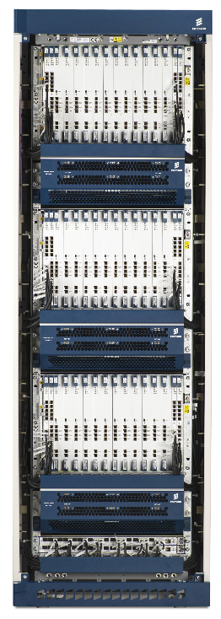
Ecim stack overview
Test data
Ecim generator maven plugin
_mp.xml model files
Auto generated
Auto generated
Ecim product model
Ecim-properties
Auto generated
Test-suite-properties
Ecim-API
Ecim-logger
Remote-cli
Test case
Ecim-helpers
Netconf rebirth

Slide 4
Ecim model – ecim API compatibility
The ecim-api version generated for some model has to be used only for a build that has the same model
2 | <?xml version="1.0" encoding="UTF-8"?> |  | 2 | <?xml version="1.0" encoding="UTF-8"?>
3 | <rpc-reply xmlns="urn:ietf:params:xml:ns:netconf:base:1.0" xmlns:ns2="urn:ietf:params:xml:ns:netconf:notification:1.0" message-id="1"> |  | 3 | <rpc-reply xmlns="urn:ietf:params:xml:ns:netconf:base:1.0" xmlns:ns2="urn:ietf:params:xml:ns:netconf:notification:1.0" message-id="1">
4 | <data> |  | 4 | <data>
5 | <ManagedElement xmlns="urn:com:ericsson:ecim:ComTop"> |  | 5 | <ManagedElement xmlns="urn:com:ericsson:ecim:ComTop">
6 | <managedElementId>1</managedElementId> |  | 6 | <managedElementId>1</managedElementId>
7 | <SystemFunctions> |  | 7 | <SystemFunctions>
8 | <systemFunctionsId>1</systemFunctionsId> |  | 8 | <systemFunctionsId>1</systemFunctionsId>
9 | <SecM xmlns="urn:com:ericsson:ecim:ComSecM"> |  | 9 | <SecM xmlns="urn:com:ericsson:ecim:DMXC_SecM">
10 | <secMId>1</secMId> |  | 10 | <secMId>1</secMId>
11 | <UserManagement> |  | 11 | <UserManagement>
12 | <userManagementId>1</userManagementId> |  | 12 | <userManagementId>1</userManagementId>
13 | <LdapAuthenticationMethod xmlns="urn:com:ericsson:ecim:ComLdapAuthentication"> |  | 13 | <LdapAuthenticationMethod xmlns="urn:com:ericsson:ecim:DMXC_LDAP_Authentication">
14 | <ldapAuthenticationMethodId>1</ldapAuthenticationMethodId> |  | 14 | <ldapAuthenticationMethodId>1</ldapAuthenticationMethodId>
15 | <administrativeState>LOCKED</administrativeState> |  | 15 | <administrativeState>LOCKED</administrativeState>
16 | </LdapAuthenticationMethod> |  | 16 | </LdapAuthenticationMethod>
17 | </UserManagement> |  | 17 | </UserManagement>
18 | </SecM> |  | 18 | </SecM>
19 | </SystemFunctions> |  | 19 | </SystemFunctions>
20 | </ManagedElement> |  | 20 | </ManagedElement>
21 | </data> |  | 21 | </data>
22 | </rpc-reply> |  | 22 | </rpc-reply>

