Slide 1
Lambdas
Why do we need it?
Syntax
Context capturing
java.util.functions package
Method reference
Examples

Slide 2
Syntax
Each lambda has three parts:
Arguments Lambda operator -> Body
() -> {}
(int x, int y) -> x + y
(x, y) -> x - y
x -> x * 2 - 3
x -> System.out.println(x)
x -> {
System.out.println(x);
int z = x * 2 - 3;
System.out.println(z);
return z;
}

Slide 3
Syntax
Each lambda has three parts:
Arguments Lambda operator -> Body
() -> {}
(int x, int y) -> x + y
(x, y) -> x - y
x -> x * 2 - 3
x -> System.out.println(x)
x -> {
System.out.println(x);
int z = x * 2 - 3;
System.out.println(z);
return z;
}

Slide 4
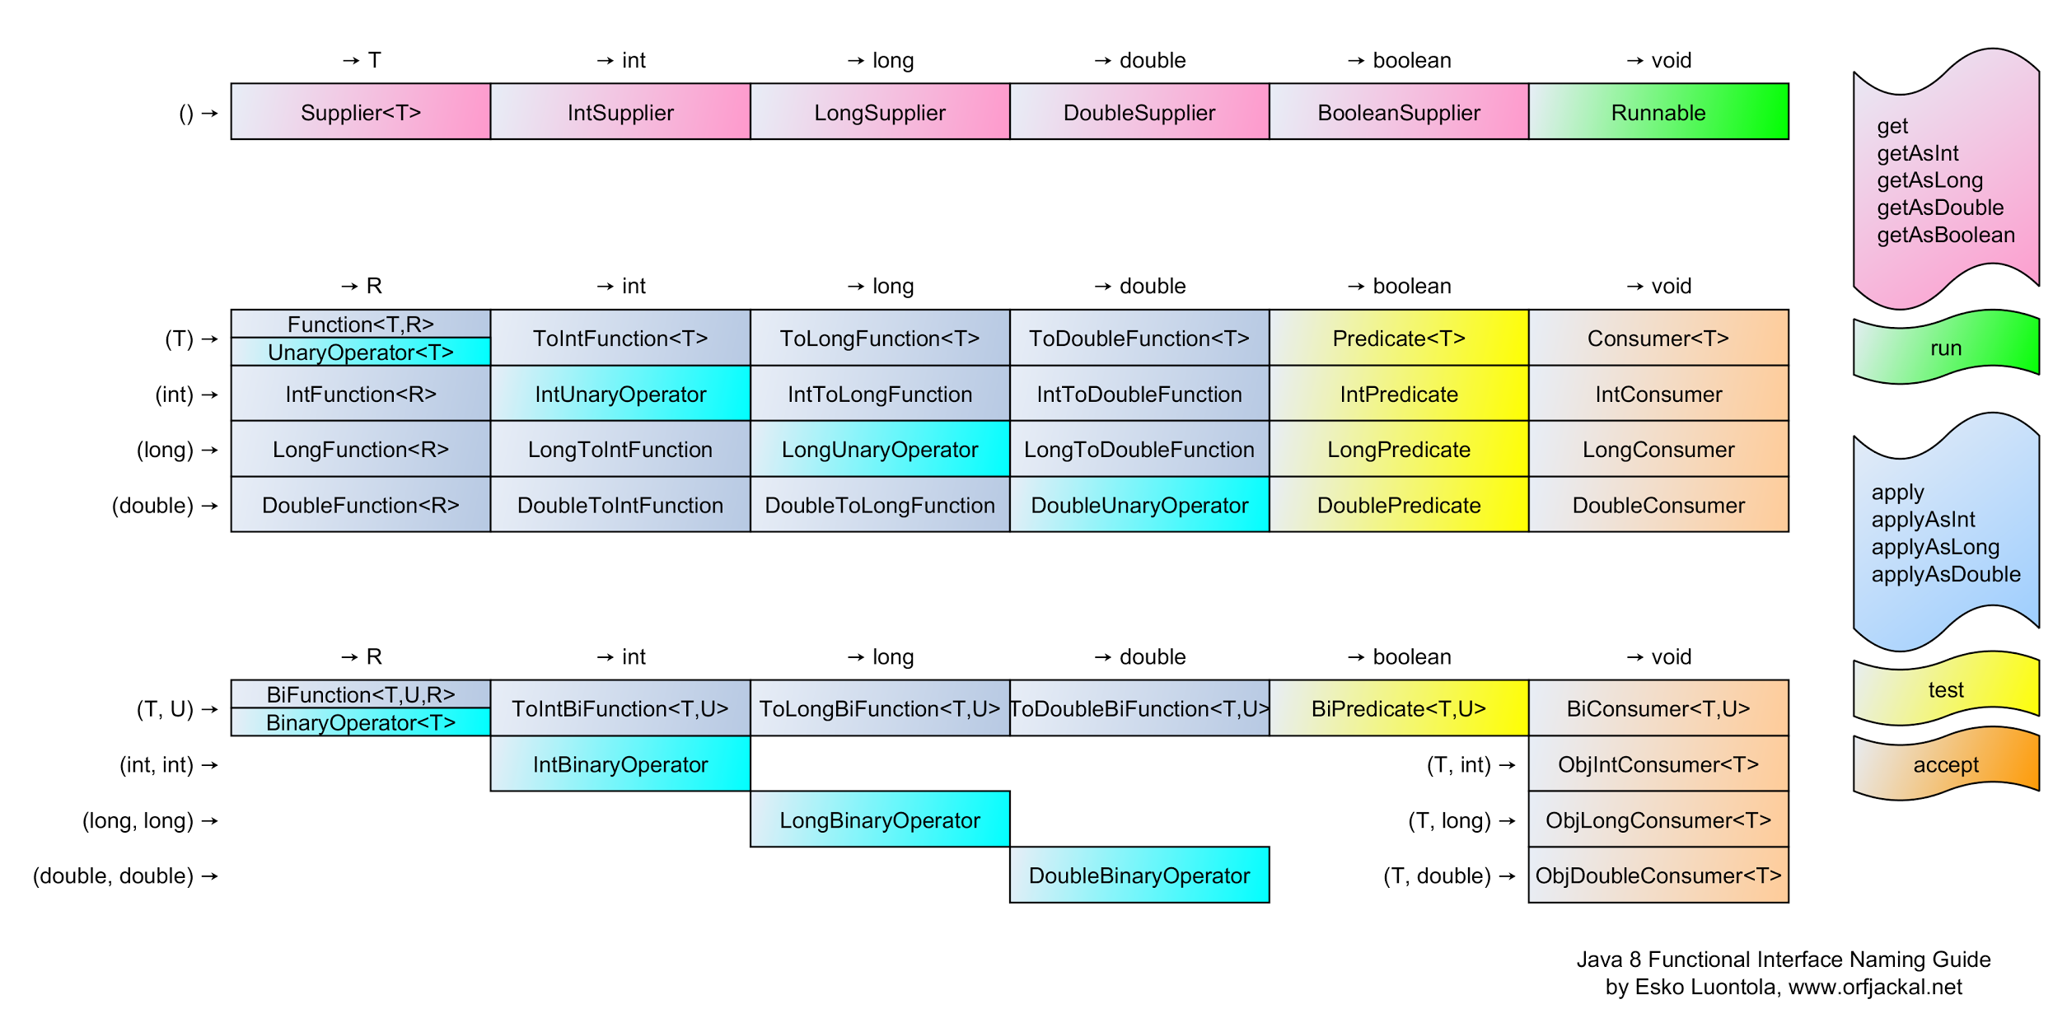
Built-in functional interfaces

Slide 5
FP style in JAVA
JAVA 8 provides feature to emulate FP style
It is not real FP, but just some abstraction to emulate the code style. It is still OOP inside

Slide 6
Improve code using FP features
@Getter @Setter class Metric { String oilTemperature; String airConsumption; String ignitionDwellAngle; String chainTensioner; String sparkMisses; String airEnrichment; String voltage; String current; String power; }

Slide 7
Improve code using FP features
public void compare(Metric m1, Metric m2) { String oilTemperature = Objects.equals(m1.getOilTemperature(), m2.getOilTemperature()) ? m1.getOilTemperature() : "Unexpected value"; String airConsumption = Objects.equals(m1.getAirConsumption(), m2.getAirConsumption()) ? m1.getAirEnrichment() : "Unexpected value"; String ignitionDwellAngle = Objects.equals(m1.getIgnitionDwellAngle(), m2.getIgnitionDwellAngle()) ? m1.getIgnitionDwellAngle() : "Unexpected value"; String chainTensioner = Objects.equals(m1.getChainTensioner(), m2.getChainTensioner()) ? m1.getChainTensioner() : "Unexpected value"; String sparkMisses = Objects.equals(m1.getSparkMisses(), m2.getSparkMisses()) ? m1.getSparkMisses() : "Unexpected value"; String airEnrichment = Objects.equals(m1.getAirEnrichment(), m2.getAirConsumption()) ? m1.getAirEnrichment() : "Unexpected value"; String voltage = Objects.equals(m1.getVoltage(), m2.getVoltage()) ? m1.getVoltage() : "Unexpected value"; String current = Objects.equals(m1.getCurrent(), m1.getCurrent()) ? m1.getCurrent() : "Unexpected value"; String power = Objects.equals(m1.getPower(), m2.getPower()) ? m1.getPower() : "Unexpected value";
}

Slide 8
Easy to make a bug
public void compare(Metric m1, Metric m2) { String oilTemperature = Objects.equals(m1.getOilTemperature(), m2.getOilTemperature()) ? m1.getOilTemperature() : "Unexpected value"; String airConsumption = Objects.equals(m1.getAirConsumption(), m2.getAirConsumption()) ? m1.getAirEnrichment() : "Unexpected value"; String ignitionDwellAngle = Objects.equals(m1.getIgnitionDwellAngle(), m2.getIgnitionDwellAngle()) ? m1.getIgnitionDwellAngle() : "Unexpected value"; String chainTensioner = Objects.equals(m1.getChainTensioner(), m2.getChainTensioner()) ? m1.getChainTensioner() : "Unexpected value"; String sparkMisses = Objects.equals(m1.getSparkMisses(), m2.getSparkMisses()) ? m2.getSparkMisses() : "Unexpected value"; String airEnrichment = Objects.equals(m1.getAirEnrichment(), m2.getAirConsumption()) ? m1.getAirEnrichment() : "Unexpected value"; String voltage = Objects.equals(m1.getVoltage(), m2.getVoltage()) ? m1.getVoltage() : "Unexpected value"; String current = Objects.equals(m1.getCurrent(), m1.getCurrent()) ? m1.getCurrent() : "Unexpected value"; String power = Objects.equals(m1.getPower(), m2.getPower()) ? m1.getPower() : "Unexpected value";
}

Slide 9
Improve without JAVA 8 features
public void compare(Metric m1, Metric m2) { String oilTemperature = fold(m1.getOilTemperature(), m2.getOilTemperature()); String airConsumption = fold(m1.getAirConsumption(), m2.getAirConsumption()); String ignitionDwellAngle = fold(m1.getIgnitionDwellAngle(), m2.getIgnitionDwellAngle()); String chainTensioner = fold(m1.getChainTensioner(), m2.getChainTensioner()); String sparkMisses = fold(m1.getSparkMisses(), m2.getSparkMisses()); String airEnrichment = fold(m1.getAirConsumption(), m2.getAirEnrichment()); String voltage = fold(m1.getVoltage(), m2.getVoltage()); String current = fold(m1.getCurrent(), m2.getCurrent()); String power = fold(m1.getPower(), m1.getPower()); } private String fold(String v1, String v2){ return Objects.equals(v1, v2) ? v1 : "Unexpected value";; }

Slide 10
Still bugs
public void compare(Metric m1, Metric m2) { String oilTemperature = fold(m1.getOilTemperature(), m2.getOilTemperature()); String airConsumption = fold(m1.getAirConsumption(), m2.getAirConsumption()); String ignitionDwellAngle = fold(m1.getIgnitionDwellAngle(), m2.getIgnitionDwellAngle()); String chainTensioner = fold(m1.getChainTensioner(), m2.getChainTensioner()); String sparkMisses = fold(m1.getSparkMisses(), m2.getSparkMisses()); String airEnrichment = fold(m1.getAirConsumption(), m2.getAirEnrichment()); String voltage = fold(m1.getVoltage(), m2.getVoltage()); String current = fold(m1.getCurrent(), m2.getCurrent()); String power = fold(m1.getPower(), m1.getPower()); } private String fold(String v1, String v2){ return Objects.equals(v1, v2) ? v1 : "Unexpected value";; }

Slide 11
Use method reference to improve
public void compare1(Metric m1, Metric m2) { String oilTemperature = fold(Metric::getOilTemperature, m1, m2); String airConsumption = fold(Metric::getAirConsumption, m1, m2); String ignitionDwellAngle = fold(Metric::getIgnitionDwellAngle, m1, m2); String chainTensioner = fold(Metric::getChainTensioner, m1, m2); String sparkMisses = fold(Metric::getSparkMisses, m1, m1); String airEnrichment = fold(Metric::getAirEnrichment, m1, m2); String voltage = fold(Metric::getVoltage, m1, m2); String current = fold(Metric::getCurrent, m1, m2); String power = fold(Metric::getPower, m1, m2); } private String fold(Function<Metric, String> getter, Metric m1, Metric m2) { return Objects.equals(getter.apply(m1), getter.apply(m2)) ? getter.apply(m1) : "Unexpected value"; }

Slide 12
A bit better but still a bug
public void compare1(Metric m1, Metric m2) { String oilTemperature = fold(Metric::getOilTemperature, m1, m2); String airConsumption = fold(Metric::getAirConsumption, m1, m2); String ignitionDwellAngle = fold(Metric::getIgnitionDwellAngle, m1, m2); String chainTensioner = fold(Metric::getChainTensioner, m1, m2); String sparkMisses = fold(Metric::getSparkMisses, m1, m1); String airEnrichment = fold(Metric::getAirEnrichment, m1, m2); String voltage = fold(Metric::getVoltage, m1, m2); String current = fold(Metric::getCurrent, m1, m2); String power = fold(Metric::getPower, m1, m2); } private String fold(Function<Metric, String> getter, Metric m1, Metric m2) { return Objects.equals(getter.apply(m1), getter.apply(m2)) ? getter.apply(m1) : "Unexpected value"; }

Slide 13
No bugs after all, but can it be better?
public void compare1(Metric m1, Metric m2) { Function<Function<Metric, String>, String> folder = g -> fold(g, m1, m2); String oilTemperature = folder.apply(Metric::getOilTemperature); String airConsumption = folder.apply(Metric::getAirConsumption); String ignitionDwellAngle = folder.apply(Metric::getIgnitionDwellAngle); String chainTensioner = folder.apply(Metric::getChainTensioner); String sparkMisses = folder.apply(Metric::getSparkMisses); String airEnrichment = folder.apply(Metric::getAirEnrichment); String voltage = folder.apply(Metric::getVoltage); String current = folder.apply(Metric::getCurrent); String power = folder.apply(Metric::getPower); } private String fold(Function<Metric, String> getter, Metric m1, Metric m2) { return Objects.equals(getter.apply(m1), getter.apply(m2)) ? getter.apply(m1) : "Unexpected value"; }

Slide 14
Inline private method
public void compare1(Metric m1, Metric m2) { Function<Function<Metric, String>, String> folder = g -> Objects.equals(g.apply(m1), g.apply(m2)) ? g.apply(m1) : "Unexpected value"; String oilTemperature = folder.apply(Metric::getOilTemperature); String airConsumption = folder.apply(Metric::getAirConsumption); String ignitionDwellAngle = folder.apply(Metric::getIgnitionDwellAngle); String chainTensioner = folder.apply(Metric::getChainTensioner); String sparkMisses = folder.apply(Metric::getSparkMisses); String airEnrichment = folder.apply(Metric::getAirEnrichment); String voltage = folder.apply(Metric::getVoltage); String current = folder.apply(Metric::getCurrent); String power = folder.apply(Metric::getPower); }

