Slide 1


Slide 2
What is it
The abbreviation JCAT resolves to Java Common Auto Tester. JCAT is a Java-based test automation framework for Ericsson products. It is an inner-source tool (i.e. open-source within Ericsson), developed by the largest community within Ericsson. Basically, anyone interested and/or involved in Test Automation within Ericsson is welcome to use JCAT, ask questions about it, and contribute to it.

Slide 3
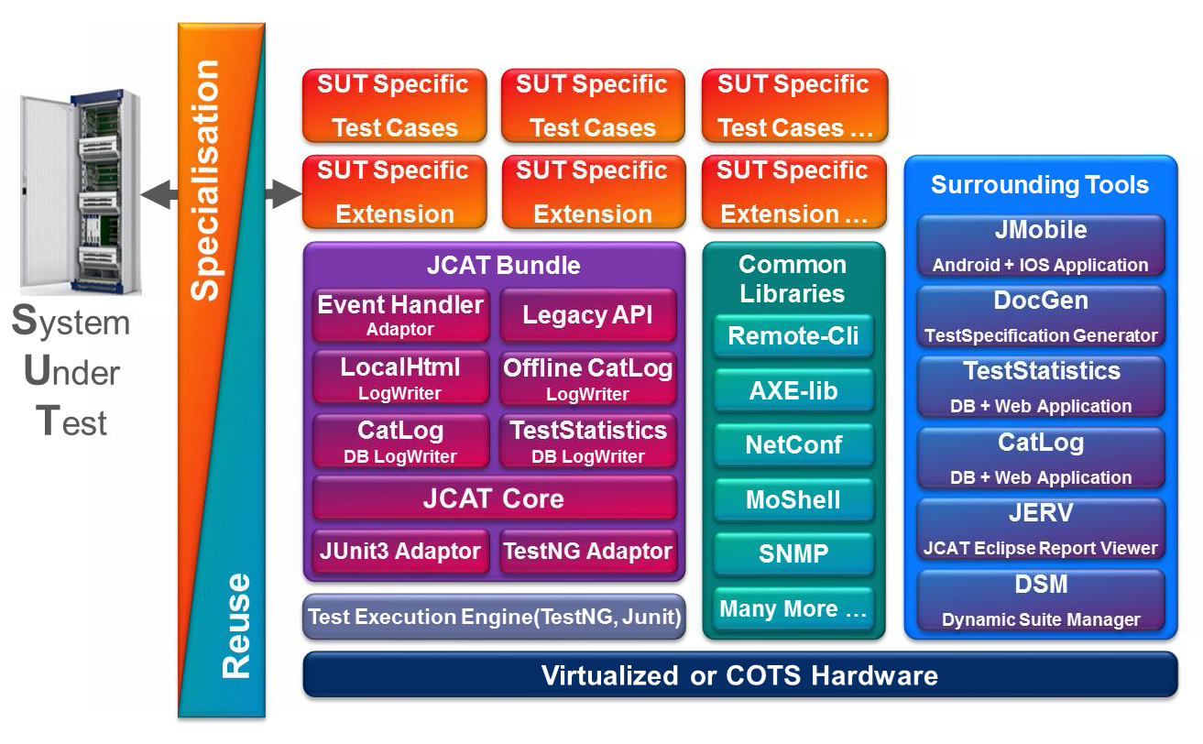
Architecture

Slide 4
Architecture
The JCAT Bundle, which enables test case automation and automated execution.
Common Libraries, which are re-usable libraries focusing on solving generic tasks, typically not tightly coupled with testing, but rather with automation; e.g. communication over different protocols, resource management, etc...
Surrounding tools provide lightweight tools to automate activities related to testing. (E.g. test specification generation.)
The user-added codebase, which includes test cases, as well as integration with the JCAT Bundle, common libraries, and additional product-specific code. The main goal is to minimize the size of this codebase by producing and sharing/re-using common libraries, so that products do not need to re-invent the wheel every time.

Slide 5
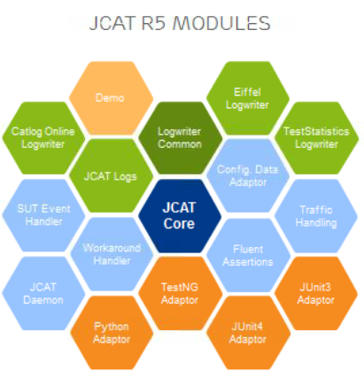
Jcat bundle

Slide 6
Core components
JCAT Core - Provide all the Test Case Model(JCAT Test Case & JCAT Test Suite),Logging API, Assert API, Properties API, Fixtures API, JCAT Event Subscriber API and Fetch Log API, and all the other component is created base on JCAT Core to make sure the functionality provided by JCAT R4 is Execution Engine Independent
JUnit Adaptor - Adapt all the abstract concepts defined in JCAT Core into the concrete implementation in JUnit, provide the test base for all JUnit test case, the TestSetup to load JCAT by JUnit
TestNG Adaptor - Adapt all the abstract concepts defined in JCAT Core into the concrete implementation in TestNG, provide the TestNG Listeners to load JCAT by TestNG
JCAT Local Html Log Writer - Provide the local html log report
JCAT Catlog Offline Log Writer - Support not only all the function of Local Html Log Writer, but also provide new features to accelerate log analysis.
JCAT Test Statistics RIP Log Writer - Send the test result to the Test Statistics by the TS RIP Serivce
JCAT Test Statistics DB Log Writer - Send the test result to the Test Statistics by write the data into the TS database directly
JCAT Catlog Log Writer - Send the test result to Catlog
JCAT Legacy Glue - Provide the api for the JCAT R3 users for backward compatible
JCAT SUT Event Handling - Provide the SUT Event Handling API
JCAT Background Traffic - Provide the JCAT Background Traffic API
JCAT Fluent Assertion API - Provide the JCAT Fluent Assertion API based on AssertJ

Slide 7
Core dependency
<dependency> <!-- JCAT Bundle (Test NG based) distribution package. --> <groupId>se.ericsson.jcat</groupId> <artifactId>jcat-testng-adaptor</artifactId> <version>${jcat.version}</version> </dependency>
Here are the features provided in JCAT Core and used in BSP:
JCAT Test Model
JCAT Logging API
JCAT Properties API
JCAT Fixture
JCAT Event Handler
JCAT Fetch Log
JCAT Fluent Assertion API

Slide 8
Common libraries
Common Libraries are JCAT independent Java libraries implementing generic tasks to provide a common solution for test automation related problems, such as communicating over a specific interface, managing resources (such as different test environment configurations), communicating with different test hardware (including certain Ericsson hardware and platforms).
Community Managed Common Libraries are well-tested, well-documented, and centrally supported inner-source libraries.
Common Libraries are reusable Java libraries developed and maintained in the community, but still owned by the organization that developed it.
Open Source Common Libraries are key common libraries owned by the JCAT community but made available to the open source community as well.
https://wiki.lmera.ericsson.se/wiki/JCAT/Common_Libraries

