Slide 1
Lambda expressions and method references

Slide 2
Agenda
Syntax
How lambdas work
Built-in functional interfaces
Context capturing
Method reference
Code improvements with lambdas

Slide 3
Syntax
Each lambda has three parts:
Arguments Lambda operator -> Body
() -> {}
(int x, int y) -> x + y
(x, y) -> x - y
x -> x * 2 - 3
x -> System.out.println(x)
x -> {
System.out.println(x);
int z = x * 2 - 3;
System.out.println(z);
return z;
}

Slide 4
Functional interface
Functional interface is an interface that has one and only one abstract method
Lambda type inferring:
Does the interface have only one abstract (unimplemented) method?
Does the parameters of the lambda expression match the parameters of the single method?
Does the return type of the lambda expression match the return type of the single method?
If the answer is yes to these three questions, then the given lambda expression is matched successfully against the interface.

Slide 5
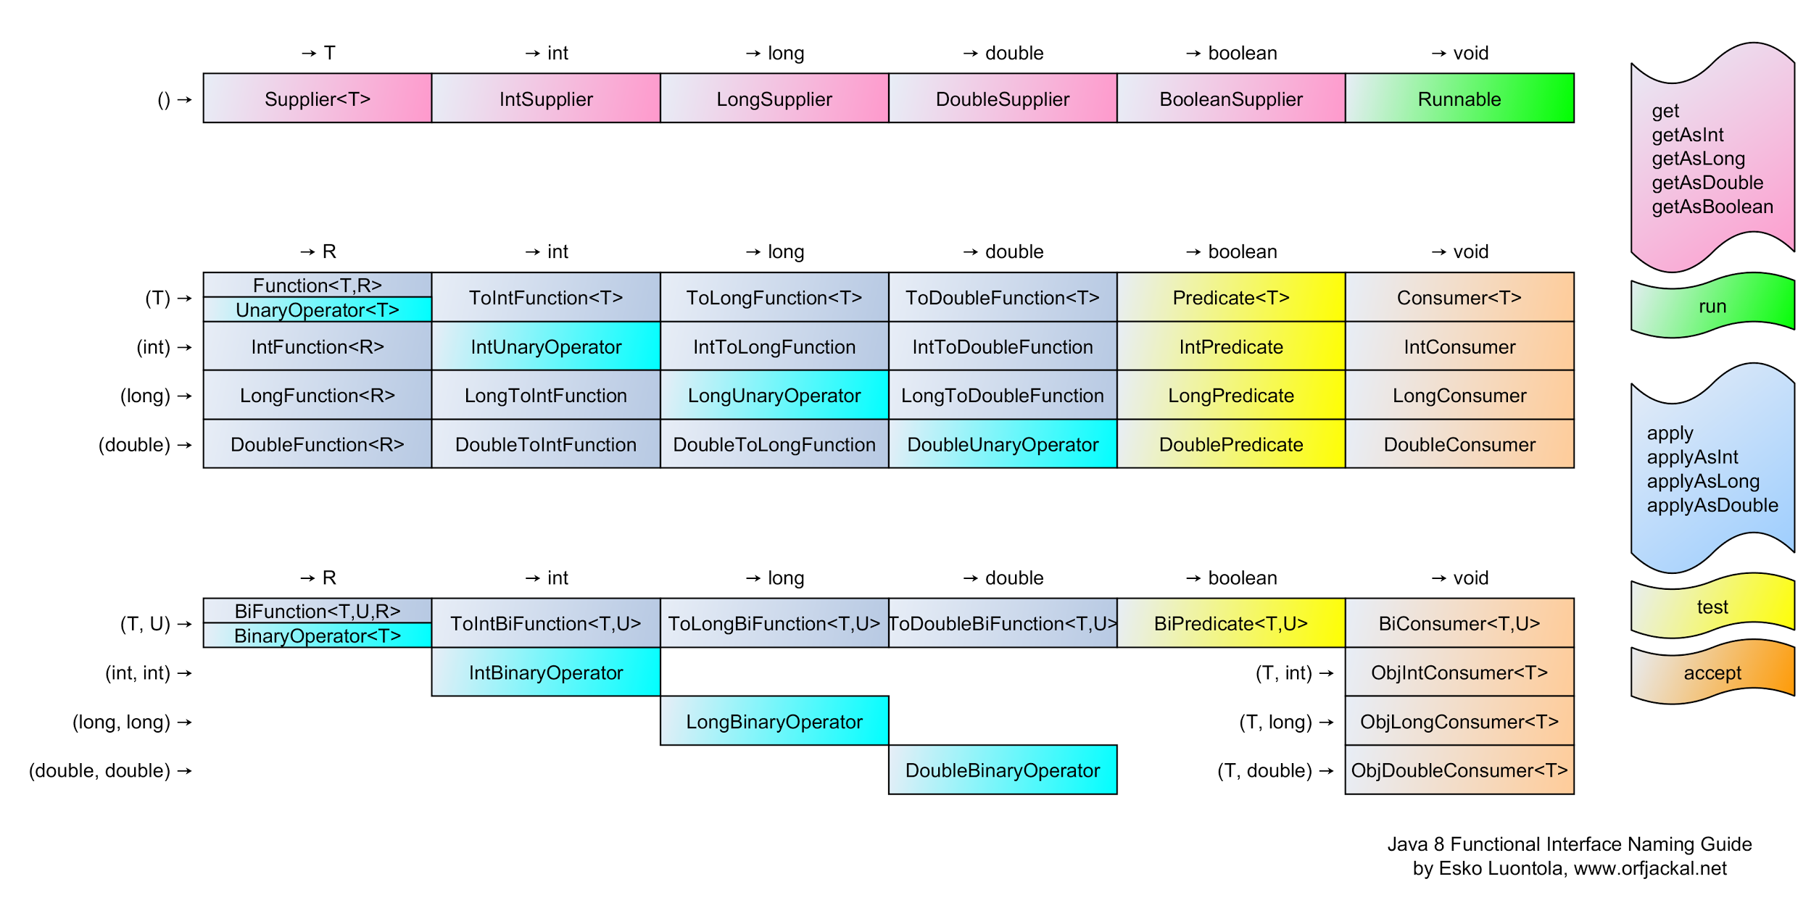
Built-in functional interfaces

Slide 6
New methods in collection framework
Iterable
void forEach(Consumer<? super T> action)
Collection
boolean removeIf(Predicate<? super E> filter)
List
void sort(Comparator<? super E> c)
Map
void forEach(BiConsumer<? super K, ? super V> action)
V compute(K key, BiFunction<? super K, ? super V, ? extends V> remappingFunction)
V computeIfAbsent(K key, Function<? super K, ? extends V> mappingFunction)
V computeIfPresent(K key, BiFunction<? super K, ? super V, ? extends V> remappingFunctionMap)
V getOrDefault(Object key, V defaultValue)
V merge(K key, V value, BiFunction<? super V, ? super V, ? extends V> remappingFunctionMap)
void replaceAll (BiFunction<? super K, ? super V, ? extends V> function)

Slide 7
FP style in JAVA
JAVA 8 provides feature to emulate FP style
It is not real FP, but just some abstraction to emulate the code style. It is still OOP inside
FP features:
Monads
Partial application
Currying

Slide 8
Partial application
Partial application (or partial function application) refers to the process of fixing a number of arguments to a function, producing another function of smaller arity.
public int sum(int x, int y, int z) { return x + y + z; } public IntBinaryOperator partialSum(int x) { return (y, z) -> sum(x, y, z); }
IntBinaryOperator biSum = partialSum(1); int sum1 = biSum.applyAsInt(3,2); int sum2 = biSum.applyAsInt(4,5);

Slide 9
Currying
Currying is the technique of translating the evaluation of a function that takes multiple arguments into evaluating a sequence of functions, each with a single argument.
public int sum(int x, int y, int z) { return x + y + z; } public IntFunction<IntFunction<IntUnaryOperator>> currySum() { return x -> y -> z -> sum(x, y, z); }
int sum = currySum().apply(1).apply(3).applyAsInt(2);

Slide 10
Improve code using FP features
@Getter @Setter class Metric { String oilTemperature; String airConsumption; String ignitionDwellAngle; String chainTensioner; String sparkMisses; String airEnrichment; String voltage; String current; String power; }

Slide 11
Improve code using FP features
public void compare(Metric m1, Metric m2) { String oilTemperature = Objects.equals(m1.getOilTemperature(), m2.getOilTemperature()) ? m1.getOilTemperature() : "Unexpected value"; String airConsumption = Objects.equals(m1.getAirConsumption(), m2.getAirConsumption()) ? m1.getAirEnrichment() : "Unexpected value"; String ignitionDwellAngle = Objects.equals(m1.getIgnitionDwellAngle(), m2.getIgnitionDwellAngle()) ? m1.getIgnitionDwellAngle() : "Unexpected value"; String chainTensioner = Objects.equals(m1.getChainTensioner(), m2.getChainTensioner()) ? m1.getChainTensioner() : "Unexpected value"; String sparkMisses = Objects.equals(m1.getSparkMisses(), m2.getSparkMisses()) ? m1.getSparkMisses() : "Unexpected value"; String airEnrichment = Objects.equals(m1.getAirEnrichment(), m2.getAirConsumption()) ? m1.getAirEnrichment() : "Unexpected value"; String voltage = Objects.equals(m1.getVoltage(), m2.getVoltage()) ? m1.getVoltage() : "Unexpected value"; String current = Objects.equals(m1.getCurrent(), m1.getCurrent()) ? m1.getCurrent() : "Unexpected value"; String power = Objects.equals(m1.getPower(), m2.getPower()) ? m1.getPower() : "Unexpected value";
…
}

Slide 12
Easy to make a bug
public void compare(Metric m1, Metric m2) { String oilTemperature = Objects.equals(m1.getOilTemperature(), m2.getOilTemperature()) ? m1.getOilTemperature() : "Unexpected value"; String airConsumption = Objects.equals(m1.getAirConsumption(), m2.getAirConsumption()) ? m1. getAirConsumption() : "Unexpected value"; String ignitionDwellAngle = Objects.equals(m1.getIgnitionDwellAngle(), m2.getIgnitionDwellAngle()) ? m1.getIgnitionDwellAngle() : "Unexpected value"; String chainTensioner = Objects.equals(m1.getChainTensioner(), m2.getChainTensioner()) ? m1.getChainTensioner() : "Unexpected value"; String sparkMisses = Objects.equals(m1.getSparkMisses(), m2.getSparkMisses()) ? m2.getSparkMisses() : "Unexpected value"; String airEnrichment = Objects.equals(m1.getAirEnrichment(), m2.getAirConsumption()) ? m1.getAirEnrichment() : "Unexpected value"; String voltage = Objects.equals(m1.getVoltage(), m2.getVoltage()) ? m1.getVoltage() : "Unexpected value"; String current = Objects.equals(m1.getCurrent(), m1.getCurrent()) ? m1.getCurrent() : "Unexpected value"; String power = Objects.equals(m1.getPower(), m2.getPower()) ? m1.getPower() : "Unexpected value";
}

Slide 13
Improve without JAVA 8 features
public void compare(Metric m1, Metric m2) { String oilTemperature = fold(m1.getOilTemperature(), m2.getOilTemperature()); String airConsumption = fold(m1.getAirConsumption(), m2.getAirConsumption()); String ignitionDwellAngle = fold(m1.getIgnitionDwellAngle(), m2.getIgnitionDwellAngle()); String chainTensioner = fold(m1.getChainTensioner(), m2.getChainTensioner()); String sparkMisses = fold(m1.getSparkMisses(), m2.getSparkMisses()); String airEnrichment = fold(m1.getAirConsumption(), m2.getAirEnrichment()); String voltage = fold(m1.getVoltage(), m2.getVoltage()); String current = fold(m1.getCurrent(), m2.getCurrent()); String power = fold(m1.getPower(), m1.getPower()); } private String fold(String v1, String v2){ return Objects.equals(v1, v2) ? v1 : "Unexpected value";; }

Slide 14
Still bugs
public void compare(Metric m1, Metric m2) { String oilTemperature = fold(m1.getOilTemperature(), m2.getOilTemperature()); String airConsumption = fold(m1.getAirConsumption(), m2.getAirConsumption()); String ignitionDwellAngle = fold(m1.getIgnitionDwellAngle(), m2.getIgnitionDwellAngle()); String chainTensioner = fold(m1.getChainTensioner(), m2.getChainTensioner()); String sparkMisses = fold(m1.getSparkMisses(), m2.getSparkMisses()); String airEnrichment = fold(m1.getAirConsumption(), m2.getAirEnrichment()); String voltage = fold(m1.getVoltage(), m2.getVoltage()); String current = fold(m1.getCurrent(), m2.getCurrent()); String power = fold(m1.getPower(), m1.getPower()); } private String fold(String v1, String v2){ return Objects.equals(v1, v2) ? v1 : "Unexpected value";; }

Slide 15
Use method reference to improve
public void compare1(Metric m1, Metric m2) { String oilTemperature = fold(Metric::getOilTemperature, m1, m2); String airConsumption = fold(Metric::getAirConsumption, m1, m2); String ignitionDwellAngle = fold(Metric::getIgnitionDwellAngle, m1, m2); String chainTensioner = fold(Metric::getChainTensioner, m1, m2); String sparkMisses = fold(Metric::getSparkMisses, m1, m1); String airEnrichment = fold(Metric::getAirEnrichment, m1, m2); String voltage = fold(Metric::getVoltage, m1, m2); String current = fold(Metric::getCurrent, m1, m2); String power = fold(Metric::getPower, m1, m2); } private String fold(Function<Metric, String> getter, Metric m1, Metric m2) { return Objects.equals(getter.apply(m1), getter.apply(m2)) ? getter.apply(m1) : "Unexpected value"; }

Slide 16
A bit better but still a bug
public void compare1(Metric m1, Metric m2) { String oilTemperature = fold(Metric::getOilTemperature, m1, m2); String airConsumption = fold(Metric::getAirConsumption, m1, m2); String ignitionDwellAngle = fold(Metric::getIgnitionDwellAngle, m1, m2); String chainTensioner = fold(Metric::getChainTensioner, m1, m2); String sparkMisses = fold(Metric::getSparkMisses, m1, m1); String airEnrichment = fold(Metric::getAirEnrichment, m1, m2); String voltage = fold(Metric::getVoltage, m1, m2); String current = fold(Metric::getCurrent, m1, m2); String power = fold(Metric::getPower, m1, m2); } private String fold(Function<Metric, String> getter, Metric m1, Metric m2) { return Objects.equals(getter.apply(m1), getter.apply(m2)) ? getter.apply(m1) : "Unexpected value"; }

Slide 17
No bugs after all, but can it be better?
public void compare1(Metric m1, Metric m2) { Function<Function<Metric, String>, String> folder = g -> fold(g, m1, m2); String oilTemperature = folder.apply(Metric::getOilTemperature); String airConsumption = folder.apply(Metric::getAirConsumption); String ignitionDwellAngle = folder.apply(Metric::getIgnitionDwellAngle); String chainTensioner = folder.apply(Metric::getChainTensioner); String sparkMisses = folder.apply(Metric::getSparkMisses); String airEnrichment = folder.apply(Metric::getAirEnrichment); String voltage = folder.apply(Metric::getVoltage); String current = folder.apply(Metric::getCurrent); String power = folder.apply(Metric::getPower); } private String fold(Function<Metric, String> getter, Metric m1, Metric m2) { return Objects.equals(getter.apply(m1), getter.apply(m2)) ? getter.apply(m1) : "Unexpected value"; }

Slide 18
Inline private method
public void compare1(Metric m1, Metric m2) { Function<Function<Metric, String>, String> folder = g -> Objects.equals(g.apply(m1), g.apply(m2)) ? g.apply(m1) : "Unexpected value"; String oilTemperature = folder.apply(Metric::getOilTemperature); String airConsumption = folder.apply(Metric::getAirConsumption); String ignitionDwellAngle = folder.apply(Metric::getIgnitionDwellAngle); String chainTensioner = folder.apply(Metric::getChainTensioner); String sparkMisses = folder.apply(Metric::getSparkMisses); String airEnrichment = folder.apply(Metric::getAirEnrichment); String voltage = folder.apply(Metric::getVoltage); String current = folder.apply(Metric::getCurrent); String power = folder.apply(Metric::getPower); }

Slide 19


What else to read
https://www.google.com/
https://docs.oracle.com/javase/tutorial/java/javaOO/lambdaexpressions.html
https://docs.oracle.com/javase/tutorial/java/javaOO/methodreferences.html
https://www.oracle.com/technetwork/articles/java/architect-lambdas-part1-2080972.html
https://www.oracle.com/technetwork/articles/java/architect-lambdas-part2-2081439.html

