Slide 1

Linear Regression

Slide 2


Platforms we use
GitHub:
GitHub is a platform that allows developer to upload their code and share them with the community
Google Colab:
Google Colab is a online Python notebook that allows users to use its cloud computing.

Slide 3
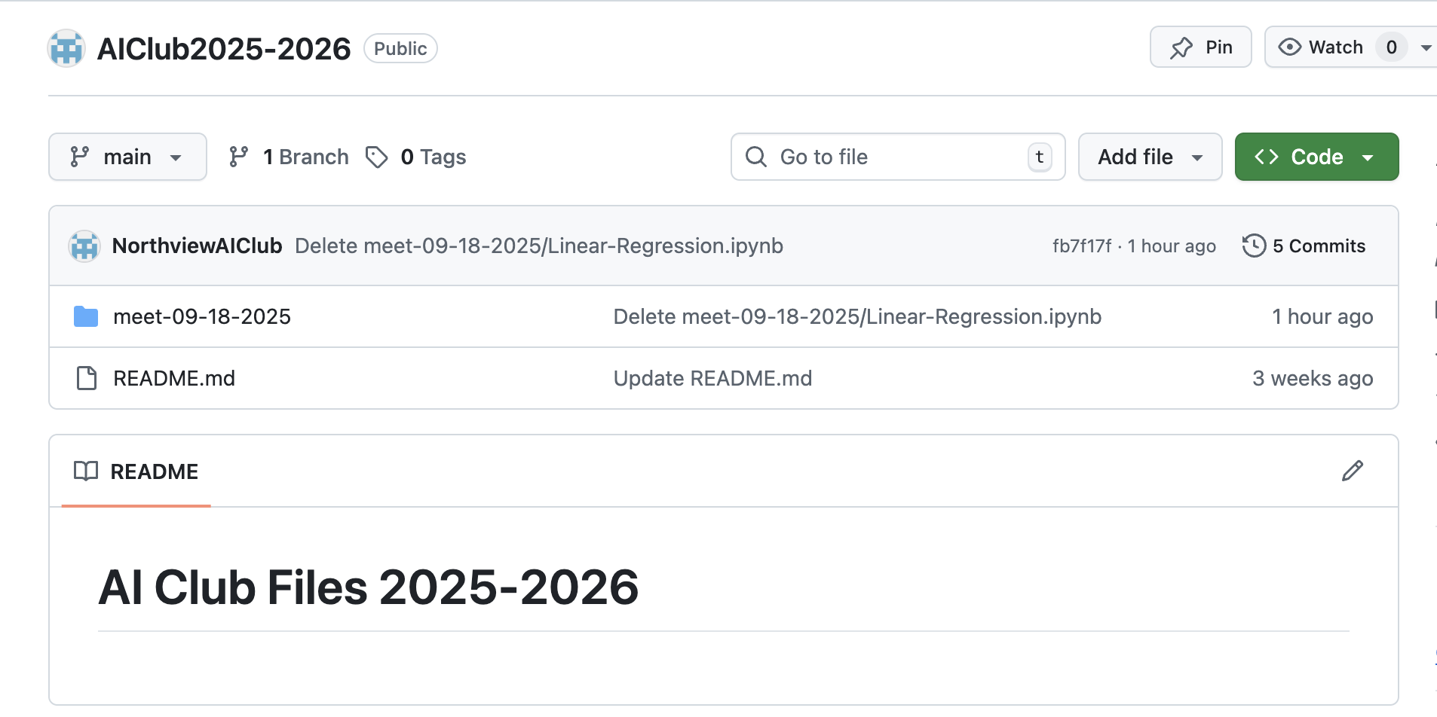
How to find the code?
We created a GitHub repository to store all the code we used in the club meetings.
If you want to review the code after a club meeting or you missed a club meeting and want to know what we did, you can go onto GitHub and download all the source code.
PPT slides will also be on GitHub too.

Slide 4
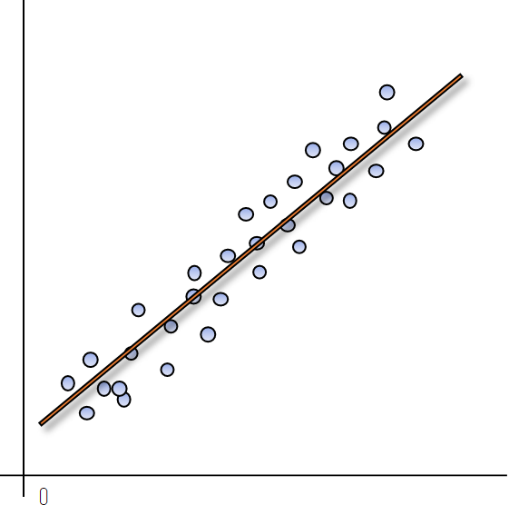
Linear Regression
Linear Regression is basically a model used to estimate the relationship between a set of data.
We assume there is a linear relationship between those data.

Slide 5
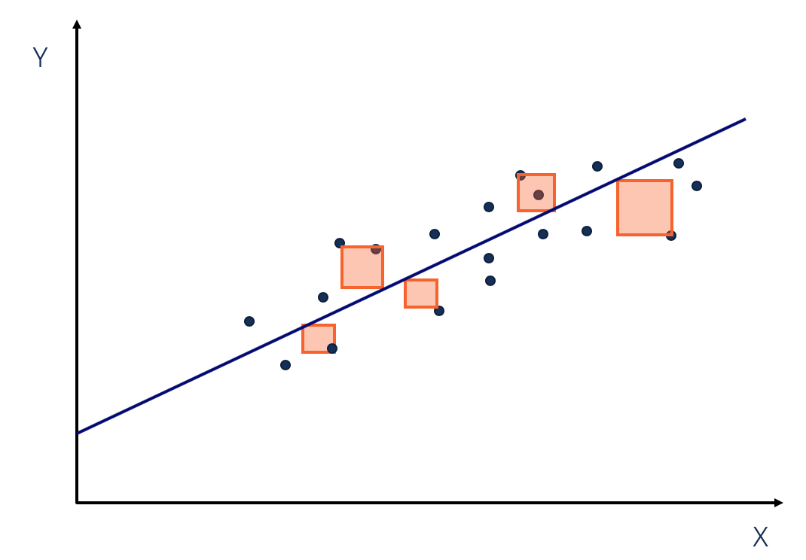
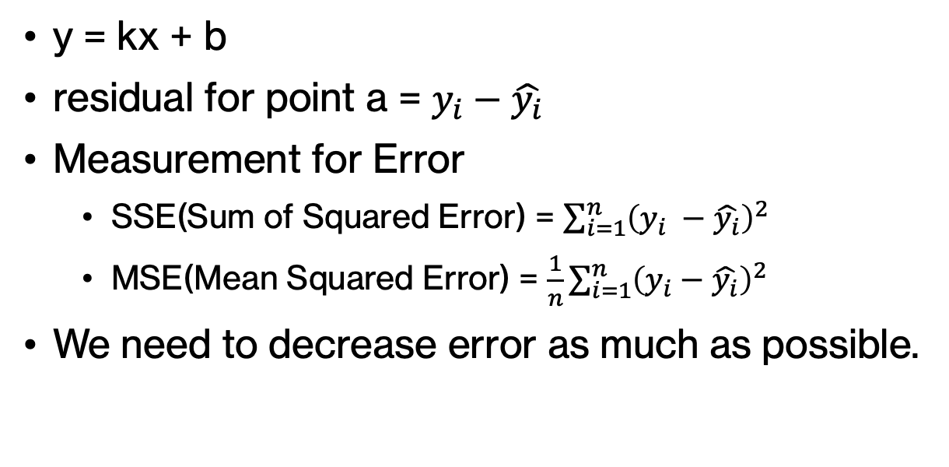
How does it work?
y = kx + b
residual for point a = $y_{i}−\hat{y_{i}}$
Measurement for Error
SSE(Sum of Squared Error) = $\sum_{i=1}^{n}{{\left(y_{i} −\hat{y_{i}}\right)}^{2 }}$
MSE(Mean Squared Error) = $\frac{1}{n}\sum_{i=1}^{n}{{\left(y_{i}−\hat{y_{i}}\right)}^{2}}$
We need to decrease error as much as possible.

Slide 6
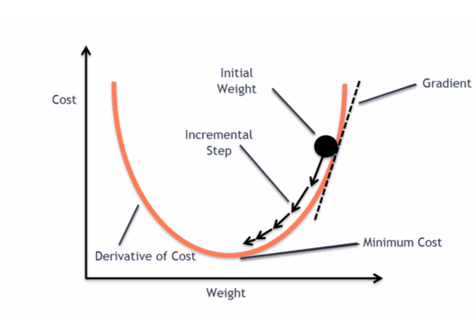
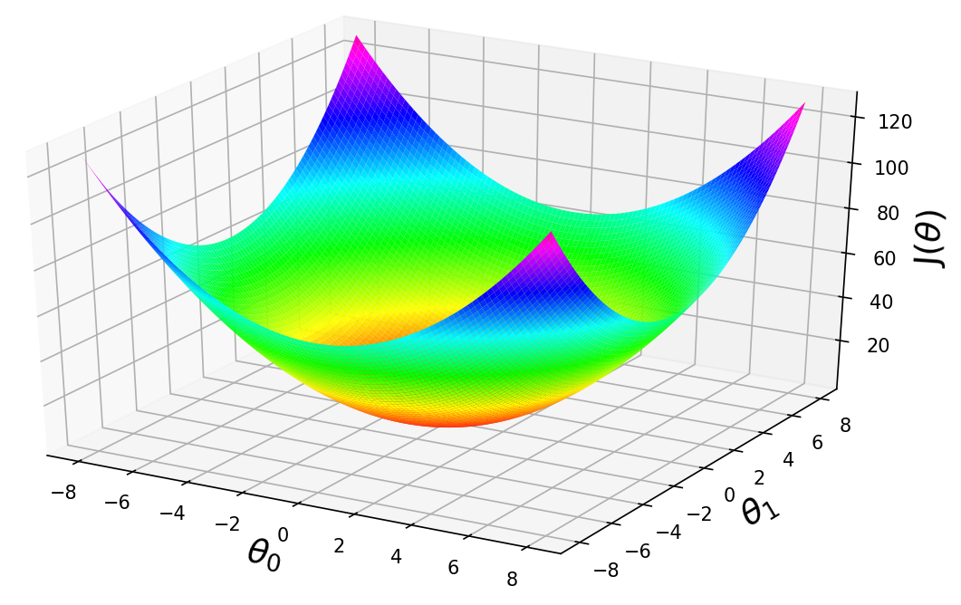
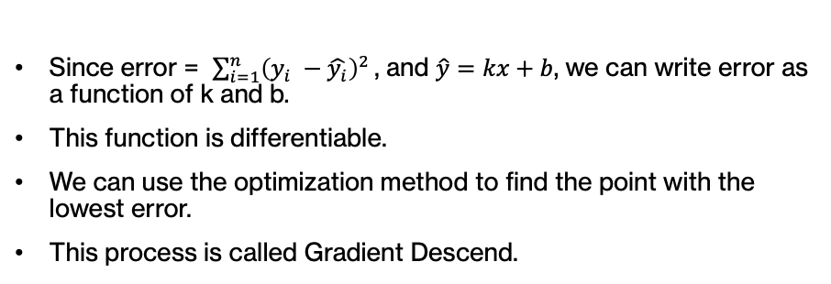
Gradient Descend
Since error = $\sum_{i=1}^{n}{{\left(y_{i} −\hat{y_{i}}\right)}^{2 }}$, and $\hat{y}=kx+b$, we can write error as a function of k and b.
This function is differentiable.
We can use the optimization method to find the point with the lowest error.
This process is called Gradient Descend.

Slide 7
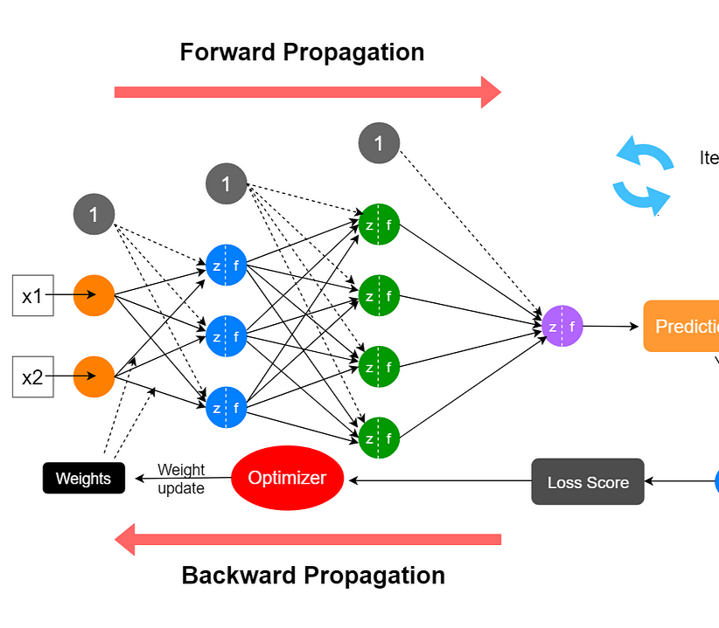
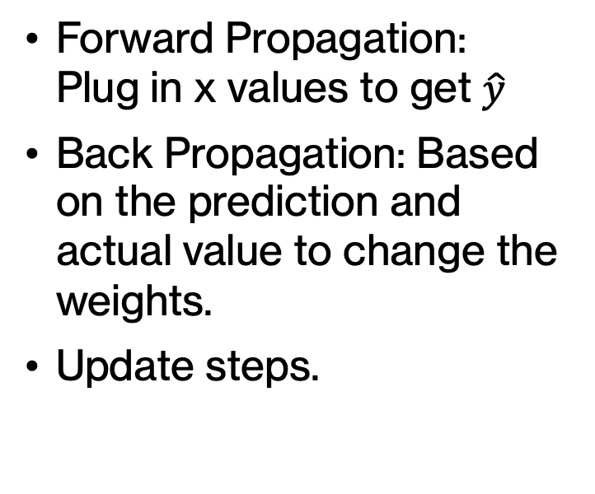
Forward/Back Propagation
Forward Propagation: Plug in x values to get $\hat{y}$
Back Propagation: Based on the prediction and actual value to change the weights.
Update steps.

Slide 8
Try the code!

Slide 9



Qrcode!
Officer Application
Groupme
Instagram

