Slide 1
NVIbatch

Slide 2
NVIcheckmate

Slide 3
NVIconfig
CFG

Slide 4
NVIdb

Slide 5
NVIpackager
R
R
R
R
R
R
R
R
R
R
R
R
R
R
R
R
R
R
R
R
R
R

Slide 6
NVIpretty

Slide 7
NVIrpackages

Slide 8
NVIspatial

Slide 9
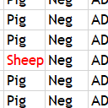
OKcheck

Slide 10
OKplan

Slide 11











Slide 14
NVItemplate

Slide 15
NVItest

Slide 16
NVIdata

