Slide 1
KSMWest
Electricity Metering Solutions
08.05.2018
KSMWest H1 interface

Slide 2
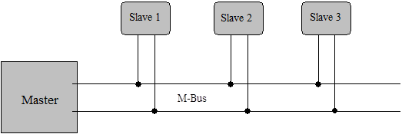
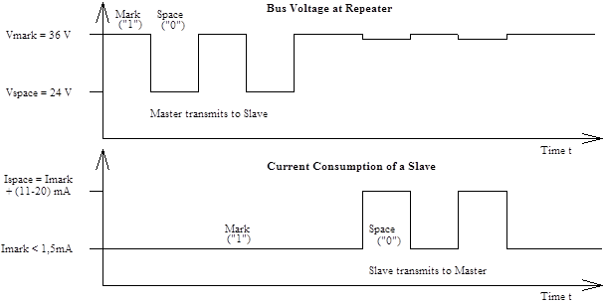
Overview M-Bus - Physical Layer
The M-Bus consists of
The master,
A number of slaves
A two-wire connecting cable
Master to Slave => The transfer of bits from master to slave is accomplished by means of voltage level shifts.
A logical "1" (Mark) corresponds to a nominal voltage of +36 V
A logical "0" (Space) reduces the bus voltage by 12 V to a nominal +24 V
Slave to Master => The transfer of bits from slave to master slave is accomplished by means of modulating the current consumption of the slave.
A logical "1" (Mark) is represented by a constant current of up to 1.5 mA,
A logical "0" (Space) is represented by an increased current drain requirement by the slave of additional 11-20 mA.

Slide 3
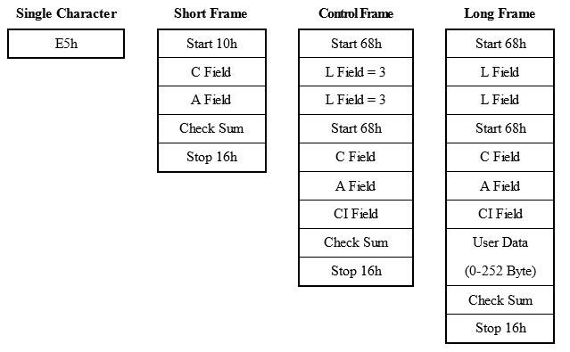
Overview M-Bus - Data Link Layer
Telegram format - FT 1.2 according to IEC 870-5:
=> The format class FT 1.2 specifies three different telegram formats, which can be recognized by means of special start characters
Single Character
This format consists of a single character, namely the E5h (decimal 229), and serves to acknowledge receipt of transmissions.
Short Frame
This format with a fixed length begins with the start character 10h, and besides the C and A fields includes the check sum (this is made up from the two last mentioned characters), and the stop character 16h.
Long Frame
With the long frame, after the start character 68h, the length field (L field) is first transmitted twice, followed by the start character once again. After this, there follow the function field (C field), the address field (A field) and the control information field (CI field). The L field gives the quantity of the user data inputs plus 3 (for C,A,CI). After the user data inputs, the check sum is transmitted, which is built up over the same area as the length field, and in conclusion the stop character 16h is transmitted.
Control Frame
The control sentence conforms to the long sentence without user data, with an L field from the contents of 3. The check sum is calculated at this point from the fields C, A and CI.

Slide 4

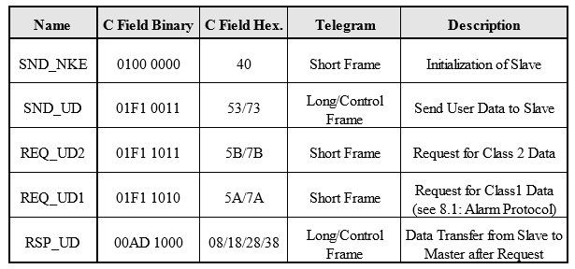
Overview M-Bus - Data Link Layer
C Field (Control Field)
The control field specifies the direction of data flow, and is responsible for various additional tasks in both the calling and replying directions.
A Field (Address Field)
The address field serves to address the recipient in the calling direction, and to identify the sender of information in the receiving direction. The size of this field is one Byte, and can therefore take values from 0 to 255.
Address 0: indicates an unconfigured slave
Address 1-250: can be allocated to the individual slaves
Address 251-252: reserved
Address 253: Network Layer addressing used instead of Data Link Layer addressing
Address 254: broadcast - all slaves reply with their own addresses
Address 255: broadcast - none of the slaves reply
CI Field (control information field)
The control information field is already a part of the Application Layer, The control information allows the implementation of a variety of actions in the master or the slaves.
Check Sum
The Check Sum is calculated from the arithmetical sum of the data mentioned above, without taking carry digits into account.
Coding of the Control Field
Control Codes of the M-Bus Protocol (F : FCB-Bit, A : ACD-Bit, D : DFC-Bit)

Slide 5
Overview M-Bus – Transport Layer
CI field values
The M-Bus transport layer allows several application layers to co-exist over the M-Bus lower layers.
These may be:
the M-Bus dedicated AL
the DLMS/COSEM AL
some other AL that may be specified in the future.
The AL used is selected by the Control Information (CI) field of the M-Bus frame.
CI | Application
00h-1Fh | DLMS/COSEM M-Bus based TL No M-Bus Data Header is present
20h-4Fh | reserved for DLMS-based applications
50h | application reset
51h | data send (master to slave)
52h | selection of slaves
53h | reserved
54h-58h | reserved for DLMS-based applications
55h-5Bh | reserved
5Ch | synchronise action
60h | DLMS/COSEM M-Bus based TL Long M-Bus Data Header present, direction master to slave
61h | DLMS/COSEM M-Bus based TL Short M-Bus Data Header present, direction master to slave
62h-6Fh | reserved
70h | slave to master: report of application errors
71h | slave to master: report of alarms
72h | slave to master: 12 byte header followed by variable format data
73h-77h | reserved
78h | slave to master: Variable data format response without header
79h | reserved
7Ah | slave to master: 4 byte header followed by Variable data format response
7Bh | reserved
7Ch | DLMS/COSEM M-Bus based TL Long M-Bus Data Header present, direction slave to master
7Dh | DLMS/COSEM M-Bus based TL Short M-Bus Data Header present, direction slave to master
7Eh-80h | reserved
81h | Reserved for a future CEN-TC294- Radio relaying and application Layer
82h | Reserved for a future CENELEC-TC205 network/application Layer
82h-8Fh | reserved
90h-97h | manufacturer specific (obsolete)
A0h-AFh | manufacturer specific
B0-B7h | manufacturer specific
B8h | set baudrate to 300 baud
B9h | set baudrate to 600 baud
BAh | set baudrate to 1200 baud
BBh | set baudrate to 2400 baud
BCh | set baudrate to 4800 baud
BDh | set baudrate to 9600 baud
BEh | set baudrate to 19200 baud
BFh | set baudrate to 38400 baud
C0h-FFh | reserved

Slide 6
DLMS/COSEM M-Bus transport layer
DLMS/COSEM AL based CI values
CI without M-Bus Data Header
The values CITL = 0x00…0x1F indicate that no M-Bus Data Header is present. In this case, the TL can provide segmentation and reassembly
Bit 4 (FIN) indicates that the Data field of the TPDU carries either one part of an xDLMS APDU or the complete APDU.
Bits 3 to 0 are used for sequence numbering. The rollover of the sequence numbers is permitted, meaning that when the sequence number reaches the value 1111 and there are segments remaining to be sent, the next segment sequence number will take the value 0000.

Slide 7
Example M-Bus frame

Slide 8
Example M-Bus frame
DLMS/COSEM APDU (decrypted payload)
DLMS/COSEM APDU
data-notification
long-invoke-id-and-priority
invoke-id: 366
not-self-descriptive
processing-option: continue on error
service-class: unconfirmed
priority: normal
date-time
07 E0 09 09 05 11 3A 00 00 FF C4 80 '......:.....'
2016/09/09 17:58:00
Day of Week: 5
Deviation to GMT: -60 minutes
Clock Status: 80
notification-body
data
structure with 7 elements
struct-element-0
octet-string:
07 E0 09 09 05 11 3A 00 00 00 00 80 '......:.....'
struct-element-1
octet-string:
01 00 01 08 00 FF '......'
struct-element-2
double-long-unsigned: 0
struct-element-3
structure with 2 elements
struct-element-0
integer: 0
struct-element-1
enum: 30
struct-element-4
octet-string:
01 00 03 08 00 FF '......'
struct-element-5
double-long-unsigned: 0
struct-element-6
structure with 2 elements
struct-element-0
integer: 0
struct-element-1
enum: 32
general-glo-ciphering
45 4C 53 65 70 00 00 01 'ELSep...'
system-title: 454c536570000001
ciphered-service:
length: 77
security-control-byte
security-suite-id: 0
encryption
key-set: unicast
frame-counter: 144
apdu:
E2 A3 30 F9 B7 E0 D6 8C 09 37 5A A1 B1 F8 F3 A7 '..0......7Z.....'
DF 14 B7 79 0E 14 D1 55 6A B8 75 B1 49 E6 84 7D '...y...Uj.u.I..}'
11 93 6D B5 19 1D D0 F4 89 BA 76 8C 2D BB 68 F6 '..m.......v.-.h.'
B0 01 E3 04 C2 1F EA 14 7E 0B 2E 2C A1 B9 1D 57 '........~..,...W'
4D F4 F7 F5 82 CE BE 92 'M.......'

Slide 9
Companion Standard – H1 interface

Slide 10
Thank you!

