Slide 1
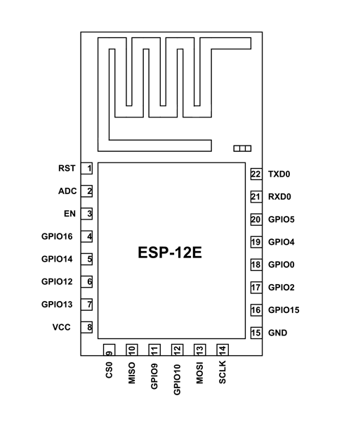
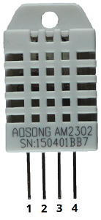
18650
10 kOhm

Slide 2
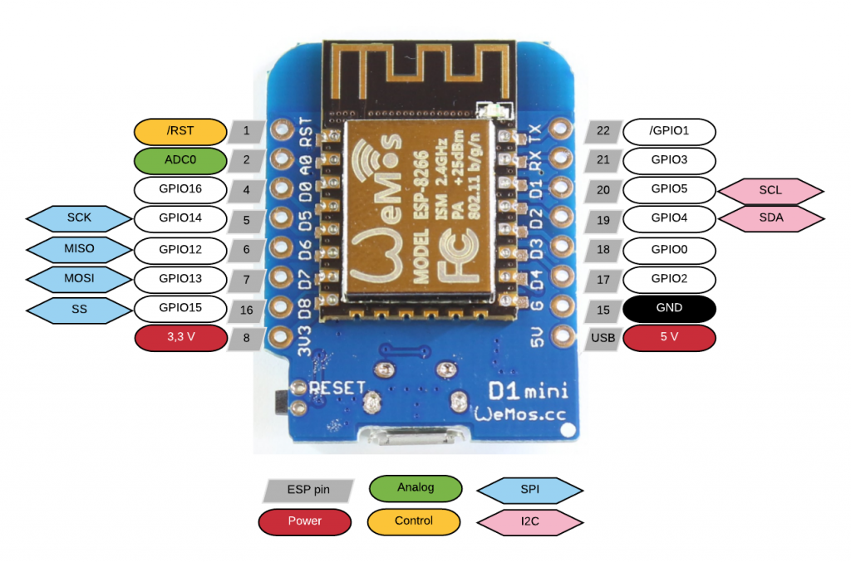
10 kOhm
5V USB

Slide 3

18650

Slide 4
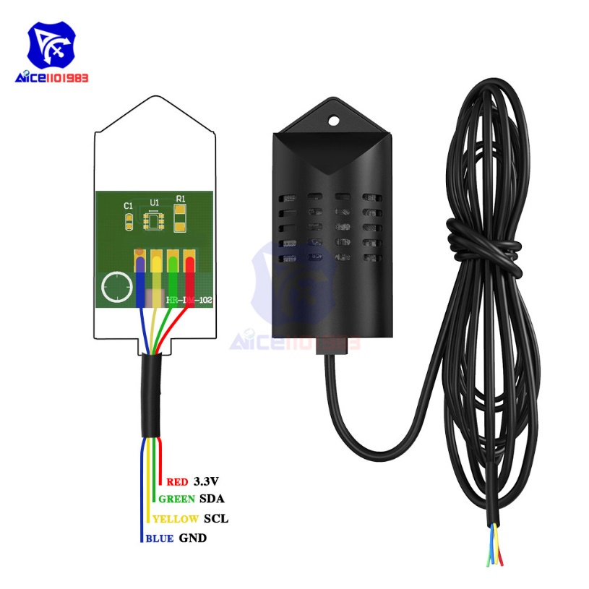
5V USB

Slide 5
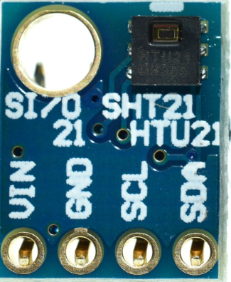
18650

Slide 6
5V USB

Slide 7
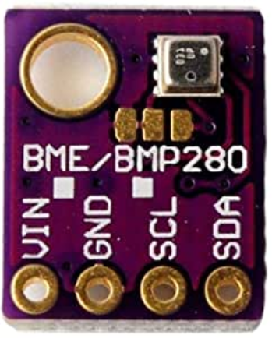
18650

Slide 8
5V USB

Slide 9
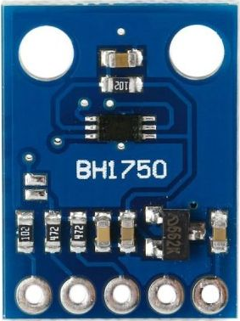
GY-302
18650

Slide 10
GY-302
5V USB

Slide 11
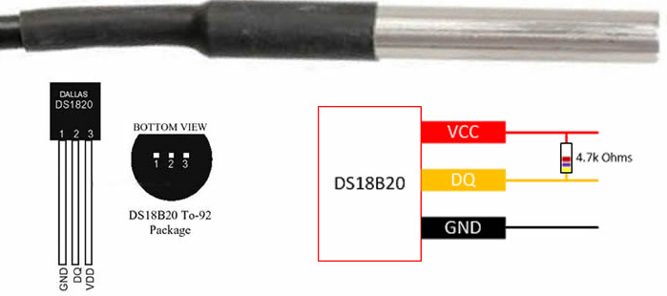
DS18B20
18650

Slide 12
DS18B20
5V USB

Slide 13
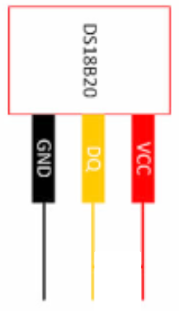

18650
4,7 kΩ

Slide 14

18650
100 nF
1 MOhm

Slide 15
