Slide 1

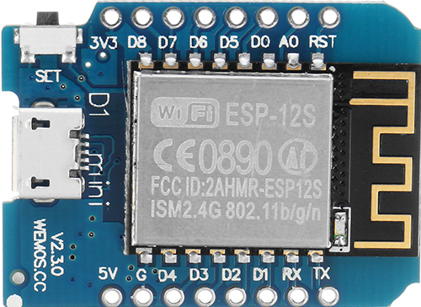

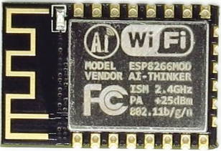
SERIAL
Home Automation
Solution
SHRDZMGateway
ESPNow
SHRDZMDevice
SHRDZMDevice
Sensor
Actor
Sensor
Actor
SHRDZMDevice
SHRDZMDevice
Sensor
Actor
SHRDZMDevice
Sensor
Actor
Sensor
Actor

Slide 2

SHRDZMGatewayMQTT
WLAN
Home Automation
Solution
SERIAL
SHRDZMGateway
ESPNow
SHRDZMDevice
SHRDZMDevice
Sensor
Actor
Sensor
Actor
SHRDZMDevice
SHRDZMDevice
Sensor
Actor
SHRDZMDevice
Sensor
Actor
Sensor
Actor

Slide 3
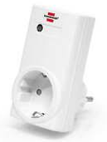
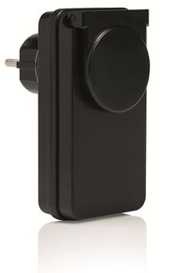
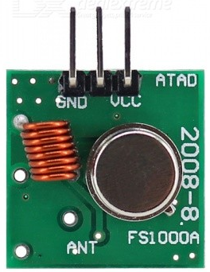
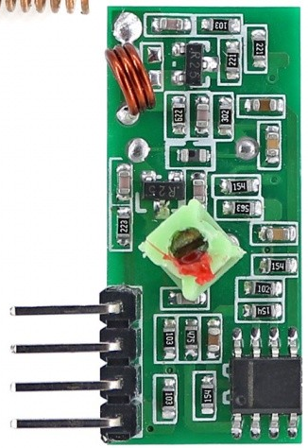

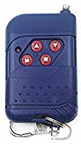

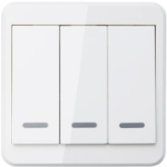
SHRDZMGatewayMQTT
WLAN
433MHz Transmitter/Receiver
Home Automation
Solution
SERIAL
SHRDZMGateway
ESPNow
SHRDZMDevice
SHRDZMDevice
Sensor
Actor
Sensor
Actor
SHRDZMDevice
SHRDZMDevice
Sensor
Actor
SHRDZMDevice
Sensor
Actor
Sensor
Actor

Slide 4
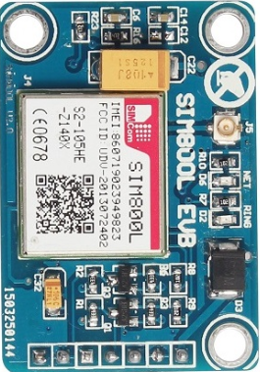
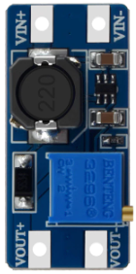
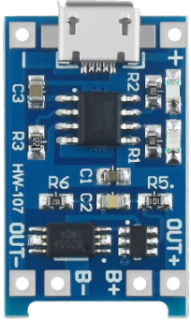

GSM
Home Automation
Solution
3.7V
5V
SERIAL
3.7V
5V - USB
SHRDZMGateway
3.7V
ESPNow
SHRDZMDevice
SHRDZMDevice
Sensor
Actor
Sensor
Actor
SHRDZMDevice
SHRDZMDevice
Sensor
Actor
SHRDZMDevice
Sensor
Actor
Sensor
Actor

Slide 5
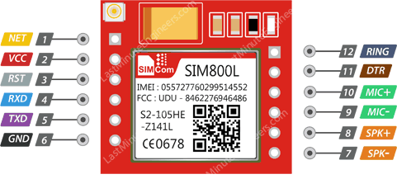
GSM
Home Automation
Solution
SERIAL
SHRDZMGatewayMobile
ESPNow
SHRDZMDevice
SHRDZMDevice
Sensor
Actor
Sensor
Actor
SHRDZMDevice
SHRDZMDevice
Sensor
Actor
SHRDZMDevice
Sensor
Actor
Sensor
Actor

Slide 6
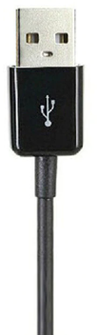

5 Volt
SHRDZMDevice
WLAN
Home Automation
Solution
Sensor
Actor

Slide 7

5 Volt/ >= 500mA

Slide 8
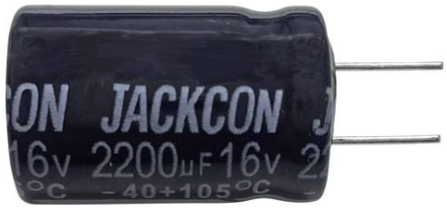
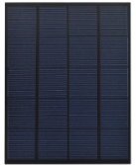

Replace existing capacitor with 2200uF
+5V
5 Volt - USB
Optional
+
-
AccessPoint
Trigger
Solar Panel
~5 Watt

Slide 9
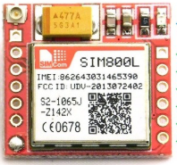
5 Volt - USB
Optional
AccessPoint
Trigger
+
-
Solar Panel
~5 Watt

Slide 10
S

Slide 11
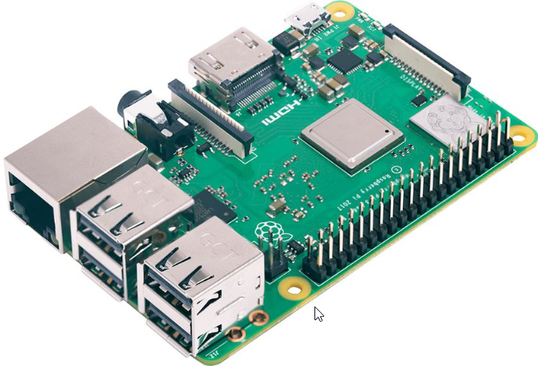
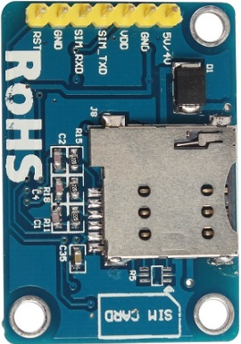
FHEM Server

