Slide 1

Product Presentation
Automatic Speech Recognition of Nepali Language to Devanagari Script
Dikson Rajbanshi (77202796)

Slide 2
Introduction
Speech is the primary means for human interaction
Computers cannot directly understand audio
So there requires the need for development of Speech to Text format allowing computer to understand human speech

Slide 3
Need For Automatic Speech Recognition
Computer Understanding of Human Speech
Easier and more accessible human-to-computer interaction

Slide 4
The Problem
Old Algorithms require large amount of training data
Low-resource language have almost no usable ASR engine
This affects more than 6000 languages out of 7000 languages around the world
Lack of availability of quality labelled audio data

Slide 5
Goals of the Project
Usage of Facebook’s Wav2Vec 2.0 for ASR training
Development of accurate enough model for low-resource languages
Pilot language as Nepali
Extension of development process to other languages

Slide 6
Objectives
Research on the literatures and technologies used currently for the Automatic Speech Recognition and their implementation
Creation of an ASR engine for Nepali languages and Speech-to-Text technologies in Devanagari Script
Exploration of the technology for future studies and progress like Natural Language Processing in Nepali Speech

Slide 7
How ASR works
Parse speech signal/ acoustic waveforms from audio
Linguistic parsing of the waveforms
Linguistic processing for conversion to set of words

Slide 8
ASR History
Development of telephone by Alexander Graham Bell
First actual ASR developed in 1952 by Bell Labs
Use of Hidden Markov Models (HMM) in 1970s
Introduction of Neural Network in ASR for model training
Increase in computation powers of hardware helped push limits of ASR models
New End-to-End Deep Learning algorithms like DeepSpeech
Use of supervised and self-supervised learWav2Vec 2.0 by Facebook AI team

Slide 9
Methods For Handling Low-resource languages in ASR
Multi-lingual resource/ system over monolingual systems
Use of Deep Neural Networks
Bottleneck Features
Transfer Learning
Pre-training
Unsupervised learning through pre-training
Wav2vec, which uses Convolutional Neural Network
Self-supervised training
Wav2vec 2.0

Slide 10
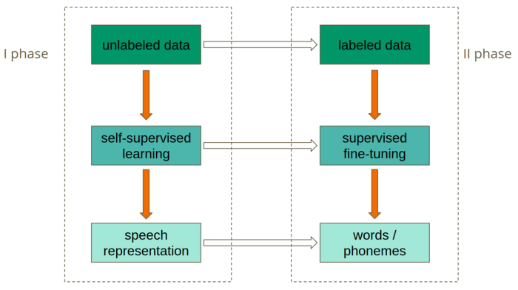
How Wav2Vec 2.0 works
Notes:
Sept 2020
50,000 hrs pretraining

Slide 11
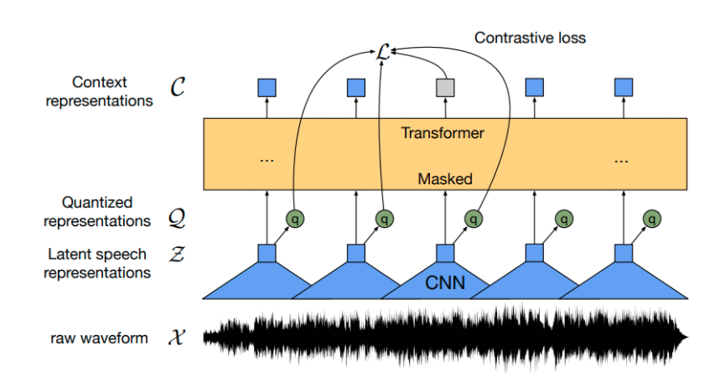
How Wav2Vec 2.0 works (contd.)
Fig: XLSR approach using feature encoder and masking
Notes:
By masking feature vectors randomly on the speech representations before passing these vectors into the transformer network, the model learns about the contextualized speech representations which helps in making predictions as required
The model is trained through the multilingual quantized speech units that are produced through the feature encoder representations. The output embeddings are used for training the Transformer model through contrastive learning.

Slide 12
Data Acquisition
Research Based model due to COVID-19
Internet based resources found for Nepali labeled data
OpenSLR-54 dataset used for training
https://openslr.org/54/
OpenSLR-43 dataset (initially designed for TTS) used for evaluation
https://openslr.org/43/

Slide 13
Data Analysis
Required audio dataset of 16kHz sampling rate
Files were cross-checked for corruption
Sampling rate was verified using librosa library of Python
Transcription containing special characters were edited out

Slide 14
Software Requirements
Python 3.7
Jupyter Lab
Python Packages
pandastransformers
torchaudio
Librosa
Flask
Pydub
pytorch

Slide 15
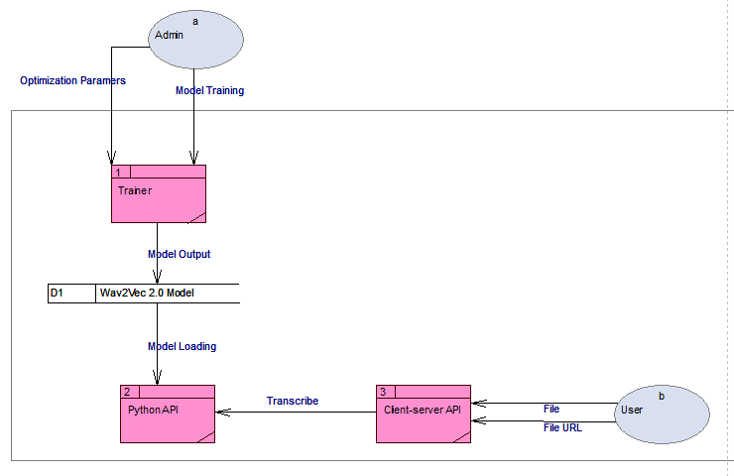
Data Flow Diagram

Slide 16
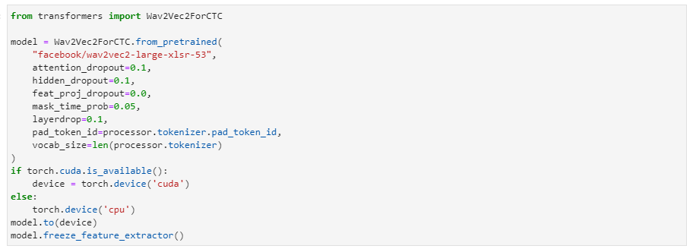
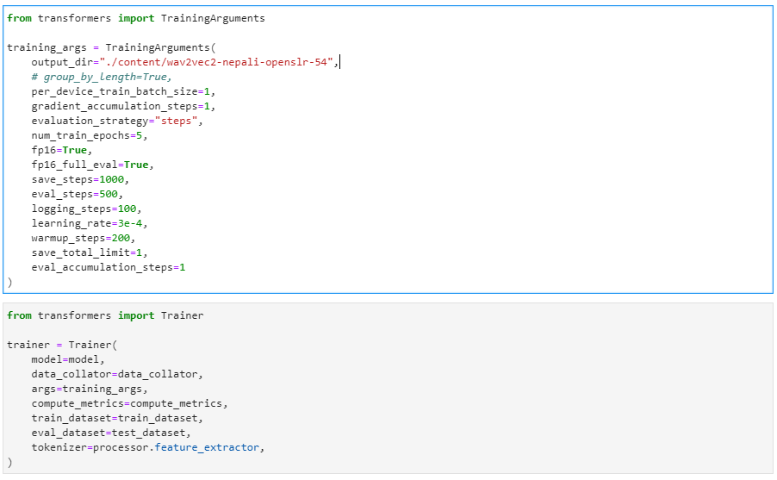
Code Screenshots
Pre-trained Model Import
Training Arguments and Trainer

Slide 17
Code Screenshots
Trainer Start and Output
Training Statistics
Device hardware used for the training
CPU: AMD Ryzen 5 3600
GPU: NVIDIA RTX 3070 8GB
RAM: 40GB
CUDA-enabled
Total Training Time: 54 hrs. (on OpenSLR-54 dataset)
Total Evaluation Time: 4 hrs. (on OpenSLR-43 dataset)

Slide 18
API Development
Flask, a Python package, was used for API server creation.
Default homepage serves the HTML/ CSS/ JS pages for the GUI access of the model
POST routes are exposed for model access through API endpoints

Slide 19
API Development
Flask, a Python package, was used for API server creation.
Default homepage serves the HTML page for the GUI access of the model
POST routes are exposed for model access through API endpoints

Slide 20
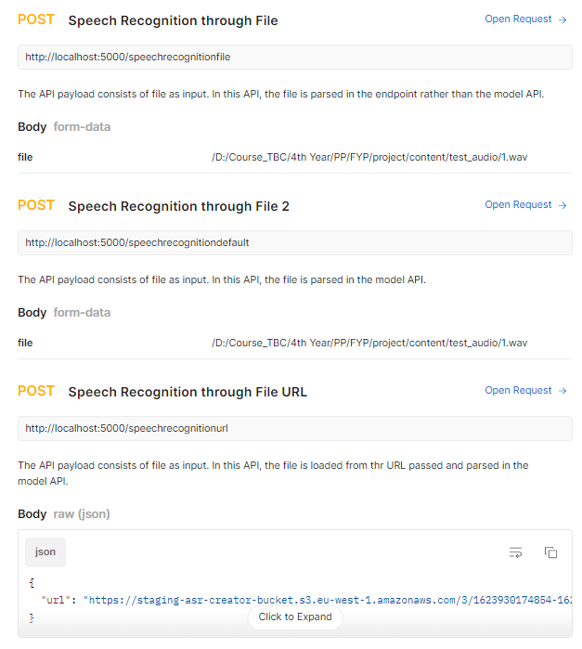
API Documentation
Notes:
https://documenter.getpostman.com/view/9905304/Tzm5GGHa

Slide 21
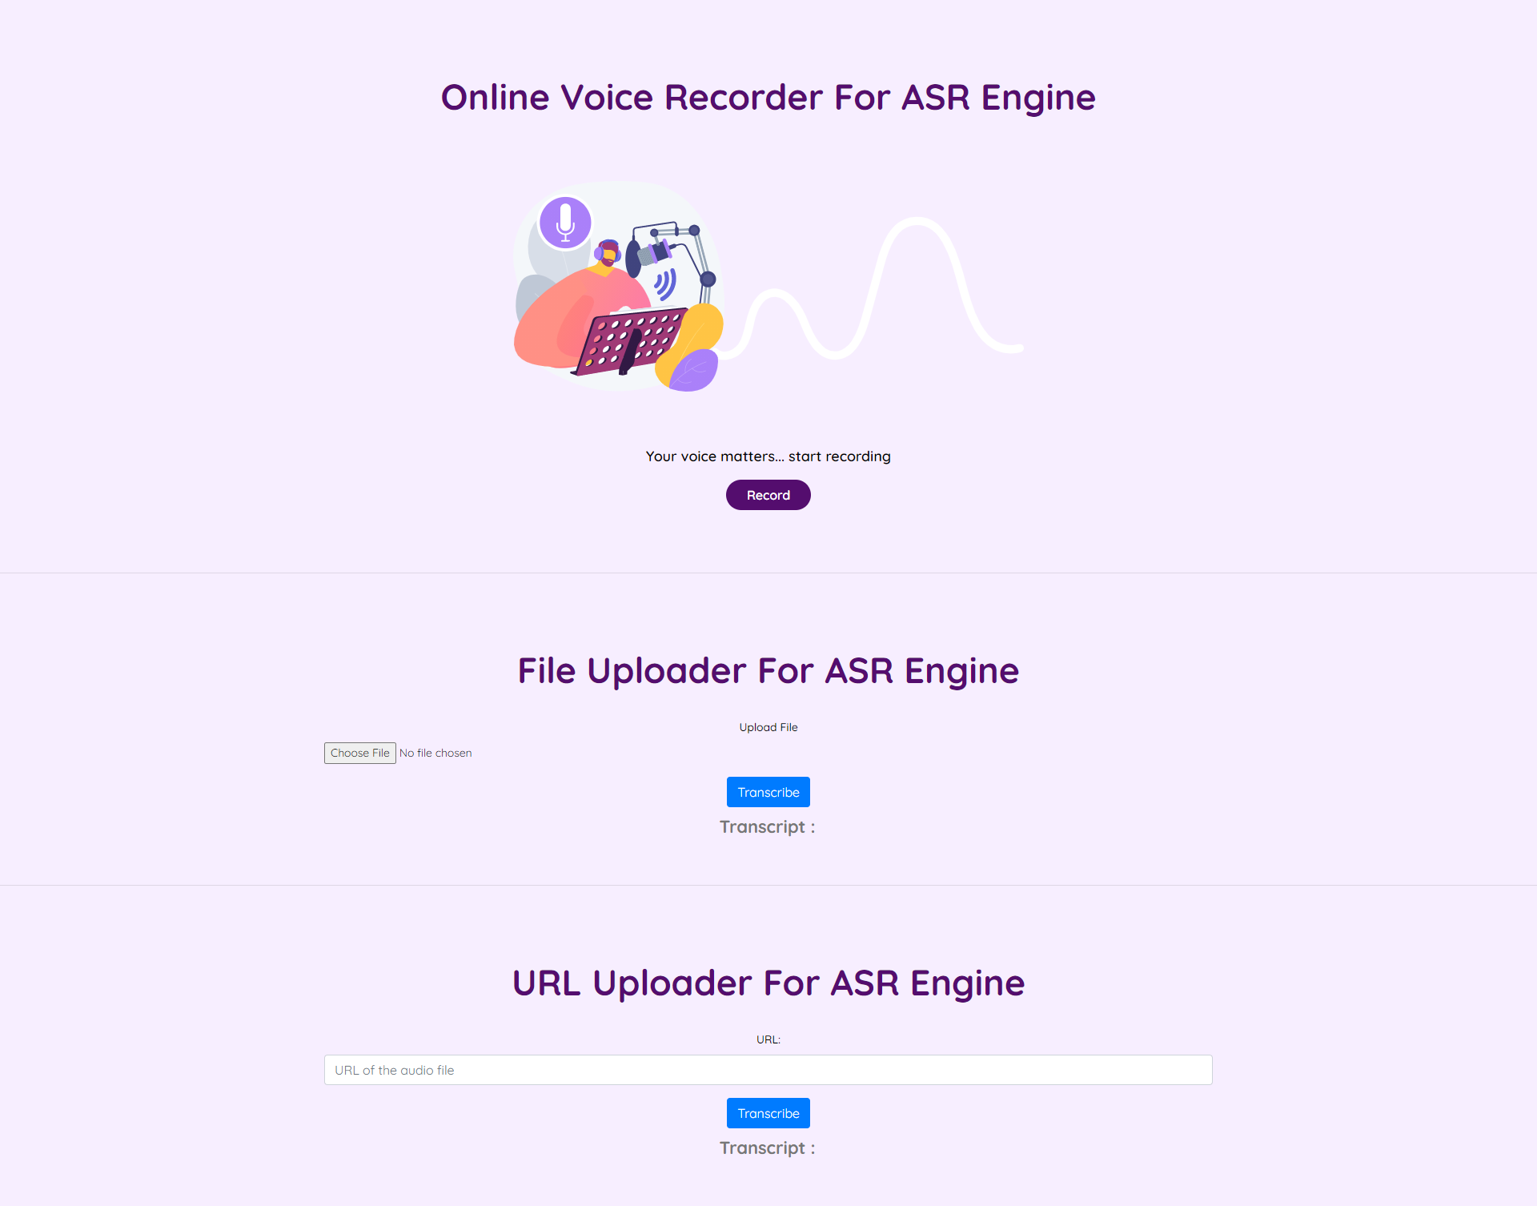
GUI Interface

Slide 22
Product Testing
Testing of the ASR engine
S.N. | Test Requirement | Result
1. | ASR engine accepts multiple formats of audio as input (WAV, MP3, FLAC) | PASS
2. | ASR engine can accept audio URL as input | PASS
3. | ASR engine can handle audio length greater than 30 seconds | PASS
4. | ASR engine accepts audio file and return transcript as a JSON object | PASS
5. | The output transcript is in Devanagari Script | PASS
Testing of the API
S.N. | Test Requirement | Result
1. | API is successfully hosted and accessible to the user | PASS
2. | API successfully connects with the ASR engine | PASS
3. | API has multiple endpoints, for input as audio file and input as URL | PASS
4. | Both the endpoints return the transcript in JSON format | PASS
Testing of the Front-end (Webapp)
S.N. | Test Requirement | Result
1. | User can record audio | PASS
2. | User can upload audio files | PASS
3. | User can insert URL for transcription | PASS
4. | User can view the transcript | PASS

Slide 23
Product Evaluation
Used OpenSLR-43 dataset for evaluating the trained model
Output Word Error Rate was 4% which is less than expected 10% WER
Required APIs for accessing the product were successfully created
GUI for accessing the ASR engine made

Slide 24
Limitations
Hardware Limitations
Only Internet-based training data was used. Hence, engine fails to completely accommodate real-world scenarios
Accent beyond training data
Wrong pronunciation leads to the engine predicting wrong words

Slide 25
Future Works
Optimizations to be done to the training arguments
Timestamping of the output transcript as well as confidence score
Linking with language model for higher accuracy on specific language
Pathway for other voice functionalities

Slide 26
Conclusion
Important for Human-computer interaction
The project output will allow for further audio processing
The project can easily be integrated into other languages and can be used as boilerplate for training ASR models in other languages

Slide 27

Thank You

