Slide 1

Product Presentation
Automatic Speech Recognition of Nepali Language to Devanagari Script
Dikson Rajbanshi

Slide 2
Introduction
Speech is the primary means for human interaction
Computers cannot directly understand audio
So there requires the need for development of Speech to Text format allowing computer to understand human speech

Slide 3
Need For Automatic Speech Recognition
Computer Understanding of Human Speech
Easier and more accessible human-to-computer interaction

Slide 4
The Problem
Old Algorithms require large amount of training data
Low-resource language have almost no usable ASR engine
This affects more than 6000 languages out of 7000 languages around the world
Lack of availability of quality labelled audio data

Slide 5
Goals of the Project
Usage of Facebook’s Wav2Vec 2.0 for ASR training
Development of accurate enough model for low-resource languages
Pilot language as Nepali
Extension of development process to other languages

Slide 6
Objectives
Research on the literatures and technologies used currently for the Automatic Speech Recognition and their implementation
Creation of an ASR engine for Nepali languages and Speech-to-Text technologies in Devanagari Script
Exploration of the technology for future studies and progress like Natural Language Processing in Nepali Speech

Slide 7
How ASR works
Parse speech signal/ acoustic waveforms from audio
Linguistic parsing of the waveforms
Linguistic processing for conversion to set of words

Slide 8
ASR history
Development of telephone by Alexander Graham Bell
First actual ASR developed in 1952 by Bell Labs
Use of Hidden Markov Models (HMM) in 1970s
Introduction of Neural Network in ASR for model training
Increase in computation powers of hardware helped push limits of ASR models
New End-to-End Deep Learning algorithms like DeepSpeech
Use of supervised and self-supervised learWav2Vec 2.0 by Facebook AI team

Slide 9
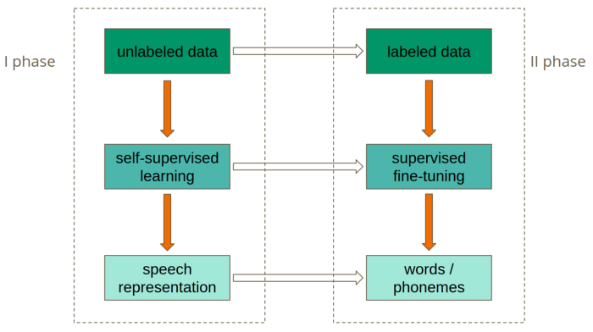
How Wav2Vec 2.0 works

