Slide 1

Product Presentation
Automatic Speech Recognition of Nepali Language to Devanagari Script
Dikson Rajbanshi

Slide 2
Introduction
Speech is the primary means for human interaction
Computers cannot directly understand audio
So there requires the need for development of Speech to Text format allowing computer to understand human speech

Slide 3
Need For Automatic Speech Recognition
Computer Understanding of Human Speech
Easier and more accessible human-to-computer interaction

Slide 4
The Problem
Old Algorithms require large amount of training data
Low-resource language have almost no usable ASR engine
This affects more than 6000 languages out of 7000 languages around the world
Lack of availability of quality labelled audio data

Slide 5
Goals of the Project
Usage of Facebook’s Wav2Vec 2.0 for ASR training
Development of accurate enough model for low-resource languages
Pilot language as Nepali
Extension of development process to other languages

Slide 6
Objectives
Research on the literatures and technologies used currently for the Automatic Speech Recognition and their implementation
Creation of an ASR engine for Nepali languages and Speech-to-Text technologies in Devanagari Script
Exploration of the technology for future studies and progress like Natural Language Processing in Nepali Speech

Slide 7
How ASR works
Parse speech signal/ acoustic waveforms from audio
Linguistic parsing of the waveforms
Linguistic processing for conversion to set of words

Slide 8
ASR history
Development of telephone by Alexander Graham Bell
First actual ASR developed in 1952 by Bell Labs
Use of Hidden Markov Models (HMM) in 1970s
Introduction of Neural Network in ASR for model training
Increase in computation powers of hardware helped push limits of ASR models
New End-to-End Deep Learning algorithms like DeepSpeech
Use of supervised and self-supervised learWav2Vec 2.0 by Facebook AI team

Slide 9
Methods For Handling Low-resource languages in ASR
Multi-lingual resource/ system over monolingual systems
Use of Deep Neural Networks
Bottleneck Features
Transfer Learning
Pre-training
Unsupervised learning through pre-training
Wav2vec, which uses Convolutional Neural Network
Self-supervised training
Wav2vec 2.0

Slide 10
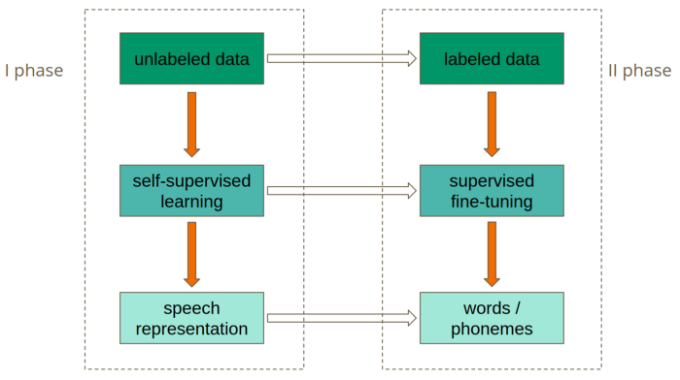
How Wav2Vec 2.0 works

Slide 11
Data Acquisition
Research Based model due to COVID-19
Internet based resources found for Nepali labeled data
OpenSLR-54 dataset used for training
https://openslr.org/54/
OpenSLR-43 dataset (initially designed for TTS) used for evaluation
https://openslr.org/43/

Slide 12
Data Analysis
Required audio dataset of 16kHz sampling rate
Files were cross-checked for corruption
Sampling rate was verified using librosa library of Python
Transcription containing special characters were edited out

Slide 13
Software requirements
Python 3.7
Jupyter Lab
Python Packages
pandas
scikit-learn
transformers
torchaudio
librosa
numpy
jiwer
datasets
flask
werkzeug
python-dotenv
Pydub
pytorch

Slide 14
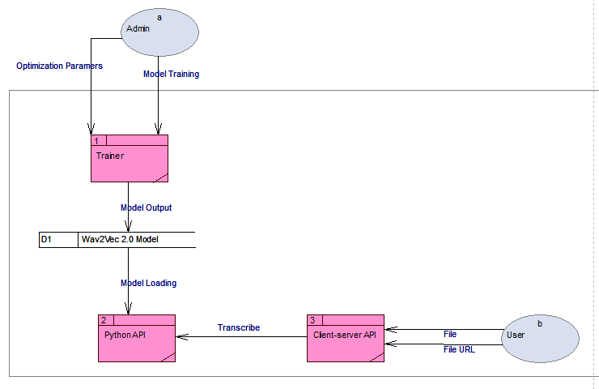
Data Flow Diagram

Slide 15
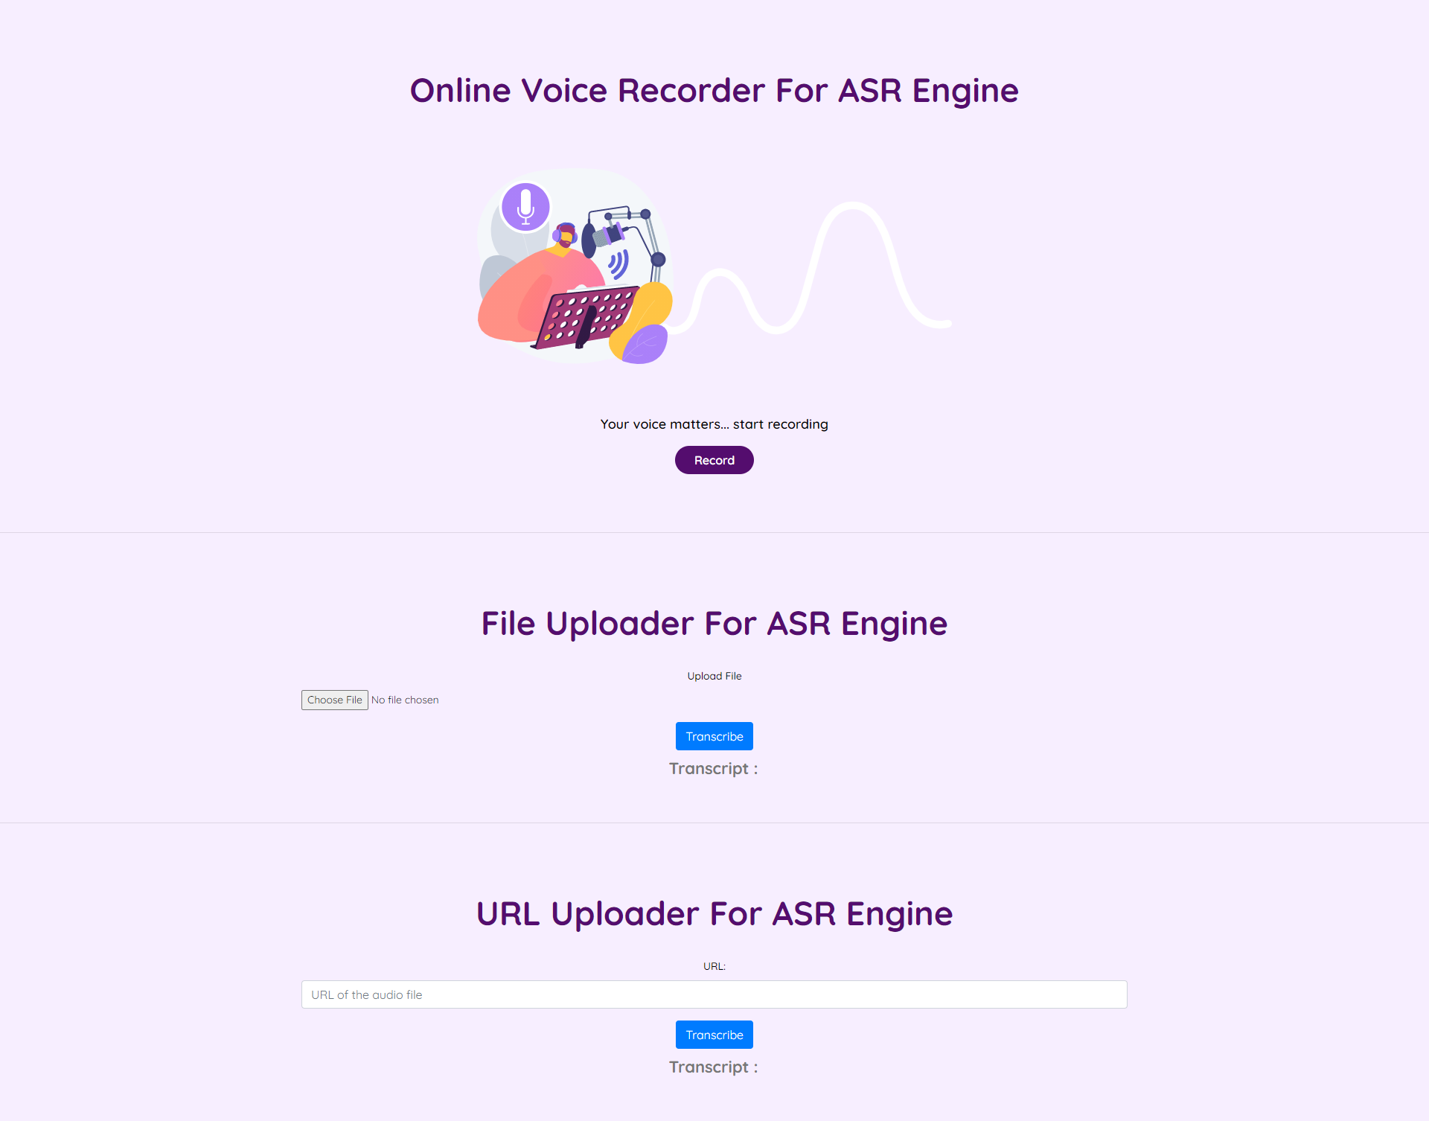
GUI Interface

Slide 16
Product Testing
Testing of the ASR engine
S.N. | Test Requirement | Result
1. | ASR engine accepts multiple formats of audio as input (WAV, MP3, FLAC) | PASS
2. | ASR engine can accept audio URL as input | PASS
3. | ASR engine can handle audio length greater than 30 seconds | PASS
4. | ASR engine accepts audio file and return transcript as a JSON object | PASS
5. | The output transcript is in Devanagari Script | PASS
Testing of the API
S.N. | Test Requirement | Result
1. | API is successfully hosted and accessible to the user | PASS
2. | API successfully connects with the ASR engine | PASS
3. | API has multiple endpoints, for input as audio file and input as URL | PASS
4. | Both the endpoints return the transcript in JSON format | PASS
Testing of the Front-end (Webapp)
S.N. | Test Requirement | Result
1. | User can record audio | PASS
2. | User can upload audio files | PASS
3. | User can insert URL for transcription | PASS
4. | User can view the transcript | PASS

Slide 17

Thank You

