Slide 1
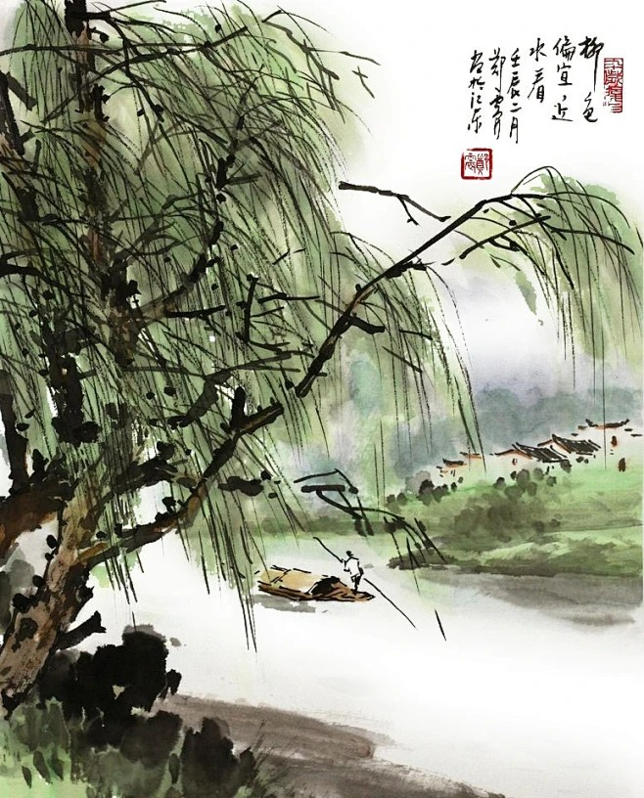
Synthetic 3D Plant Data: Augmenting Geometry & Topology
柳柳 (Liǔ Liǔ) — the Willow team · 柳 liǔ “willow” ≈ 留 liú “stay” · 我们会想你, “we’ll miss you”
柳柳，我们会想你
Liǔ liǔ, wǒmen huì xiǎng nǐ
Nelson Broyer-Paco · Angel Marquez-Aguilar · Li Shi · Josine Uwihanganye · Pacifique
Ruberwa
github.com/Nosl3n/Synthetic_Tree_G
LiuLiu Willow team - Synthetic 3D plant data - 1/10

Slide 2
The problem & the goal
Models that work with 3D plant data need large amounts of labelled examples — point clouds, meshes, structure.
Labelling is the bottleneck: scanning is hard, but manual annotation is the slowest and most expensive step.
Goal: a method to AUGMENT 3D plant data — generate more, diverse, labelled examples of plant geometry & topology. To train the EYES (Computer Vision), BRAINS (Models, decision-making), and even the MUSCLES (robotics).
The tropical forest below is just our test bed; the method applies to any tree and could apply to other plants.
LiuLiu Willow team - Synthetic 3D plant data - 2/10

Slide 3
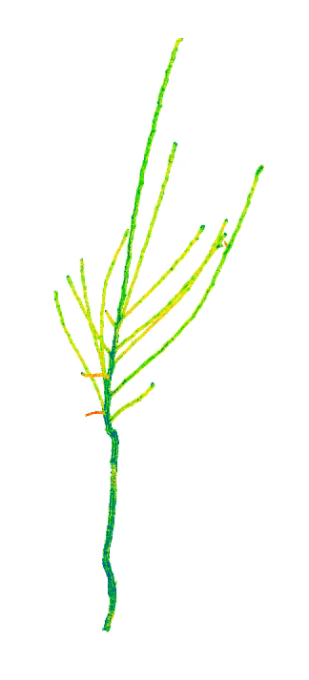
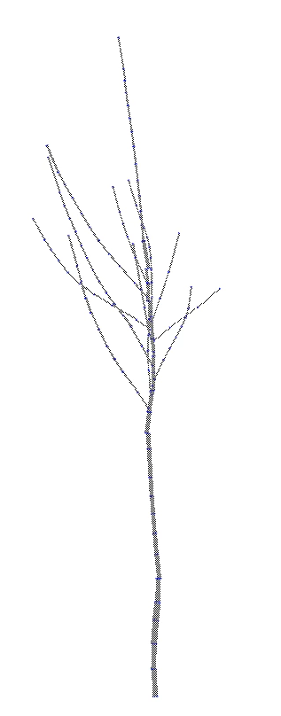
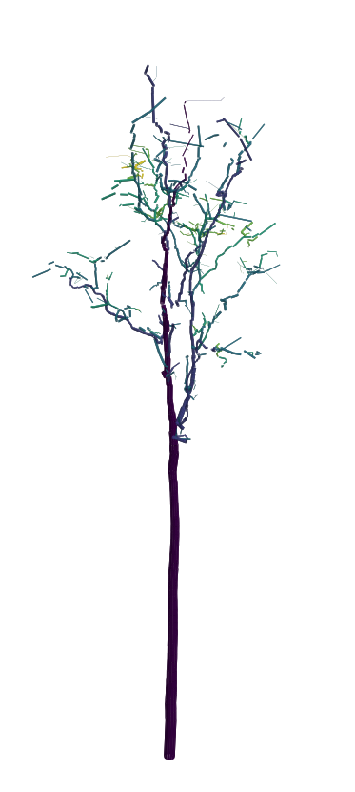
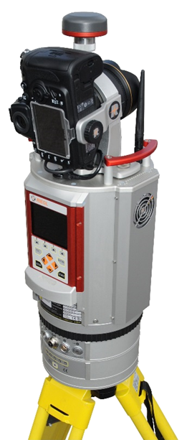
Starting point: real scanned trees as QSMs
A Quantitative Structure Model (QSM) is a cylinder table: start point, axis, length, radius, and parent/child topology — the geometry and topology of a tree.
Test bed: 201 tropical trees, 53 species, scanned with terrestrial laser scanning on Barro Colorado Island (Panama).
Split by tree: 152 train / 49 test (stratified, fixed seed).
Feasible to download and work with — but any tree fits the same representation.
Tree point cloud
Tree QSMs
TLS
Sources: Data: Krishna Moorthy et al. 2022, Zenodo 6981485 (CC BY 4.0)
LiuLiu Willow team - Synthetic 3D plant data - 3/10
Notes:
Add Tropical Forest QSM

Slide 4
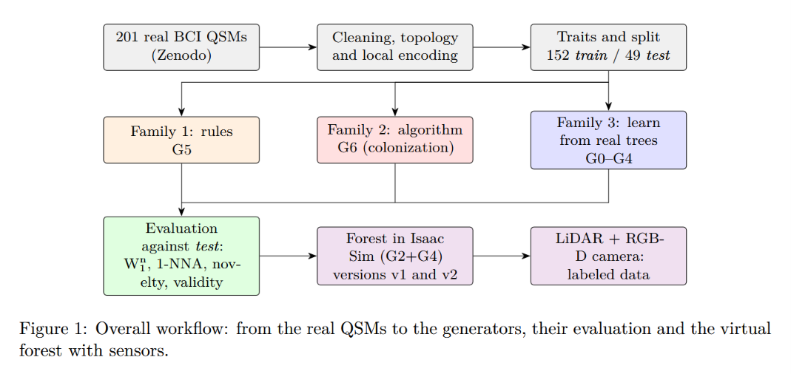

Slide 5
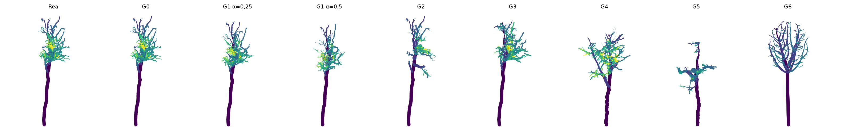
The method: eight generators, three families
Real QSMs
cylinder models
8 generators
3 families
Evaluate
fidelity & novelty
Augmented
3D plant data
A real tree (left) and one synthetic tree from each generator.
G2 (recombination) is the most faithful · G4 (procedural) the most novel · their mix G2+G4 is the best trade-off.
Sources: QSM: TreeQSM (Raumonen et al. 2013) · space colonization: Runions et al. 2007
LiuLiu Willow team - Synthetic 3D plant data - 4/10
Notes:
We looked for different available methodologies to generate feasible and realistic QSMs of tress.

Slide 6
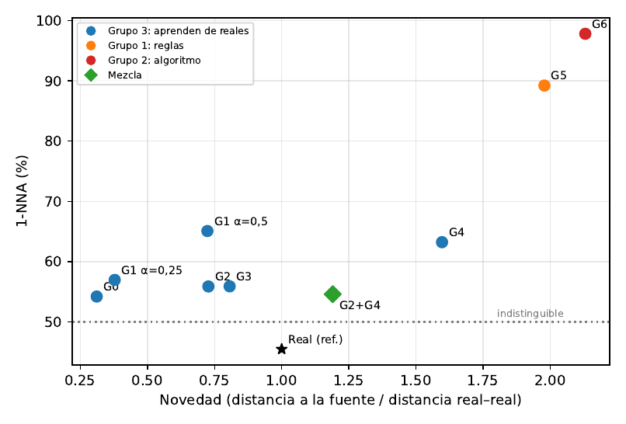
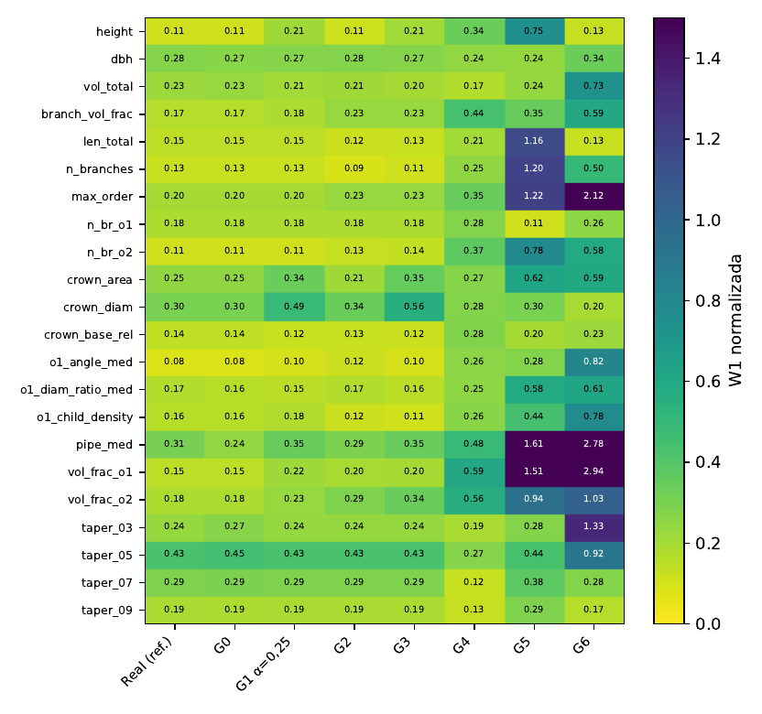
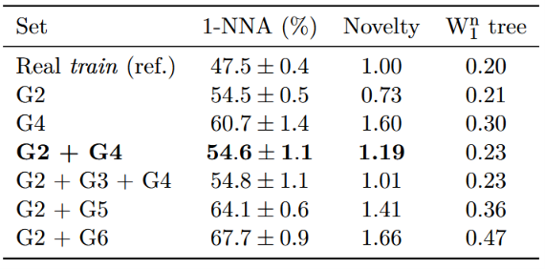
Proof: are they realistic?
1-NNA fidelity vs novelty per generator.
Wasserstein W1 per trait.
Over 22 tree + 10 branch traits: 1-NNA 56 % for G2 vs 46 % real–real; novelty 0.73 → 1.19 with G2+G4.
Sources: Metrics: normalized Wasserstein W1, 1-NNA two-sample test, novelty, botanical validity
LiuLiu Willow team - Synthetic 3D plant data - 5/10

Slide 7
Applications
Instance segmentation — individual trees and organs (trunk, branches, leaves).
Phenotyping — biomass, DBH, volume, crown size.
Robotics — orchard robots: pruning, navigation, harvesting.
Agronomy — light interception and yield estimation.
FSPM — feed the structure into growth models (GroIMP / L-Py).
LiuLiu Willow team - Synthetic 3D plant data - 7/10

Slide 8
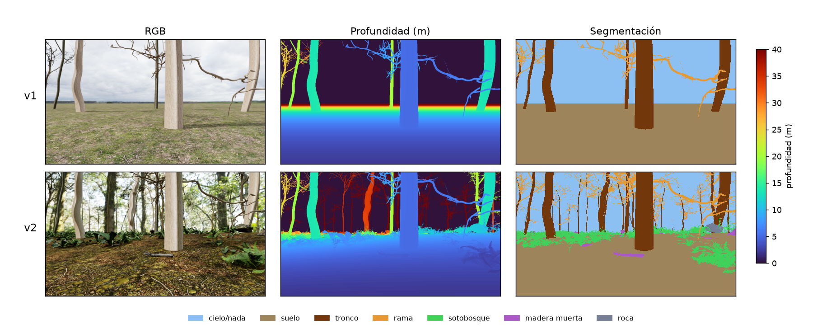
Demo 1: automatically-labelled sensor data
Using IssacSim from NVIDIA, we simulated two versions of a digital scene, one more realistic, complex and hopefully more useful than the other.
LiDAR: understory 21.7 % of points in v2.
LiuLiu Willow team - Synthetic 3D plant data - 8/10

Slide 9
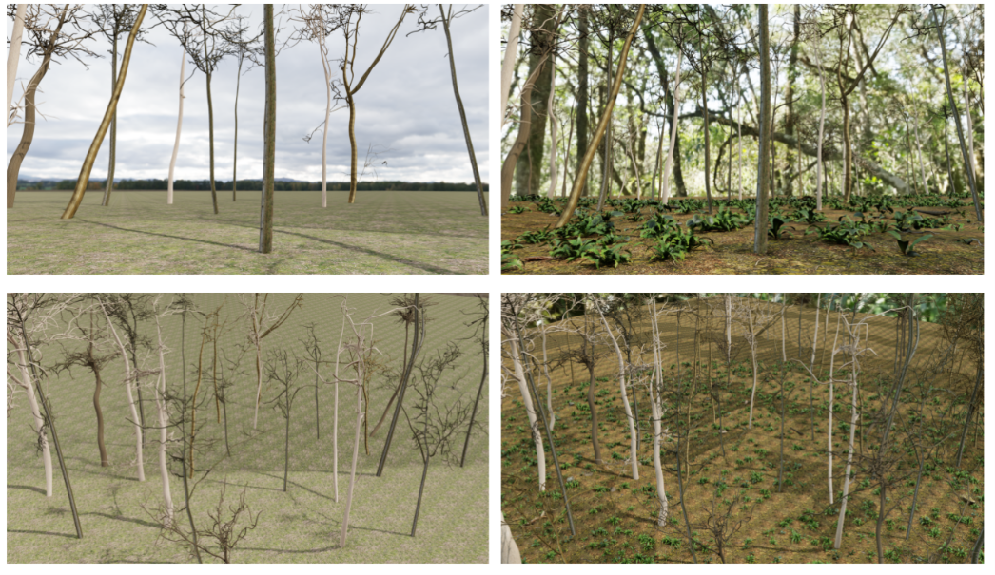

Slide 10
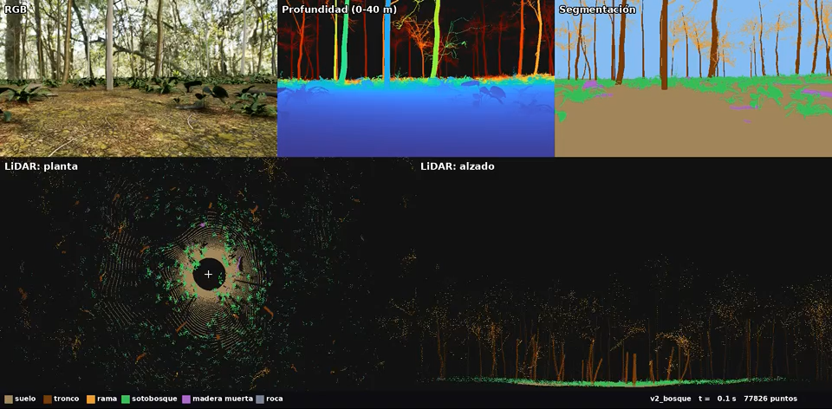
Demo 1: automatically-labelled sensor data
24 synthetic trees · 128-channel Ouster OS1 LiDAR + RGB-D (D455) @ 10 Hz · per-class labels in real time -Isaac Sim forest route (84 s) — LiDAR + RGB-D in real time.
LiuLiu Willow team - Synthetic 3D plant data - 8/10

Slide 11
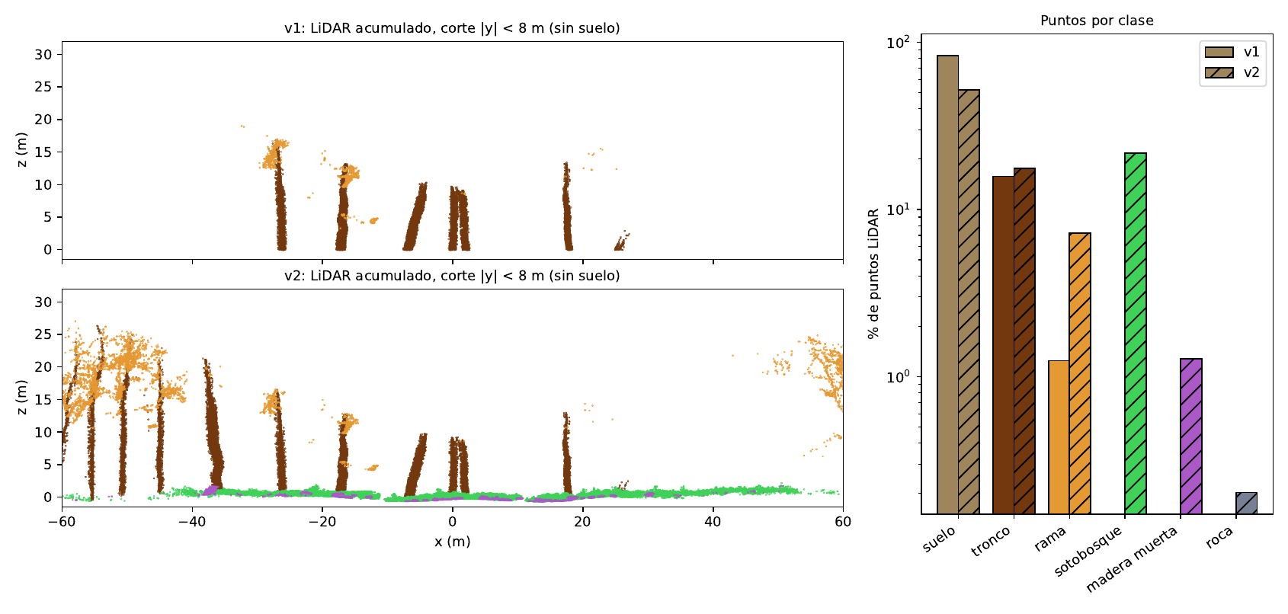
Demo 1: automatically-labelled sensor data
LiDAR: understory 21.7 % of points in v2.
LiuLiu Willow team - Synthetic 3D plant data - 8/10

Slide 12

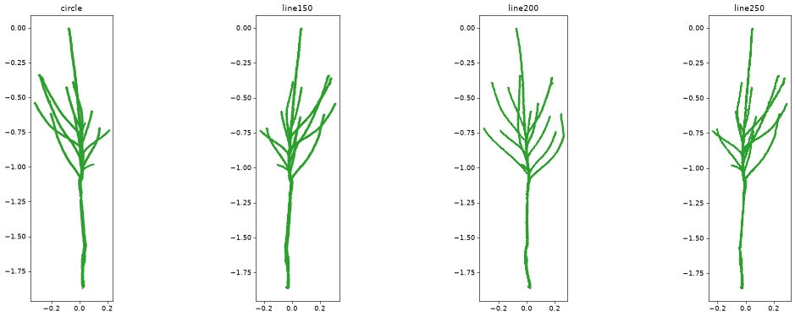
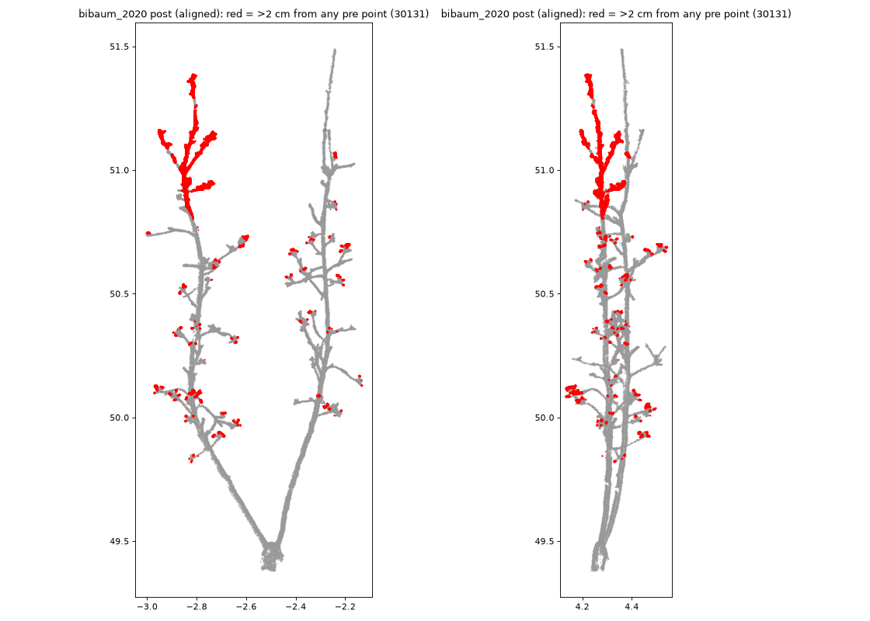
Demo 2: robotic pruning (orchard-robot repo)
The same tree models drive a real pruning robot in the orchard.
Segmentation of four orchard trees.
Robotic pruning plan (Nemotron 550B) on the apple tree.
Pruning: wood added/removed on the apple tree.
LiuLiu Willow team - Synthetic 3D plant data - 9/10

Slide 13
Takeaway
Synthetic 3D plant data = more, diverse, labelled examples of geometry & topology.
One representation serves forest and orchard trees alike.
Evaluated by fidelity and novelty — not just by eye.
Downstream: segmentation, phenotyping, robotics, agronomy, FSPM.
柳柳，我们会想你 (Liǔ liǔ, wǒmen huì xiǎng nǐ) — “Liu Liu, we’ll miss you.”
LiuLiu Willow team - Synthetic 3D plant data - 10/10

