Slide 1
Group AI Offer
DevX and AI4Dev ecosystem
AI
+
Developer
Experience
One slide per ecosystem element, with Green IT positioned at the end as a cross-functional capability.
AI4DEV
DevX
Kevin
Green IT
BNP PARIBAS
The bank for a changing world
Internal Use Only | 31/07/2026 | 1

Slide 2
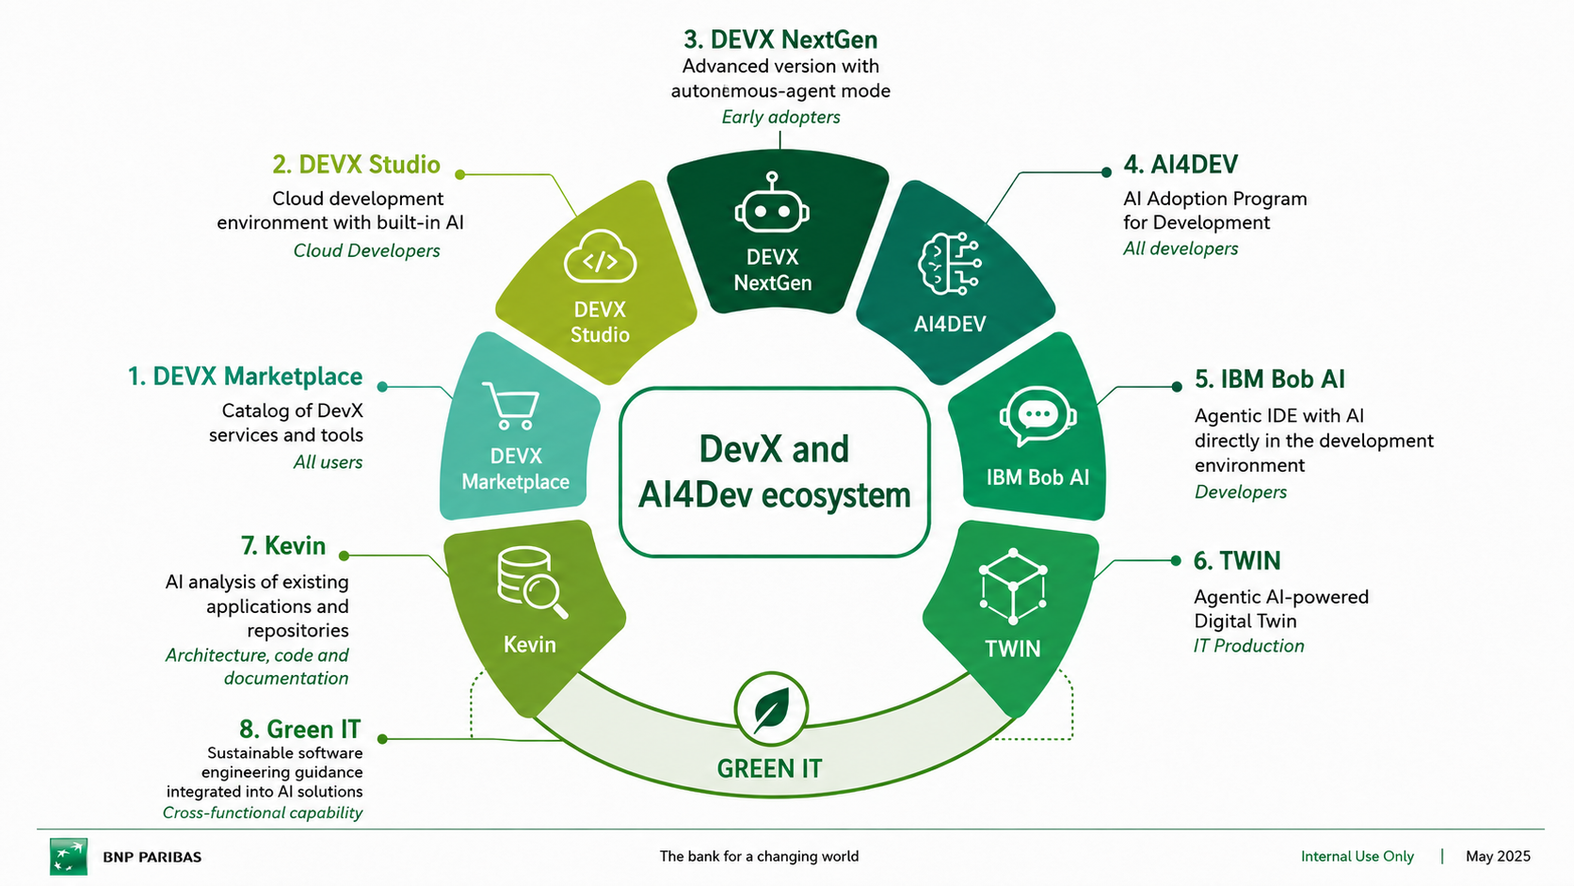
Ecosystem overview
The offer combines adoption, developer tools, agentic capabilities, repository analysis, production intelligence and sustainable engineering.

Slide 3
AI4DEV
AI Adoption Program for Development
AI
Definition
Purpose Accelerate productivity, improve code quality, train teams, standardize practices and measure impact across development teams.
AI4DEV is the Group adoption program that democratizes the use of generative AI in software development and frames how teams learn, use and measure AI assistance.
Key capabilities
Primary audience All developers and delivery teams using AI-assisted development.
Green IT link AI4DEV can host and govern Green IT guidelines so recommendations stay consistent across tools.
•
AI tools and plugins made available to developers
•
Documentation, usage guides and quick references
•
Training, workshops and onboarding material
•
Templates, shared practices and community support
Role in the ecosystem AI4DEV connects adoption, tooling, development workflows and measurable impact inside the overall DevX and AI4Dev ecosystem.
•
Productivity and quality indicators
BNP PARIBAS
The bank for a changing world
Internal Use Only | 31/07/2026 | 3

Slide 4
DEVX Marketplace
Catalog of DevX services and tools
🛒
Definition
Purpose Simplify access to services, centralize the catalog, make provisioning faster and provide a consistent user journey.
DEVX Marketplace is the single entry point used to discover, request and access DevX services, AI tools and development environments.
Key capabilities
Primary audience All users who need to discover or request DevX / AI services.
Green IT link Marketplace can expose the Green IT capability as an optional service or guidance package.
•
Service catalog for DevX and AI tools
•
Ordering and provisioning entry point
•
Access to DevX Studio and LLM testing environments
•
Transparent service information and links
Role in the ecosystem DEVX Marketplace connects adoption, tooling, development workflows and measurable impact inside the overall DevX and AI4Dev ecosystem.
•
Integrated support and documentation
BNP PARIBAS
The bank for a changing world
Internal Use Only | 31/07/2026 | 4

Slide 5
DEVX Studio
Cloud development environment with built-in AI
☁
Definition
Purpose Provide a secure, standardized and fast development environment that reduces setup friction and embeds AI assistance in the workflow.
DEVX Studio is a browser-accessible cloud development environment with integrated AI assistance and ready-to-use development configurations.
Key capabilities
Primary audience Cloud developers and teams needing standardized environments.
Green IT link Green IT recommendations can be surfaced directly while developers design, code and test.
•
Cloud-native access from anywhere
•
Preconfigured development environments
•
AI assistance during development
•
Group security standards and controls
Role in the ecosystem DEVX Studio connects adoption, tooling, development workflows and measurable impact inside the overall DevX and AI4Dev ecosystem.
•
Collaboration and environment sharing
BNP PARIBAS
The bank for a changing world
Internal Use Only | 31/07/2026 | 5

Slide 6
DEVX NextGen
Advanced version with autonomous-agent mode
🤖
Definition
Purpose Enable complex development tasks, agentic workflows and advanced assistance for early adopters.
DEVX NextGen is the advanced version of DevX Studio, introducing autonomous-agent capabilities for assisted development at a higher level of automation.
Key capabilities
Primary audience Early adopters and teams experimenting with advanced AI-assisted development.
Green IT link Green IT can become one of the agent skills used to propose sustainable design or remediation actions.
•
Autonomous-agent mode for complex tasks
•
CLI and automation-oriented interactions
•
Advanced model integration and tool usage
•
MCP-style integration with external tools
Role in the ecosystem DEVX NextGen connects adoption, tooling, development workflows and measurable impact inside the overall DevX and AI4Dev ecosystem.
•
Enhanced productivity metrics and user experience
BNP PARIBAS
The bank for a changing world
Internal Use Only | 31/07/2026 | 6

Slide 7
IBM Bob AI
Agentic IDE with AI inside the development environment
💬
Definition
Purpose Bring AI assistance closer to developers’ daily work, inside the IDE, with profiles adapted to usage levels.
IBM Bob AI is an agentic IDE experience that embeds AI directly in the developer environment to assist coding, analysis and task execution.
Key capabilities
Primary audience Developers using agentic assistance inside their development environment.
Green IT link Green IT rules can guide code suggestions and explanations inside the IDE.
•
Agentic assistance inside the IDE
•
Developer profiles and usage allocation
•
Support for coding, analysis and generation tasks
•
SSO-based access and controlled onboarding
Role in the ecosystem IBM Bob AI connects adoption, tooling, development workflows and measurable impact inside the overall DevX and AI4Dev ecosystem.
•
Integration into the AI tooling landscape
BNP PARIBAS
The bank for a changing world
Internal Use Only | 31/07/2026 | 7

Slide 8
Kevin
AI analysis of existing applications and repositories
🔎
Definition
Purpose Generate architecture, technical and functional documentation from existing applications and support repository understanding.
Kevin analyzes existing code repositories with a mono-agent pipeline that progressively enriches the context through facets such as architecture, development, UML, functional and technologies.
Key capabilities
Primary audience Architects, developers and teams needing to understand existing repositories.
Green IT link Kevin is the best entry point for analyzing the Green IT maturity of existing applications.
•
Repository ingestion and analysis
•
Progressive context enrichment through facets
•
Architecture and developer documentation
•
UML, functional and technology views
Role in the ecosystem Kevin connects adoption, tooling, development workflows and measurable impact inside the overall DevX and AI4Dev ecosystem.
•
Current mono-agent architecture
BNP PARIBAS
The bank for a changing world
Internal Use Only | 31/07/2026 | 8

Slide 9
TWIN
Agentic AI-powered Digital Twin for IT Production
⬡
Definition
Purpose Help IT Production teams model, analyze and interact with production-oriented digital representations.
TWIN is an agentic AI-powered Digital Twin capability focused on IT Production and operational intelligence.
Key capabilities
Primary audience IT Production teams and operational stakeholders.
Green IT link Green IT indicators can enrich production intelligence with sustainability-oriented operational signals.
•
Digital Twin capability for IT Production
•
Agentic AI-powered interaction layer
•
Operational analysis and assistance
•
Potential bridge between development and production insights
Role in the ecosystem TWIN connects adoption, tooling, development workflows and measurable impact inside the overall DevX and AI4Dev ecosystem.
•
Production-focused adoption perimeter
BNP PARIBAS
The bank for a changing world
Internal Use Only | 31/07/2026 | 9

Slide 10
Green IT section
Placed at the end of the deck and translated from the existing Green IT presentation.
Positioning principle
Green IT is not another separate tool. It is a cross-functional capability that enriches Kevin, DevX Studio, IBM Bob AI and the AI4DEV adoption program.
Existing applications
analysis
Development
assistance
AI adoption
and governance
Production
intelligence
GREEN IT KNOWLEDGE & RECOMMENDATIONS
BNP PARIBAS
The bank for a changing world
Internal Use Only | 31/07/2026 | 10

Slide 11
Green IT — Vision & Objectives
Translation of the Green Code Challenge positioning slide.
Context As part of the Green Code Challenge 2026, BNP Paribas explored how artificial intelligence can support development teams in reducing the environmental footprint of applications. The objective is not to create a new tool, but to leverage acquired knowledge by integrating it into AI solutions already used by developers.
Two complementary use cases Kevin: analysis of existing applications
DevX / IBM Bob AI: development assistance and code generation
Objectives • Spread Green IT good practices
• Standardize AI-generated recommendations
• Reduce the environmental footprint of applications
• Mutualize Green IT knowledge across AI assistants
Expected outcome A shared Green IT capability available across the Group AI ecosystem, from repository analysis to developer assistance.
BNP PARIBAS
The bank for a changing world
Internal Use Only | 31/07/2026 | 11

Slide 12
Green IT — Current Kevin architecture
Kevin is currently a mono-agent pipeline enriched by sequential facets.
Current behavior
Kevin currently relies on a single AI agent. Each analysis step progressively enriches the context sent to the model through facets.
Code
repository
Repository
analysis
Kevin
mono-agent
Architecture
Developer
UML
Current limitation
Functional
Features
Technologies
Kevin is not currently designed as a native multi-agent architecture. Adding specialized AI agents guided by skills would require changing the full processing chain.
Generated documentation
Pragmatic Green IT integration Add a Green IT facet first, then evolve towards reusable skills and specialized agents once the architecture is ready.
BNP PARIBAS
The bank for a changing world
Internal Use Only | 31/07/2026 | 12

Slide 13
Green IT — Target integration model
Reusable knowledge, consistent recommendations and progressive rollout.
Green IT
knowledge base
Rules, skills
and prompts
Kevin / DevX /
IBM Bob AI
Recommendations
and remediation
Measured
improvement
Analysis scope Architecture • code • APIs • distributed systems • cloud • containers • data • infrastructure
Outputs Score • prioritized recommendations • explanation • suggested remediation • before/after comparison
Next action Upload the existing Green IT PowerPoint so the full Green IT section can be translated and inserted at the end with the same structure.
BNP PARIBAS
The bank for a changing world
Internal Use Only | 31/07/2026 | 13

