Slide 1
2026 – DEVX AND AI4DEV
ECOSYSTEM UPDATE
AI4DEV
Updated quarterly view — July 2026
Adoption program
DEVX
Studio + NextGen
What changed in this version
IBM Bob AI
• Ecosystem scope extended beyond DevX Studio and AI4DEV
• IBM Bob AI, Kevin, TWIN and Green IT included
• Adoption indicators updated with +3 to +4 points
• LLM view clarified with agentic coding tools
Agentic IDE
TWIN
IT Production
Kevin
Green IT
HAMZA EL KILALI & OUEB RACHEDI
ITG IT PS — 2026, July 31st
Repo analysis
Sustainable dev
BNP PARIBAS
La banque d’un monde qui change
31/07/2026 | 1
Classification : Internal

Slide 2
ITPS – GOVERNANCE UPDATE
Transition from project mode to run mode — updated communication structure
From project mode to run
Deliverables
A lighter run governance has been established while keeping regular reporting under AECC management.
Run deliverables remain in place
1
Effective transition
• Weekly and monthly reports remain under AECC management
• Sharing extended to all stakeholders: APS TO + Factor and Monetique, in addition to Cash Management and CDS
• A quarterly update is delivered using the refreshed structure of this deck
Run mode effective since March 1st, 2026
2
Delegation model
Users management and activity follow-up delegated to Group deputies
3
Department support
Assistance and follow-up remain under AECC staff management
4
Cadence
Switch from weekly to bi-monthly central team meeting
New message
The governance is now positioned as an operating model supporting adoption, usage follow-up and ecosystem evolution.
BNP PARIBAS
La banque d’un monde qui change
31/07/2026 | 2
Classification : Internal

Slide 3
GLOBAL OVERVIEW — EVOLUTION SINCE JANUARY 2026
Updated strengths and attention points
Strengths
Areas to watch
✓ Agent Mode now live for autonomous execution of complex tasks ✓ Continue CLI provides a command-line interface for seamless automation ✓ Approved models expanded with Gemma and Nemotron in the sandbox ✓ MCP protocol enables integration with external tools ✓ Advanced metrics support productivity tracking and analytics ✓ DevX support remains responsive and production-oriented
• Integrated browser remains slower than local environments in some testing scenarios
• Docker image initialization can be time-consuming on large images
• Top-tier model availability is still evolving and should be monitored
• Enterprise rollout of IBM Bob AI and agentic coding needs clear qualification and onboarding
• Usage growth must remain supported by training, support and governance
Updated positioning
The scope is no longer limited to DevX Studio and AI4DEV: it now covers a broader ecosystem including IBM Bob AI, Kevin, TWIN, RTK/FinOps and Green IT.
BNP PARIBAS
La banque d’un monde qui change
31/07/2026 | 3
Classification : Internal

Slide 4
DevX AND AI4DEV MAJOR ENHANCEMENTS
Updated view — new ecosystem capabilities and positioning
LIVE
UPDATED
NEW
APPROVED
EARLY
NEW
AI Agent Mode
Token quota raised
IBM Bob AI + Claude Code
Gemma & Nemotron
New SaaS platform
Green IT / RTK
Agent mode can be activated through Continue or OpenCode to bring autonomous task execution into DevX workflows.
Daily quota raised to 20M tokens per model, supporting higher usage as agent mode adoption increases.
IBM Bob AI is positioned as the agentic IDE capability. Claude Code comes with IBM Bob AI for agentic coding workflows.
Security-cleared models are available in the sandbox and can be integrated into upcoming DevX releases.
Early-adopter launch introduces a SaaS platform as the next evolution of the DevX ecosystem.
RTK reduces noisy terminal outputs before they reach the LLM context, lowering token usage and compute cost.
BNP PARIBAS
La banque d’un monde qui change
31/07/2026 | 4
Classification : Internal

Slide 5
Green-IT & FinOps — Integrating RTK into DevX
New scope for cost, token and compute optimization
https://www.rtk-ai.app/
KEY MESSAGES
1. Raw command output
2. RTK cleanup
3. AI assistant
4. Impact
Long terminal logs, stack traces and verbose build outputs are often too noisy for direct LLM usage.
→
RTK cleans and compresses the text, keeping the essential information before sending it to the AI.
→
Claude, Cursor, Copilot, Aider or DevX assistants receive more focused and cheaper context.
→
Lower token usage, lower LLM cost and reduced compute demand.
What RTK does
Why add RTK to DevX
Green IT impact
Command-line utility that acts as a filter between the developer and AI-powered code assistants.
Significant token savings by compressing command-line outputs before they reach the LLM context.
Token reduction proportionally lowers compute power required on model servers and supports FinOps objectives.
BNP PARIBAS
La banque d’un monde qui change
31/07/2026 | 5
Classification : Internal

Slide 6
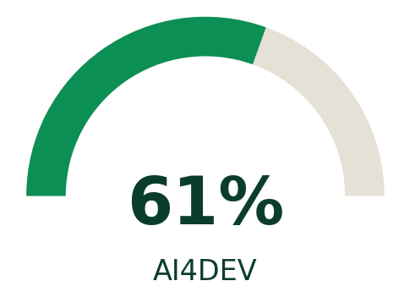
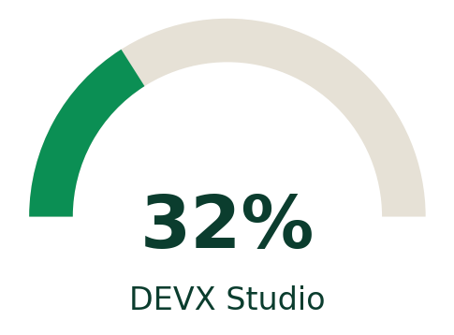
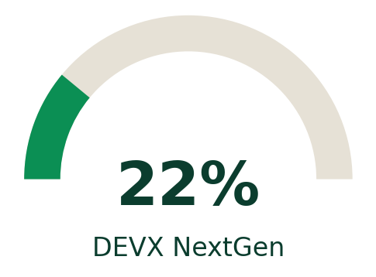
ITPS – DevX AND AI4DEV ADOPTION
Indicators updated with +3 to +4 percentage points
AI4DEV
DEVX STUDIO
DEVX NEXTGEN
KEY MESSAGES
KEY MESSAGES
KEY MESSAGES
LLM remains the major driver of usage.
LLM extensions continue to sustain the adoption dynamic.
Adoption remains strong while the subscription remains open.
A progressive shift to NextGen is expected in Q3.
Still in early-adopter phase.
Usage should increase by year-end as rollout expands.
Updated interpretation
Adoption continues to grow across the three main services, with each indicator gaining 3 to 4 percentage points compared with the previous version.
BNP PARIBAS
La banque d’un monde qui change
31/07/2026 | 6
Classification : Internal

Slide 7
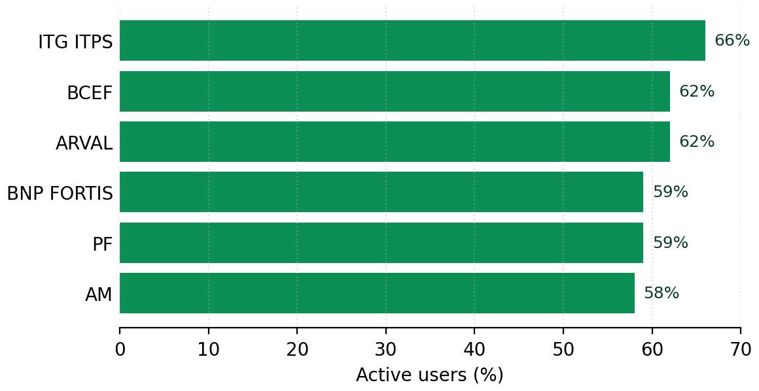
DevX AND AI4DEV Usage Dashboard within the Group
Updated usage view and key messages
Entity
Users
Active users
Big
Medium
Small
KEY MESSAGES
ITG ITPS
279
66%
20%
30%
9%
BCEF
1,539
62%
17%
32%
12%
• ITPS remains well positioned in the Group ranking
• Recent enhancements sustain usage momentum
• Next updates should reinforce the positive trend and keep ranking at a high level
• Active-user rates shown here include a +3 to +4 point refresh vs. previous version
ARVAL
456
62%
19%
27%
10%
BNP FORTIS
831
59%
14%
29%
12%
PF
1,133
59%
14%
29%
13%
AM
158
58%
20%
29%
7%
BGL
101
54%
11%
34%
7%
ITG PROD
693
48%
14%
19%
12%
LEASE GROUP
189
47%
15%
17%
10%
OTHER
1,129
45%
10%
17%
8%
BNP PARIBAS
La banque d’un monde qui change
31/07/2026 | 7
Classification : Internal

Slide 8
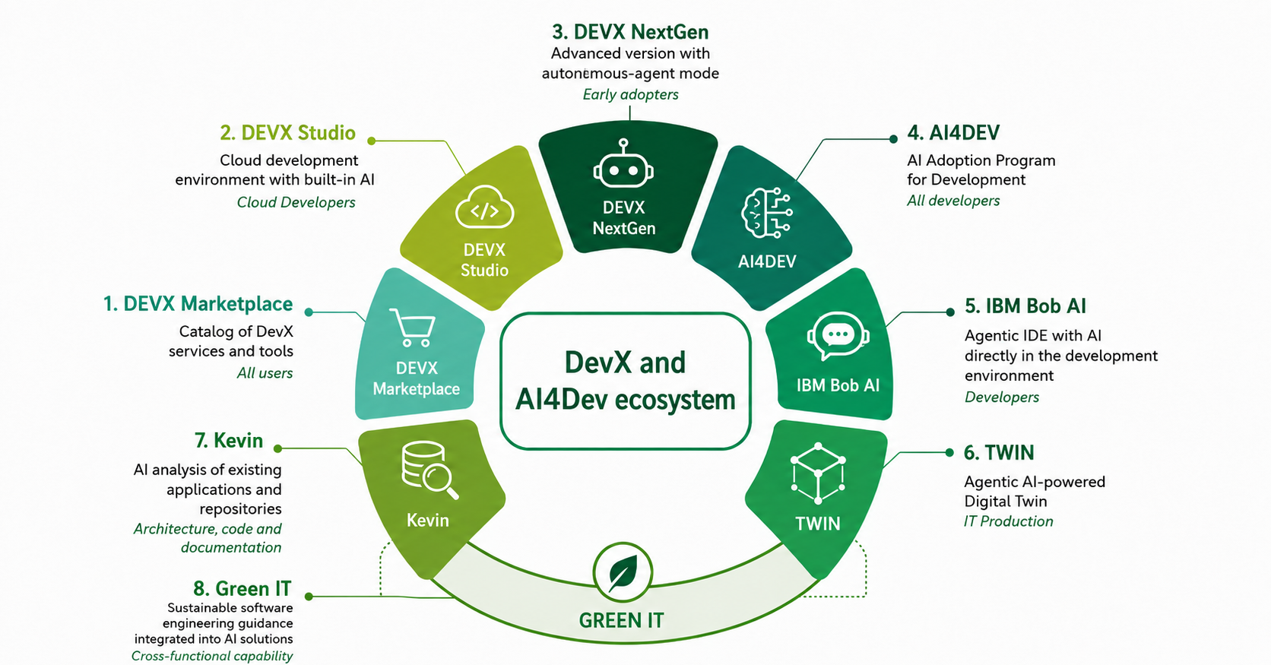
APPENDIX – DevX and AI4DEV ECOSYSTEM
New ecosystem scope including IBM Bob AI, Kevin, TWIN and Green IT
BNP PARIBAS
La banque d’un monde qui change
31/07/2026 | 8
Classification : Internal

Slide 9
APPENDIX – OFFERS COMPARISON
Updated interpretation of DevX and AI4Dev ecosystem components
Criteria
DevX Studio
DevX NextGen
DevX Marketplace
AI4DEV
IBM Bob AI
Maturity
Production
Early Access
Standard
Program
Under qualification / onboarding
Agent mode
No
Yes
No
No
Yes
Environment
Cloud IDE
Advanced cloud IDE
Service catalog
Program & practices
Agentic IDE
Use case
Standard development
Advanced development
Ordering & access
Adoption
Agentic coding
Support
Complete
Priority
Complete
Standard
Dedicated onboarding
KEY MESSAGES
NEW SCOPE
• AI4DEV remains the Group program to democratize generative AI usage in software development.
• DevX Studio is the cloud development environment with built-in AI.
• DevX NextGen adds autonomous-agent mode for advanced AI-assisted development.
• The Marketplace remains the single entry point for ordering and access.
• IBM Bob AI is now positioned as the agentic coding capability, aligned with Claude Code-like workflows.
• Kevin, TWIN and Green IT complete the wider ecosystem view.
BNP PARIBAS
La banque d’un monde qui change
31/07/2026 | 9
Classification : Internal

Slide 10
APPENDIX – LLM AVAILABLE MODELS & AGENTIC TOOLS
Updated model view with IBM Bob AI and Claude Code positioning
Model / tool
Category
Positioning
Max tokens
Vision
Function calling
Structured output
Agentic coding layer
Mistral Medium
Text model
General purpose: writing, analysis, chat
128k
✓
✓
✕
IBM Bob AI is positioned as the agentic coding environment in the Group ecosystem.
Claude Code comes with IBM Bob AI positioning: it is shown as part of the agentic coding layer, not as a standalone LLM model.
Mistral Small
Text model
Lightweight reasoning model
128k
✓
✓
✕
Llama 3.3
Text model
High-capacity open model for text tasks
128k
✕
✓
✓
GPT-OSS
Text model
Open-source GPT implementation
128k
✕
✓
✓
Gemma
Text model
Google open AI model approved in sandbox
256k
✕
✕
✓
Nemotron
Text model
Cutting-edge model now live in sandbox
256k
✓
✓
✓
Codestral
Code model
Coding assistance and productivity
256k
✓
✓
✓
How to read this slide
Devstral
Code model
Code generation and code reasoning
128k
✕
✓
✕
LLMs provide model capabilities. IBM Bob AI packages the agentic coding workflow — including Claude Code — with repository context and task execution on top of models.
IBM Bob AI + Claude Code
Agentic coding tool
Agentic coding environment provided with IBM Bob AI
N/A
N/A
N/A
N/A
Definitions
Vision = image/video understanding. Function calling = structured tool/API execution. Structured output = JSON/XML/CSV-like controlled response usable by downstream code.
BNP PARIBAS
La banque d’un monde qui change
31/07/2026 | 10
Classification : Internal

