Slide 1
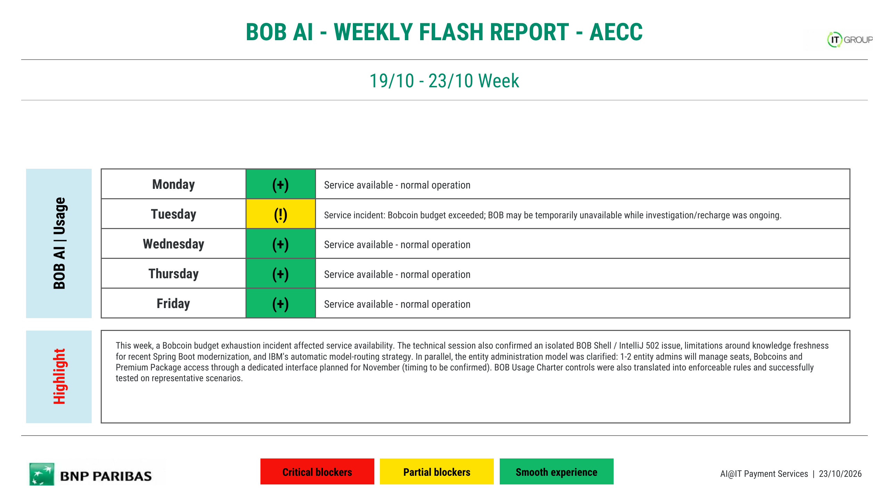
26/10 - 30/10 Week
(+)
Service available - normal operation
(!)
Service incident: BNP-wide Bobcoin allocation was exhausted, temporarily impacting BOB access; service was restored later the same day.
(+)
Service available - normal operation
(+)
Service available - normal operation
(+)
Service available - normal operation
This week, a BNP-level Bobcoin allocation incident temporarily affected BOB availability on Tuesday; service was restored later the same day. User feedback remained strongly positive on the local agent experience, especially for work beyond code generation (Git/branch operations, CI/package/Docker activities, documentation and automated review). A troubleshooting feedback also showed that restarting with a clean investigation plan and a fresh session produced the correct root cause after an initially poor answer. BOB is also being used in TDD workflows, while reusable Usage Charter rules and a Green IT skill are being tested. Skills governance, prompt-injection risk and context/token efficiency remain points to address.
AI@IT Payment Services | 30/10/2026

Slide 2
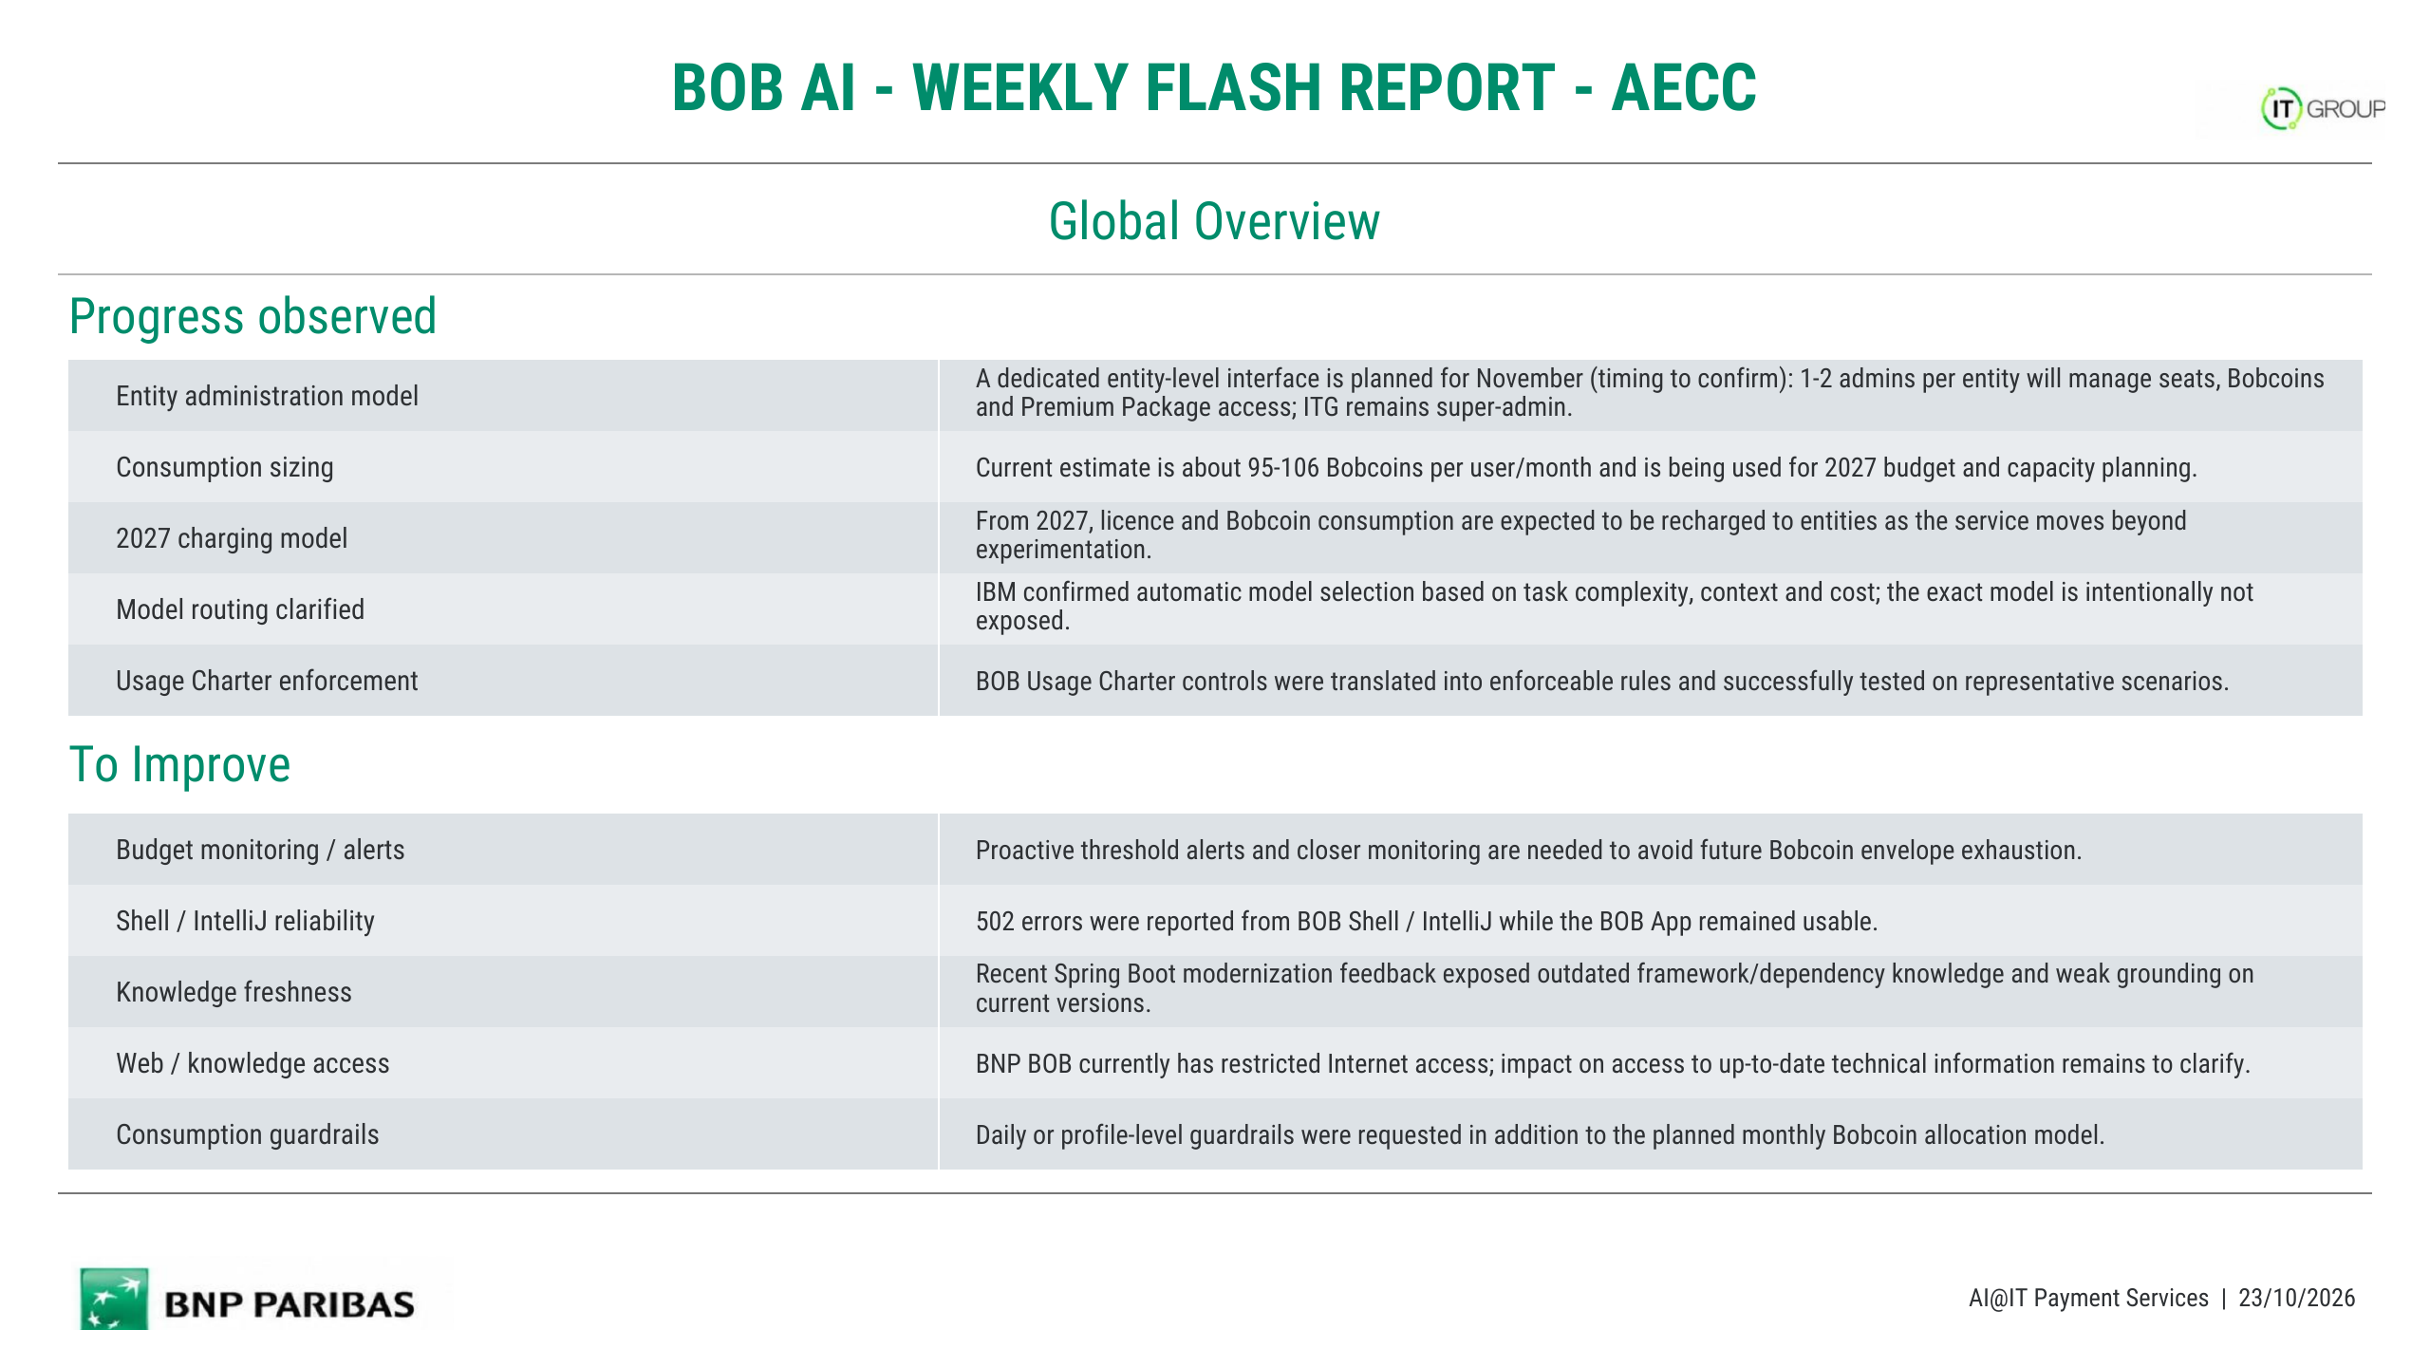
Local agent workflow
Users highlighted the local BOB agent as a key value: a fluid experience that supports tasks beyond code generation, including Git/branch work, CI/package/Docker activities and documentation.
Troubleshooting / context reset
One feedback showed that restarting with a clean investigation plan and a fresh session led to correct root-cause identification after an initially poor response.
TDD / automated reviews
BOB is being used in TDD-oriented implementation, starting from tests; automated review capabilities were also cited as useful.
Usage Charter rules
Usage Charter controls are being shared as reusable BOB rules to guide application-level/security checks and reduce risky data or URL exposure.
Green IT skill POC
Green IT rules are being transformed and tested as a BOB skill, with selective rule use based on the task context.
User experience feedback
Users described the BOB interface and local workflow as fluid and intuitive, with useful handling of broader project context.
Bobcoin global capacity
The BNP-wide Bobcoin allocation was exhausted on Tuesday, temporarily impacting BOB access; service was restored later the same day.
Shell / IntelliJ reliability
A 502 incident on the CLI / IntelliJ path was still reported as being under resolution and requires retesting once closed.
Model routing transparency
Users still lack visibility on which LLM is selected for a request and raised questions about the effective model pool used by BOB.
Skills governance / security
Reusable or external skills require validation and governance; prompt-injection and unsafe-skill risks were explicitly raised.
Context / token efficiency
Large rule sets or skills may increase context and token consumption; selective rule loading and compact instructions should be favored.
AI@IT Payment Services | 30/10/2026

Slide 3
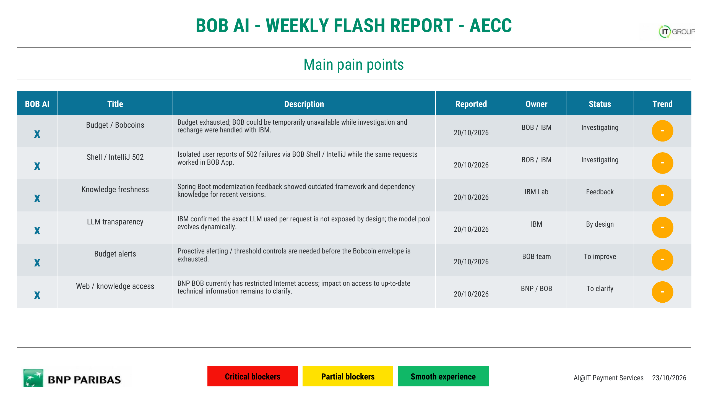
×
Budget / Bobcoins
BNP-wide Bobcoin allocation was exhausted, temporarily impacting BOB access; service was restored later the same day.
27/10/2026
BOB / IBM
Resolved
↑
×
Shell / IntelliJ 502
A 502 incident on the CLI / IntelliJ path was still reported as under resolution; retesting is needed after closure.
29/10/2026
BOB / IBM
Investigating
-
×
LLM routing transparency
Users still cannot clearly see which LLM is selected for each request and raised questions about the effective model pool being used.
29/10/2026
IBM / BOB
To clarify
-
×
Skills governance / security
Shared or external skills need a controlled validation/governance path; prompt-injection and unsafe-skill risks were raised.
29/10/2026
BNP / BOB
To define
-
×
Rule context / token cost
Large reusable rule sets may consume context and tokens; selective loading and compact rules should be assessed.
29/10/2026
Skill owners
To assess
-
×
Client version management
Users on older BOB versions may face usage blockers; keeping the client/plugin updated was recommended.
29/10/2026
Users / BOB
Preventive
↑
AI@IT Payment Services | 30/10/2026

