Slide 1
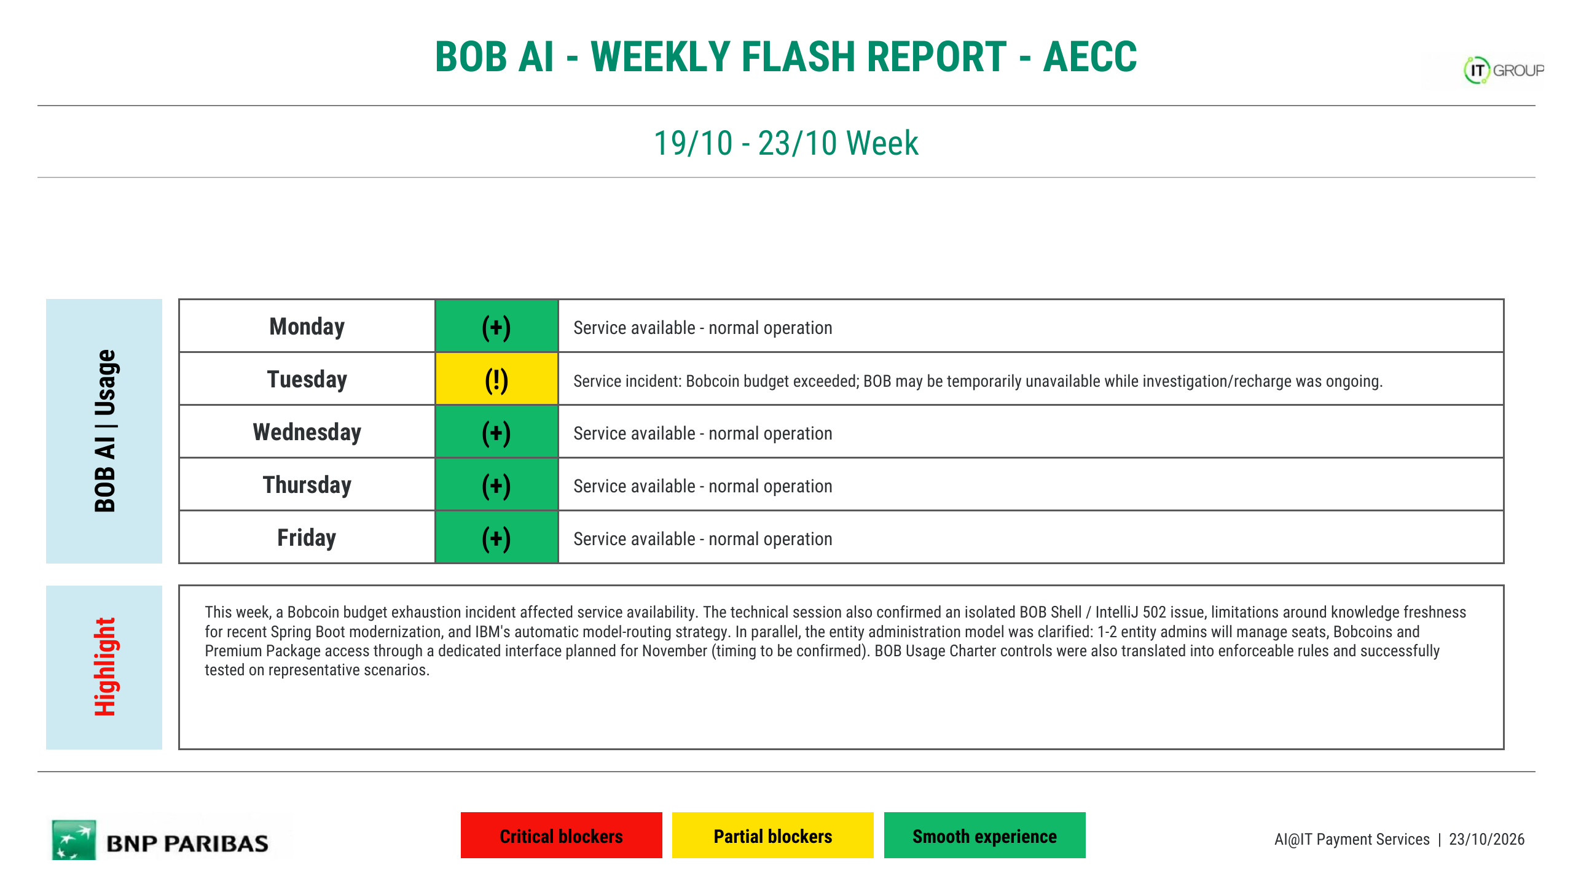
26/10 - 30/10 Week
Monday
(+)
Service available - normal operation
Tuesday
(!)
Service incident: Bobcoin budget exceeded again; BOB was temporarily unusable. A new Bobcoin batch was received at 14:40 and service was restored.
Wednesday
(+)
Service available - normal operation
Thursday
(+)
Service available - normal operation
Friday
(+)
Service available - normal operation
This week, BOB experienced another Bobcoin budget exhaustion incident on Tuesday. BOB became temporarily unusable while the team investigated the issue with IBM and waited for the expected replenishment. A new batch of Bobcoins was received at 14:40 and service was restored the same day. The recurrence of the issue reinforces the need for proactive budget monitoring, earlier replenishment and sufficient Bobcoin capacity to avoid repeated service interruptions.
AI@IT Payment Services | 30/10/2026

Slide 2
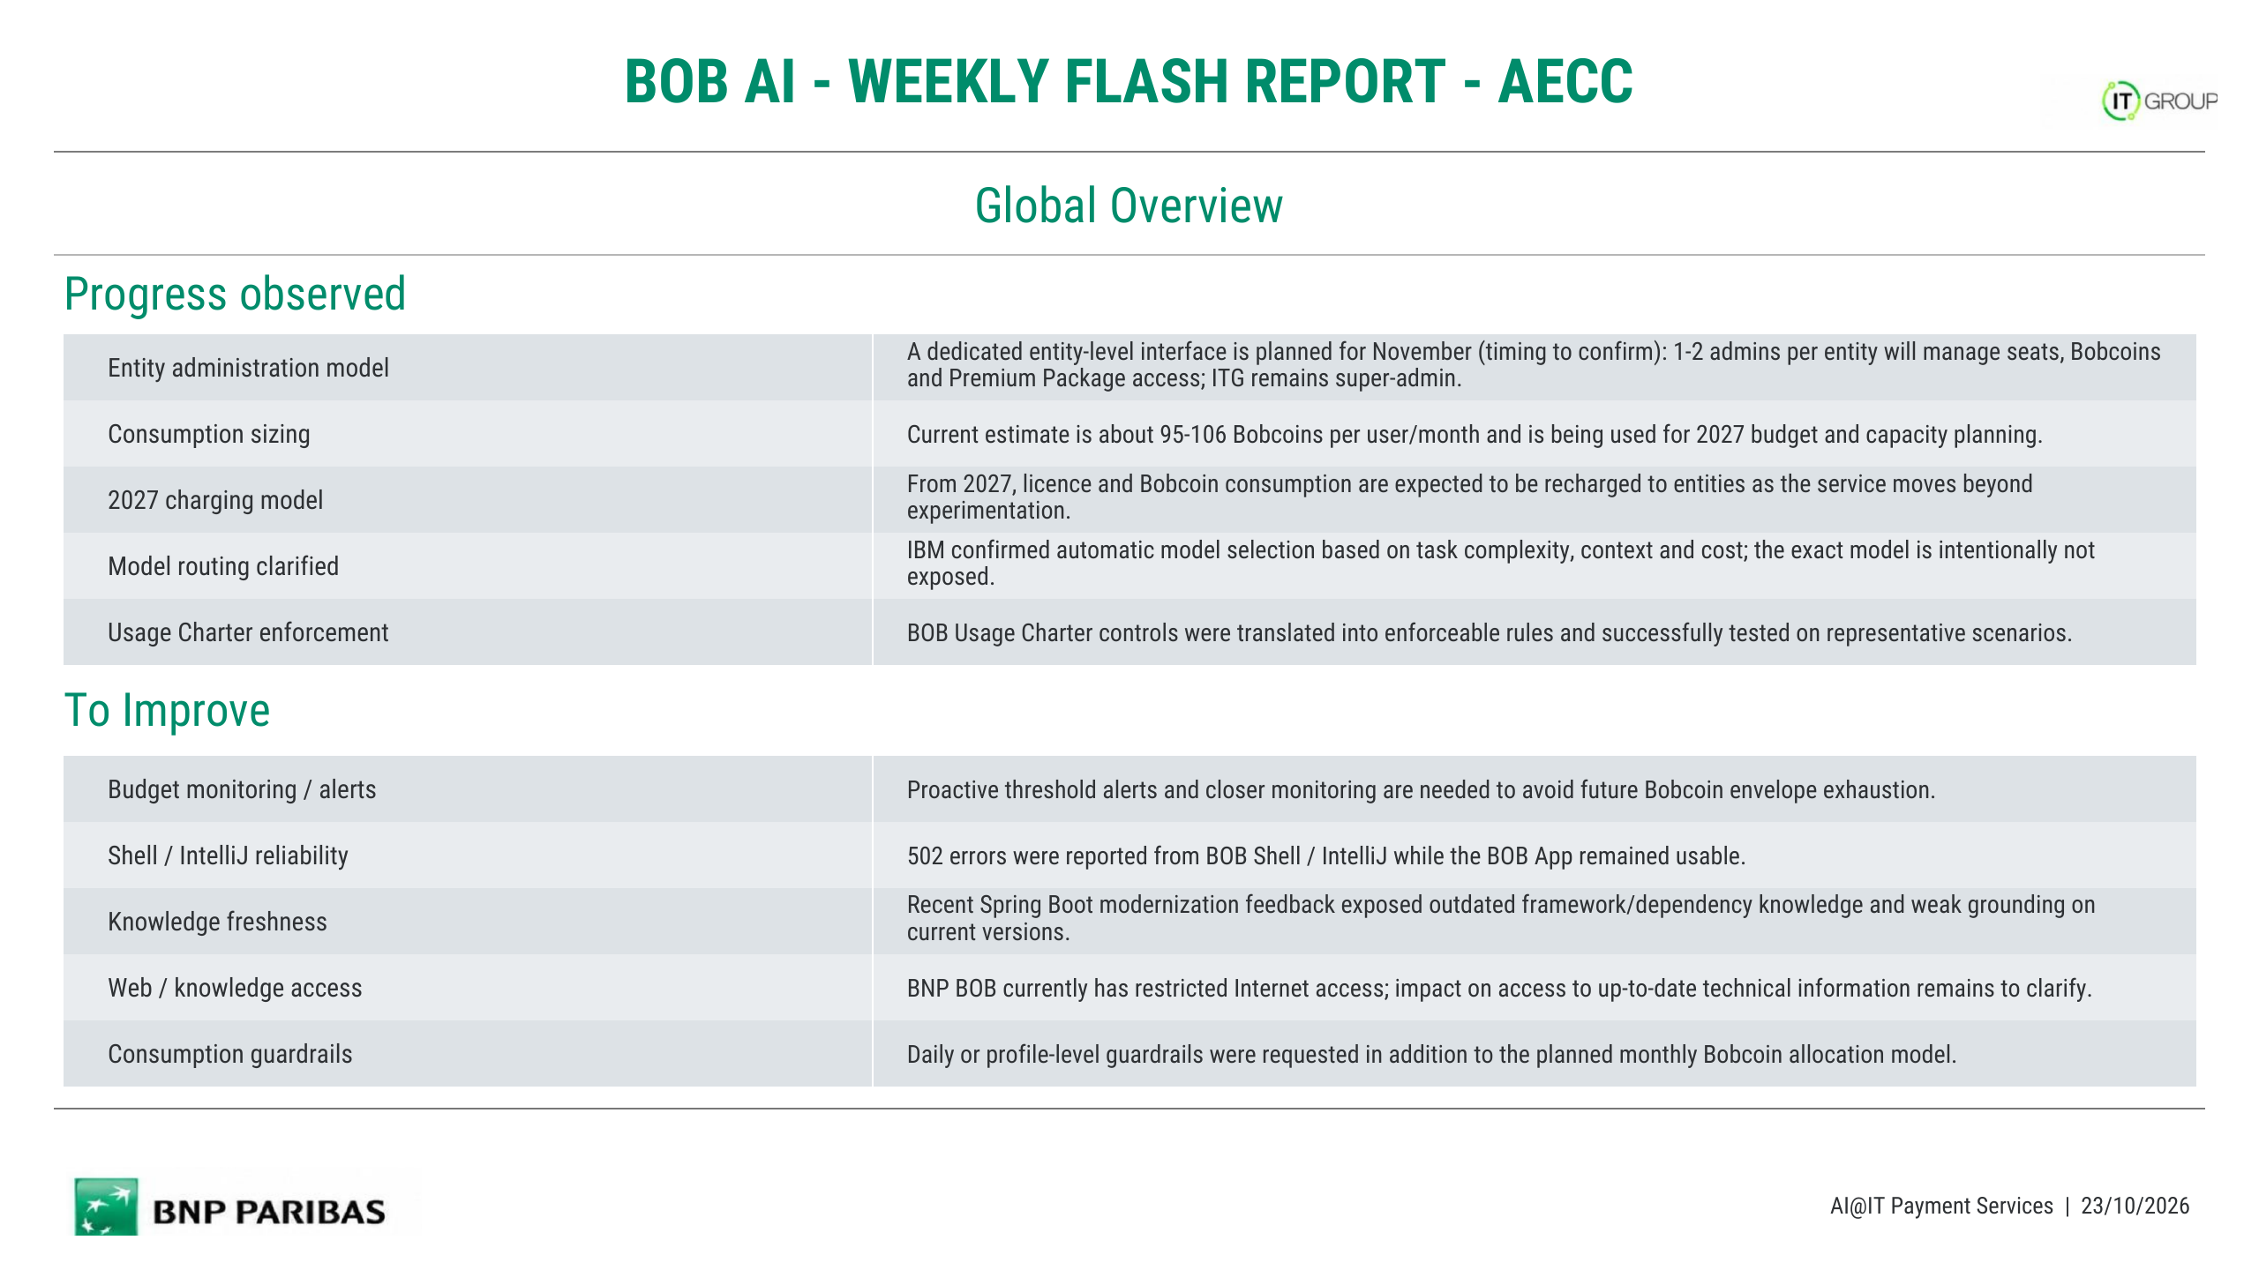
Same-day service recovery
BOB service was restored on Tuesday after a new batch of Bobcoins was received at 14:40.
Bobcoin replenishment
A new Bobcoin batch was received after the budget-exceeded incident, allowing users to resume normal usage.
IBM coordination
The team investigated the budget exhaustion issue with IBM while waiting for the planned Bobcoin replenishment.
BOB usage strategy
BOB usage positioning is still being defined according to user profiles, use cases, cost, security and data constraints.
2027 cost governance
Cost and consumption are being considered as key criteria for future BOB usage guidance and 2027 governance.
Recurrent budget exhaustion
The budget-exceeded issue occurred again, creating another service interruption within a short period.
Budget monitoring / alerts
Proactive thresholds and earlier alerts are needed before the available Bobcoin envelope is exhausted.
Replenishment timing / buffer
The new Bobcoins were expected in the morning, but BOB remained unusable until the replenishment arrived at 14:40.
Knowledge freshness
Recent framework and dependency changes can exceed the model's embedded knowledge, especially for fast-moving technologies.
Web / knowledge access
Web access is constrained by BNP network rules, and some public or official technical sources may remain unavailable.
AI@IT Payment Services | 30/10/2026

Slide 3
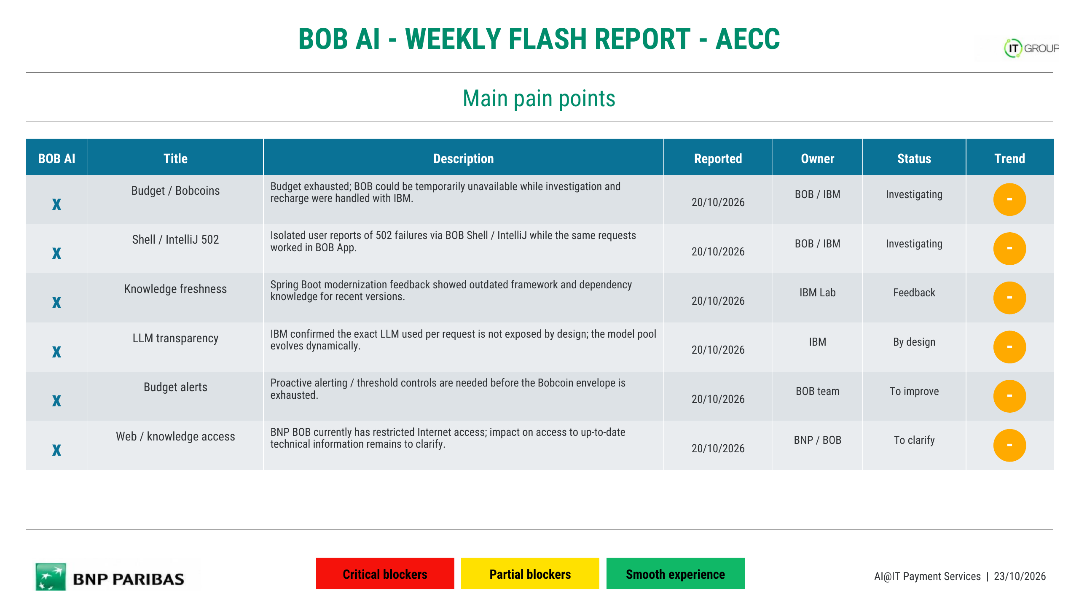
x
Budget / Bobcoins
Bobcoin budget was exceeded again on Tuesday, making BOB temporarily unusable until a new batch was received.
27/10/2026
BOB / IBM
Resolved
↑
x
Recurrent budget exhaustion
The same budget issue recurred within a short period, showing that the available envelope can still be exhausted unexpectedly.
27/10/2026
BOB / IBM
To improve
–
x
Replenishment timing
New Bobcoins were expected in the morning, but service remained unavailable until the replenishment arrived at 14:40.
27/10/2026
BOB / IBM
To improve
–
x
Budget alerts
Proactive alerting and threshold controls are still needed before the Bobcoin envelope is exhausted.
27/10/2026
BOB team
To improve
–
x
Knowledge freshness
Fast-moving framework and dependency versions can be newer than the model's embedded knowledge.
29/10/2026
IBM / BOB
Feedback
–
x
Web / knowledge access
BNP network restrictions can prevent access to some external technical sources required for very recent information.
29/10/2026
BNP / BOB
Constraint
–
AI@IT Payment Services | 30/10/2026

