Slide 1
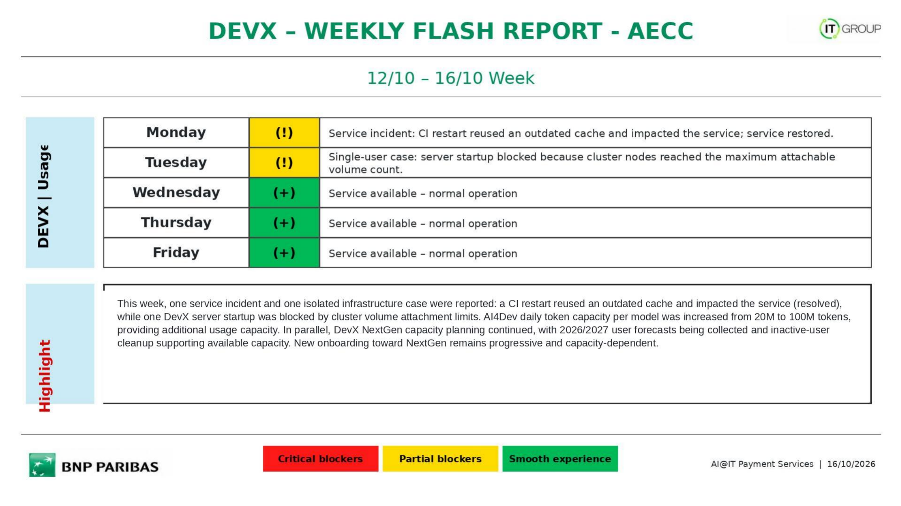
26/10 - 30/10 Week
(+)
Service available - normal operation
(!)
Service incident: strong adoption of the newly available GLM 5.3 caused a peak of concurrent usage and rate-limit errors; the rate limit was doubled.
(+)
Service available - normal operation
(+)
Service available - normal operation
(+)
Service available - normal operation
This week, GLM 5.3 became a key new model available in DevX Studio and quickly saw strong adoption. This high concurrent usage caused rate-limit errors on Tuesday; the GLM 5.3 rate limit was then doubled with LLMaaS and usage remains under monitoring. Qwen 3.8 is already running on the backend while the UI may still temporarily display 3.6. New model versions go through internal quality checks, test chains and sandbox validation before production availability. DevX Studio 5.3.2 with the PHP security fix is available from the marketplace.
AI@IT Payment Services | 30/10/2026

Slide 2
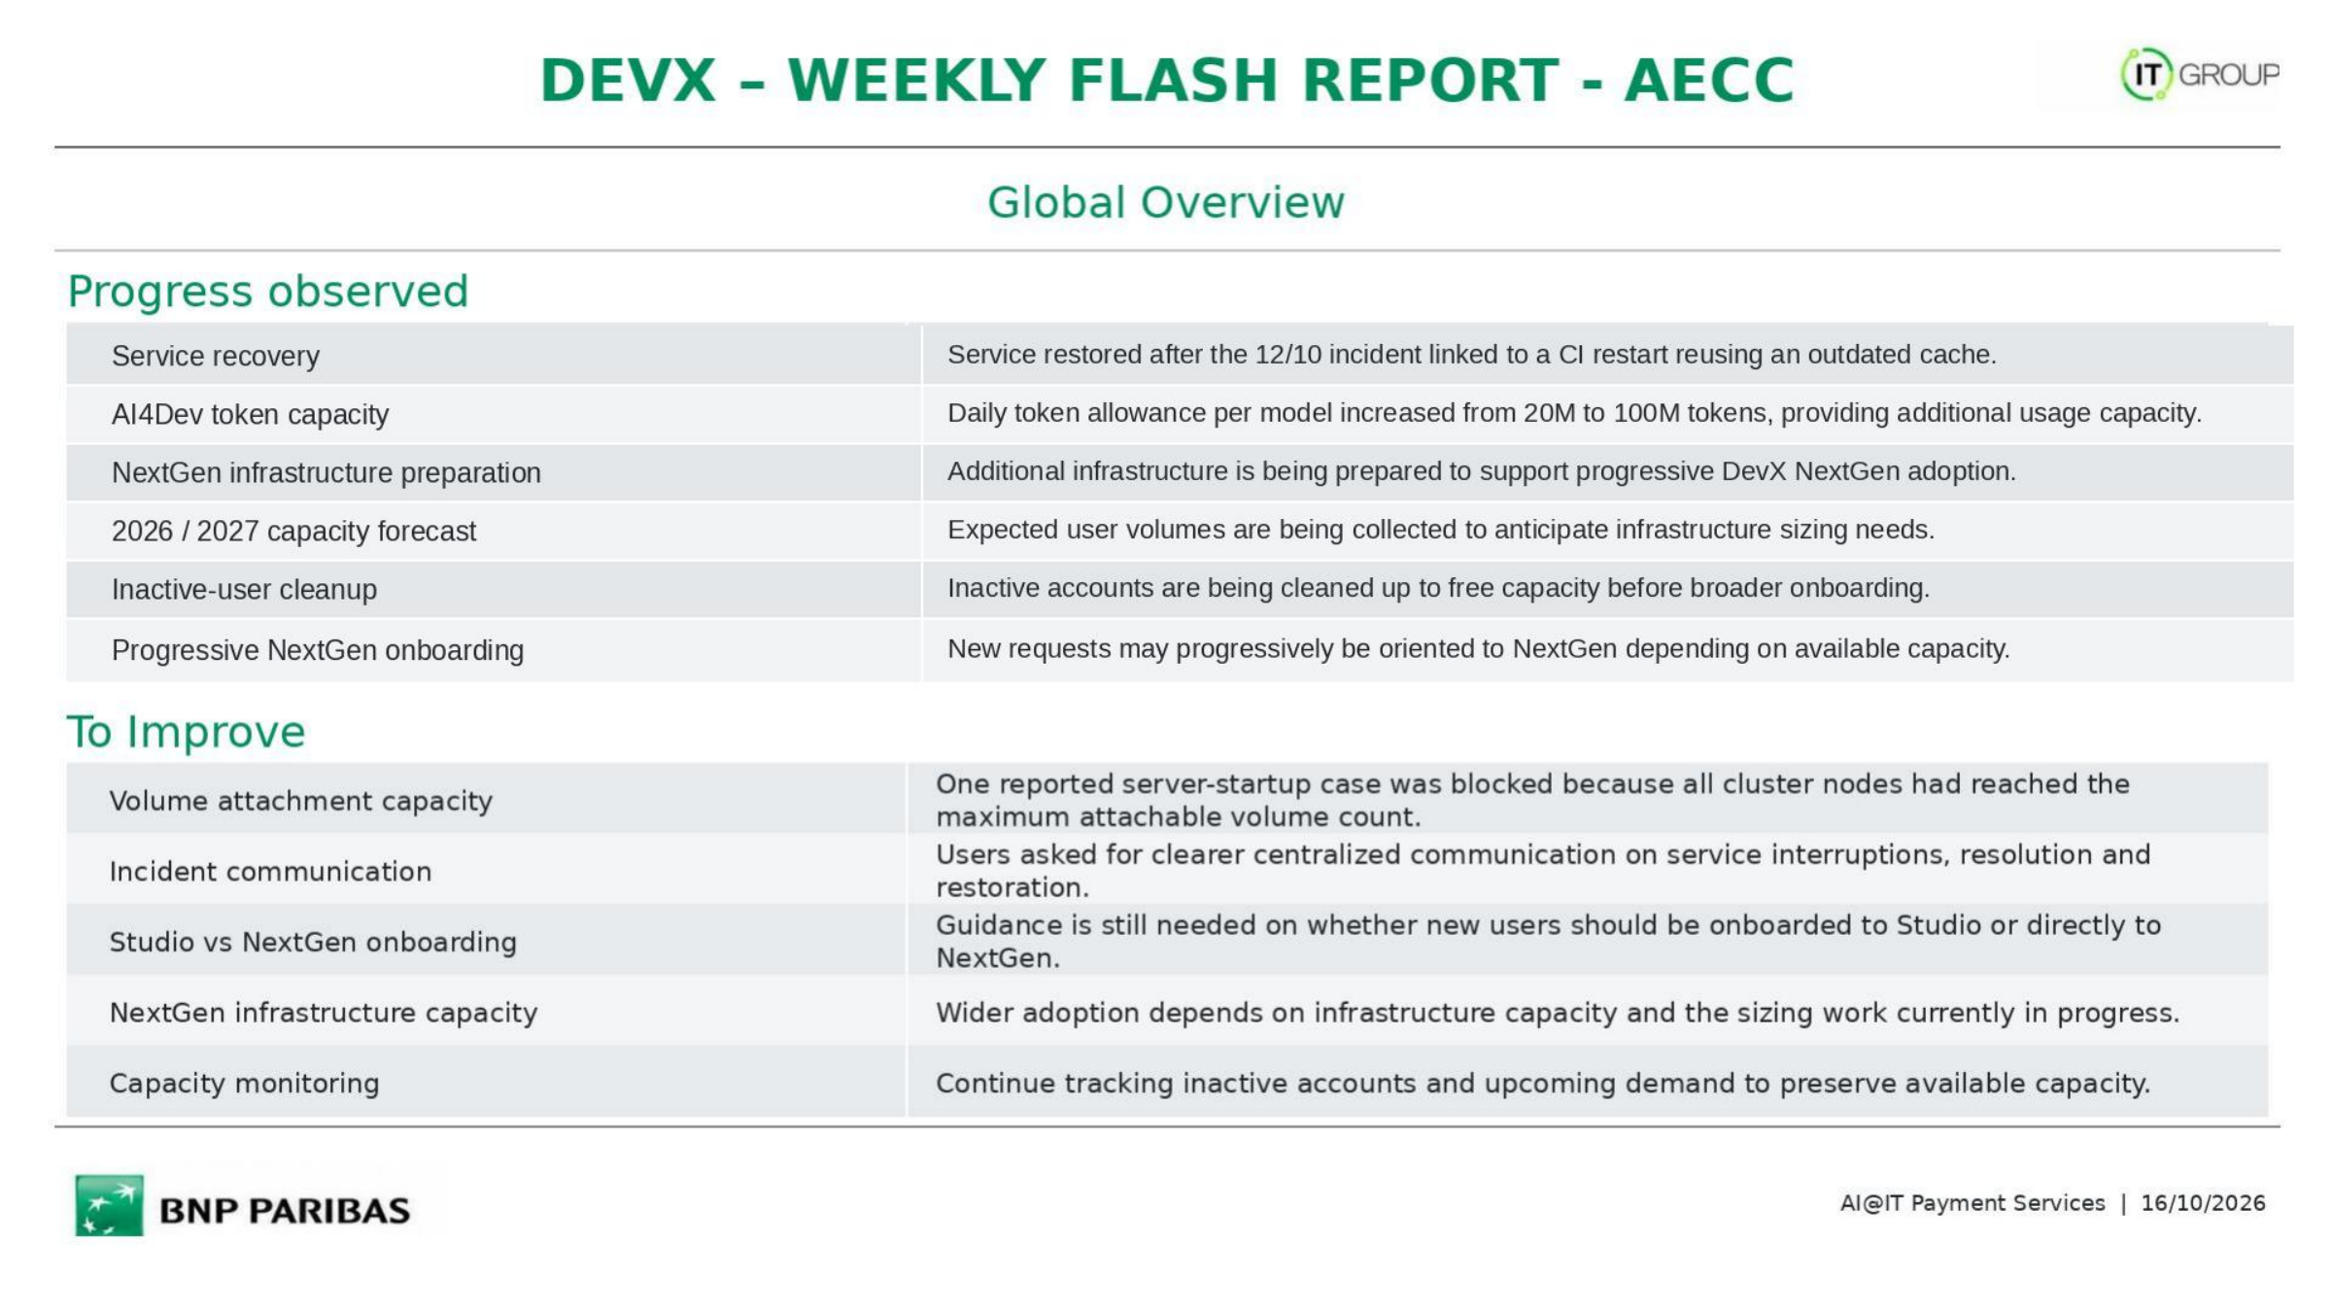
GLM 5.3 availability
GLM 5.3 is now available in DevX Studio and has seen strong adoption since its introduction.
GLM 5.3 capacity adjustment
Following a peak of concurrent usage driven by strong GLM 5.3 adoption, rate-limit errors were observed and the limit was doubled with LLMaaS.
Qwen backend update
Qwen 3.8 is already active on the backend, while the UI label may still temporarily display version 3.6.
Model qualification process
New model versions pass internal quality/code evaluation, test chains and sandbox validation before production availability.
Security fix release
DevX Studio 5.3.2 was released with a fix for the recently identified PHP vulnerability; update/redeploy is required to benefit from it.
Model naming evolution
A more generic model naming approach was discussed so an alias can point to the latest validated version.
Knowledge freshness
Recent framework/dependency versions can exceed the model’s embedded knowledge; this was raised during Spring Boot modernization feedback.
Recent technical context
For very recent topics, current documentation or repository context may need to be provided directly to the model.
External documentation access
BNP network/security restrictions can limit access to some public technical sources needed for up-to-date information.
UI/backend version visibility
The model version displayed in the UI should stay aligned with the effective backend version to avoid confusion.
Peak-usage monitoring
Popular models such as GLM 5.3 need continued monitoring and timely capacity adjustment during peaks.
AI@IT Payment Services | 30/10/2026

Slide 3
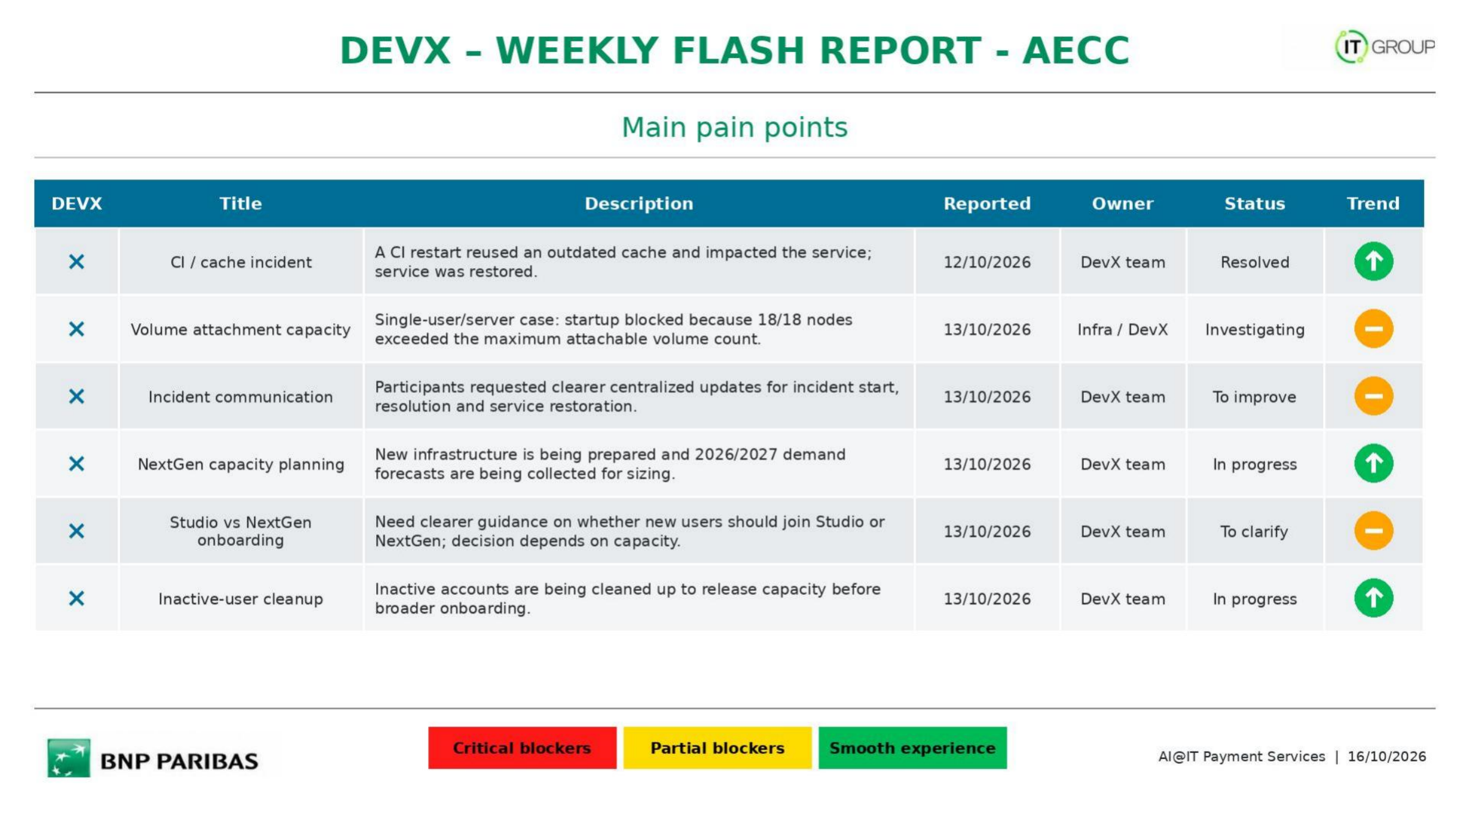
×
Security fix deployment
DevX Studio 5.3.2 contains the PHP security fix; users must update or redeploy from the marketplace to benefit from it.
26/10/2026
DevX Studio Team
Action required
–
×
GLM 5.3 rate limiting
Strong adoption of GLM 5.3 caused a peak of concurrent usage and rate-limit errors; the limit was doubled and monitoring continues.
27/10/2026
DevX / LLMaaS
Mitigated
↑
×
Qwen version display mismatch
The backend runs Qwen 3.8 while the UI may still display 3.6 until the display/naming update is completed.
29/10/2026
—
To correct
–
×
Knowledge freshness
Recent Spring Boot modernization feedback showed that embedded model knowledge can lag behind fast-moving framework versions.
29/10/2026
—
Feedback
–
×
Web / knowledge access
BNP network restrictions can block some public technical sources, limiting access to very recent documentation.
29/10/2026
—
Constraint
–
×
Model release validation
New model versions require internal evaluation, test chains and sandbox validation before production availability.
29/10/2026
—
By design
–
AI@IT Payment Services | 30/10/2026

