Slide 1
Introduction to Artificial Neural Networks

Slide 2
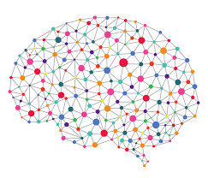
Brain → A highly complex, non-linear parallel computer.
Structural Constituents → “neurons”
Notes:
The subject of Artificial Neural Networks has matured to a great extent over the past few years.
Especially, with the advent of very high performance computing, the subject has assumed a tremendous significance and has got very big application potential in the recent years.
Neurons → nerve cells

Slide 3
ICs Nanosecond → 10⁻⁹ sec
Human brain (in milliseonds) → 10⁻³ sec
How is it that the neural processing within the human brain happens to be much faster than that of today’s computer?
The network of human neurons in the brain is massively parallel.
10 billion “neurons”
60 trillions of interconnections
Notes:
When we see a person, may be 5 years later, we recognize him/her instantly.
How is it possible in the human brain?
Is it that the computational capability of our brain quite different from the way a computer is doing?
If we try to think in terms of the processing speed, we’ll be getting a different type of result.
Today’s silicon ICs’ response time is measured in nanoseconds.
But if we look at the processing speed of a human neuron, that may be 5 – 6 order slower that of a typical IC.

Slide 4
Is it possible to realize that speed using the computer software?
It is not that EASY!!!
Notes:
Even in the age of parallel computers we cannot really think of putting so many processing units and realizing it in a massively parallel scheme.

Slide 5
All that we can do within our limitations is that we can interconnect our network of processors. Also, rather than considering the structure of the human brain in totality, we can only try to mimic a VERY SMALL PART of it in order to do some very specific task.
We can make neurons, but that is surely going to be different from the biological neurons that we have talked over.

Slide 6
Artificial Neural Networks (ANN)
Usefulness and Capabilities
Non-linearity
We’ve an interconnection of non-linear neurons
Non-linearity is distributed throughout.
Input-Output Mapping
Learning “with” a teacher
3. Adaptivity
Can adapt the free parameters to the changes in the surrounding environment
4. Evidential Response
Decision with a measure of confidence
Notes:
POINT-1
If there is a system where we give a set of inputs and we expect some output out of it, in that case we call the system to be linear.
If the relation between the output and the input can be best described in terms of a simple linear equation (e.g., if there 4 inputs and 1 output, then if the output is a linear combination of all the 4 inputs, then naturally the system is linear).
Whereas, if we can write the output only in terms of not only the linear terms, but also it’s higher-order terms, in that case the system is called non-linear.
Most of the real life problems are highly non-linear in nature.
Neurons are non-linear.
POINT-2
We’ll provide some input to the system, and in response we’re going to get some output.
We can go in for a learning mechanism where a teacher is involved. In this case, we feed the inputs and we also say what the expected output is going to be.
In other words, we’re specifying that for a given input, what is going to be the output (or the desired response).
It is possible that our computational unit that we’re having is not able to achieve the desired output.
If our system has got a set of free parameters, then we can actually modify them such that for a given set of inputs, we can obtain the output that is closest to our desired output. In that case, we may not be able to achieve that immediately.
First time we feed a pattern, our system doesn’t know about it, and the actual output will be different. So, the difference that exists between the actual output and the desired output, adjusts the parameters of the system such that the difference between the actual and the desired is minimized.
And that we may have to do several times.
So, there is a process of learning and this learning involves a teacher. There is a teacher who says that corresponding to this input, this is what the output should be. And if it is not, then the teacher is asking you to adjust the free parameters (which are available in the system) so that next you feed the same input, you can get an output which should be closer to that of the desired.
There may be some times where we have to learn without a teacher also (may be from simple associations).
E.g. – a child is born with a brain and that brain has got a massive interconnection of neural processing units. But a child has to develop with a process of learning. A child sees so any new things and learns through some process of association. A child learns to distinguish between a cat and a dog although both are 4-legged animals. The child may do mistakes initially, but his/her parents are there to rectify. With time, after seeing more no. of cats and dogs, the child knows the specific characteristics that differentiates a dog from a cat.
Many a times the child also learns from his own mistakes.
Thus, we have 2 types of learning:-
With a teacher
Without a teacher
POINT-3
We definitely have to go through the process of learning throughout our life in some sense or the other.
The world that was there during our childhood is not the same world that we’re seeing today. Many changes have taken place.
Still we’re able to cope up with this world. Now how is it so?
We can adapt ourselves by doing some internal adjustments.
POINT-4
We can always say that “Yes, I think it can happen that way”. We’re associating a confidence with the decision.

Slide 7
Artificial Neural Networks (ANN)
Usefulness and Capabilities
Fault Tolerance
Graceful degradation
6. VLSI implementability
7. Neuro-biological Analogy
Notes:
POINT-5
What happens when one particular nerve cell is malfunctioning or one connection between two particular nerve cells are simply not working?
Will our entire nervous system collapse due to that? NO.
We can still carry on with our day-to-day work.
If too many nerve cells get affected, it will have some effect of it.
Unless we purposefully buil in a fault tolerance system into the computer system, the entire computer sytem or the network can collapse.
With biological neurons, it leads some to some kind of degradation in performance.
The biological neural network is highly fault tolerant.
It is possible to incorporate this kind of fult tolerance in the case of artificial neural networks also.
POINT-6
With very large scale integradted circuits, it is possible to integrate a large no. of neurons together.
Naturally we cannot think of integrating 10 million neurons. If we could do that, then we could have mimicked the humar brain completely.
POINT-7
Everything was motivated by the biological neural network systems.

Slide 8
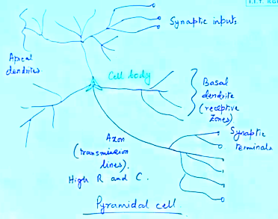
Notes:
The pyramidal cells as shown here can receive synaptic inputs from other neurons and carries the signals to the cell body (where the processing part will be done). The signals will be combined according to the strengths of the connections. Now, all the connections are not of the same strength. Some connections are very strong and some connections are weak.
The strength of the synaptic connections will decide what is the net signal that will come to the cell body as net input. That will ultimately decide what the response is going to be. The response will be transmitted through the synaptic terminals to the other neurons.
The free parameters refer to the strengths of the synapses.
If the actual response differs from the desired one, we’ve to adjust the internal parameters (the strengths of the synaptic connections). We now alter the connections strengths and then feed the same inputs and find out what the output is going to be.
This time we may be closer to that of the desired output.
This process coud go on alternatively till the actual response is close to that of the desired response.
The synaptic strengths are dictating what the signal strengths are going to be and are thus acting as free parameters to our biological nerve cell processing.
In the Artificial Neural Network we should be building up some electrical equivalent of such synaptic stregths.

Slide 9
Biological Model
x₁
w₁
w₂
∑
x₂
w_{n}
x_{n}
Net signal
x₁w₁ + x₂w₂ + … + x_{n}w_{n}
This is a linear summation.
But we want some decision out of it (which is more quantifiable).
Notes:
In an equivalent electrical model we can represent a neuron (or, nerve cell) as given.
w₁, w₂, w₃, … w_{n} → connection strengths
x₁, x₂, x₃, …,x_{n} → input sgnal

Slide 10
Equivalent Electrical Model
x₁
w₁
Non-linear unit
w₂
∑
x₂
w_{n}
x_{n}
Net signal
x₁w₁ + x₂w₂ + … + x_{n}w_{n}
Notes:
If the output, after adding the non-linear unit, doe match with our desired output, then we must change the signal stregnths (w₁, w₂, …, w_{n}) keeping the inputs same.

Slide 11
Introduction to Artificial Neural Networks

Slide 12
Artificial Neural Network (ANN) uses the processing of the brain as a basis to develop algorithms that can be used to model complex patterns and prediction problems.

Slide 13
What is an ANN?
An Artificial Neural Network (ANN) is a mathematical model that tries to simulate the structure and functionalities of biological neural networks.
Basic building block of every artificial neural network is artificial neuron, i.e., a simple mathematical model (function).
Notes:
Neurons → nerve cells

Slide 14
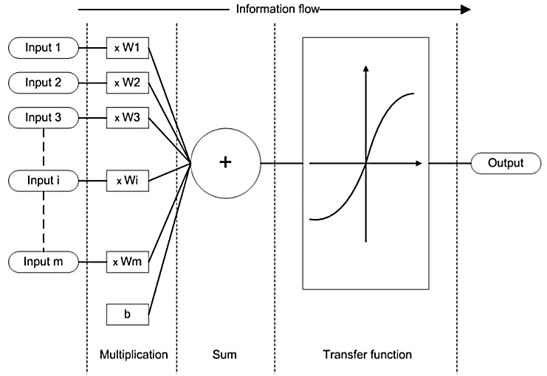
Working Principle of an Artificial Neuron
Notes:
Such a model has 3 simple sets of rules:
multiplication,
summation and
activation.
At the entrance of artificial neuron the inputs are weighted what means that every input value is multiplied with individual weight.
In the middle section of artificial neuron is sum function that sums all weighted inputs and bias.
At the exit of artificial neuron the sum of previously weighted inputs and bias is passing through activation function (also called transfer function).

Slide 15
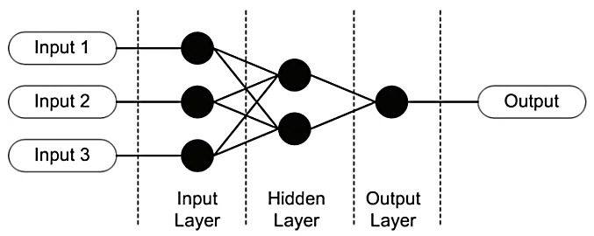
Example of Simple Artificial Neural Network
Notes:
Although the working principles and simple set of rules of artificial neuron looks like nothing special the full potential and calculation power of these models come to life when we start to interconnect them into artificial neural networks.

Slide 16
Researchers have come up with several “standardised” topographies of artificial neural networks.
help us with easier, faster and more efficient problem solving.
Different types of artificial neural network topographies are suited for solving different types of problems.

Slide 17
Teach the ANN in solving the type of given problem.
Just as biological neural networks can learn their behaviour/responses on the basis of inputs that they get from their environment, the artificial neural networks can do the same.
Major learning paradigms:
Supervised learning
Unsupervised learning
Reinforcement learning
Notes:
We choose learning paradigm similar as we chose artificial neuron network topography - based on the problem we are trying to solve. Although learning paradigms are different in their principles they all have one thing in common; on the basis of “learning data” and “learning rules” (chosen cost function) artificial neural network is trying to achieve proper output response in accordance to input signals.

Slide 18
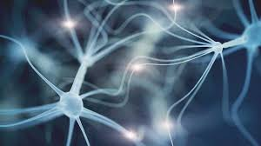
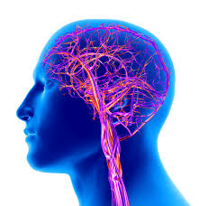
In our brain, there are billions of cells called neurons, which processes information in the form of electric signals. External information/stimuli is received by the dendrites of the neuron, processed in the neuron cell body, converted to an output and passed through the Axon to the next neuron. The next neuron can choose to either accept it or reject it depending on the strength of the signal.

Slide 19
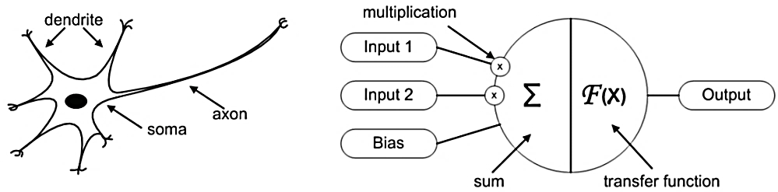
Biological and Artificial Neuron Design
Information comes into the neuron via dendrite, soma processes the information and passes it on via axon.
Information comes into the body of an artificial neuron via inputs that are weighted (each input can be individually multiplied with a weight). The body then sums the weighted inputs, bias and “processes” the sum with a transfer function. At the end an artificial neuron passes the processed information via output(s).

Slide 20
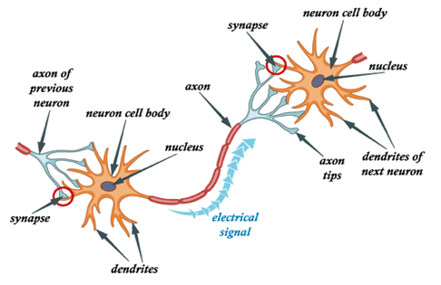
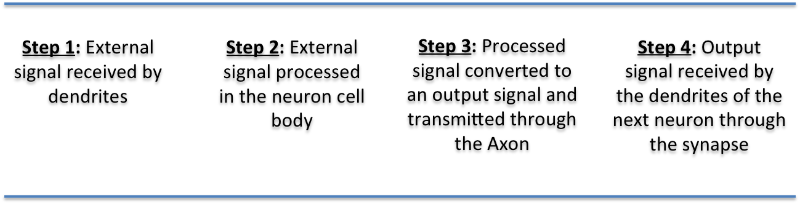

Slide 21
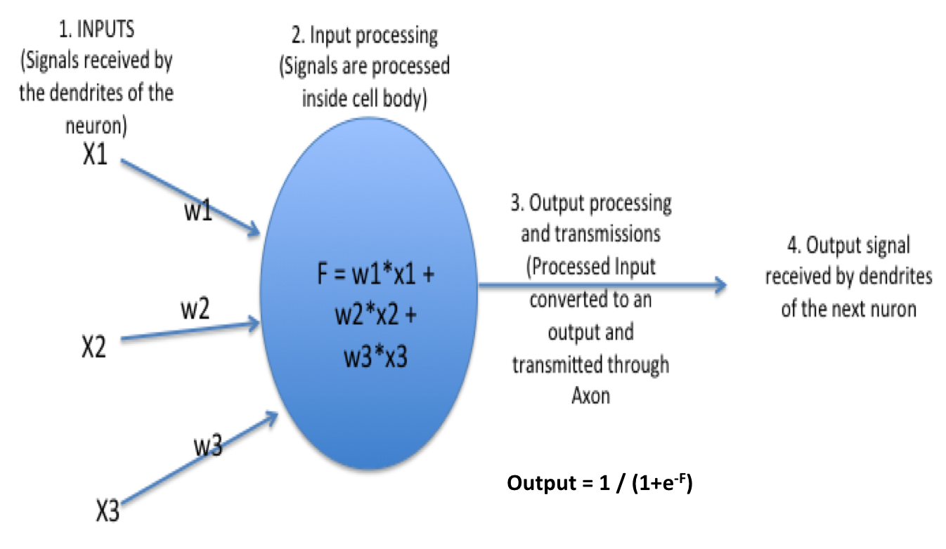
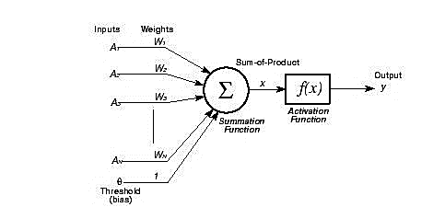
How an ANN work?
w1, w2, w3 gives the strength of the input signals

Slide 22
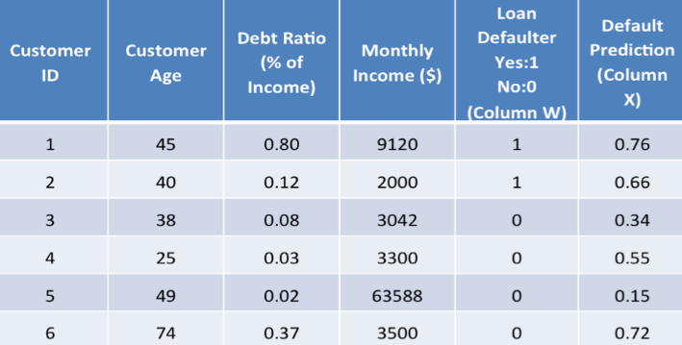
A Simple Example
A bank wants to assess whether to approve a loan application to a customer. So, it wants to predict whether a customer is likely to default on the loan.
It has data like below:
So, we have to predict Column X. A prediction closer to 1 indicates that the customer has more chances to default.

Slide 23
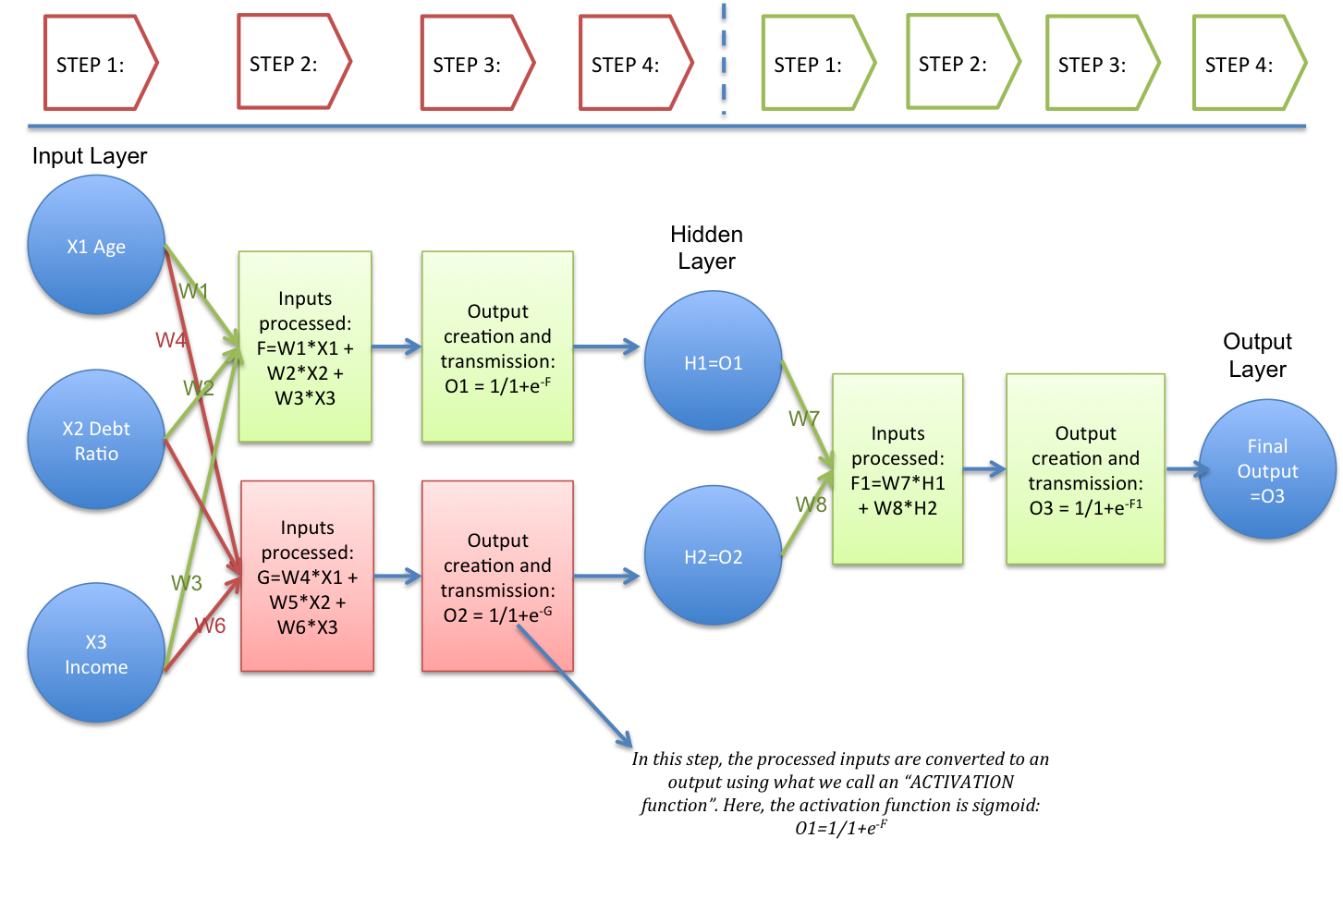
Lets try to create an Artificial Neural Network architecture loosely based on the structure of a neuron using this example:

Slide 24
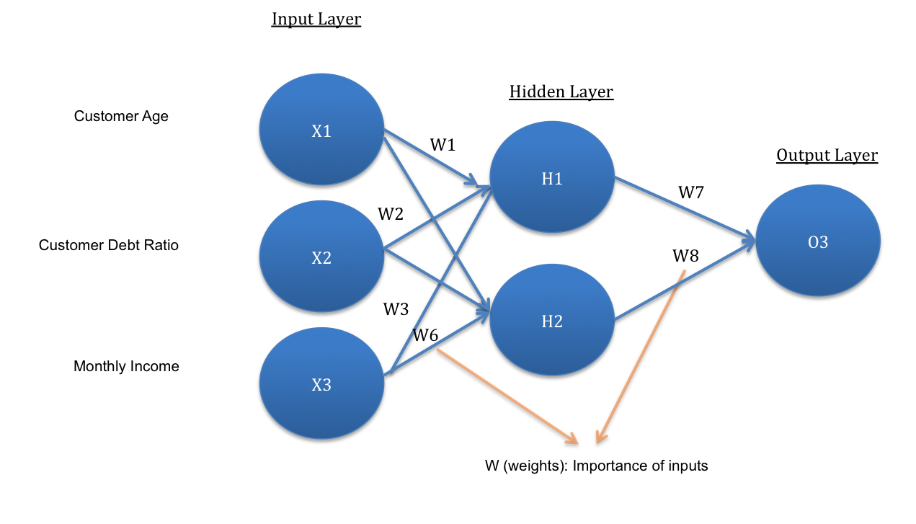
Notes:
Key Points related to the architecture:
The network architecture has an input layer, hidden layer (there can be more than 1) and the output layer. It is also called MLP (Multi Layer Perceptron) because of the multiple layers.
The hidden layer can be seen as a “distillation layer” that distills some of the important patterns from the inputs and passes it onto the next layer to see. It makes the network faster and efficient by identifying only the important information from the inputs leaving out the redundant information.
The activation function serves two notable purposes:-
It captures non-linear relationship between the inputs
It helps convert the input into a more useful output.
In the above example, the activation function used is sigmoid:
O1 = 1 / (1+exp(-F))
(where F = W1*X1 + W2*X2 + W3*X3)
[Sigmoid activation function creates an output with values between 0 and 1. There can be other activation functions like Tanh, softmax and RELU.]
Similarly, the hidden layer leads to the final prediction at the output layer:
O3 = 1 / (1+exp(-F 1))
(where F 1= W7*H1 + W8*H2)
[Here, the output value (O3) is between 0 and 1. A value closer to 1 (e.g. 0.75) indicates that there is a higher indication of customer defaulting.]
The weights W are the importance associated with the inputs. If W1 is 0.56 and W2 is 0.92, then there is higher importance attached to X2: Debt Ratio than X1: Age, in predicting H1.
The above network architecture is called “feed-forward network”, as you can see that input signals are flowing in only one direction (from inputs to outputs). We can also create “feedback networks” where signals flow in both directions.

Slide 25
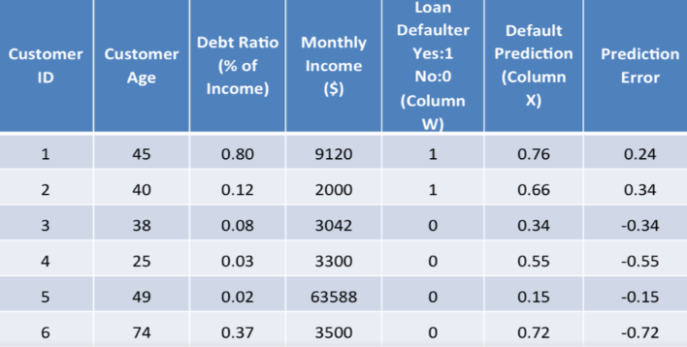
A good model with high accuracy gives predictions that are very close to the actual values.
So, in the table below, Column X values should be very close to Column W values. The error in prediction is the difference between column W and column X:

Slide 26

How To Train A Neural Network In Python
Deep learning uses neural networks to build sophisticated models.
The basic building blocks of these neural networks are called “neurons”.
When a neuron is trained to act like a simple classifier, we call it “perceptron”.
A neural network consists of a lot of perceptrons interconnected with each other.

Slide 27
Let’s say we have a bunch of inputs and the corresponding desired outputs.
The goal of deep learning is to train this neural network so that the system outputs the right value for the given set of inputs.
This process basically involves tuning each neuron in the network until it behaves a certain way.
So what exactly is this perceptron?
How do we train it in Python?

Slide 28
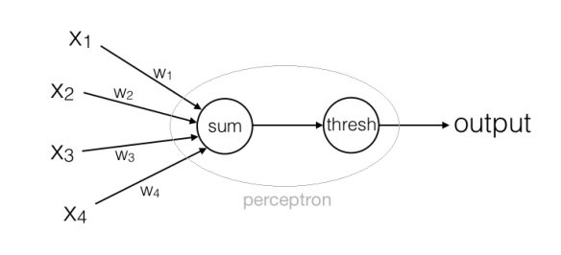
What is a Perceptron?
A perceptron basically takes a bunch of inputs and produces a binary output.
These inputs can be weighted depending on the problem at hand.
If the output exceeds a certain threshold value, it becomes 1. If not, the output becomes 0.

Slide 29
What is an ANN?
Output
weighted sum = w₁*x₁ + w₂*x₂ + w₃*x₃ + w₄*x₄
(a real number)
Now once we set the threshold, the rule would be:
output = 1 if weighted sum > threshold
output = 0 if weighted sum <= threshold

Slide 30
How do we use it?
We can train a perceptron so that it behaves in a specific way.
Let’s say we have defined a problem. This means that the inputs and outputs are fixed. We have some inputs which we cannot control, and we desire certain outputs which are dictated by the problem definition.
So given this situation, the only things we can control are the weights and the threshold. We can keep changing the weights and the threshold until we get what we want.
In machine learning lingo, this process is called “training”.

Slide 31
Example
Suppose that you are considering buying a new car right now. For the sake of argument, let’s say that it depends on only 4 factors – price of the car, ease of public transport, your driving skills, and the model of the car. This decision making process can be modeled as a perceptron. Those 4 factors can be the inputs and the output is a yes/no decision. In this input list, you can see that some factors are more important than the others. For example, the price is a crucial factor, so you want to give that the highest priority. This means that the corresponding weight for this input should be higher as compared to others. You might not be so concerned about your driving skills because you are fairly confident about driving a car well. The corresponding weight for this input should be relatively lower. You can keep modifying the weights until you hit the sweet spot.
You can do something similar for the threshold as well. If you increase it, it means that you want all the factors to work for you. If the threshold is high, then the weighted sum might not hit that value unless everything is optimal. This means you are biasing your decision towards not buying the car. If you decrease it, it means that you are training your perceptron to favor the car-buying decision.
simple_neural_network.ipynb

Slide 32
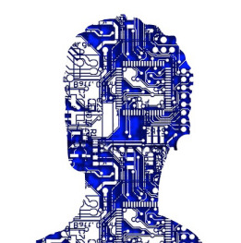
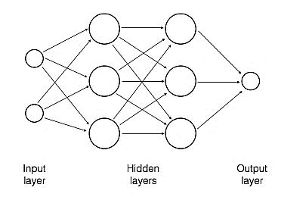
What is a Multilayer Neural Network?
A Multilayer Neural Network consists of multiple layers and each layer consists of many perceptrons, and it is much better at classifying data that a single perceptron.
Notes:
As we can see here, this network consists of one input layer, two hidden layers, and one output layer.
The hidden layers are not exactly “hidden”, it’s just the nomenclature.
Any layer that’s not input or output is called “hidden”.
Each perceptron in the 1st layer takes all the inputs and makes a decision.
The perceptrons in the next layer take the outputs of these perceptrons in the 1st layer and take decisions.
Similarly, the perceptron in the output layer takes a decision based on the outputs of the perceptrons in the 2nd hidden layer to get the final result.

Slide 33
How do we train a Multilayer Neural Network?
When we say we want to “train” a perceptron, we basically want to find out the right set of weights and the threshold (also known as bias) that will produce the desired output.
When we want to train a neural network with many perceptrons, we need to tune the weights and biases for all the perceptrons until we get the desired result.

