Slide 1



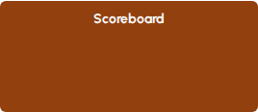


Testbench Hierarchy
top_module
uvm_test
FIFO_env
FIFO_agent
Seq Items
Virtual
Interface
Virtual
Interface
FIFO Interface

