Slide 1

CLISOL
A step to unite and to Change

Slide 2
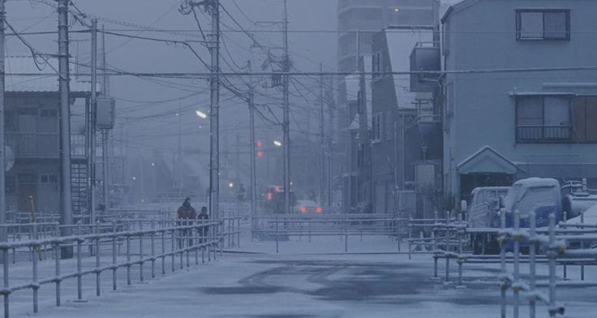
Problem Statement :
In Recent years we have seen a variety of climate changes brought on by numerous sources. The current generation is eager to act to fend off these changes, but they frequently lack a clear plan of action for how to proceed. They do not sometimes have a united front and necessary information they need.

Slide 3

Overview
The urgent crisis of climate change is the focus of our website. We provide a platform on which people and NGOs will be united. Users sign in and access petitions to have awareness about climate degradation, organize and promote cleanup actions in their communities through discussion rooms , and share their creative solutions for halting climate change. We offer strategies from well-known environmental conservation groups, a thorough schedule of worldwide environmental events and campaigns, and discussion groups where users can have fruitful exchanges to organise their own events locally or globally. Additionally, get daily updates on environmental news to keep informed. Come work with us to fight climate change and create a sustainable future.

Slide 4

Market Prospects:
As more people become concerned about the environment, there is a growing potential user base for an app like CliSol .
Many individuals are actively seeking ways to get involved in environmental activism and CliSol
can tap into this trend by providing a platform.
People are increasingly interested in making a difference in their own communities. CliSol's feature that helps users find and join local clean-up activities aligns with this trend.
Building partnerships with NGOs and environmental organizations is mutually beneficial.

Slide 5

Future Scope :
The Climate is changing and the world is not blind to not see it. We see it everyday from the moment we wake-up to the moment we rest our brain to slumber. People are starting to realise the change and are growing restless knowing they have to do something, ‘WE have to do something’ and then to ‘I have to do something’. With this ideal in the society there is no better time than Now
-> People will be needing more suitable platform for all kinds of updates and a united front where they can find everything regarding the Climate changes.
-> More Corporate companies are starting to engage with the CSR and that would be a greater boon.
->Climate Change is always a need to be addressed and will always be a Global priority.

Slide 6

*Data Analytics and Reporting:*
- Analytics tools and performance reports.
*Search and Navigation:*
- Powerful search and intuitive navigation.
*Interactive Features:*
- Submission forms and real-time chat.
*API Integration:*
- Connection with external data sources.
*Scalability and Performance:*
- Load balancing and CDN.
*Security and Privacy:*
- Data encryption and compliance.
*Mobile Apps (Optional):*
- iOS and Android apps.
*Monitoring and Maintenance:*
- Regular updates and monitoring.
*Backup and Disaster Recovery:*
- Automated backups and recovery plan.
Technical Overview
(GUI using Python)
*Infrastructure:*
- Reliable hosting and a user-friendly CMS.
*User Interface (UI) and Experience (UX):*
- Responsive design and accessibility features.
*Database Management:*
- Secure data storage and encryption.
*User Registration and Profiles:*
- Secure authentication and customizable profiles.
*Content Management:*
- Easy content creation and categorization.
*Community Engagement:*
- Forums, discussions, and user interactions.
*Compliance and Accessibility:*
- Adherence to accessibility and legal standards.
*Scalable Architecture:*
- Modular and scalable design for future growth
#The working is shown in the Video attached

