Slide 1
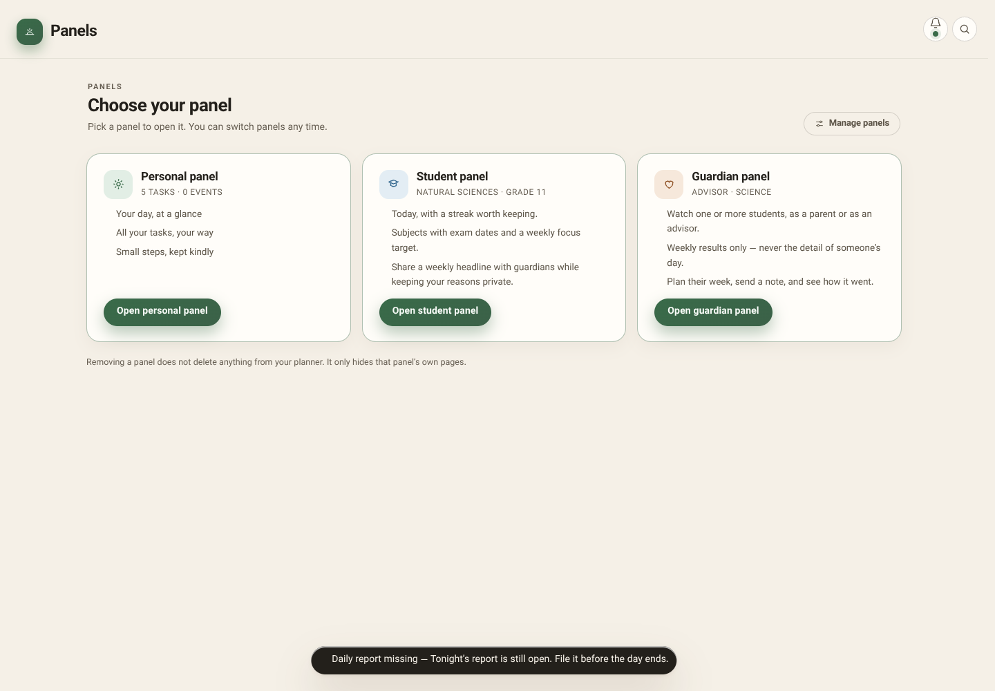
Choose a workspace
01/31
Actual Planner screens, captured with fictional local sample data. Personal, Student and Guardian remain distinct. This is a visual walkthrough—not proof of live cross-account sync, video playback, media upload or AI operation.
PLANNER / REAL APP SCREENSHOTS / FICTIONAL LOCAL SAMPLE DATA
Notes:
Actual Planner screens, captured with fictional local sample data. Personal, Student and Guardian remain distinct. This is a visual walkthrough—not proof of live cross-account sync, video playback, media upload or AI operation.
Screenshot: 01-panels.png
Actual app running locally; sample state. No live backend verification.

Slide 2
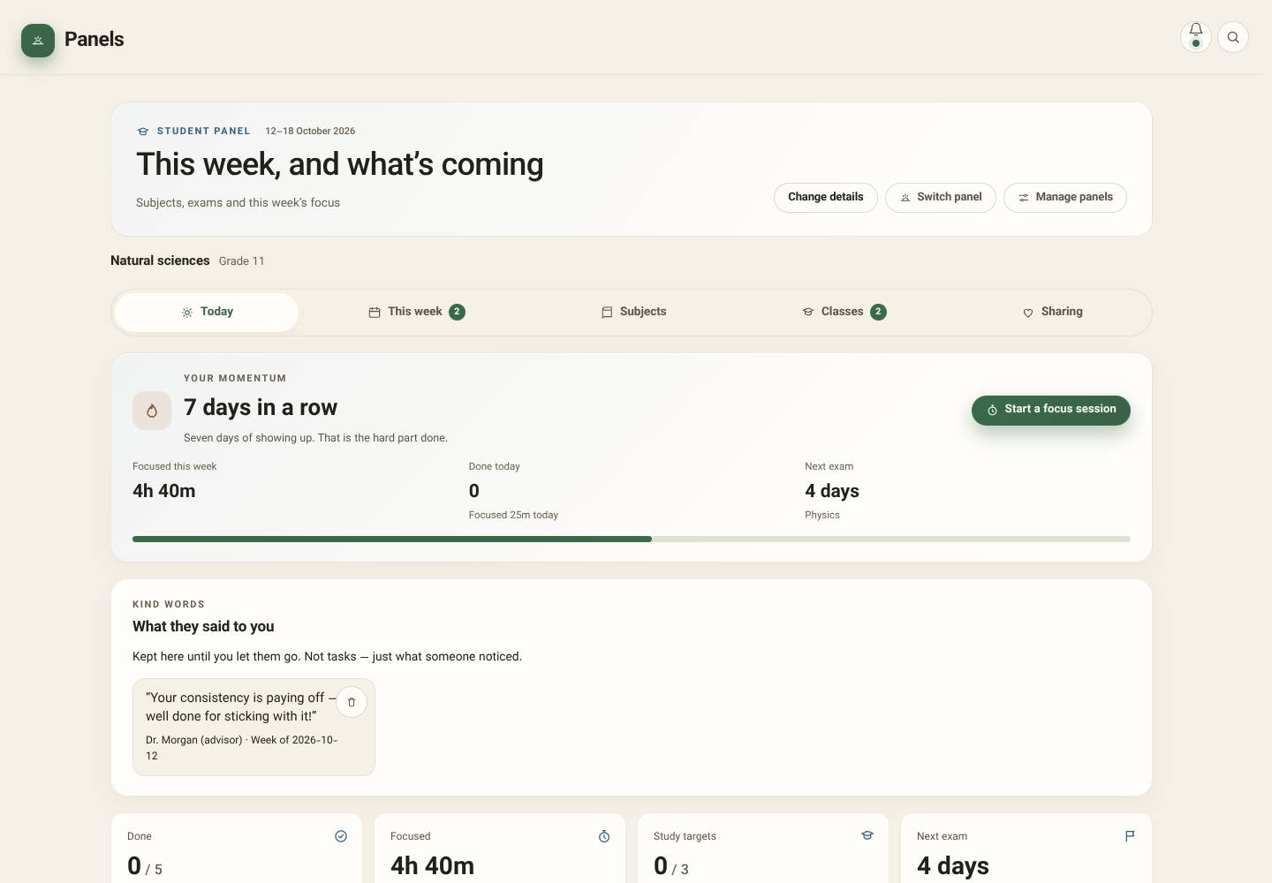
Student: Today
02/31
Momentum, praise and current priorities bring the next study action into view.
PLANNER / REAL APP SCREENSHOTS / FICTIONAL LOCAL SAMPLE DATA
Notes:
Momentum, praise and current priorities bring the next study action into view.
Screenshot: 02-student-today.png
Actual app running locally; sample state. No live backend verification.

Slide 3
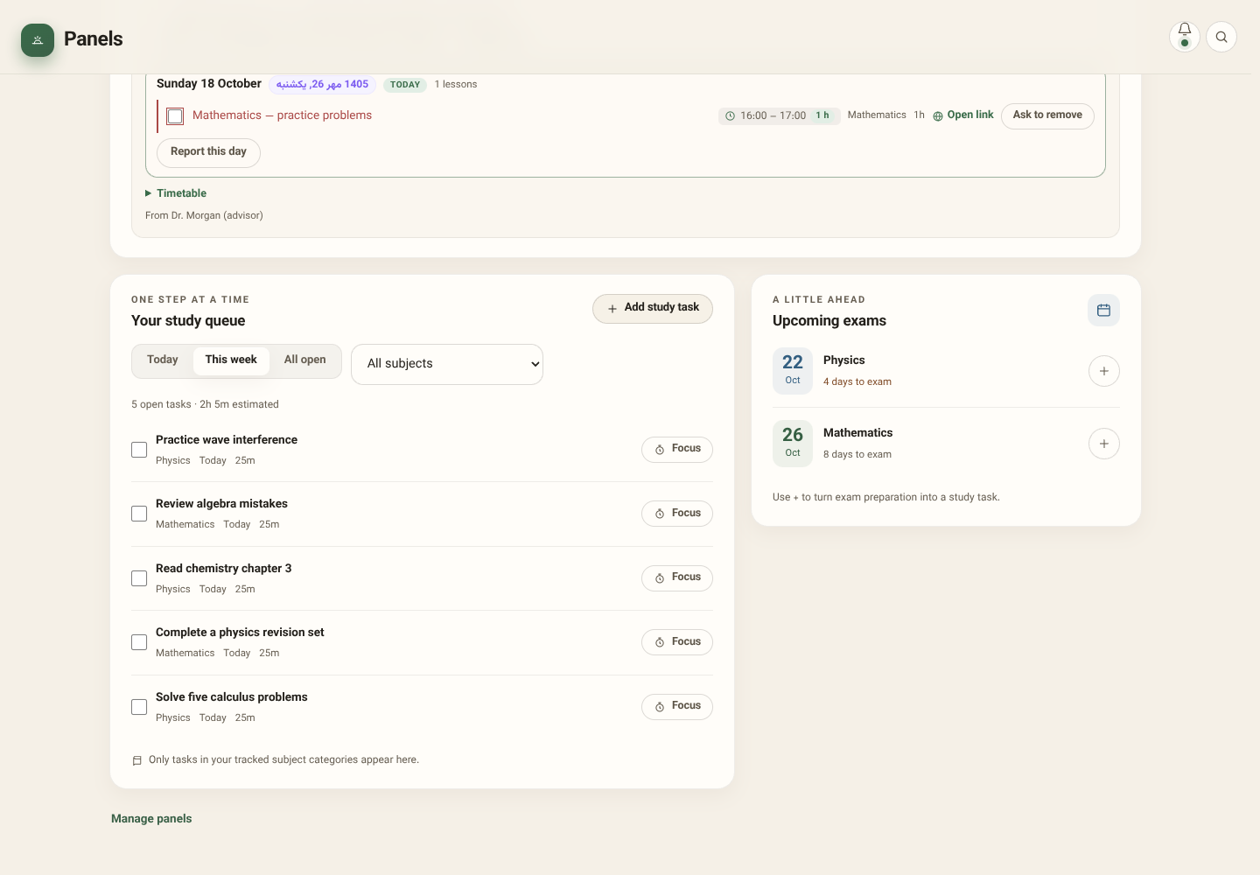
Study queue and exams
03/31
Filter open study work, create subject-linked tasks, complete them or start focus. Upcoming exams can create revision drafts.
PLANNER / REAL APP SCREENSHOTS / FICTIONAL LOCAL SAMPLE DATA
Notes:
Filter open study work, create subject-linked tasks, complete them or start focus. Upcoming exams can create revision drafts.
Screenshot: 03-study-queue.png
Actual app running locally; sample state. No live backend verification.

Slide 4
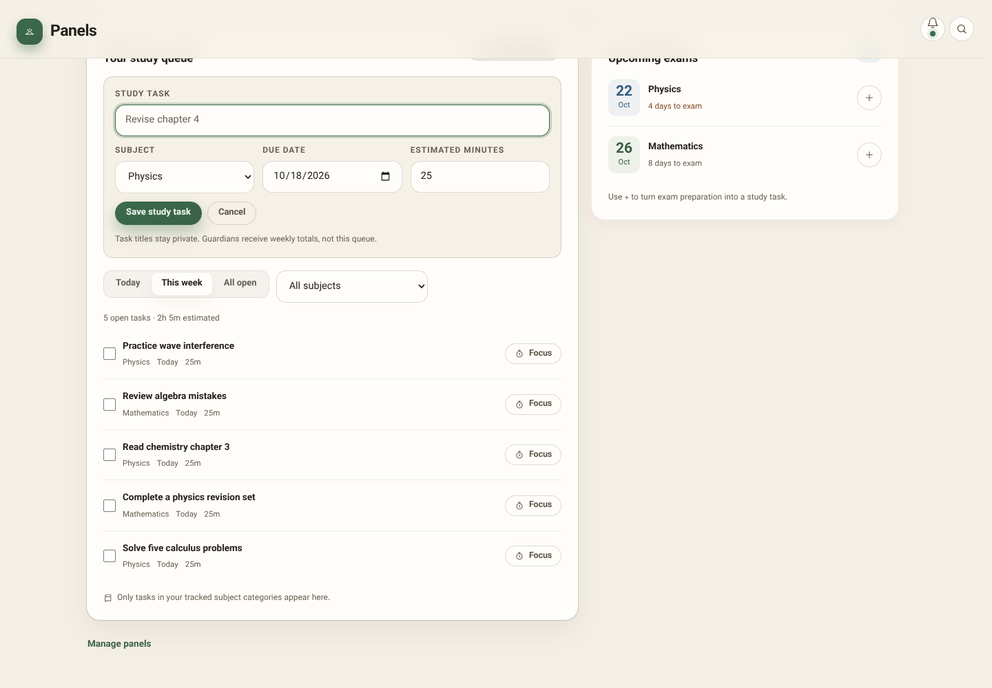
Create a study task
04/31
Choose a subject, title, date and estimated minutes. These are the student’s own tasks.
PLANNER / REAL APP SCREENSHOTS / FICTIONAL LOCAL SAMPLE DATA
Notes:
Choose a subject, title, date and estimated minutes. These are the student’s own tasks.
Screenshot: 04-task-form.png
Actual app running locally; sample state. No live backend verification.

Slide 5
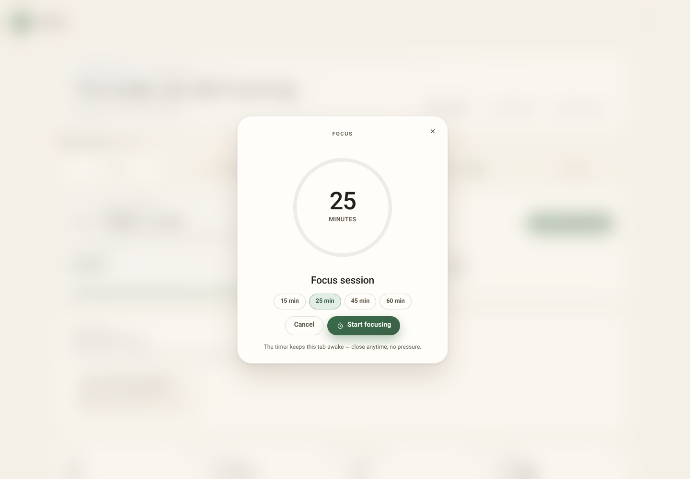
Start a focused study session
05/31
Student starts focus, studies and ends the session. Logged minutes feed subject and weekly progress.
PLANNER / REAL APP SCREENSHOTS / FICTIONAL LOCAL SAMPLE DATA
Notes:
Student starts focus, studies and ends the session. Logged minutes feed subject and weekly progress.
Screenshot: 26-focus.png
Actual app running locally; sample state. No live backend verification.

Slide 6
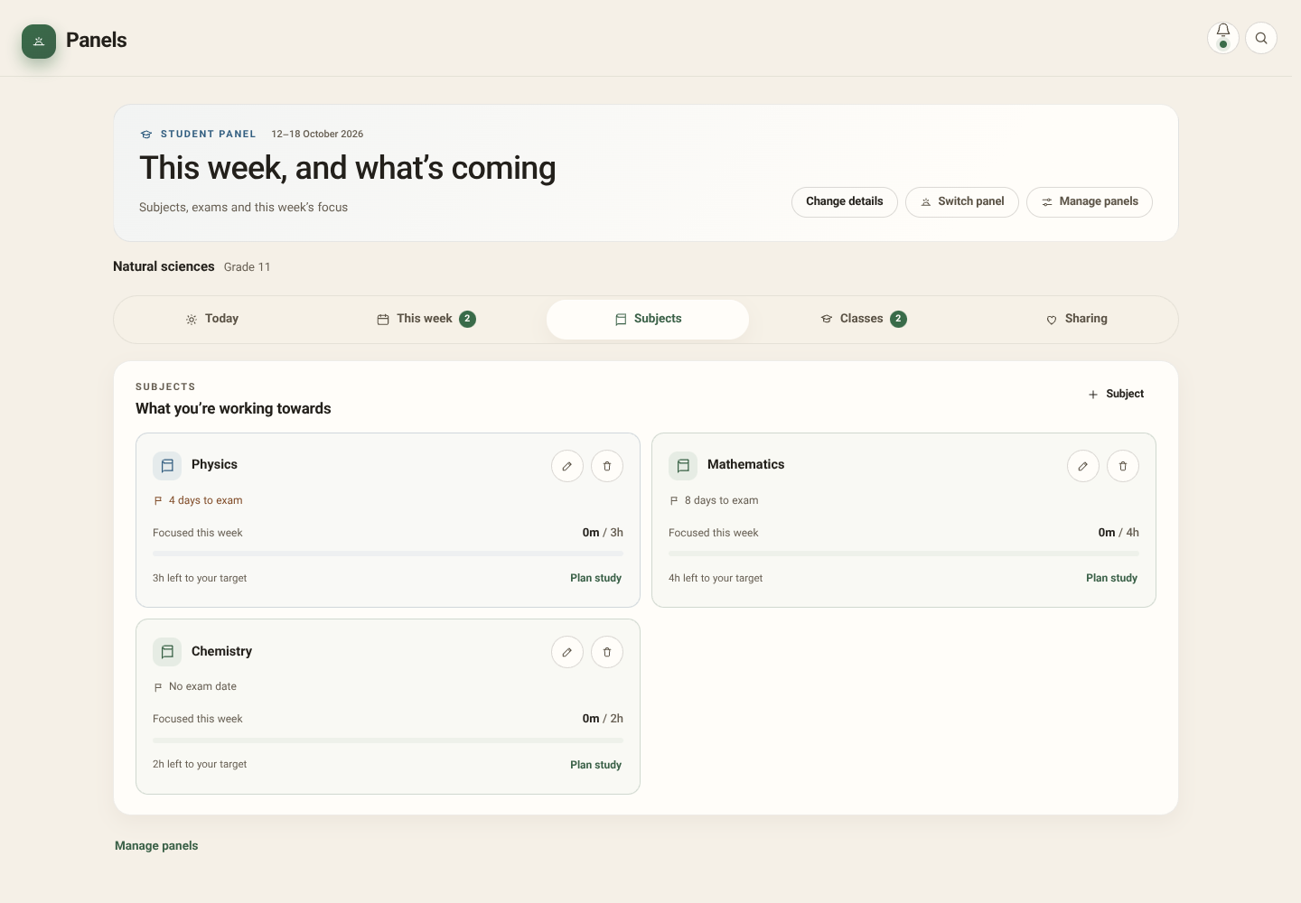
Subjects, exam dates and targets
06/31
Track study time by subject, set weekly targets and exam dates. Rename without losing attribution; remove trackers without deleting tasks.
PLANNER / REAL APP SCREENSHOTS / FICTIONAL LOCAL SAMPLE DATA
Notes:
Track study time by subject, set weekly targets and exam dates. Rename without losing attribution; remove trackers without deleting tasks.
Screenshot: 07-subjects.png
Actual app running locally; sample state. No live backend verification.

Slide 7
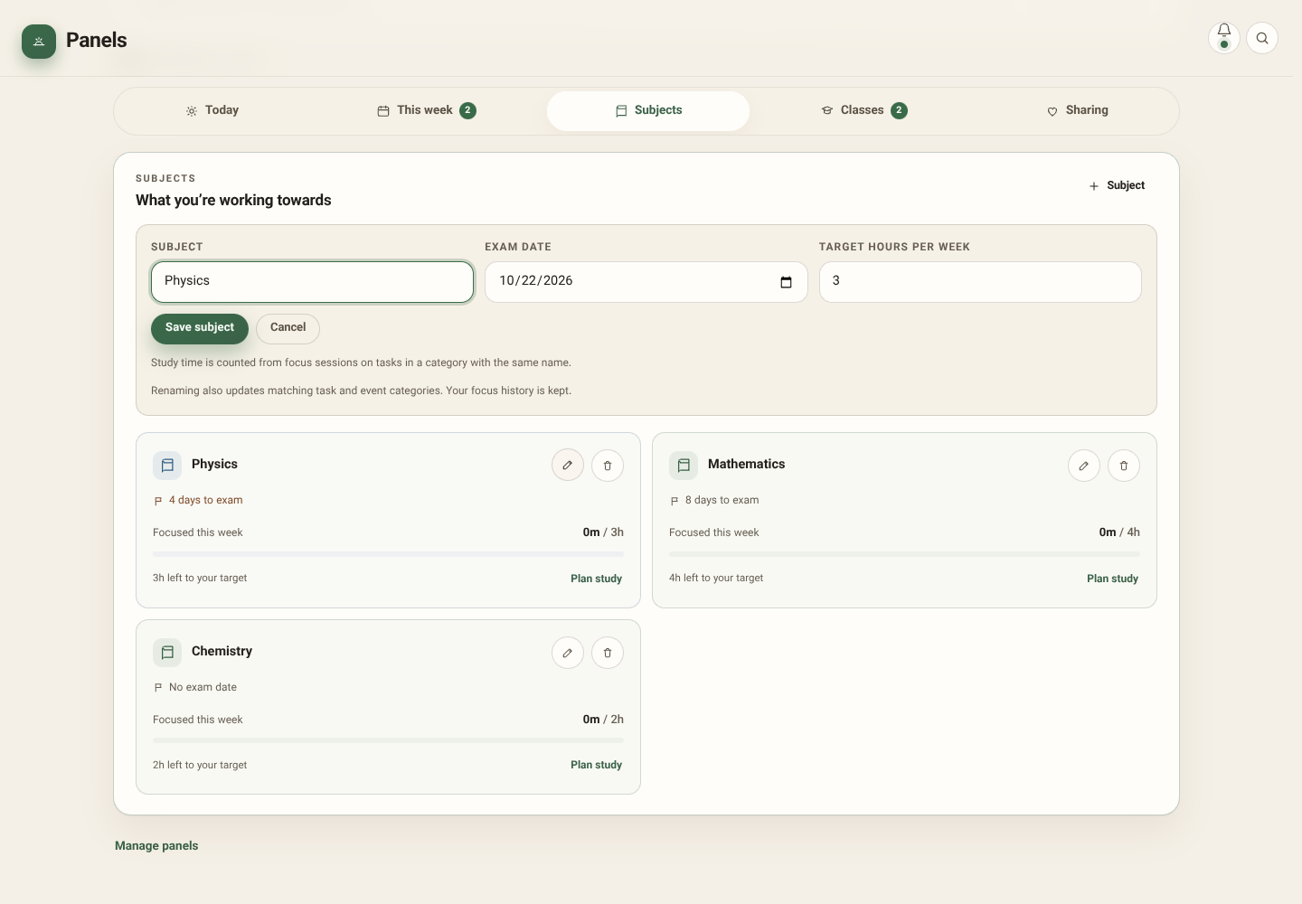
Edit a subject
07/31
Subject name, exam date and weekly focus target remain under the student’s control.
PLANNER / REAL APP SCREENSHOTS / FICTIONAL LOCAL SAMPLE DATA
Notes:
Subject name, exam date and weekly focus target remain under the student’s control.
Screenshot: 08-subject-edit.png
Actual app running locally; sample state. No live backend verification.

Slide 8
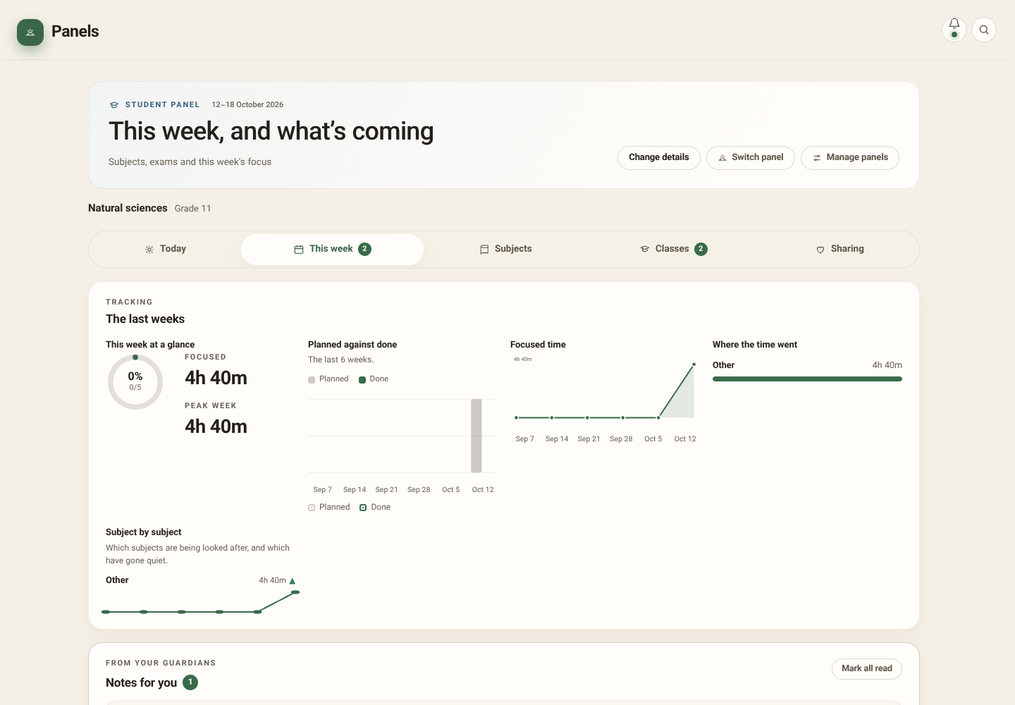
Student: This week
08/31
Review weekly completion, focus and subject trends. Optional AI interprets the shared numbers.
PLANNER / REAL APP SCREENSHOTS / FICTIONAL LOCAL SAMPLE DATA
Notes:
Review weekly completion, focus and subject trends. Optional AI interprets the shared numbers.
Screenshot: 05-student-week.png
Actual app running locally; sample state. No live backend verification.

Slide 9
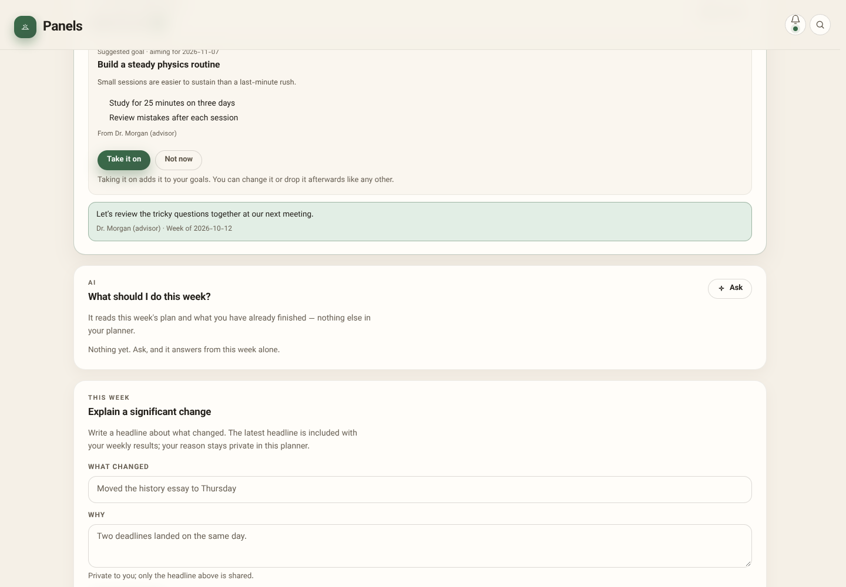
Notes and suggested goals
09/31
A guardian’s note is a conversation; a suggested goal is accepted or declined by the student.
PLANNER / REAL APP SCREENSHOTS / FICTIONAL LOCAL SAMPLE DATA
Notes:
A guardian’s note is a conversation; a suggested goal is accepted or declined by the student.
Screenshot: 06-inbox.png
Actual app running locally; sample state. No live backend verification.

Slide 10
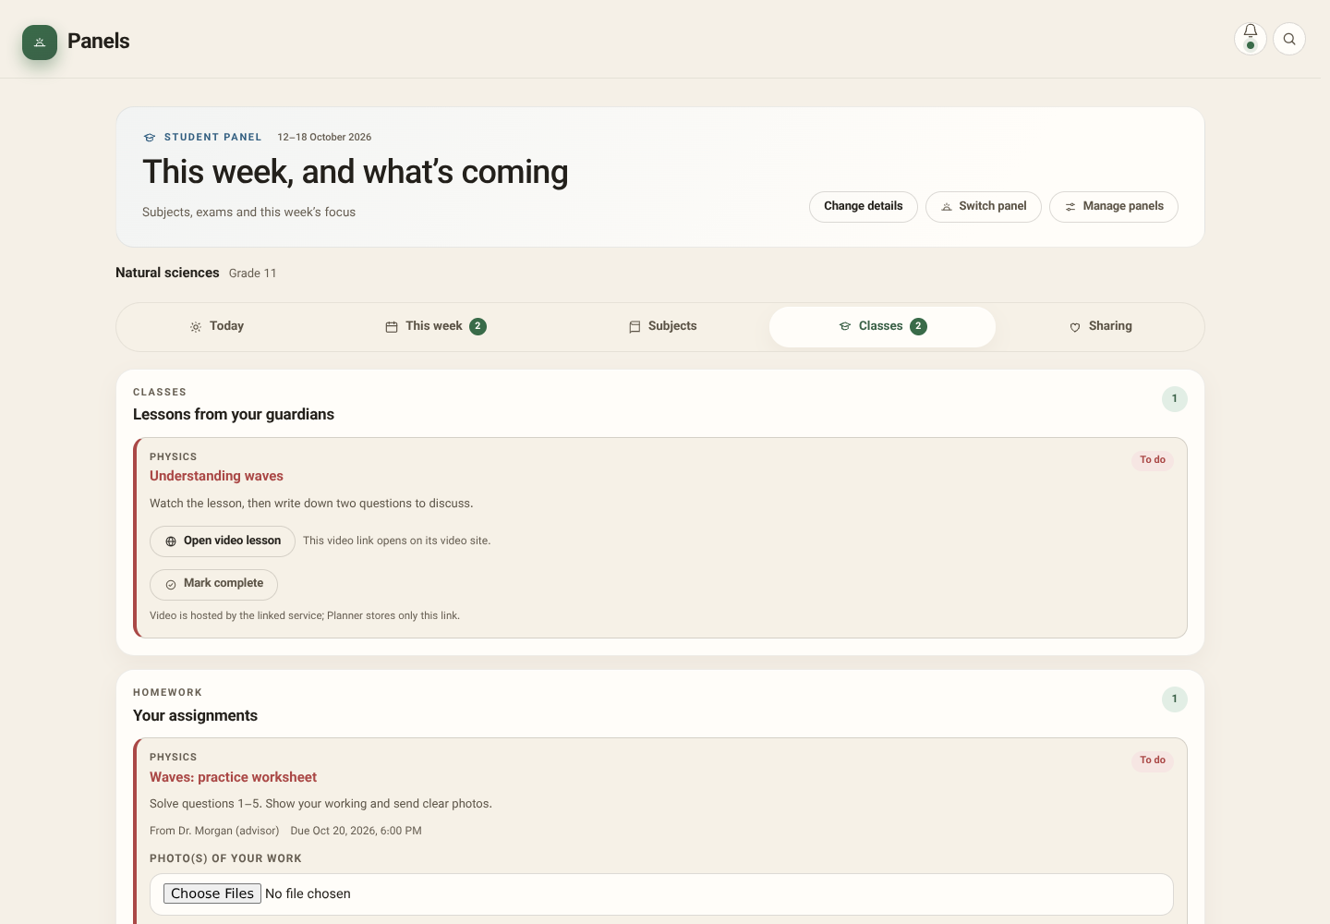
Assigned classes and homework
10/31
Classes are hosted video links with completion marks. Homework carries instructions and an optional deadline.
PLANNER / REAL APP SCREENSHOTS / FICTIONAL LOCAL SAMPLE DATA
Notes:
Classes are hosted video links with completion marks. Homework carries instructions and an optional deadline.
Screenshot: 09-student-classes.png
Actual app running locally; sample state. No live backend verification.

Slide 11
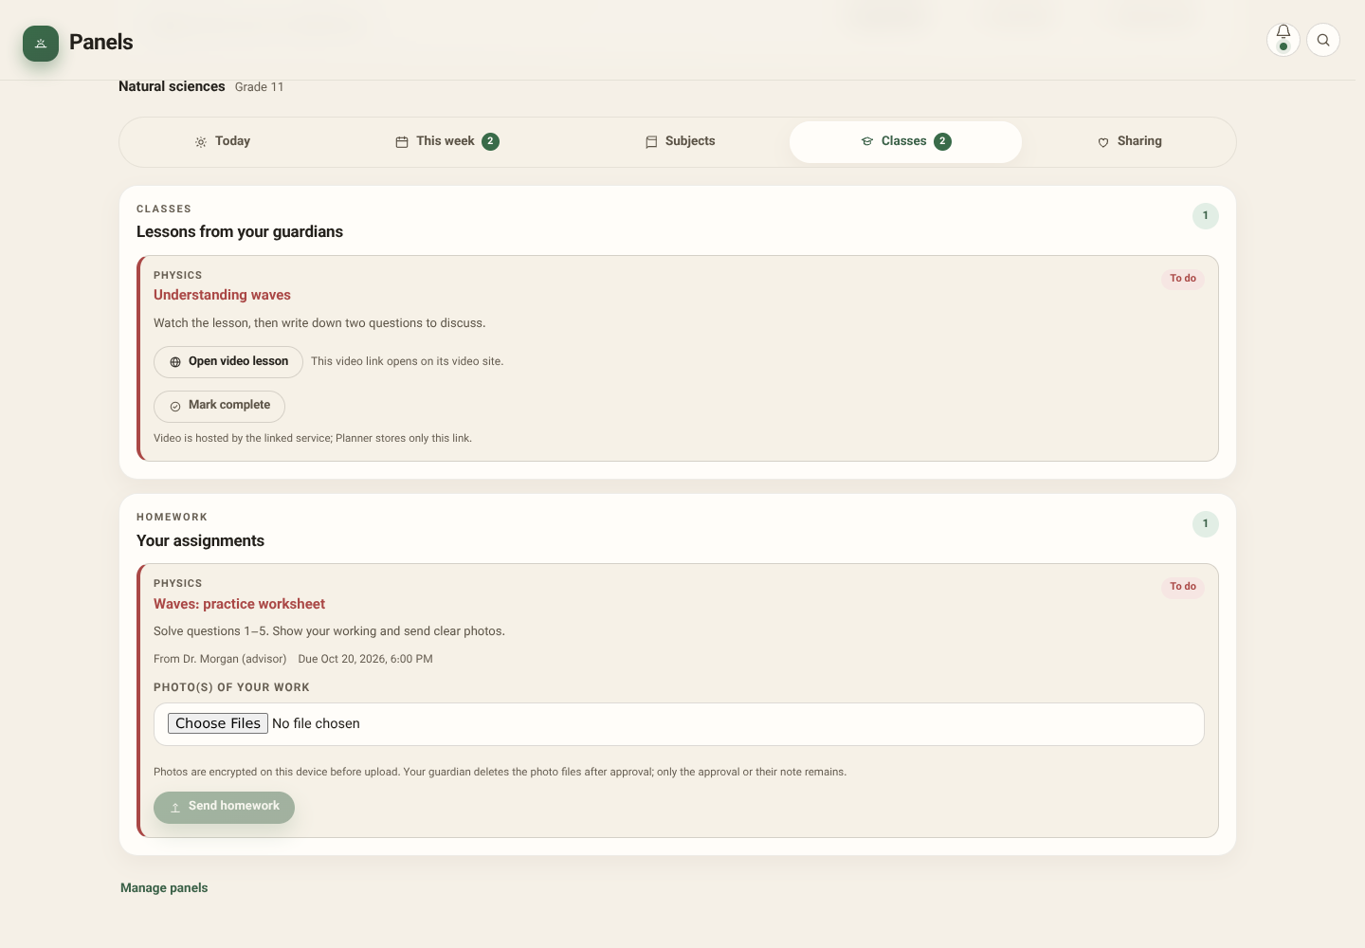
Submit homework photos
11/31
Choose one to three JPEG, PNG or WebP photos (8 MB each maximum). The app encrypts them before upload; guardian approval deletes hosted photos.
PLANNER / REAL APP SCREENSHOTS / FICTIONAL LOCAL SAMPLE DATA
Notes:
Choose one to three JPEG, PNG or WebP photos (8 MB each maximum). The app encrypts them before upload; guardian approval deletes hosted photos.
Screenshot: 10-homework-upload.png
Actual app running locally; sample state. No live backend verification.

Slide 12
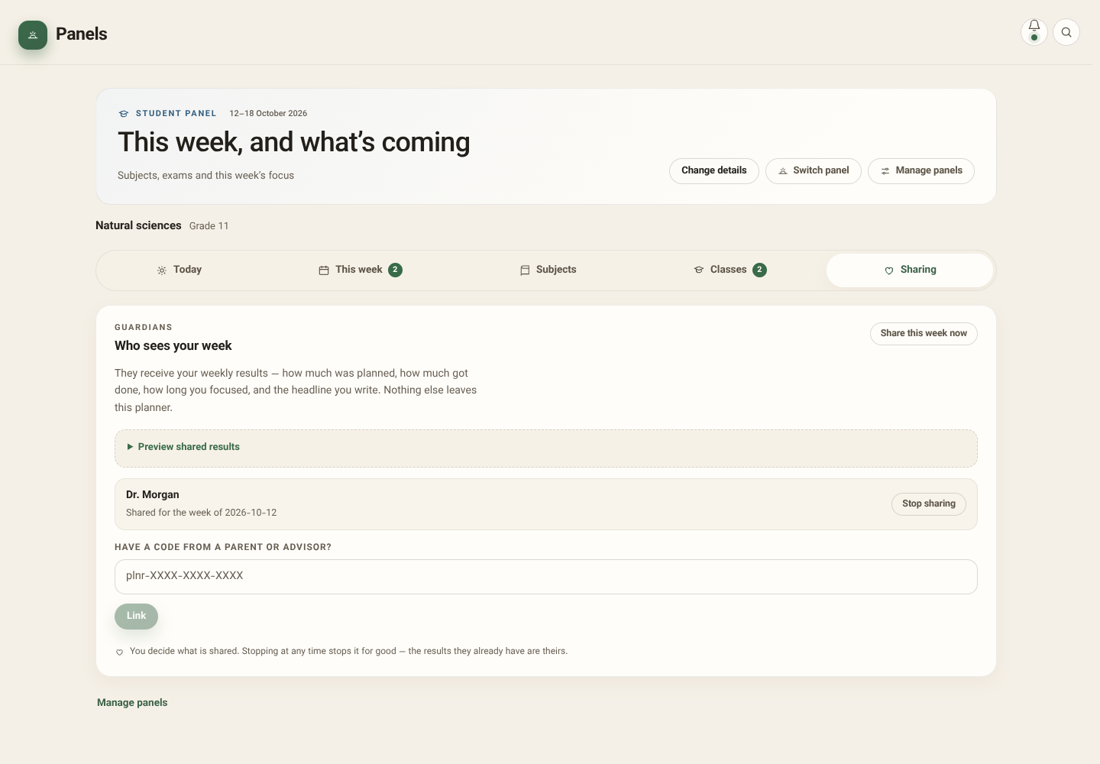
Sharing and guardian links
12/31
Review who receives results. Connecting accounts requires the configured server; this presentation uses local sample data.
PLANNER / REAL APP SCREENSHOTS / FICTIONAL LOCAL SAMPLE DATA
Notes:
Review who receives results. Connecting accounts requires the configured server; this presentation uses local sample data.
Screenshot: 11-sharing.png
Actual app running locally; sample state. No live backend verification.

Slide 13
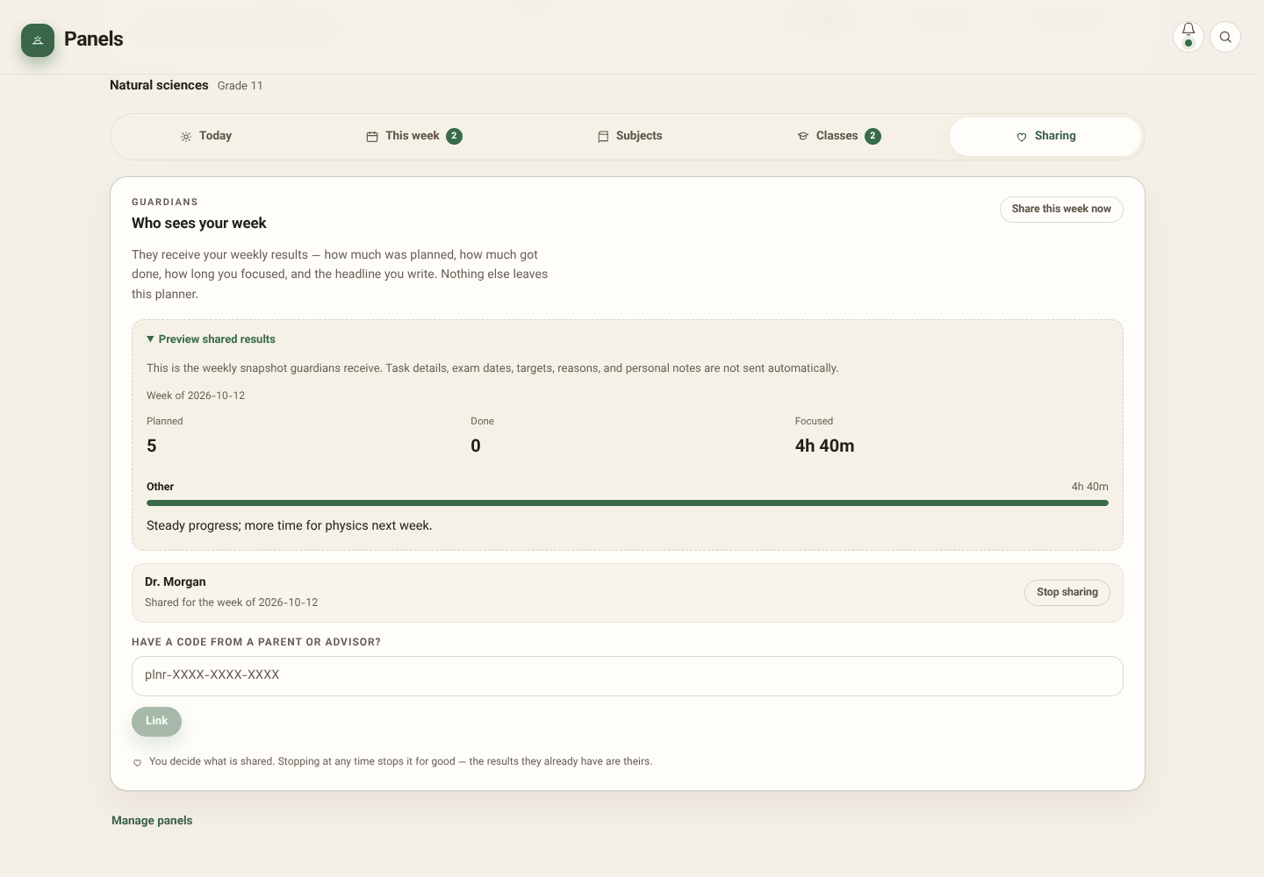
Exactly what the guardian sees
13/31
Weekly counts, focus, up to four subject totals and the chosen headline—not private task text, notes, exam dates, targets or detailed reasons.
PLANNER / REAL APP SCREENSHOTS / FICTIONAL LOCAL SAMPLE DATA
Notes:
Weekly counts, focus, up to four subject totals and the chosen headline—not private task text, notes, exam dates, targets or detailed reasons.
Screenshot: 12-share-preview.png
Actual app running locally; sample state. No live backend verification.

Slide 14
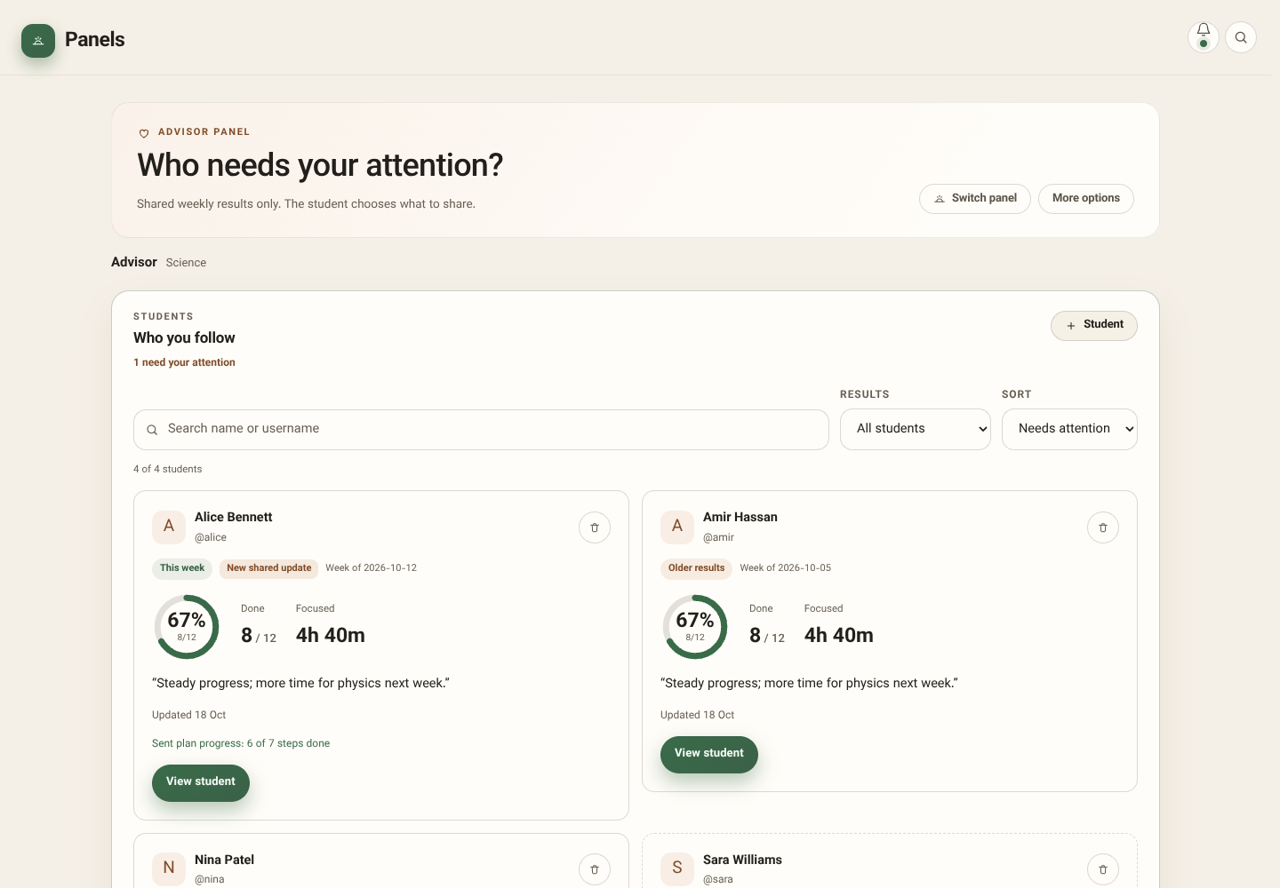
Guardian: student roster
14/31
Search, filter freshness and sort students. Pending invitations and accepted links awaiting first results are different states.
PLANNER / REAL APP SCREENSHOTS / FICTIONAL LOCAL SAMPLE DATA
Notes:
Search, filter freshness and sort students. Pending invitations and accepted links awaiting first results are different states.
Screenshot: 13-guardian-roster.png
Actual app running locally; sample state. No live backend verification.

Slide 15
Invite and connect
15/31
Invite by username, then share the code or QR link for the student to accept. Pending, linked and awaiting-first-results states stay distinct. This local demo does not create a live invitation.
PLANNER / REAL APP SCREENSHOTS / FICTIONAL LOCAL SAMPLE DATA
Notes:
Invite by username, then share the code or QR link for the student to accept. Pending, linked and awaiting-first-results states stay distinct. This local demo does not create a live invitation.
Screenshot: 14-invitation.png
Actual app running locally; sample state. No live backend verification.

Slide 16
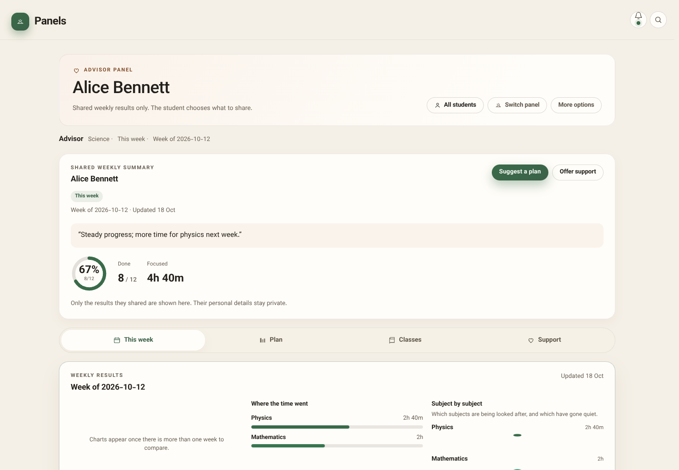
Guardian: one student’s week
16/31
The guardian reviews shared totals, charts, currentness and sent-plan progress—not the student’s private planner.
PLANNER / REAL APP SCREENSHOTS / FICTIONAL LOCAL SAMPLE DATA
Notes:
The guardian reviews shared totals, charts, currentness and sent-plan progress—not the student’s private planner.
Screenshot: 15-guardian-week.png
Actual app running locally; sample state. No live backend verification.

Slide 17
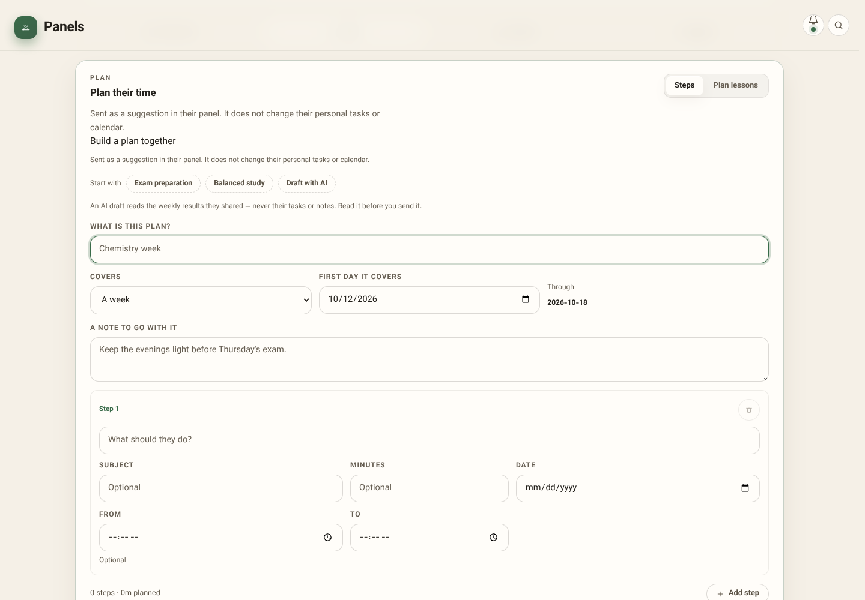
Plan in steps: day, week or month
17/31
Send editable suggestions with dates, subjects, effort and optional start/end times. Preview total effort before sending.
PLANNER / REAL APP SCREENSHOTS / FICTIONAL LOCAL SAMPLE DATA
Notes:
Send editable suggestions with dates, subjects, effort and optional start/end times. Preview total effort before sending.
Screenshot: 17-step-plan.png
Actual app running locally; sample state. No live backend verification.

Slide 18
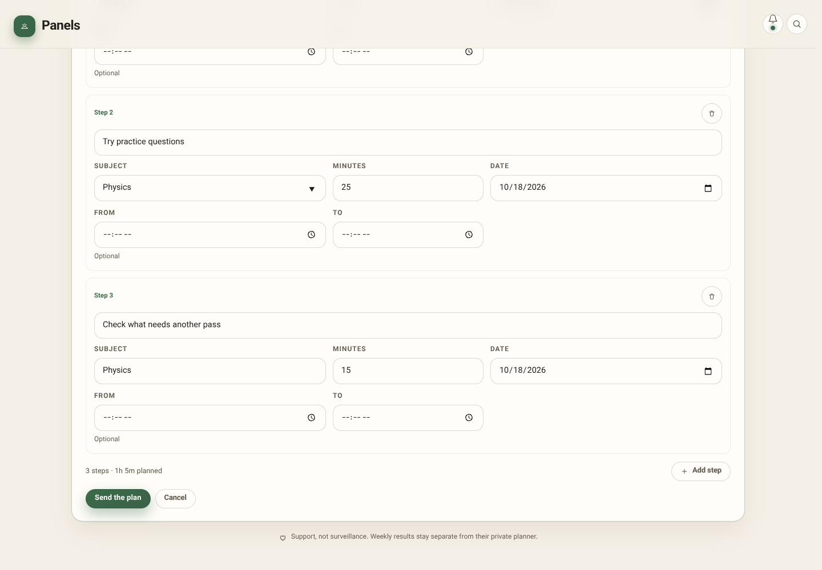
Start from exam preparation
18/31
Templates create editable steps, not silent personal tasks. Current-period suggestions start today rather than assigning elapsed days.
PLANNER / REAL APP SCREENSHOTS / FICTIONAL LOCAL SAMPLE DATA
Notes:
Templates create editable steps, not silent personal tasks. Current-period suggestions start today rather than assigning elapsed days.
Screenshot: 18-plan-template.png
Actual app running locally; sample state. No live backend verification.

Slide 19
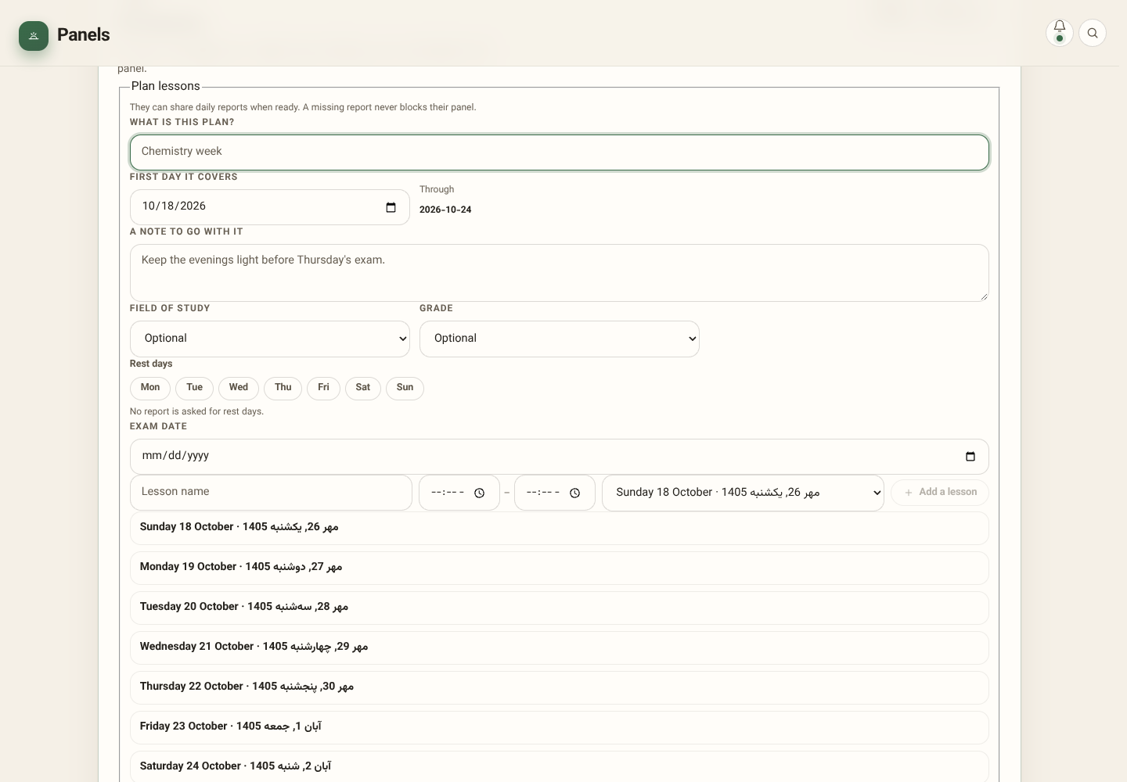
Build a timed lesson week
19/31
Choose Iranian curriculum lessons (grades 10–12), field/grade, lesson times, rest days and prep links. A warning flags heavy pre-exam loads. Offline guardian plans queue for later delivery; sending requires a configured account link.
PLANNER / REAL APP SCREENSHOTS / FICTIONAL LOCAL SAMPLE DATA
Notes:
Choose Iranian curriculum lessons (grades 10–12), field/grade, lesson times, rest days and prep links. A warning flags heavy pre-exam loads. Offline guardian plans queue for later delivery; sending requires a configured account link.
Screenshot: 19-lesson-composer.png
Actual app running locally; sample state. No live backend verification.

Slide 20
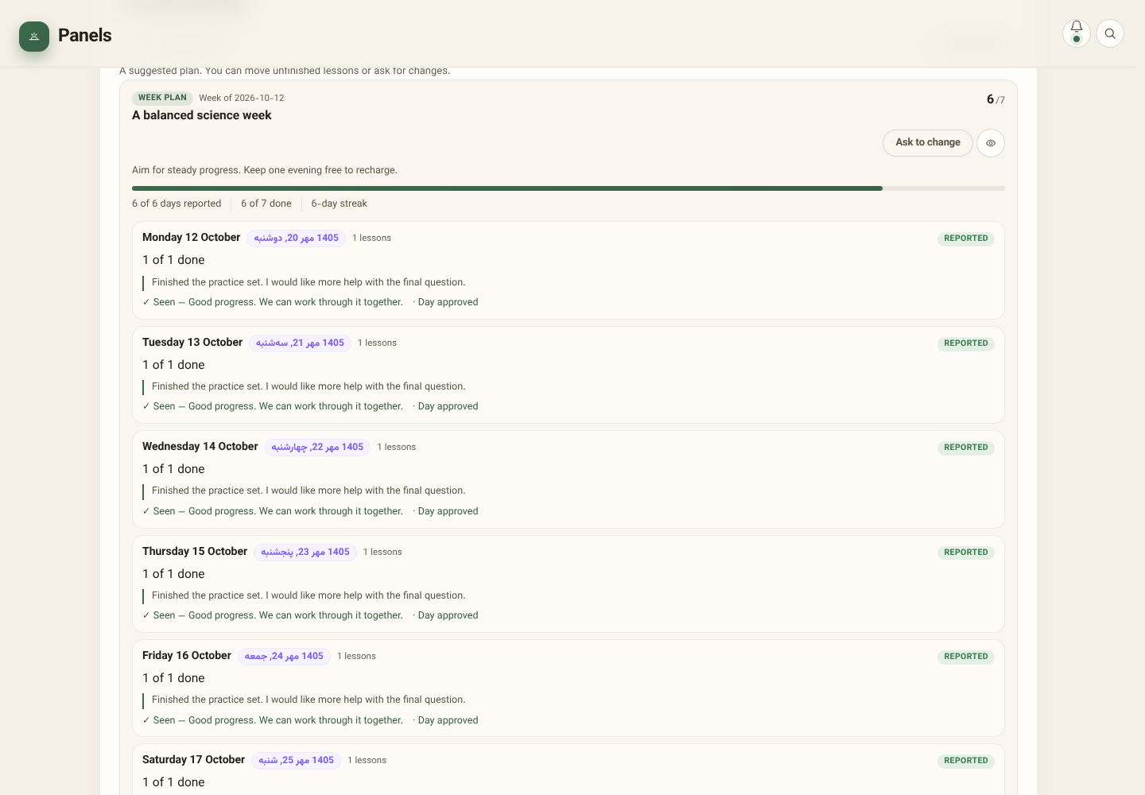
Student receives the guardian’s week
20/31
Guardian → student: the same timed lessons and prep links. Student → guardian: ticks and daily reports. Ask for a plan, move unfinished work or request a change. Preview/print offers a narrative week and wall timetable.
PLANNER / REAL APP SCREENSHOTS / FICTIONAL LOCAL SAMPLE DATA
Notes:
Guardian → student: the same timed lessons and prep links. Student → guardian: ticks and daily reports. Ask for a plan, move unfinished work or request a change. Preview/print offers a narrative week and wall timetable.
Screenshot: 28-student-plan.png
Actual app running locally; sample state. No live backend verification.

Slide 21
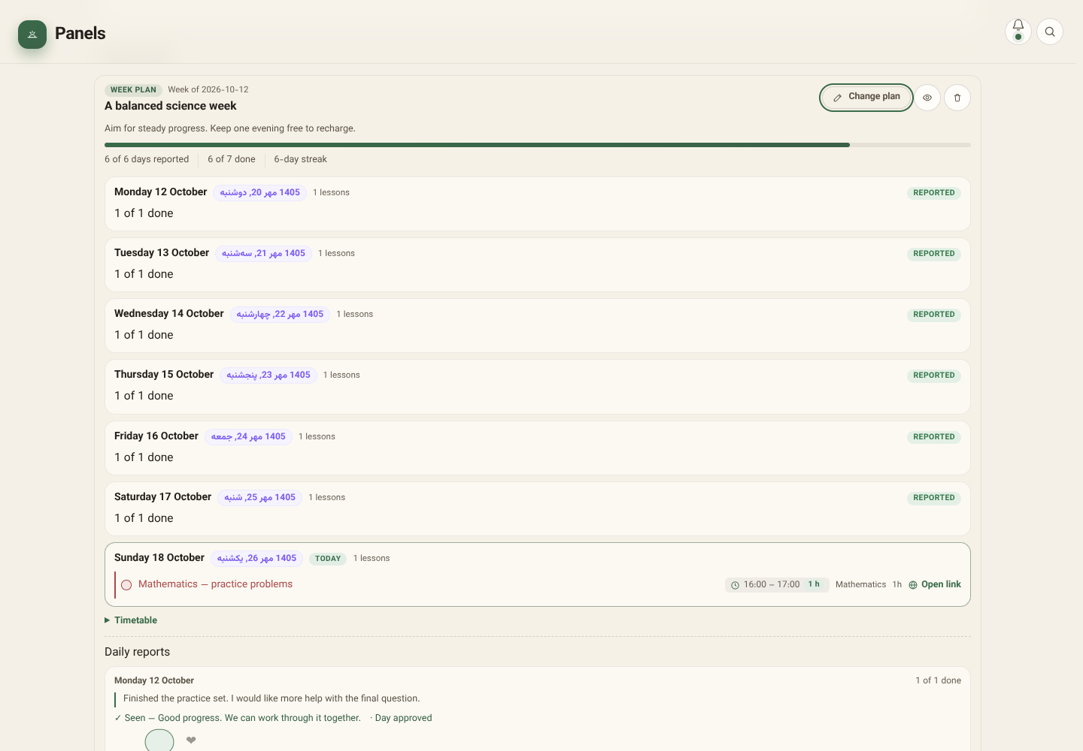
The shared lesson week
21/31
Student reports return completed lessons and an optional note. Guardian can mark seen, reply, react and approve. Missing reports do not block the panel, but can restrict lesson/report actions until catch-up. One weekly repair is available.
PLANNER / REAL APP SCREENSHOTS / FICTIONAL LOCAL SAMPLE DATA
Notes:
Student reports return completed lessons and an optional note. Guardian can mark seen, reply, react and approve. Missing reports do not block the panel, but can restrict lesson/report actions until catch-up. One weekly repair is available.
Screenshot: 16-week-plan.png
Actual app running locally; sample state. No live backend verification.

Slide 22
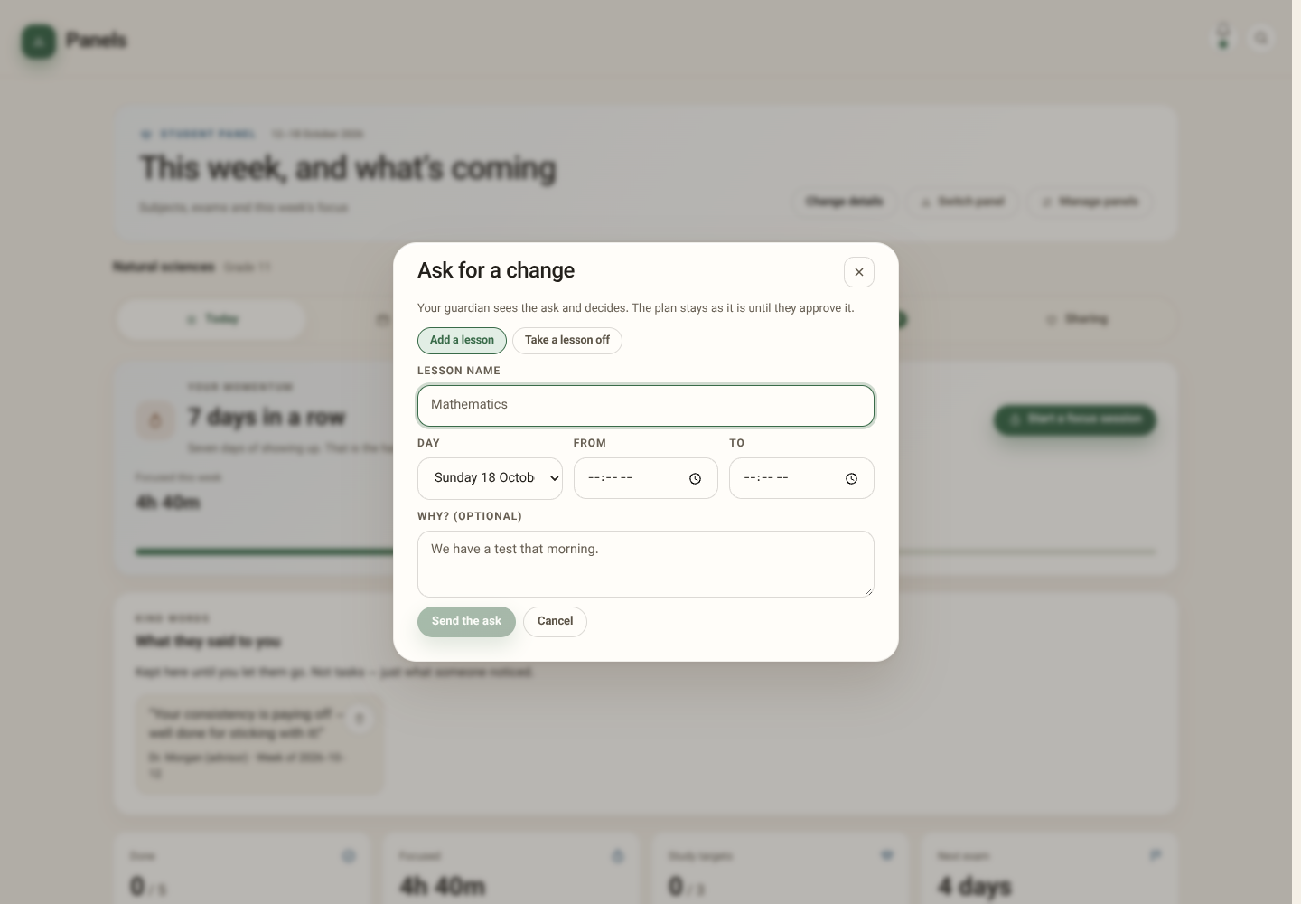
Student asks; guardian decides
22/31
Request a lesson addition/removal with a reason. Nothing changes until the guardian approves; decline can include a reply.
PLANNER / REAL APP SCREENSHOTS / FICTIONAL LOCAL SAMPLE DATA
Notes:
Request a lesson addition/removal with a reason. Nothing changes until the guardian approves; decline can include a reply.
Screenshot: 29-change-request.png
Actual app running locally; sample state. No live backend verification.

Slide 23
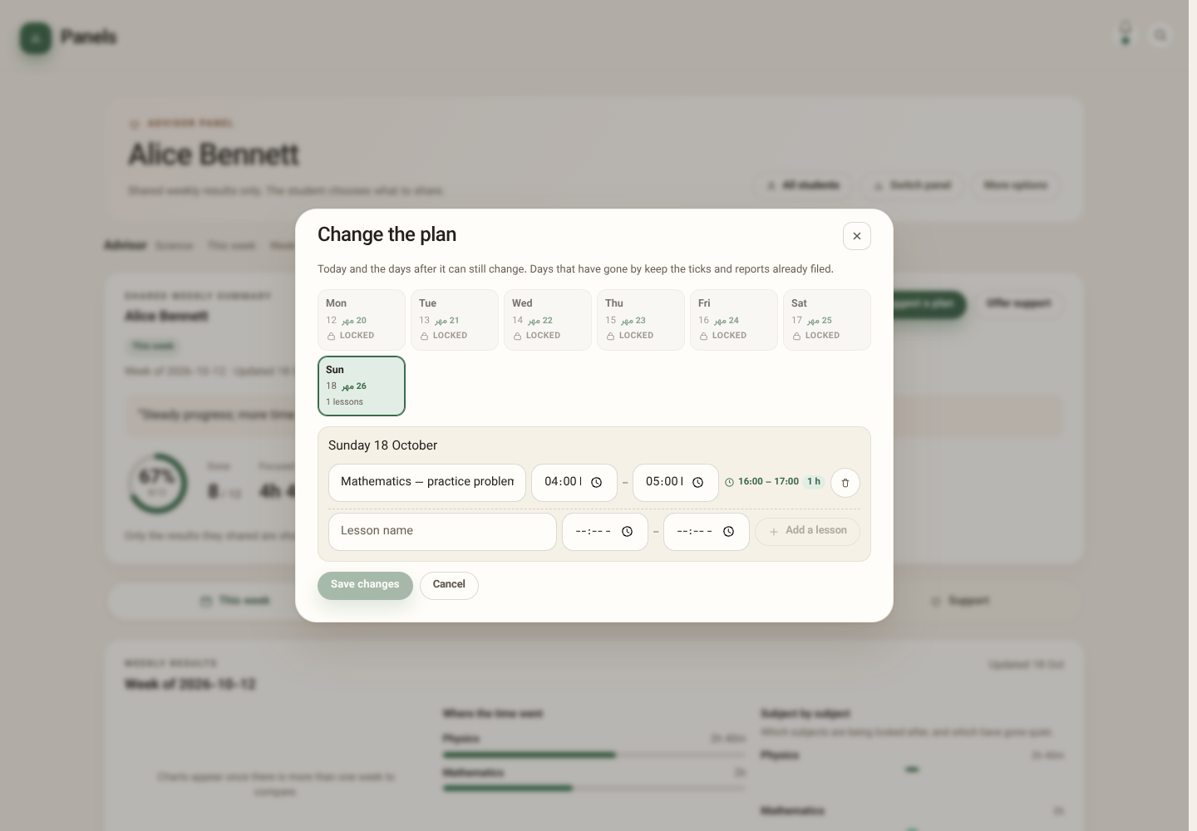
Change the remaining week
23/31
Guardian edits today/future lessons; past ticks and reports stay locked. At period end, summaries replace item detail; guardian sign-off closes a plan. Students can delete eligible old plans or plans from disconnected guardians.
PLANNER / REAL APP SCREENSHOTS / FICTIONAL LOCAL SAMPLE DATA
Notes:
Guardian edits today/future lessons; past ticks and reports stay locked. At period end, summaries replace item detail; guardian sign-off closes a plan. Students can delete eligible old plans or plans from disconnected guardians.
Screenshot: 25-change-plan.png
Actual app running locally; sample state. No live backend verification.

Slide 24
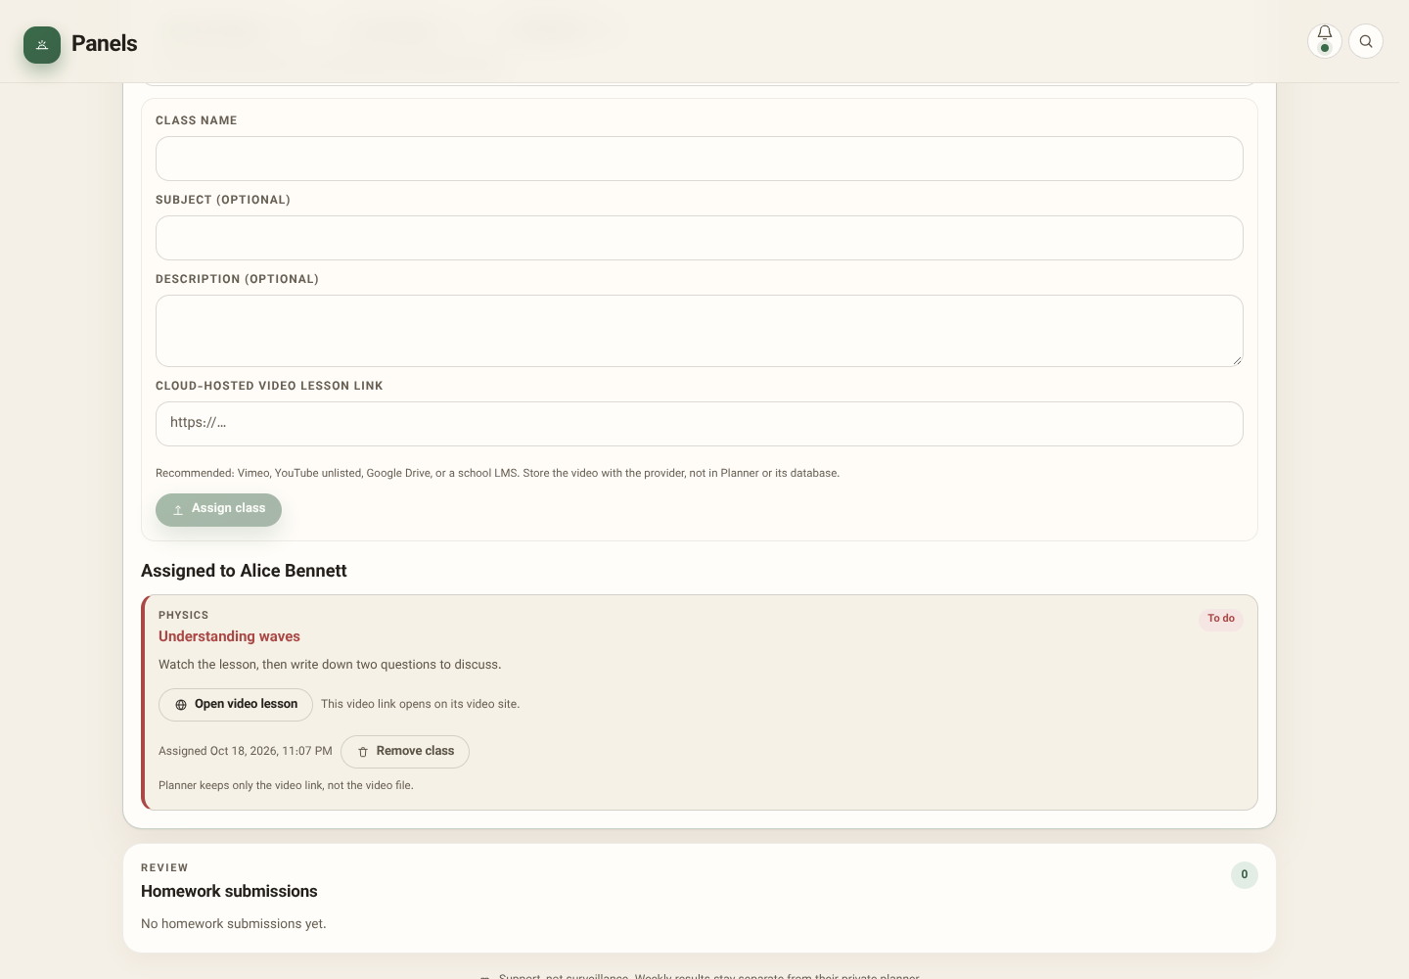
Assign classes to students
24/31
Write a class title, subject, description and external video link. Multi-select students; each keeps an independent completion status.
PLANNER / REAL APP SCREENSHOTS / FICTIONAL LOCAL SAMPLE DATA
Notes:
Write a class title, subject, description and external video link. Multi-select students; each keeps an independent completion status.
Screenshot: 20-guardian-classes.png
Actual app running locally; sample state. No live backend verification.

Slide 25
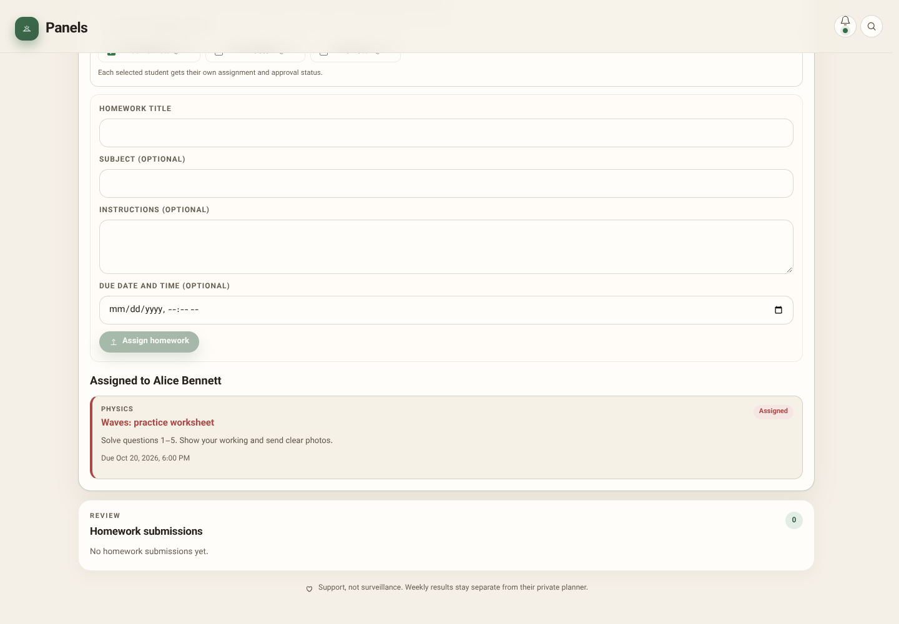
Assign and review homework
25/31
Assign instructions/deadlines to selected students. Review decrypts submitted photos; approval deletes hosted photos and retains status plus feedback. This local demo has no uploaded photos: live upload/review was not tested.
PLANNER / REAL APP SCREENSHOTS / FICTIONAL LOCAL SAMPLE DATA
Notes:
Assign instructions/deadlines to selected students. Review decrypts submitted photos; approval deletes hosted photos and retains status plus feedback. This local demo has no uploaded photos: live upload/review was not tested.
Screenshot: 21-guardian-homework.png
Actual app running locally; sample state. No live backend verification.

Slide 26
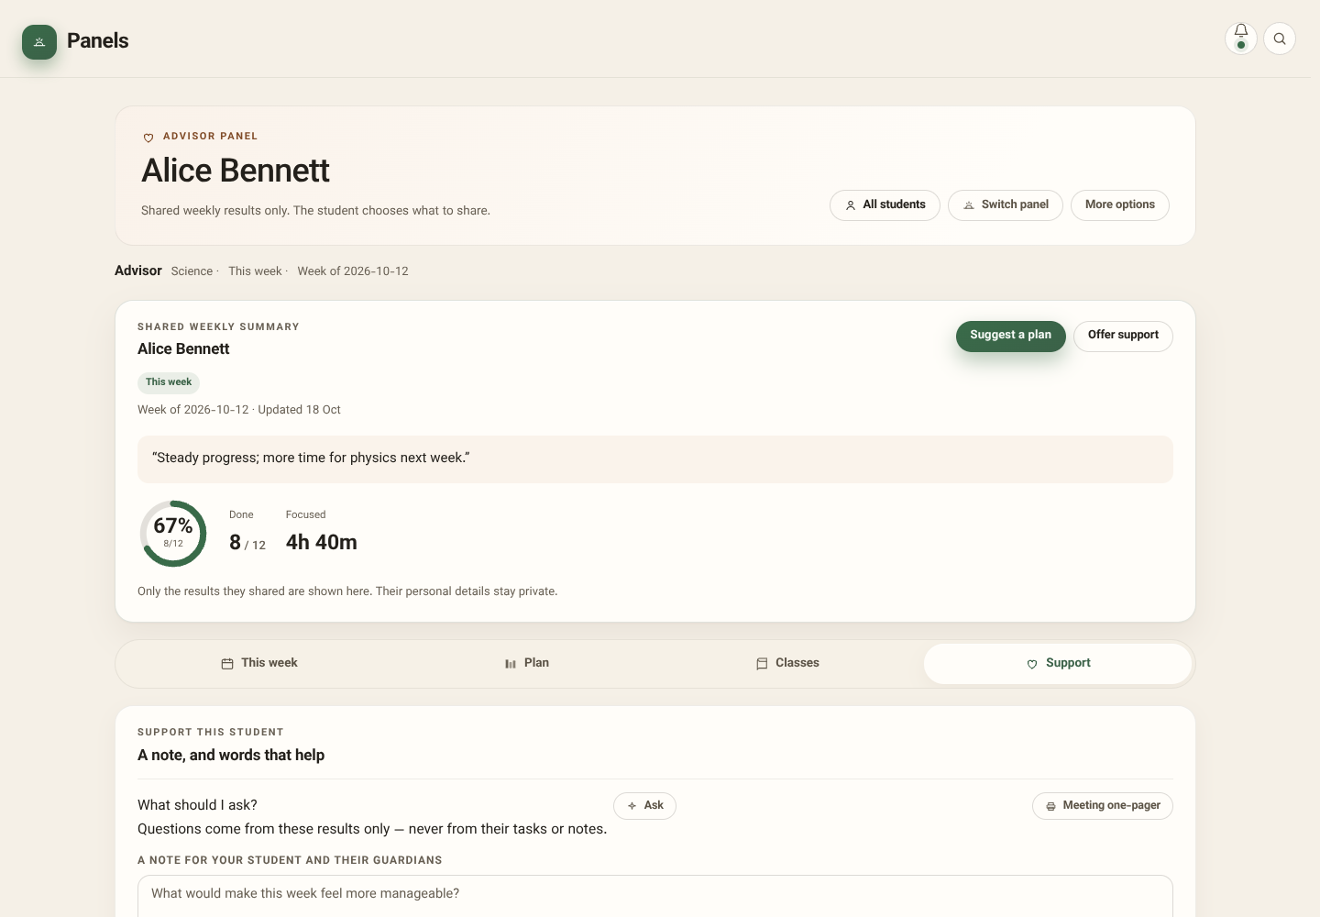
Support: notes, AI and meetings
26/31
Optional AI suggests questions from shared results; edit a question into a note before sending. Generate a meeting one-pager. AI needs a configured service and sends request-relevant context to its provider; no live AI response is shown.
PLANNER / REAL APP SCREENSHOTS / FICTIONAL LOCAL SAMPLE DATA
Notes:
Optional AI suggests questions from shared results; edit a question into a note before sending. Generate a meeting one-pager. AI needs a configured service and sends request-relevant context to its provider; no live AI response is shown.
Screenshot: 22-support.png
Actual app running locally; sample state. No live backend verification.

Slide 27
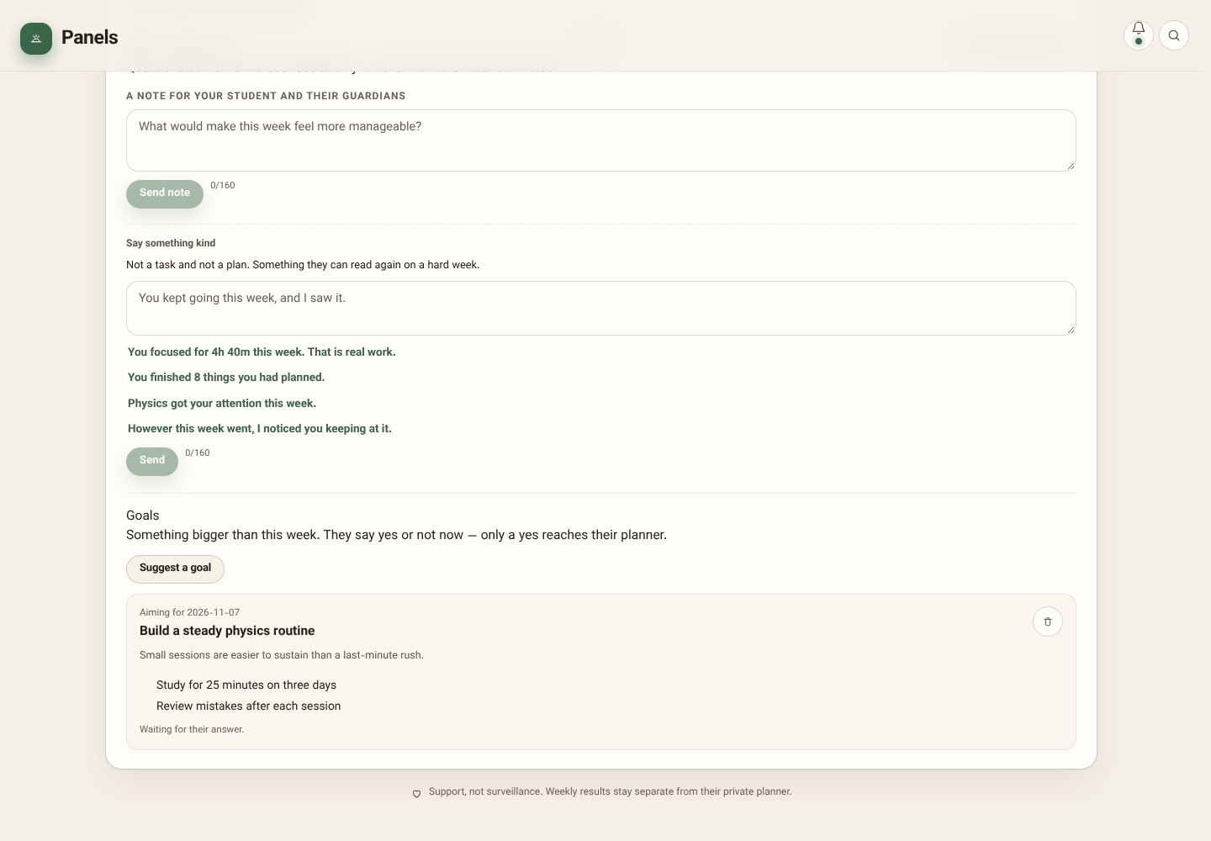
Praise and suggested goals
27/31
Keep encouragement distinct from tasks. Goal suggestions become personal goals only when the student accepts.
PLANNER / REAL APP SCREENSHOTS / FICTIONAL LOCAL SAMPLE DATA
Notes:
Keep encouragement distinct from tasks. Goal suggestions become personal goals only when the student accepts.
Screenshot: 23-praise-goals.png
Actual app running locally; sample state. No live backend verification.

Slide 28
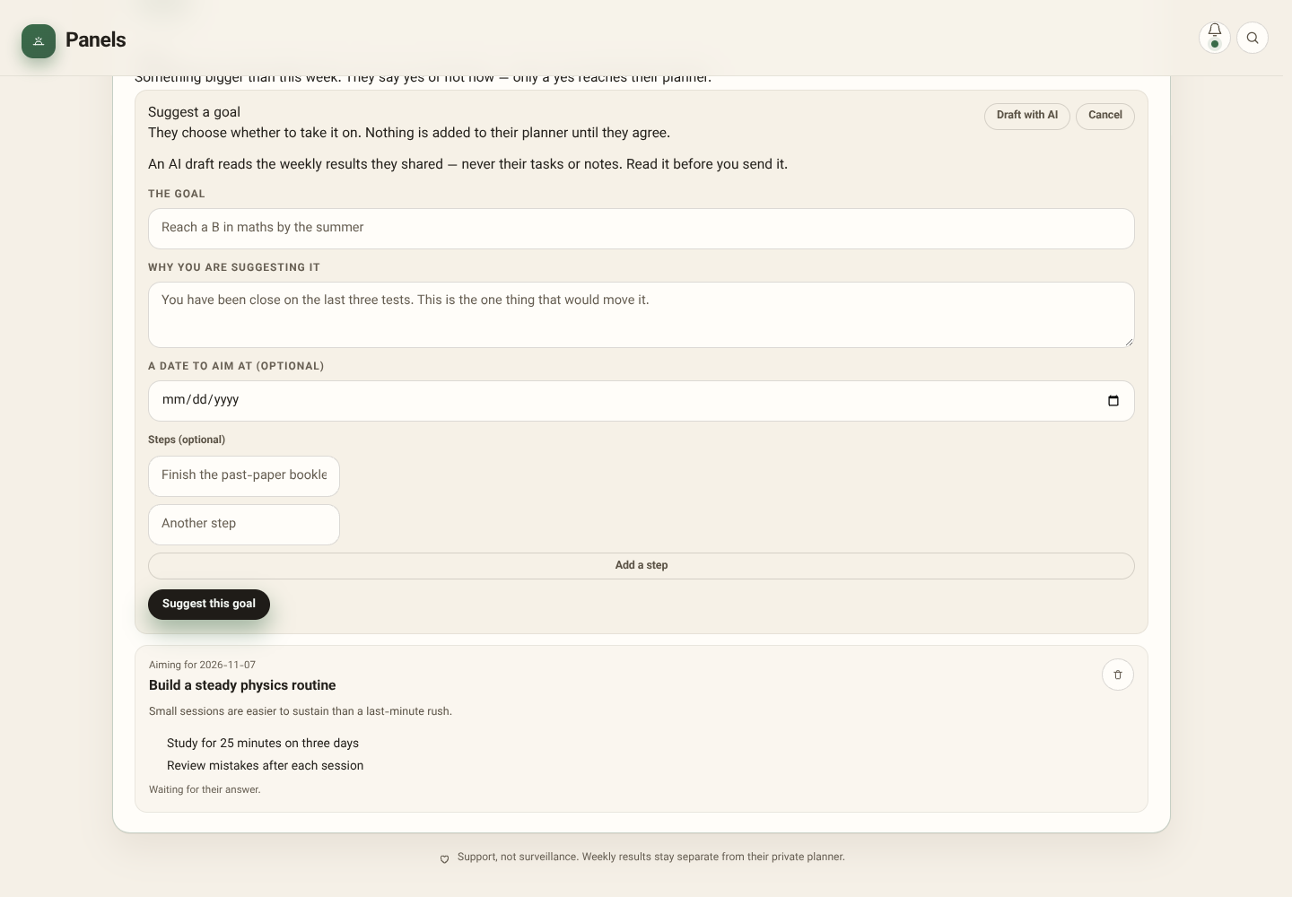
Suggest a goal—with student consent
28/31
Guardian writes the goal, optional target and steps. The student chooses Take it on or Not now; accepting creates a personal goal.
PLANNER / REAL APP SCREENSHOTS / FICTIONAL LOCAL SAMPLE DATA
Notes:
Guardian writes the goal, optional target and steps. The student chooses Take it on or Not now; accepting creates a personal goal.
Screenshot: 30-goal-form.png
Actual app running locally; sample state. No live backend verification.

Slide 29
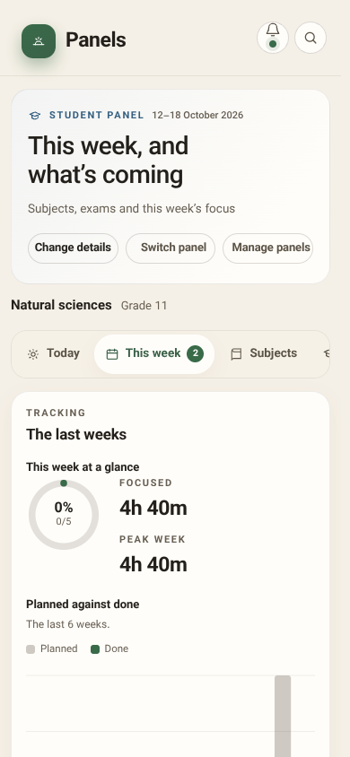
Student on mobile
29/31
Responsive tabs and touch-friendly controls support daily use. The same panels support light/dark themes and Persian RTL.
PLANNER / REAL APP SCREENSHOTS / FICTIONAL LOCAL SAMPLE DATA
Notes:
Responsive tabs and touch-friendly controls support daily use. The same panels support light/dark themes and Persian RTL.
Screenshot: 24-mobile.png
Actual app running locally; sample state. No live backend verification.

Slide 30
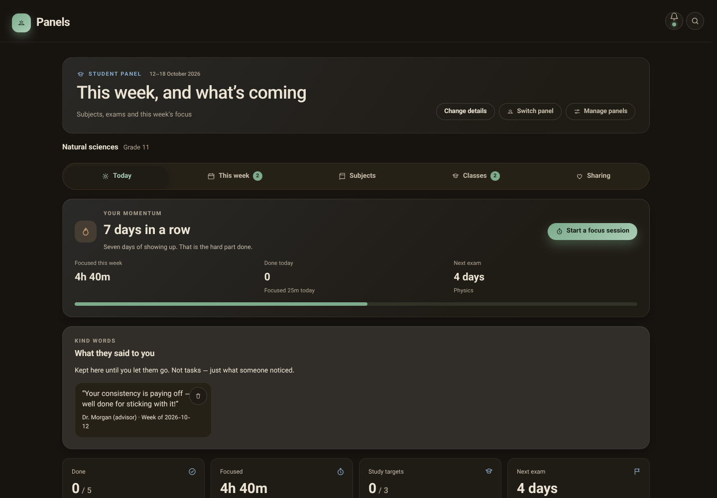
The same workspace in dark mode
30/31
Student and guardian workflows support light/dark themes, keyboard navigation and responsive layouts.
PLANNER / REAL APP SCREENSHOTS / FICTIONAL LOCAL SAMPLE DATA
Notes:
Student and guardian workflows support light/dark themes, keyboard navigation and responsive layouts.
Screenshot: 31-dark.png
Actual app running locally; sample state. No live backend verification.

Slide 31
How both sides work together
31/31
CONNECT → Guardian suggests a plan/assigns work → Student studies, ticks and reports → Guardian reviews, replies and supports → Both adapt. Weekly snapshots share totals, not private planner details. Remote delivery happens after sync.
PLANNER / REAL APP SCREENSHOTS / FICTIONAL LOCAL SAMPLE DATA
Notes:
CONNECT → Guardian suggests a plan/assigns work → Student studies, ticks and reports → Guardian reviews, replies and supports → Both adapt. Weekly snapshots share totals, not private planner details. Remote delivery happens after sync.
Screenshot: 12-share-preview.png
Actual app running locally; sample state. No live backend verification.

