Slide 1

Skeletal System Increment Demo
Not A Clue
David Bishop, Lead Config Manager
Connor Finn, Lead Architect
Shunguan Mai, Project Manager
Chuan Lin, Lead SQ&A Engineer
Yang Zhang, Lead Programmer

Slide 2
BLUF
Purpose
Demonstrate the integration and interplay of the major subsystems within the Clue-Less architecture.
Key Messages
The successful development of a skeletal architecture is proven by the completion of a character selection process on the webpage, and the starting of a game instance.
In doing so, multiple players will interact with a live webpage, and information will be passed shared between all subsystems defined in the system requirements specification.
The players, graphical user interface (GUI), the API, the Server and the Database.

Slide 3
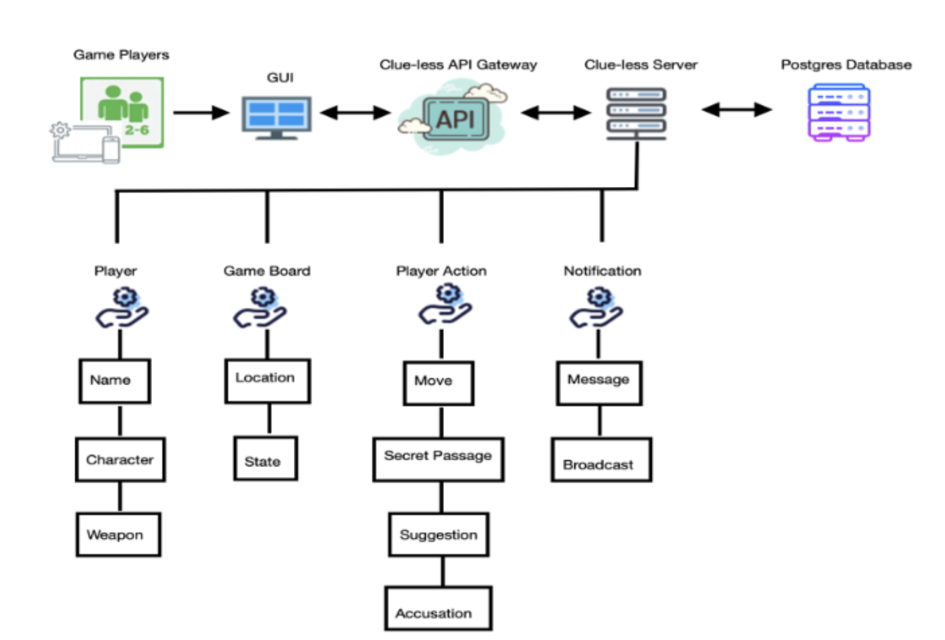
Key Subsystems
Players: Our users will access the clue less webpage and interact directly with the Clue-less GUI.
Clue-less GUI: [FLASK]
The Clue -less GUI acts as an interface between the game players and the Clue-less API.
Clue-less API: [FLASK]
The API will receive information from the players through the GUI, and process event updates according to information in the Database.
Clue-less Server: [SOCKET.IO]
The server hosts the API, and processes event triggered by the users interacting with the GUI
Database: [MySQL]*
Holds essential gameplay and user information that the API will query throughout the game.
Image: Subsystems listed in Requirements Doc.
*Updated from Postgres to MySQL following requirements specification.

Slide 4
Demonstrated Integration
This demo will prove subsystem integration by accessing the built webpage, and sending messages between the key subsystems.
In the context of Object Oriented Analysis, a message refers to the invoking of operations of other objects. (course lecture 8B)
Key Messages shown in this demo:
Players make game decisions by selecting buttons on the GUI.
The Server processes events on the GUI, and sends data to the API.
The API receives event data from the Server, and updates the data stored in the Database.
The API queries data in the database
The API sends updated information to the Server, which in turn, updates the information shown on the GUI.

Slide 5
Skeletal System Increment Demo
Not A Clue
David Bishop, Lead Config Manager
Connor Finn, Lead Architect
Shunguan Mai, Project Manager
Chuan Lin, Lead SQ&A Engineer
Yang Zhang, Lead Programmer

