Slide 1
Query Campus
A Retrieval-Augmented Generation Based Conversational Assistant for College Website Information Access
Ask about your campus. Get answers with sources.
Akshat Sharma (23BIT005) Tanmay Choudhary (23BCS072) Riya Rawat (23BIT060)
Guide: Vedpriya Dongre
Institute of Engineering & Technology, DAVV, Indore | B.E. in Information Technology and Computer Science Engineering | 2026-2027
Notes:
Good morning. We are presenting Query Campus, a chat assistant that answers questions about IET DAVV using only the information published by the college, and shows the sources. It was built by the three of us under the guidance of Vedpriya Dongre.

Slide 2
The problem
160
606
243
web pages
PDF files
timetable documents
College information is spread over many pages, files and a separate timetable website
A student cannot simply ask a question and get a direct answer
General chatbots do not know the college and may give wrong answers
Notes:
The college has 160 web pages and 606 PDF files, and the class timetables are on another website, which gives 243 more documents. To find one fact, a student has to guess where to look. Chatbots like ChatGPT have not read the college notices, so they can give confident but wrong answers.

Slide 3
Existing solutions and the gap
Solution | Main problem
College website search | Information is scattered; no direct answers
Timetable website | User must know the class; cannot ask questions
Perplexity, ChatPDF | Whole web, or only one uploaded file
Paid college chatbots | Closed, paid, not made for IET DAVV
ChatGPT, Gemini, FAQ bots | May make up facts, or answer only fixed questions
The gap: no solution answers only from official IET DAVV pages, with sources, at low cost.
Notes:
We compared the main ways to find information: the college website, the timetable website, Perplexity and ChatPDF, paid college chatbots, and general chatbots. Each one has a problem for our case. None of them answers only from official IET DAVV pages, with sources, at low cost. That is the gap.

Slide 4
Objectives
1
Collect the text of the college website and the timetable website
2
Store it so it can be searched by meaning and by keywords
3
Answer using only that text, and show the sources
4
Show answers in a simple chat screen with documents
5
Test the accuracy with a fixed list of questions
Notes:
Our five objectives: collect the data, store it so it can be searched in two ways, answer only from that data with sources, present it in a simple chat screen, and measure the accuracy with a fixed list of questions.

Slide 5
Our solution: RAG in simple words
1
2
3
Question
Find the text
Write the answer
The student types it in plain English
Search the college data by meaning and by keywords
Gemini answers only from that text and shows sources
No guessing: if the text is not there, the system says it cannot answer.
Notes:
RAG means Retrieval-Augmented Generation. First we find the right text from the college data, then we let the AI write the answer using only that text. To update the knowledge we only update the database, we do not retrain any model. If the text is not available, the system says it cannot answer instead of guessing.

Slide 6
System architecture
Chat screen (React)
Student asks, reads answers, opens documents
Screen: React chat app
Backend: finds the best text and asks Gemini
Services: turn text into numbers, store it, write answers
Indexing: prepares the data, so answers are fast
Backend (NestJS)
Searches, builds the prompt, streams the answer
Voyage AI
text to numbers
Pinecone
database
Google Gemini
writes answers
Indexing (done in advance)
Crawler + timetable scraper fill Pinecone
Notes:
The system has four parts. The chat screen is a React app. The backend, built with NestJS, receives questions, searches and asks Gemini. Voyage AI turns text into numbers, Pinecone stores them and Google Gemini writes the answers. Separately, a crawler and a timetable scraper collect the college data in advance and save it in Pinecone, so answering is fast.

Slide 7
How a question is answered
1
2
3
4
5
Ask
Search
Merge
Answer
Show
Student types a question
By meaning and by keywords
Keep the best 16 chunks
Gemini uses only those chunks
Answer streams in with sources
Typical answer time: 1.5 to 4 seconds
Notes:
Step one: the student asks a question. Step two: the backend searches the database by meaning and by keywords at the same time, because keyword search is better for names and codes. Step three: it merges the two lists and keeps the best 16 chunks. Step four: Gemini writes the answer using only those chunks. Step five: the answer appears word by word, with source links and document cards.

Slide 8
Key features
1
Answers with sources
2
Honest refusal
3
Documents
Every answer shows the pages it used
Says “I cannot answer this question”
Open or download timetables and PDFs
4
Saved chats
5
Works on phones
6
Keeps working
Kept in the user’s own browser
Simple, responsive chat screen
Backup AI models and keyword fallback
Notes:
The main features: answers always show their sources; when the answer is not available it says so; it can give documents such as timetables; chats are saved only in the user’s browser; it works on phones; and it keeps working when one AI model or one search is busy.

Slide 9
Technology stack
Backend
Frontend
Embeddings
Database
Node.js, NestJS, TypeScript
React 19, Vite, Tailwind CSS
Voyage AI
Pinecone
AI answers
Keyword search
Testing
Hosting
Google Gemini
MiniSearch (BM25)
Vitest, Supertest
Render
Notes:
We used one language, TypeScript, on both sides. NestJS for the backend and React for the screen. Voyage AI makes the embeddings, Pinecone stores them, and Google Gemini writes the answers. MiniSearch gives us the keyword search. We test with Vitest and host on Render.

Slide 10
The knowledge base
1,009
documents collected
2,864
searchable chunks
Notes:
The database holds 1,009 documents: 160 web pages, 606 PDF files and 243 timetable documents, one for each class and each teacher. They are cut into 2,864 small chunks, which are what the search actually looks at.

Slide 11
Results and testing
19 of 19
1.5–4 s
36
test questions passed
normal answer time
automatic tests passed
The right page was found for all 14 questions that name a page
When one search is busy, the other still answers
Unanswerable questions get a clear refusal
Notes:
We tested with 19 real questions about faculty, timetables, fees and documents, and all 19 pass. A normal answer takes 1.5 to 4 seconds. The right page was found for all 14 questions that name a page, and it was the first result in 8 of them. We also have 26 unit tests and 10 end-to-end tests, all passing.

Slide 12
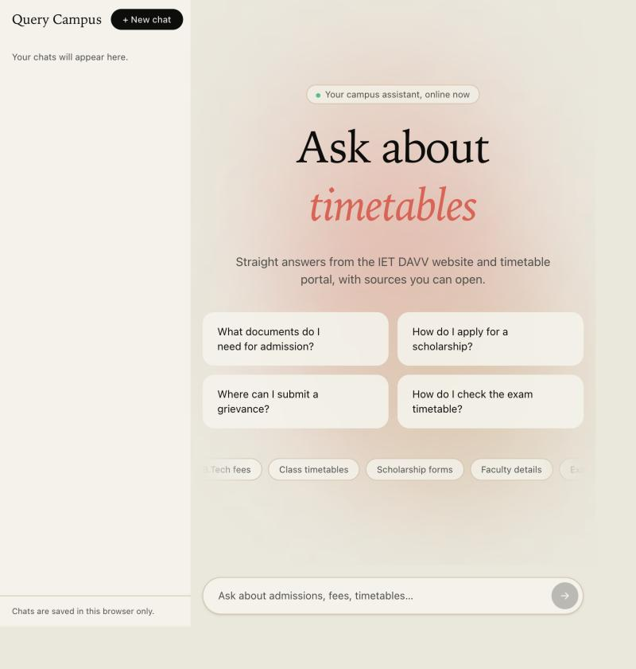
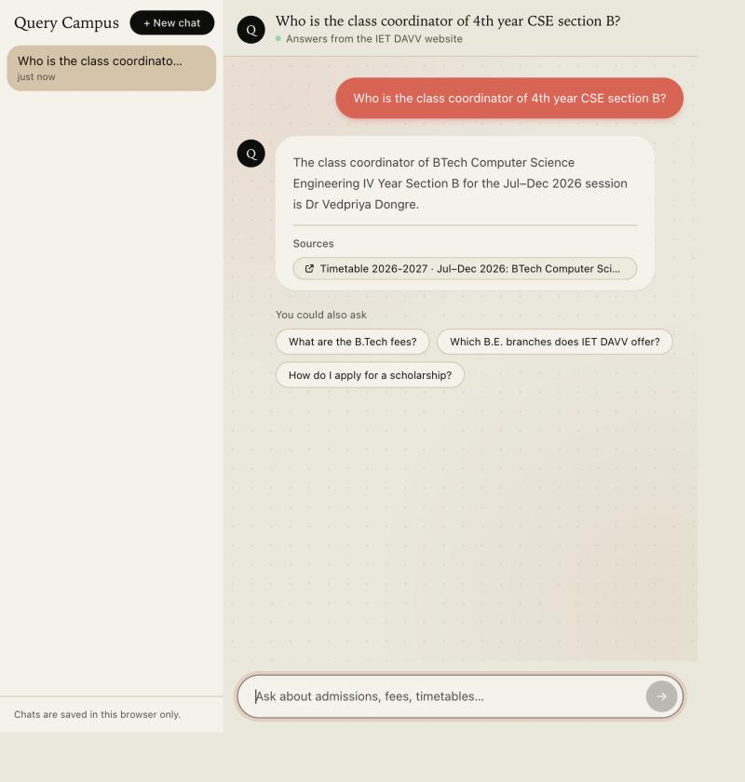
Live demo
query-campus-web.onrender.com
Try asking:
Who is the class coordinator of 4th year CSE section B?
Send me the 2nd year IT section A timetable
What are the B.Tech fees?
Notes:
This is the live website. The left screenshot is the home screen with suggestion cards. The right one shows an answer with its source link. During the demo, ask the three sample questions: a class coordinator, a timetable document, and the B.Tech fees. Then ask something it cannot answer, to show the refusal.

Slide 13
Limitations, future work and conclusion
Limitations
Future work
Conclusion
No chat memory
Data is as new as the last crawl
Scanned PDFs are not read
Free plan limits
Chat memory
Hindi support
Automatic updates
WhatsApp or Telegram bot
Small, low-cost and self-hosted
Answers come only from college pages
Shows sources, never guesses
Thank you | Questions?
Notes:
To finish: the main limits are that it has no chat memory, its data is as new as the last crawl, it cannot read scanned PDFs and it depends on free plans. Next we would add chat memory, Hindi support, automatic updates and a messaging bot. In conclusion, Query Campus shows that a small, low-cost system can turn a hard-to-use college website into a reliable chat service that shows its sources and does not guess. Thank you. We are happy to take questions.

