Slide 1

SAARZEIT
Alessandro Beatini, Akhil Mehta

Slide 2
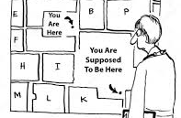
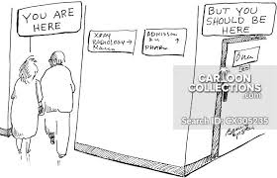

WIDESPREAD PROBLEM
Hard to find your way into hospitals
Unnecessary time wasted waiting or wandering
Money are wasted on missed appointments

Slide 3
What does the data from an U.K. study regarding the amount of money wasted in regard to missed appointments can tell us about Germany ?
# Hospitals in UK
1257 (2019)
# Hospitals in Germany 1925 (2019)
# Hospitals in UK
1257 (2019)
?
ESTIMATED 1277 MILLIONS OF EUROS EACH YEAR
(0.2% of national healthcare annual budget)

Slide 4
Hard to go further than a rough estimate
Part of the problem is the lack of infrastructure
So?
-30%
Huge margin of error
More conservative estimate of
around 830 millions each year

Slide 5



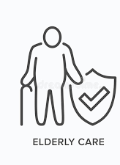
Key Features of our solution

Slide 6
Our Solution
End-to-end solution
Appointment scheduling system
NFC based navigation system
Data analytics dashboard
How our solution works is that the device has records of each location in the health care facility and directions to the destinations. When patient comes to hospital, he receives a card with the destination encoded onto the NFC tag which can be read by our device guiding the person to its final destination.

Slide 7
Several app based, beacon/wifi solution available(all of them with the same conceptual problems)
Few ‘’Interactive map’’ based solution
Competitors?
Same problems about adoptability and usage for stakeholders with low technology proficiency

Slide 8






What makes us special?

Slide 9
Unique points about our solution?
Independent from network coverage of any kind
User friendliness and ease of adoption, does not require elderly to interact with technological devices more than scanning a card like on the metro
Unified, customizable booking system, flexible depending on the specific needs of every doctor or department
Completely anonymous and precise data collection
Data analysis and policy suggesting dashboard, enable self learning through data-backed information
Stable technology, can later easily be upgraded for smartphone compatibility. Modular approach make it robusts to shutdowns

Slide 10
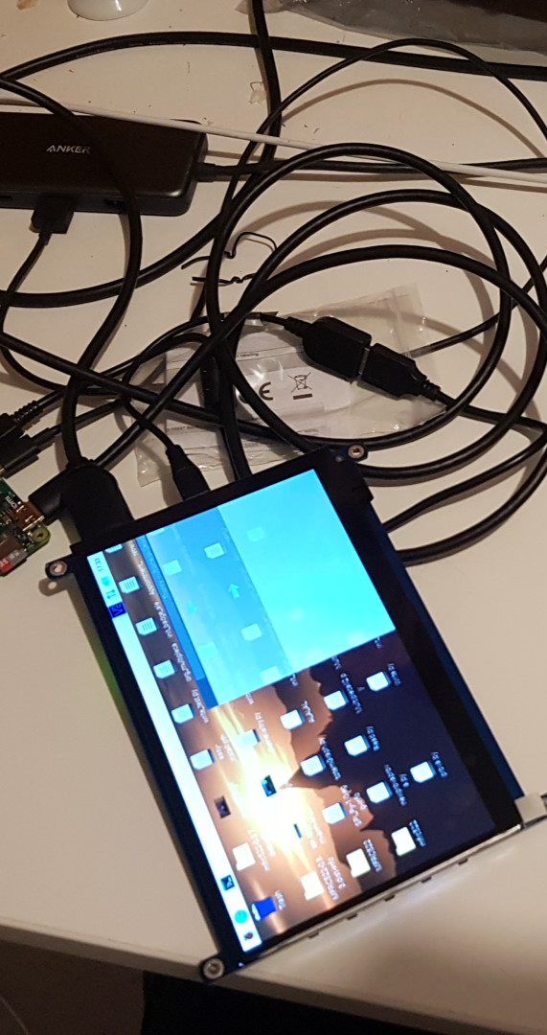
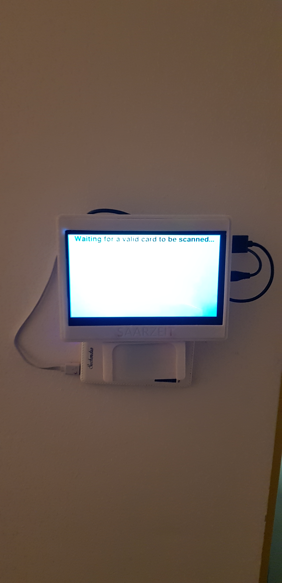
Prototype

