Slide 1

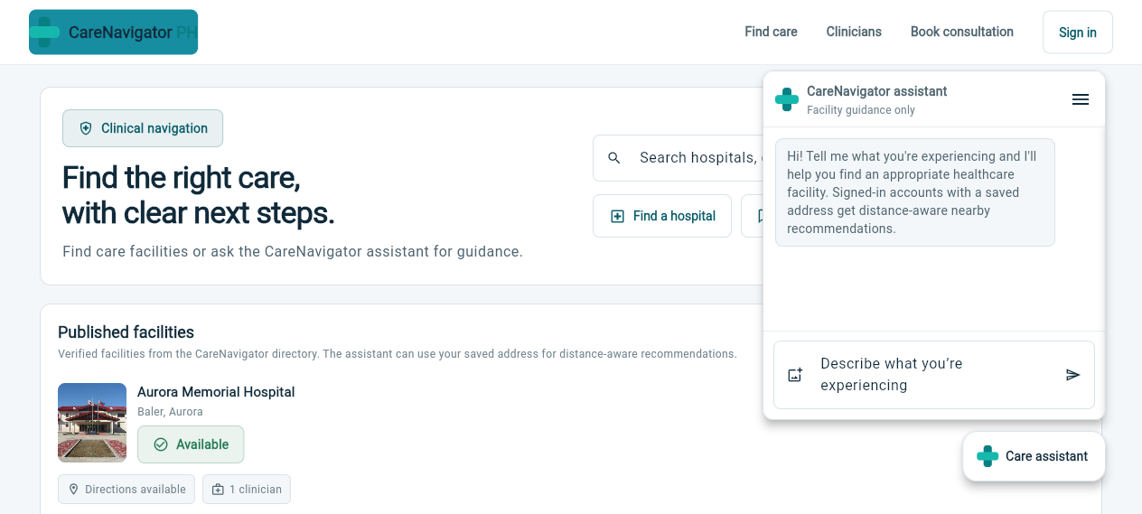
CareNavigator PH
A role-aware healthcare navigation and digital care platform
SYSTEM DEFENSE PRESENTATION
Prepared for project defense | 02 September 2026 | Proponents: [Insert names]
Notes:
[Sources]
- README.md
- SYSTEM_ARCHITECTURE.md
- tmp/carefix-open.png
[/Sources]

Slide 2
SYSTEM DEFENSE
Care access breaks across disconnected steps
Finding a hospital is only the first decision.
DESIGN RESPONSE
01
Guide
Public hospital, service, clinician, schedule, and capacity information are difficult to compare in one place.
Verified discovery plus safety-aware assistance
02
Connect
Guest intake, booking, consultation, and follow-up often require repeated handoffs and duplicate information.
A continuous path from request to consultation
03
Protect
Clinical records, documents, prescriptions, laboratory results, and reminders can become fragmented across actors.
Role-scoped data, private files, and auditability
2
Notes:
[Sources]
- README.md
- SYSTEM_ARCHITECTURE.md sections 1 and 6
[/Sources]

Slide 3
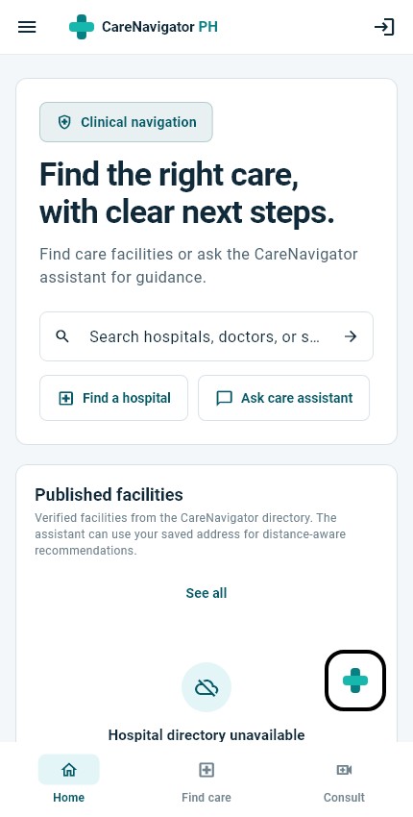
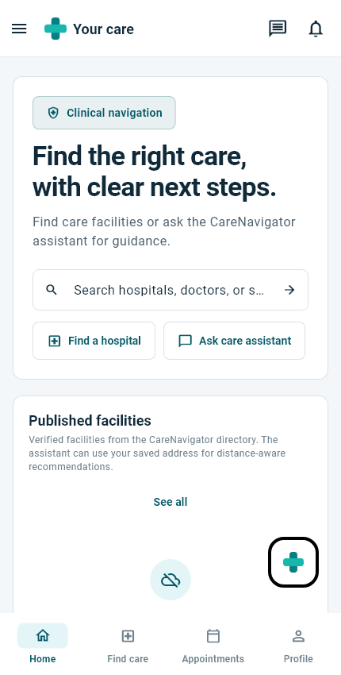
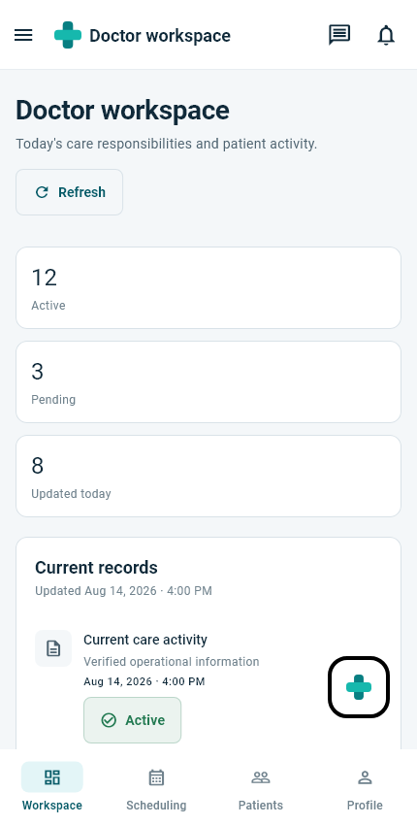
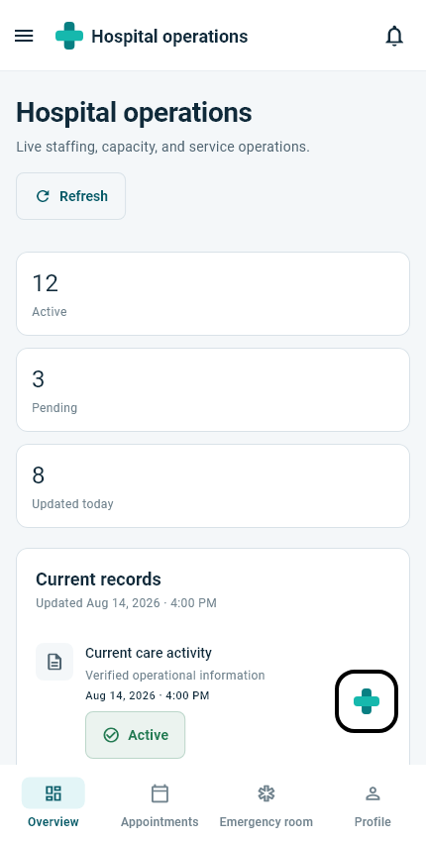
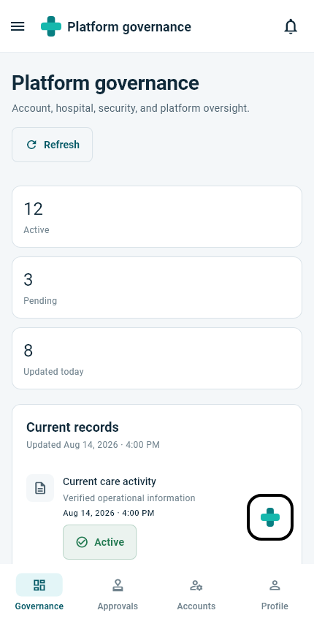
SYSTEM DEFENSE
One platform supports five role-aware experiences
The same care journey changes by responsibility; routes, actions, and data visibility follow the signed-in role.
Guest
Patient
Doctor
Hospital admin
Super admin
Discover care, ask the assistant, and submit a verified request
Book care, communicate, and manage records
Manage schedules, consultations, prescriptions, and labs
Operate one hospital, staff, services, and capacity
Govern hospitals, accounts, settings, analytics, and audits
3
Notes:
[Sources]
- lib/src/models/auth/user_role.dart
- lib/src/routing/app_router.dart
- test visual artifacts named on slide
[/Sources]

Slide 4
SYSTEM DEFENSE
Six objectives make care accountable
GENERAL OBJECTIVE
Design and implement a secure, responsive platform that helps people find appropriate care and supports the care lifecycle across authorized users.
1
Make care discoverable
2
Guide safely
3
Connect the journey
Publish verified hospitals, services, clinicians, schedules, routes, and availability.
Use deterministic emergency checks and preliminary AI guidance without replacing diagnosis.
Link guest intake, booking, consultation, communication, documents, and follow-up.
4
Enable role-based work
5
Protect clinical data
6
Verify quality
Provide patient, doctor, hospital-administrator, and platform-governance workspaces.
Enforce authorization with JWTs, RLS, private storage, constraints, triggers, and audit logs.
Use analysis, unit/widget tests, SQL acceptance tests, build checks, and visual baselines.
4
Notes:
[Sources]
- README.md
- SYSTEM_ARCHITECTURE.md sections 1, 5, 6, 8, and 10
- test/ and supabase/tests/
[/Sources]

Slide 5
SYSTEM DEFENSE
The workflow preserves continuity from discovery to follow-up
Discover
Guide
Request
Consult
Document
Follow up
Hospitals, clinicians, services, availability
Assistant triage and emergency escalation
Guest verification or patient booking
In person, email-assisted, or video
Checkup, prescription, and laboratory data
Private files, messages, and reminders
Authorization and safety remain continuous
Role guards in the client; RLS, constraints, and server-side checks in the backend; preliminary AI always separated from official clinical decisions.
5
Notes:
[Sources]
- docs/defense/system_flowchart.mmd
- SYSTEM_ARCHITECTURE.md section 6
[/Sources]

Slide 6
SYSTEM DEFENSE
Scope is broad; production boundaries are explicit
IN SCOPE
CURRENT LIMITATIONS
Responsive Flutter mobile and web experiences
Care-assistant output is preliminary guidance, not a diagnosis or prescription
Public hospital and clinician discovery with maps and routes
External-provider behavior depends on configured Groq, SMTP, Jitsi, map, and Supabase services
Guest intake, patient booking, consultation, messaging, and notifications
Live role-to-role end-to-end tests require seeded non-production accounts and credentials
Doctor schedules, structured clinical documentation, prescriptions, and laboratories
iOS/device, load, disaster-recovery, privacy, and compliance validation remain before release
Hospital operations plus platform governance
Public directory screenshots show explicit unavailable states when backend configuration is absent
Supabase Auth, RLS, Realtime, private Storage, RPCs, Edge Functions, and audit controls
Current visual regression baselines require review after recent UI changes
6
Notes:
[Sources]
- README.md
- SYSTEM_ARCHITECTURE.md sections 8 and 11
- VERIFICATION_REPORT.md
- Local flutter test run, 2026-09-02
[/Sources]

Slide 7
SYSTEM DEFENSE
Layers separate presentation, data access, and authority
Actors
Flutter UI
Repositories
Supabase
Five role-aware user types
Feature screens, shared widgets, GoRouter, Riverpod
Typed queries, mutations, validation, and realtime mapping
Auth | API and RPC | PostgreSQL plus RLS | Realtime | private Storage | Edge Functions | Cron
Server integrations
Client integrations
Groq AI and Gmail SMTP
Jitsi, OpenStreetMap, OSRM
Public configuration stops at the client. Privileged keys and clinical authorization remain server-side.
7
Notes:
[Sources]
- docs/defense/system_architecture.mmd
- SYSTEM_ARCHITECTURE.md sections 2 through 5
[/Sources]

Slide 8
SYSTEM DEFENSE
Care relationships govern clinical access
users
hospitals
care relationships
medical records
Role, status, hospital scope
Verified directory and operations
Purpose, scope, status, expiry
Structured checkups and notes
patients
employments
consultations
prescriptions
Application patient identity
Hospital-clinician links
Schedule and lifecycle
Signed medication orders
doctors
departments
chat conversations
lab requests / results
Clinician identity and profile
Hospital-specific care units
Doctor-patient communication
Order, upload, analysis, review
Full field-level Mermaid ERD: docs/defense/database_erd.mmd
RLS policies, grants, triggers, functions, indexes, audit logs, and private Storage policies complete the physical design.
8
Notes:
[Sources]
- docs/defense/database_erd.mmd
- supabase/migrations/
- lib/src/repositories/
[/Sources]

Slide 9
SYSTEM DEFENSE
Security is enforced below the interface
The UI improves usability. It is not the authorization boundary.
1
Role-aware routes and guarded actions
Presentation layer prevents invalid navigation and exposes clear account states
2
Typed repository boundary
Validation, exact IDs, controlled mutations, and explicit failure handling
3
JWT plus PostgreSQL Row Level Security
Patient, doctor, hospital, relationship, and action scope are checked by the backend
4
Private Storage and signed URLs
Clinical and identity files are never permanent public assets
5
Constraints, triggers, audits, and server-only secrets
Clinical invariants and privileged operations remain observable and accountable
9
Notes:
[Sources]
- SYSTEM_ARCHITECTURE.md sections 7 and 8
- docs/MULTI_HOSPITAL_SCHEMA_AUTHORIZATION_AUDIT.md
- supabase/migrations/
[/Sources]

Slide 10
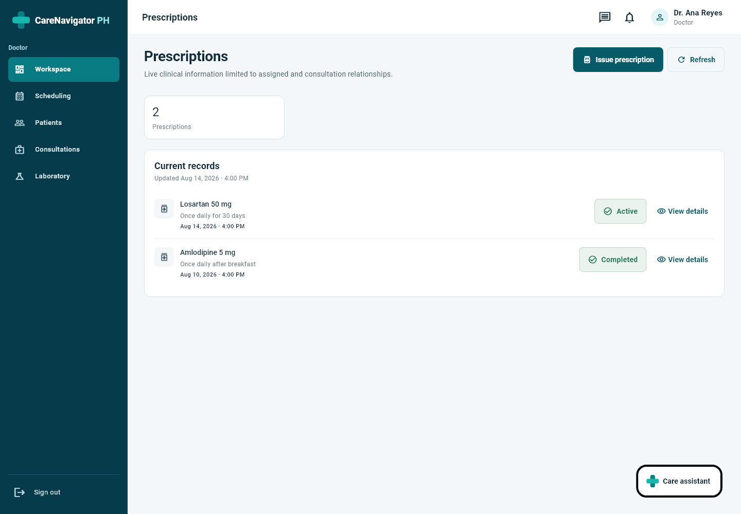
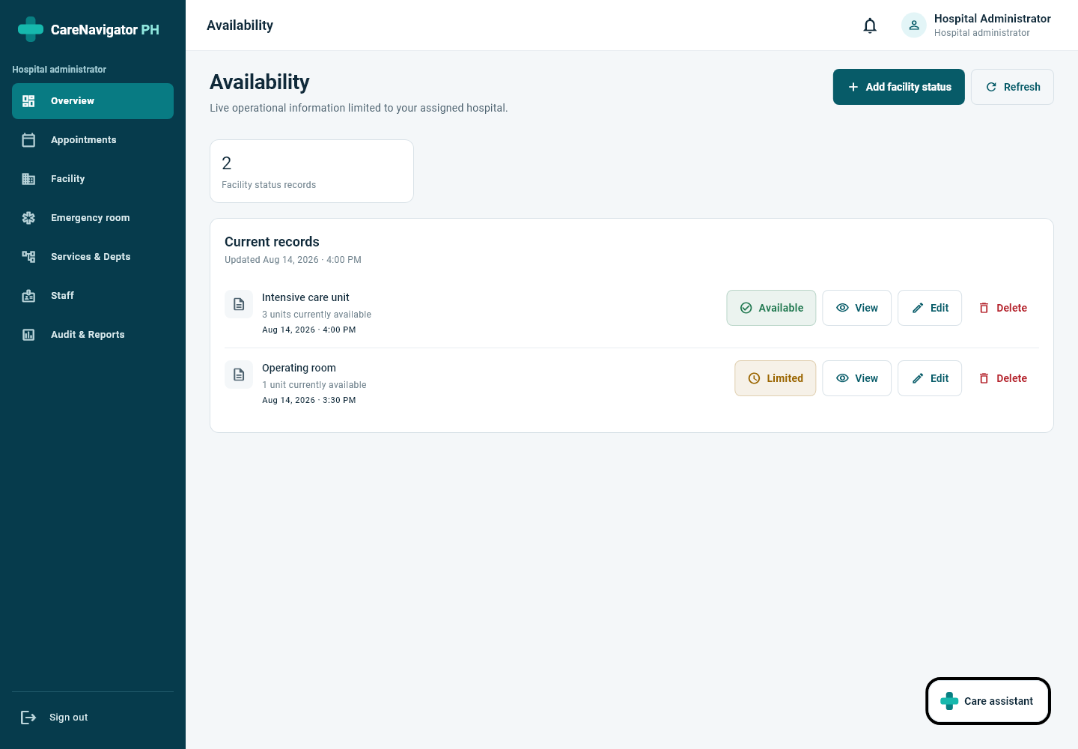
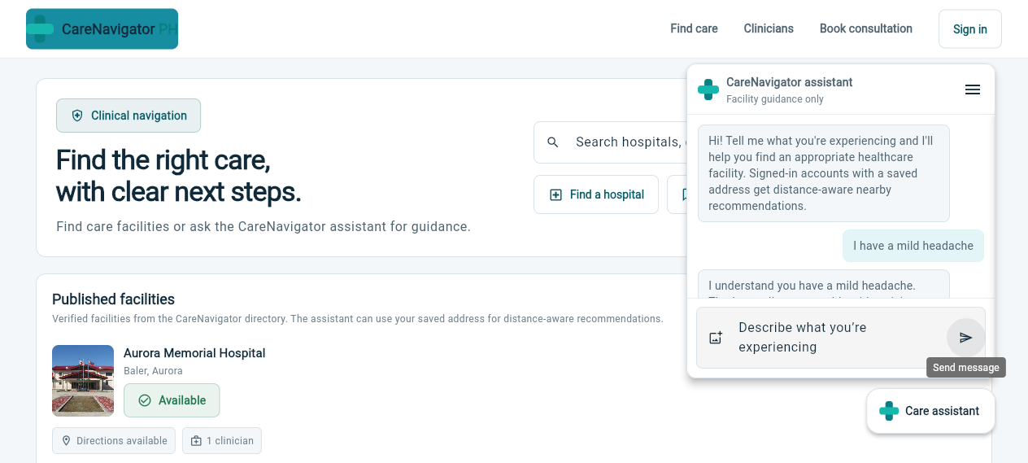
SYSTEM DEFENSE
Implemented screens span care and operations
Care assistant
Doctor prescription workflow
Hospital operations
Safety-aware guidance with facility context
Reviewable structured medication orders
Connected availability and capacity controls
10
Notes:
[Sources]
- tmp/carefix-result.png
- test/failures/doctor_prescriptions_web_testImage.png
- test/visual_catalog/hospital_availability_web.png
[/Sources]

Slide 11
SYSTEM DEFENSE
Current build evidence is strong - but not fully green
Verified locally on 02 September 2026
0
243
11
63
analyzer issues
tests passed
live tests skipped
migration files
Visual regression status
The failures are golden-image differences after recent UI changes. They require intentional review and baseline refresh - not concealment - before claiming a fully green suite.
8 passed | 8 failed
11
Notes:
[Sources]
- Local command: flutter analyze (no issues), 2026-09-02
- Local command: flutter test (243 passed, 11 skipped, 8 failed), 2026-09-02
- supabase/migrations/ directory count
[/Sources]

Slide 12
SYSTEM DEFENSE
Progress moved from foundation to integrated care
09 AUG
23-26 AUG
02 SEP
Foundation verified
Care workflow expansion
Current defense state
Flutter architecture, role routing, live Supabase contract, public discovery, auth, and initial workspaces.
Multi-hospital authorization, online requests, patient linking, structured prescriptions and diagnostics, persistent messaging, reminders.
Care assistant integration, 63 migrations, clean static analysis, broad automated coverage, and identified golden-test drift.
Current state: a functioning integrated prototype with verified strengths and explicit gaps.
12
Notes:
[Sources]
- git log through 5bd0866
- PRE_BUILD_REPORT.md
- supabase/migrations/
- Local verification on 2026-09-02
[/Sources]

Slide 13
SYSTEM DEFENSE
Four actions remain before production
01
Review visual drift
Confirm intended UI changes, then update only approved golden baselines.
02
Run live role journeys
Use seeded non-production accounts for patient-to-doctor-to-admin end-to-end tests.
03
Validate providers and devices
Exercise Groq, SMTP, Jitsi, scheduled jobs, Android hardware, and iOS/macOS builds.
04
Formalize operations and compliance
Complete privacy/security review, monitoring, load tests, backups, retention, recovery, and key rotation.
13
Notes:
[Sources]
- SYSTEM_ARCHITECTURE.md section 11
- VERIFICATION_REPORT.md remaining production verification
- Local visual regression run 2026-09-02
[/Sources]

Slide 14
DEFENSE CONCLUSION
CareNavigator PH demonstrates a viable, secure path from finding care to managing care.
The prototype is defensible because its value, architecture, authorization boundaries, database relationships, implemented workflows, and remaining risks are all visible and testable.
Panel decision requested
Approve continued development toward live end-to-end validation and production-readiness controls.
CareNavigator PH | System Defense | 02 September 2026
Notes:
[Sources]
- README.md
- SYSTEM_ARCHITECTURE.md
- Local repository and verification evidence reviewed 2026-09-02
[/Sources]

