Slide 1

SMART INDIA HACKATHON 2026
Problem Statement ID - SIH26167
Problem Statement Title - SatQuery AI – An Interactive Vision-Language Assistant for Multimodal Remote Sensing Image Analysis through Text Queries
Theme - Space Technology
PS Category - Software
Team ID -
Team Name (Registered on portal) - NextGen

Slide 2

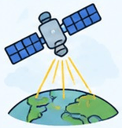








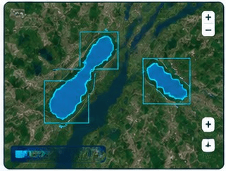





NextGen
SatQuery AI: Interactive Vision-Language Assistant for
Multimodal Remote Sensing Image Analysis
SMART INDIA
HACKATHON
2026
PROBLEM
OUR IDEA
Remote sensing analysts struggle to extract insights
from multimodal satellite imagery. Existing tools
require complex GIS software and expert skills,
while natural language queries cannot be answered
directly, delaying critical decisions in agriculture,
disasters, and defence.
SatQuery AI is an interactive Vision-Language model
that allows users to ask natural language questions about
multimodal remote sensing images and receive accurate,
source-cited answers with visual grounding (bounding boxes /
heatmaps). It understands both text queries and satellite
imagery simultaneously.
PROPOSED SOLUTION
How SatQuery AI Works
INNOVATION/UNIQUENESS
Users upload one or more remote sensing images (or select from ISRO data sources) and type a natural language question (e.g., “Show all water bodies larger than 2 hectares and detect any change since last year”).
A multimodal Vision-Language model (fine-tuned on remote sensing data) jointly understands the image and the text query.
The system returns:
  Natural language answer
  Visual grounding (highlighted regions on the image)
  Confidence score & source citations
Supports multi-temporal analysis, change detection, object counting, and semantic segmentation through conversation.
India's first conversational Vision-Language
assistant
Satellite Image
SatQuery AI
Specifically built for multimodal satellite imagery
(optical + SAR + hyperspectral).
Natural Language
Query
Answer & Visual
Evidence
Upload or select
remote sensing data
Ask your question
in simple language
Understands image & query
using a multimodal
model
Get results with
highlights, confidence and
sources
Query-to-map grounding
Answers are not just text, they are spatially linked
back to the exact pixels in the image.
🔴🟡🟢 SatQuery AI
Show all water bodies larger than hectares
2 hectares and detect any change
since last year.
Multi-temporal reasoning
Compare images from different dates using
natural language.
Optical
I found 3 water bodies larger than
2 hectares. There is a noticeable increase
in area for 1 water body compared to
last year.
Domain-adapted model
SAR
Trained/fine-tuned on Indian satellite datasets
(Cartosat, Resourcesat, RISAT, etc.) for better
accuracy on Indian landscapes.
Confidence: 94%
Hyperspecral
Source: ISRO
Explainable outputs
Detected Water Bodies
Ask another question...
With confidence scores and visual evidence -
critical for scientific and defence use-cases.
2

Slide 3





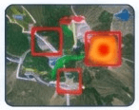
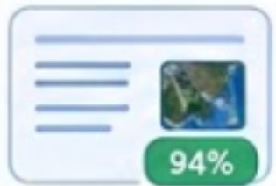




















TECHNICAL APPROACH
NextGen
TECHNICAL APPROACH
SMART INDIA
HACKATHON
2026
HARDWARE & SOFTWARE
FLOW CHART / METHODOLOGY
Python 3.10+
1
2
3
4
5
6
7
with PyTorch and Hugging Face
Transformers
Vision-Language Models
Fine-tuned LLAVA / RemoteCLIP /
GeoChat-style models adapted for
satellite imagery
Visual Grounding
User Upload & Query
Pre-processing
Vision Encoder
Text Encoder
Multimodal Fusion
Final Output
Multimodal satellite
image(s) & natural
language query
Normalization
and tiling when
needed
Extracts visual
features
Processes
the query
Combines image & text
and generates
the answer
Bounding boxes /
heatmaps
Natural language answer,
visual highlights &
confidence score
Frontend
Streamilt/Gradio for rapid prototype +
React for final production web app
3-LAYER APPROACH
FUTURE IMPROVEMENTS
Backend
Real-time streaming satellite data
FastAPI
Layer 1
Pre-trained Vision-Language Backbone
Multi-user collaboration and annotation
Image Processing
More indian satellite constellations
OpenCV, Rasterio, GDAL
Higher-accuracy multi-temporal change
detection
Cloud/Compute
Layer 2
Domain Adaptation on Indian Satellite Data
Mobile offline mode with on-device inference
Google Colab/Kaggle for training +
lightweight CPU/GPU inference
Better explainability with attention maps &
natural language justifications
Datasets
GitHub: github.com/NotAzie/SatQuery-AI.git
Layer 3
Query-to-Map Grounding & Multi-Temporal
Reasoning
YouTube: Coming soon
ISRO public datasets (Cartosat, Resourcesat,
RISAT) & open remote sensing benchmarks
Above 15% of the prototype is completed
3

Slide 4






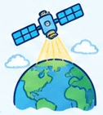





NextGen
FEASIBILITY AND VIABILITY
SMART INDIA
HACKATHON
2026
COMMERCIAL FEASIBILITY
FEASIBILITY
Market Validation
Strong demand from agriculture, disaster management, urban planning,
defence, and research institutions for easier satellite data analysis.
Lab-based development
Using open-source Vision-Language models and publicly available satellite datasets - no expensive
hardware required at early stage.
Validation
Possible by comparing model outputs with ground-truth annotations from open remote sensing
benchmarks and ISRO sample data.
Technical Readiness
Highly feasible using existing open-source models & domain adaptation.
Safe testing environment
Fully software-based pipeline; no real-time satellite access needed initially.
Algorithm flexibility
Modular design allows easy swapping of backbone models (LLAVA, RemoteCLIP, etc.) as better
models become available.
Timeline
Core prototype (text query & image → answer & basic grounding)
achievable in short time using available tools.
Current progress
Architecture designed and base pipeline selected (~10% completed).
Success Likelihood
High if we start with a focused MVP and gradually expand features.
CHALLENGES
Limited high-quality annotated multimodal Indian satellite datasets.
1
Start with a lightweight MVP
STRATEGY
Using pre-trained models + limited fine-tuning.
High computational cost for fine-tuning large Vision-Language models.
2
Use free/open datasets first
From Satellite Data to Real-World Impact
Then request ISRO sample data for better adaptation.
Achieving accurate visual grounding (bounding boxes / heatmaps) on complex satellite scenes.
3
Optimize for edge / low-resource inference
So it can run on normal laptops.
Handling multi-temporal queries and different sensor types (optical, SAR, etc.) in one system.
4
Keep the architecture modular
So new features (multi-temporal analysis, more sensors, collaboration tools, etc.)
can be added later as the idea expands.
Small steps today
↓
Bigger impact tomorrow
Uncertainty about the final scope the idea may expand further based on progress and feedback.
5
Continuously evaluate progress
And adjust scope based on results.
4
4

Slide 5

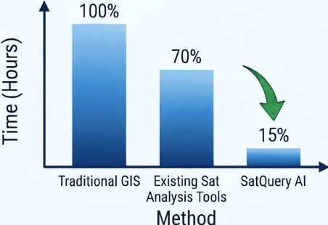







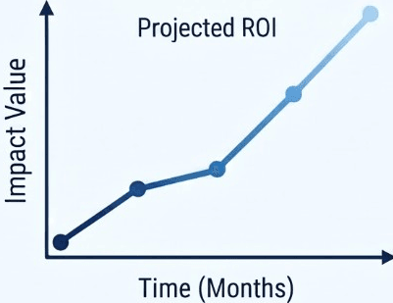







NextGen
IMPACT AND BENEFITS
SMART INDIA
HACKATHON
2026
DIRECT IMPACT ON TARGET USERS
ECONOMIC & STRATEGIC BENEFITS
ISRO Scientists (natural language analysis for faster insights)
Economic Benefits
Analysis Efficiency
Disaster Teams (rapid assessment of flood-affected zones with
visual evidence)
Cost Reduction
(lower operational costs in data analysis)
Revenue Generation
(new markets for satellite data products)
Agriculture (crop health monitoring and yield prediction)
Investment Attraction
(increased private sector engagement in space tech)
Defence (enhanced imagery interpretation for security threats)
Strategic Benefits
Urban Planners (efficient infrastructure development planning)
Cost Reduction
(lower operational costs in data analysis)
STRATEGIC IMPACT
Revenue Generation
(new markets for satellite data products)
Data Accessibility (democratizing access to
complex satellite data via natural language)
Faster Decision-Making (accelerating
critical decisions in key sectors)
Strategic Growth
Investment Attraction
(increased private sector engagement in space tech)
Space-AI Capability (pioneering advanced AI
for space-based based applications)
Aatmanirbhar Bharat (strengthening
indigenous technological self-reliance)
5

Slide 6
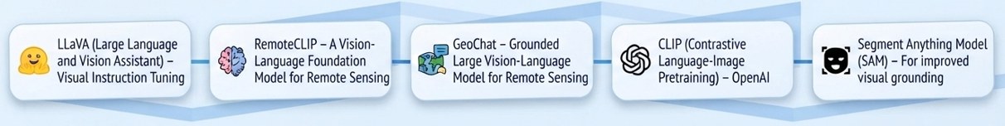







NextGen
RESEARCH AND REFERENCES
SMART INDIA
HACKATHON
2026
KEY RESEARCH FOUNDATIONS
DATASETS USED / REFERENCED
TOOLS & TECHNOLOGIES
ADDITIONAL REFERENCES
ISRO public datasets (Cartosat, Resourcesat, RISAT sample data)
RSICD, NWPU-RESISC45, AID (Remote Sensing Image
Captioning & Classification datasets)
Open remote sensing benchmarks for visual question
answering
Hugging Face Transformers
ISRO Official Website & Data Portal
PyTorch
Smart India Hackathon 2026 Problem
Statement (SIH26167)
Rasterio & GDAL
Recent papers on Vision-Language
Models for Satellite Imagery
(2023-2025)
Streamlit/FastAPI
6

