Slide 1
Smoodle War
An online multiplayer game where you can draw/guess against your friends!
Dakota Varnell, Landon Johnson, Colby Noel, Ian Fields, Brian Cavin

Slide 2
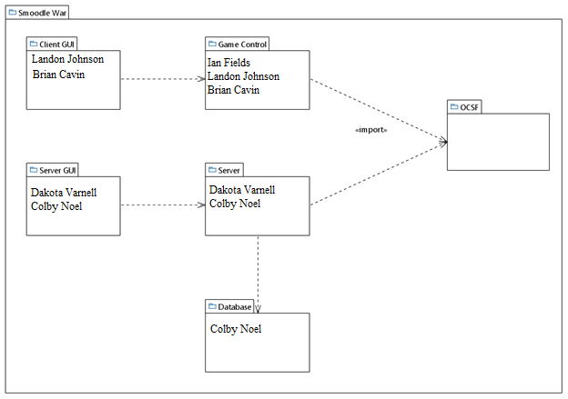
Package Diagram

Slide 3
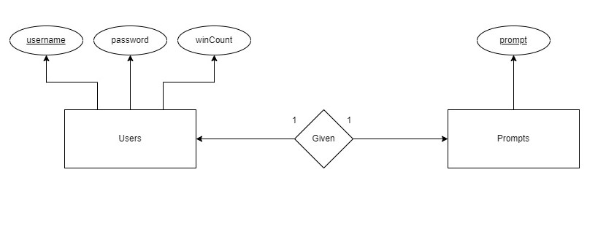
Database Design Diagram

Slide 4
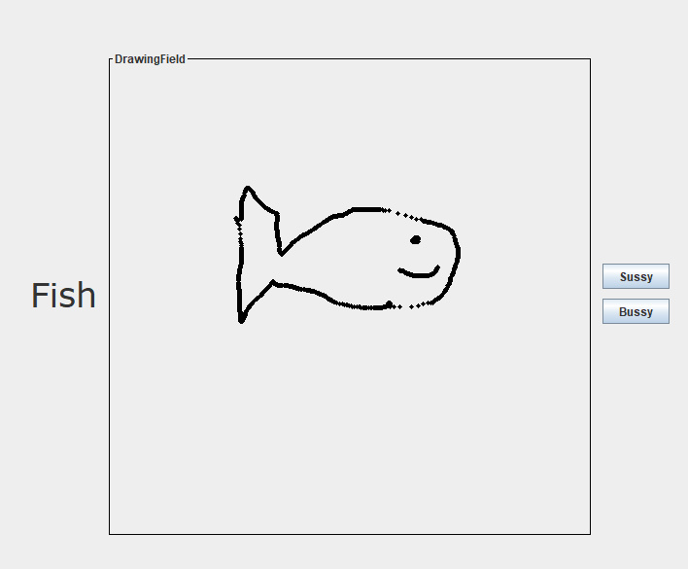
Functional Requirement (Drawing Round)
Drawing User will be given a randomly generated prompt telling them what they need to draw
Drawing User can press send to send the drawing to the Guessing User, once send button is pressed the image is sent to the server and the server then sends the image to the other client

Slide 5
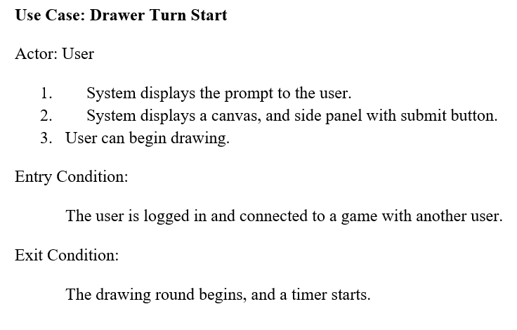
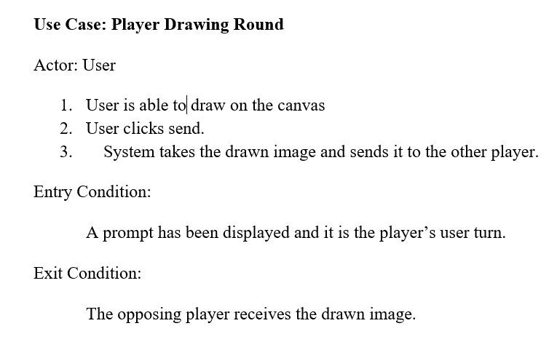
Use Case Description (Drawing Round)

Slide 6
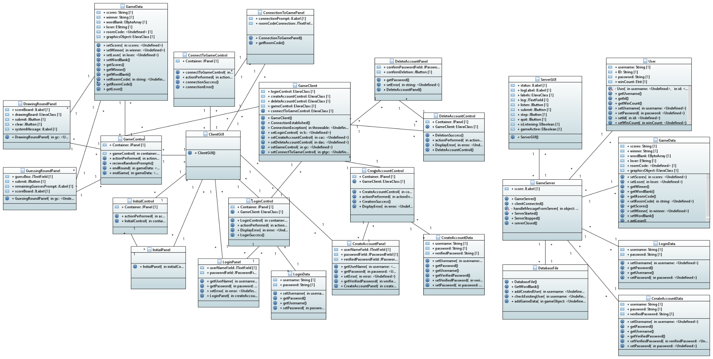
Initial Class Diagram

Slide 7
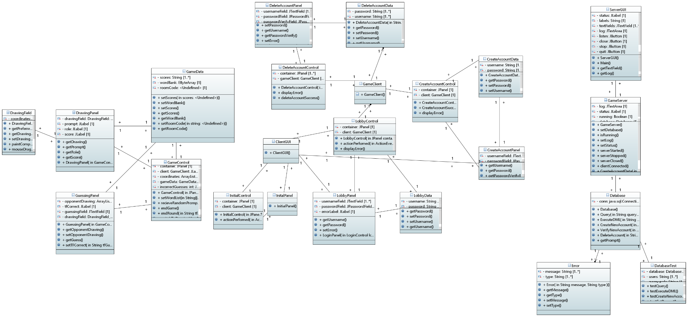
Final Class Diagram

