Slide 1
Hydroponic Farm
By StemFreak

Slide 2
Who are we?
We are students at an educational center called StemFreak at Evelthontos 20, Strovolos, 2003, Cyprus
https://maps.windows.com/?form=WNAMSH&collection=point.35.152394_33.373522_My%20location%20%28within%20292%20m%29

Slide 3
The Problem
Humans will soon need more food than the planet can proved with the land we have available to us.
We need a better and more efficient way to farm plants.
Hydroponics is growing plants in water without any soil

Slide 4
Details
In the past centuries humans have been increasing in numbers rapidly. This wasn’t a major problem in the past, but now it has become a problem. As the population increased so did the needs for humanity, that includes food. The land we can farm food at is decreasing; plants can only grow in specific places. Our way of solving the problem is Hydroponics.

Slide 5
What is Hydroponics?
Because we can’t grow plants on land, we believe that the next step is to grow them on water.
Hydroponics is a technic of growing plants without the usage of soil.
Plants in hydroponic systems are grown in water streams.
The plant’s roots are exposed to flowing water where they get the nutrients they need to grow.
Many plants will grow faster and healthier this way.

Slide 6
How does a Hydroponic System
In hydroponic systems water flows in tubes and is kept flowing by a water pump.
Holes are drilled in the tubes, one next to each other in a staring line, and plant’s roots, without any soil, are placed in the water.
Note that the plants are grown in soil briefly before placed in the system, just enough so the plant has roots that can observe nutrients from the water
The water has additional nutrients in it because water alone does not have enough nutrients for the plants.

Slide 7
Over population
The current world population is 7.9 billion as of March 2022 according to the most recent United Nations estimates elaborated by Worldometer. The term "World Population" refers to the human population (the total number of humans currently living) of the world.
What causes overpopulation : The life spam of the human average life increase by a lot so new humans are born before other humans die so the numbers rapidly increases.
The Effects of Overpopulation More people means an increased demand for food, water, housing, energy, healthcare, transportation, and more. And all that consumption contributes to ecological degradation, increased conflicts, and a higher risk of large-scale disasters like pandemics.

Slide 8
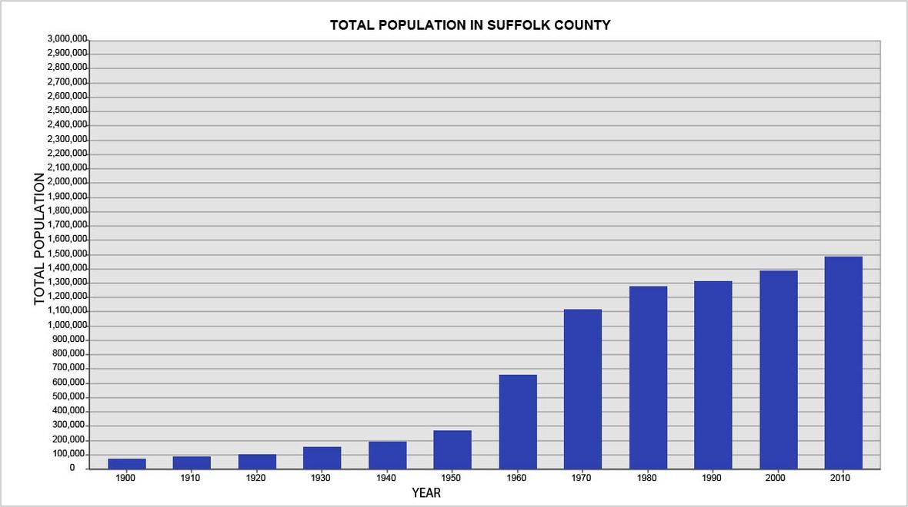
Chard

