Slide 1
SIGMA BOT
A CS3 GROUP SIGMA PROJECT

Slide 2
WHAT IS SIGMA BOT?
Sigma Bot is a simple chatbot developed by members of CS3 Group Sigma as an AI class project.
A chatbot is …
Using Python, the bot is designed to learn answers to new (unknown) questions by asking the user to “teach” it when it cannot answer a question presented to it.
The bot then takes the user’s input and updates its knowledge base for reference anytime it comes across that same question or a similar one in the future.
The bot’s knowledge base is stored in a JSON file containing pre-existing questions and answers to those questions.

Slide 3
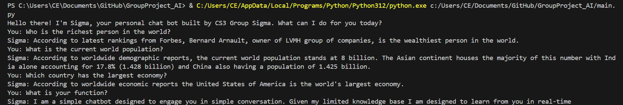
EXPLAINING THE CODE BEHIND SIGMA BOT
https://github.com/NotEkluCalvin/GroupProject_AI
The link above is for a GitHub repository containing the source code for the project. We’ll break down the source code into four separate blocks and over the next few slides we’ll explain the role of each block in bringing Sigma Bot to life. Below is a screenshot of a user’s interaction with Sigma.

Slide 4
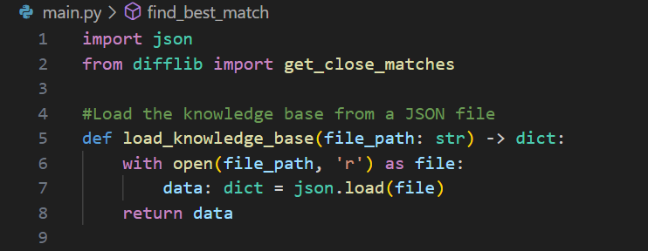
EXPLAINING THE CODE BEHIND SIGMA BOT: BLOCK I
The first two lines are used to bring in some dependencies our project needs. The first line adds the JSON file to the main python script and the second line adds a function that helps us derive the best response to user input (questions).
Lines 5 to 8 define a function that reads the knowledge base from the JSON file. The parameter of the function (file_path) is the path to the JSON file containing the knowledge base. The function returns a dictionary with the knowledge base data.

Slide 5
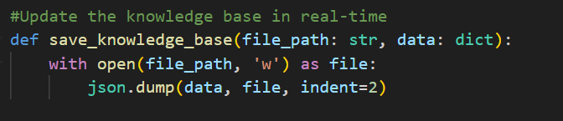
EXPLAINING THE CODE BEHIND SIGMA BOT: BLOCK ii
This block of code defines a function that saves the dictionary to the knowledge base, updating it so that new responses are added for future use. This is done by opening the file (file_path) in write mode (‘w’) and inserting the dictionary (data) into the JSON file (json.dump).

Slide 6
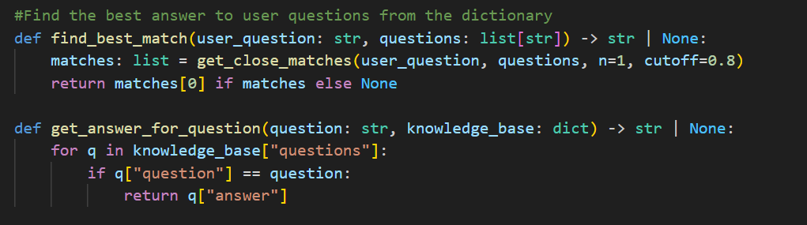
EXPLAINING THE CODE BEHIND SIGMA BOT: BLOCK III
This block contains two functions which are used to find the best answer to user questions from the dictionary. The first function, defined with the parameters user_question and questions of types string and list(string) respectively, checks whether the question asked exists in the knowledge base. It either returns a string or nothing due to the chance that the knowledge base for that question might not exist. Line 17 and 18 creates a list of matches for the question using the get_close_matches function which returns the best possible question (n=1) with an accuracy (similarity) of at least 80% (0.8). The function returns None if there are no matches found (Line 18).
The second function, as the name implies, gets the answer for each question asked. The for loop defined in lines 21 to 23, returns the answer for every q (i.e. question) in the knowledge base of questions if the q asked matches a question in the knowledge base.

Slide 7
EXPLAINING THE CODE BEHIND SIGMA BOT: BLOCK IV
This block creates the main script for the program. This script contains a number of different statements each carrying out a specific function:
I. First the knowledge base variable is created
II. A infinite loop is created to receive input from the user. This input is stored in a variable named ‘user_input’. An exit is included by breaking the loop if the user types ‘Quit’. The best_match variable for the user input is created to search for the best match inside the JSON file.
III. Inside the loop, a conditional statement is created to check if there is indeed a best match for the question asked by the user. If the best match exists, an answer variable is created which obtains the answer for the best match using the get_answer_for_question function defined previously in block III. The answer is then printed to the screen. If the best match doesn’t exist the Sigma prompts the user that it doesn’t know the answer and asks the user to teach it. The answer entered by the user is then stored and the knowledge base is updated to reference that question and answer should Sigma encounter the same or a similar question in future interactions. The user can also type in ‘skip’ to skip that question.

Slide 8
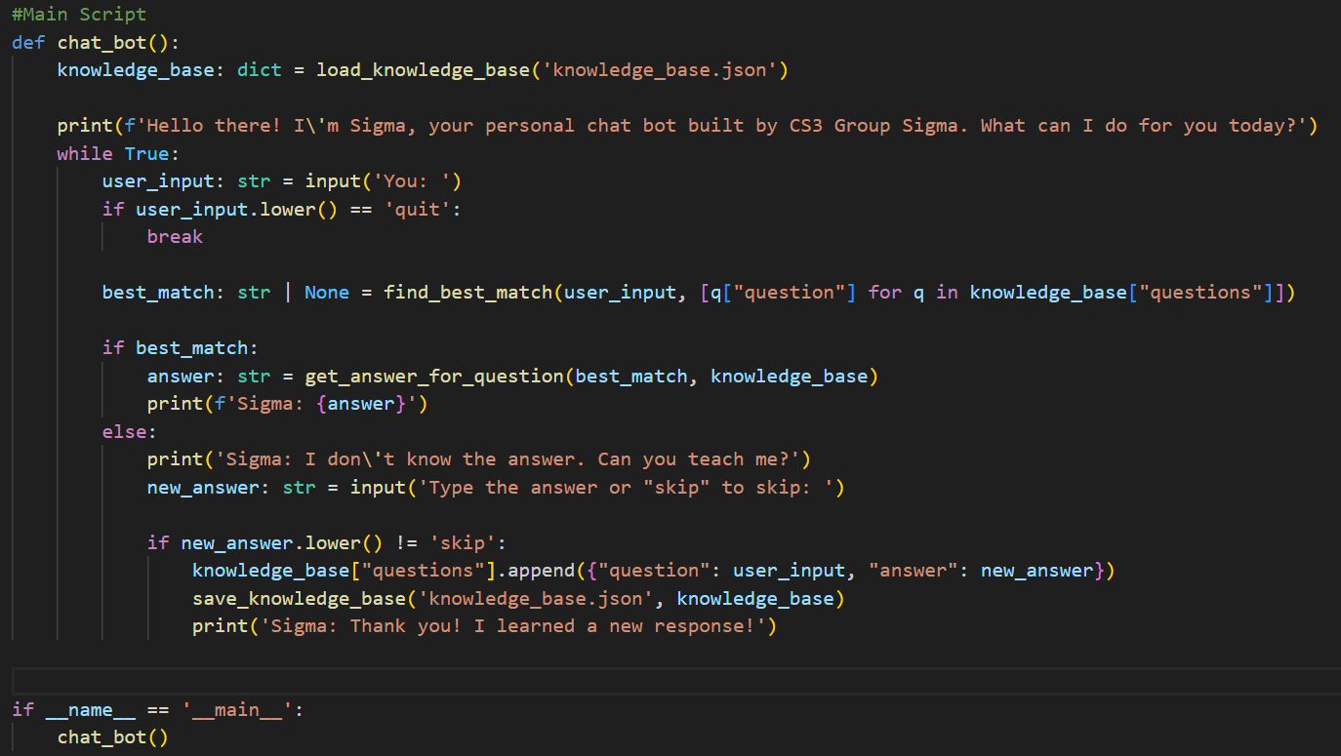
EXPLAINING THE CODE BEHIND SIGMA BOT: BLOCK IV CONT’D
The last statement of the block is a simple main check.

Slide 9
LIMITATIONS OF SIGMA BOT
The limited size of the current knowledge base means Sigma Bot can only answer a handful of questions.
Due to the nature of English language, and the limited capacity of the bot to understand/interpret the language properly, Sigma provides inaccurate answers or, in some cases, may not understand different variations of questions that generally have the same answer. For example, when asked who the richest person in the world is Sigma can answer accurately. However, when the question is changed to “Who has the largest net worth in the world?”, Sigma fails to comprehend that both questions have the same answer and prompts the user that it does not know the answer to that question.

Slide 10
CS3 GROUP SIGMA MEMBERS:
EMMANUELLA EDINAM DUNYO – 8547321
FRANCIS GYASI SARPONG – 8567621
NGOLUBE PRINCE HENRY – 8558421
EKLU CALVIN MISORNU – 8548421
PRINCEWILL SIGISMUND TELEMA – 8565921
WIREDU FELIX – 8571421
ABDUL-RAUF YAKUBU – 8571621

Slide 11
END of presentation

