Slide 1

Tutorial 0 : Java basics + jacoco
COS 212 2024
Sean Macmillan

Slide 2

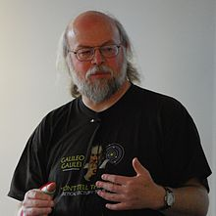
Background
Developed by James Gosling in 1995.
Current version Java SE 19 (Released 20/09/22).
You need Java SE 8/1.8
Java part of the OO Paradigm.
Pure OO
Typing discipline.
Statistically strongly typed
Platform independent thanks to JVM.
Garbage collector.
Syntactically similar to C/C++.
Idea:
Safer by design then C++
All errors are exception based thanks to JVM (more on this later).
Note java uses “null” where C++ uses “NULL”.

Slide 3
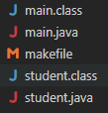

Compilation and Running
Much simpler than C++.
Assuming the following files:
main.java
student.java
To compile:
javac *.java
Note java creates .class files for each class.
To run, assuming the main function is in the main.java file:
java main

Slide 4
File structure
File extension: .java
Must have public class with same name as file name.
Can have nonpublic classes with other names.
Does the order of functions and member variables matter in the file?
No.
C++?
Yes, as you need to define a global variables before using it. Same with functions.
Note local variables work the same in C++ as in Java.

Slide 5

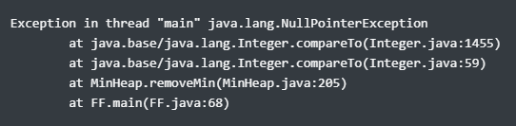
File structure
How does Java crash?
Exceptions.
What does this mean?
How much info does the following error about where the error occurred?
Compared to:

Slide 6
Inheritance and templates
What is an annotation?
Metadata labels used to describe source code.
Annotations are proceeded with an @
Useful annotations:
@Override
@SuppressWarnings(“unchecked”). The “” are necessary.
Used when no generic/template type is specified for a container.
@SuppressWarnings(“rawtypes”)
Used when no generic/template type is specified for a variable.
@SuppressWarnings({“unchecked”, “rawtypes”})
Example of having multiple warnings suppressed.
Will a warning cause your code to not compile or run?
No, unless the compiler is configured like that (not default).

Slide 7
Hints and tricks
Add custom helper functions for recursive functions.
Do not perform exception swallowing.
What is exception swallowing?
Wrapping everything in try catch blocks.
Why is this problematic?
Makes it nearly impossible to see on FF where your code goes wrong.
Take advantage of for each loops

Slide 8
Jacoco exampLe

