Slide 1
Faisla
HAMZA GARMENTS · 80 × JACK F5
Quoted plan
فیصلہ
“decision” in Urdu
Rs 60,00,000
“0% markup”, 12 × Rs 5 lakh
CFO-in-a-box for Pakistani SMEs
Faisla’s pick
Islamic LTFF
Islamic finance first. AI reads, code calculates, the owner decides.
SBP scheme, 8.5% profit rate
Saved
Rs 5,79,103
Rs 4,73,603 after tax
Team CodeStorm · AICON'26 Build With AI · Financial Operations
Notes:
[0:00–0:12 · 12 s]
Assalam-o-alaikum. We are Team CodeStorm, Financial Operations track. This is Faisla, Urdu for “decision”: a CFO in a box for Pakistani small businesses, built Islamic finance first.

Slide 2
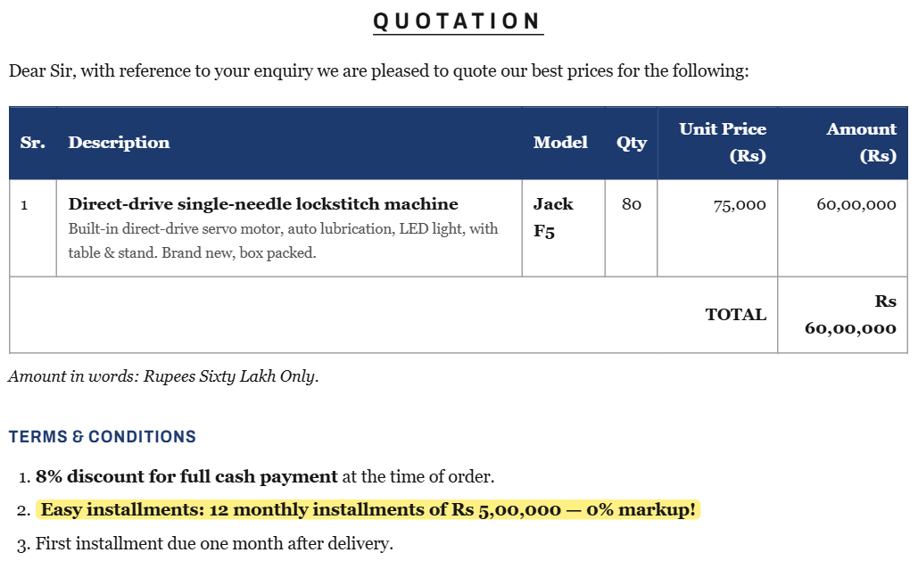
“0% markup” is not free
PROBLEM → DATA / INPUT → AI COMPONENT → SOLUTION → IMPACT
Hamza Garments, Faisalabad
Exporter · Rs 1 crore cash · Rs 35 lakh a month in costs · no finance team. Needs 80 new machines.
Rs 4,80,000
more than the cash price of Rs 55,20,000
FOUR MISTAKES SMEs KEEP MAKING
1 Not seeing the cost of paying later
2 Missing cheap Islamic financing
Supplier A’s quotation (fictional demo data, printed and photographed for the demo)
3 Ignoring tax
4 Paying cash, then no cash for salaries
Notes:
[0:12–0:52 · 40 s]
Meet Hamza Garments in Faisalabad: an exporter with one crore in the bank, thirty-five lakh a month in costs, and no finance team. Hamza needs eighty new lockstitch machines.
Supplier A quotes sixty lakh, with “easy installments, zero percent markup”. Sounds free. It isn’t: twelve times five lakh is four lakh eighty thousand more than the cash price.
Owners like Hamza make the same four mistakes again and again: they don’t see the cost of paying later, they miss cheap Shariah-compliant financing, they ignore tax, and they pay cash and run short for salaries.

Slide 3
AI reads. Code calculates. Owner confirms.
PROBLEM → DATA / INPUT → AI COMPONENT → SOLUTION → IMPACT
INPUTS
Quotation photo / PDF
Roman Urdu replies
Web prices & reviews
Company cash & costs
SBP rate & KIBOR
AI reads & writes
Code calculates
Owner confirms
OpenAI
finance.ts · no AI
human in the loop
Reads the quotation photo into fields
Reads replies like “67 hazar per unit”
Cleans web listings, reads reviews
Writes RFQ emails and the memo
Every rupee: cost of paying later, profit, rentals, PV, tax, runway
Fraud rules: IBAN checksum, account change, sender domain
145 automated tests
Every extracted field
The final choice
Any new bank account, by phone
→
→
Guardrails a price is kept only if it is written in the source · every memo number checked against the calculation · fraud level always from rules
Models gpt-6-luna (vision, reading, writing) · gpt-4.1-nano (fast extraction), chosen by benchmark · ≈ $0.002 per full decision
Notes:
[0:52–1:40 · 48 s]
The inputs are what an owner already has: a photo of the quotation, Roman Urdu supplier replies, web prices and reviews, the company’s cash and costs, and SBP rates.
AI does the reading: the photo into fields, a reply like “sixty-seven hazar per unit” into a price, web listings and reviews into clean data. It also writes the emails and the memo.
AI never does the maths. Code calculates every rupee, and the owner confirms every field.
Guardrails: a price is kept only if it is written in the source, memo numbers are checked against the calculation, and fraud levels come from rules. Models were chosen per task by benchmark; a full decision costs about a fifth of a US cent.

Slide 4
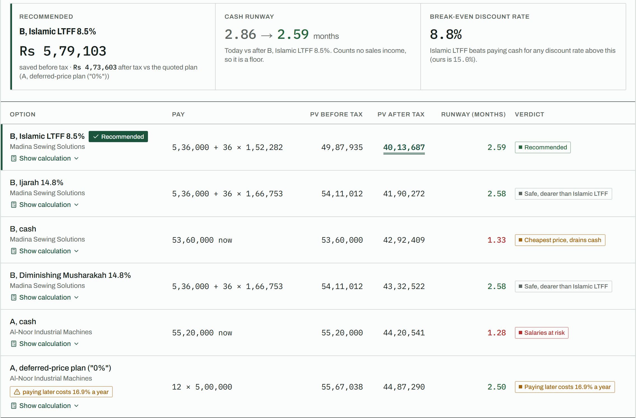
Every way to pay, compared by code
PROBLEM → DATA / INPUT → AI COMPONENT → SOLUTION → IMPACT
16.9%
a year: the cost of paying later on the “0%” plan
8.5%
SBP Islamic LTFF for exporters: recommended
Blocked
a fake “new bank account” email, before any payment
Live app, seeded demo decision: Supplier B found via a Roman Urdu reply at Rs 67,000 a machine
Notes:
[1:40–2:28 · 48 s] (Live option: show these three moments on the seeded decision “80 × Jack F5 lockstitch machines” in the app instead of this slide; keep to 48 s.)
Here is Hamza’s result. Faisla checked the market: the quote is about 9% above our benchmark, and real OLX listings put the median at seventy thousand a machine. It found Supplier B, who replied in Roman Urdu at sixty-seven thousand. Then code compared every way to pay.
Three money moments. One: the “0%” plan is a deferred-price sale; paying later costs 16.9% a year.
Two: Hamza is an exporter, so SBP’s Islamic LTFF at 8.5% wins, and Faisla recommends it.
Three: an email arrives saying “our bank account has changed, pay today”. Faisla flags the new IBAN, the wrong account title and the Gmail address, and blocks payment until Hamza confirms by phone.

Slide 5
Shariah-compliant by default
PROBLEM → DATA / INPUT → AI COMPONENT → SOLUTION → IMPACT
SBP Islamic LTFF
8.5%
Ijarah
14.8%
WHY NOW
1 Jan 2028
Exporters, new machinery · SBP policy rate − 3%
Lease: deposit + rentals · KIBOR + 3%
26th Amendment: riba to be eliminated before this date
Diminishing Musharakah
14.8%
Murabaha
preset
38.1%
Co-own, then buy the bank’s units · KIBOR + 3%
Cost-plus sale, price fixed at the contract
of bank financing in Pakistan is already Islamic
Tax: the correct treatment for each mode.
“0%” plan: a permissible deferred-price sale; we show its yearly cost.
Conventional loans: only on request, labelled, never recommended.
New: a “pay in full when affordable” switch.
Source: SBP Islamic Banking Bulletin, Dec 2025
Notes:
[2:28–3:05 · 37 s]
Faisla is Islamic finance first. By default it only compares Shariah-compliant options: Islamic LTFF, Ijarah, Diminishing Musharakah, and Murabaha as a preset, each with its correct tax treatment. Conventional loans appear only if the owner asks, labelled, and never recommended.
Why now? The 26th Amendment commits Pakistan to eliminating riba before the first of January 2028, and Islamic banks already hold over a third of bank financing.
And if an owner would rather not finance at all, one switch recommends paying in full whenever cash allows.

Slide 6
What one decision is worth
PROBLEM → DATA / INPUT → AI COMPONENT → SOLUTION → IMPACT
5.8 lakh
2.59 mo
Stopped
$0.002
rupees saved vs the quoted plan
of costs kept in the bank
fake bank-account email
AI cost per full decision
Rs 5,79,103 · Rs 4,73,603 after tax
paying cash would leave 1.33
blocked until a phone check
OpenAI API usage
SUSTAINABLE DEVELOPMENT GOALS
8
SDG 8.3
8
SDG 8.10
9
SDG 9.3
SME growth
Access to financial services
Affordable credit for small industry
Better capital decisions for small manufacturers and exporters
A ready term-sheet request to an Islamic bank’s SME desk
Surfaces SBP Islamic LTFF that most owners never ask for
Notes:
[3:05–3:40 · 35 s]
The impact of one decision: five lakh seventy-nine thousand rupees saved against the quoted plan, four lakh seventy-three thousand even after tax. Hamza keeps two and a half months of costs in the bank; paying cash would leave just over one. The fraud email is stopped before any money moves. And the AI costs about a fifth of a cent.
This supports SDG 8.3, SME growth; 8.10, access to financial services; and 9.3, affordable credit for small industry.

Slide 7
All five Financial Operations areas, one flow
PROBLEM → DATA / INPUT → AI COMPONENT → SOLUTION → IMPACT
✓ Financial planning
Every way to pay: PV, after-tax view, cash runway, KIBOR stress test
WHO PAYS
SMEs
✓ Credit & risk
Islamic LTFF vs Ijarah vs Musharakah, cash-risk check, supplier reputation
Monthly plan
✓ Accounting automation
Quotation photo → checked data (qty × price vs printed totals)
Islamic banks
✓ Payments
Installment schedule, upcoming payments, term-sheet request to the bank
Clean, documented financing requests
✓ Fraud detection
“New bank account” check: IBAN, account title, sender domain, urgency
Suppliers
Listed in comparisons
Notes:
[3:40–4:00 · 20 s]
It covers all five areas of the Financial Operations brief in one flow: planning, credit and risk, accounting automation, payments and fraud detection.
Who pays: SMEs on a monthly plan; Islamic banks, who receive clean, documented financing requests; and suppliers listed in comparisons.

Slide 8
Built here, and built to be checked
WHAT WE BUILT DURING AICON'26
First commit 10 Oct 2026 · public Git history
ARCHITECTURE
Finance engine in pure TypeScript, no AI
9 AI tasks, each followed by a code check
Payment-fraud rules
Email loop: RFQs out, replies read
5-step decision workspace + dashboard
Login, MongoDB data layer, model benchmark
Browser · React 19
↓
Next.js 16 on Vercel · session-checked API routes
↓
OpenAI
Tavily search
Gmail
finance.ts
↓
MongoDB Atlas · users, companies, decisions
Honest disclosure
Simulated and labelled: the company, supplier names, price benchmark, bank desk.
Real: Jack F5 market prices and product reviews, with links.
Built with AI coding assistants (allowed by the rules).
145
✓ Every number checked against the calculation
automated tests
Code compares every figure in the AI-written memo with the comparison. “Show calculation” on every row.
Notes:
[4:00–4:35 · 35 s]
Everything here was built during AICON’26; the commit history starts on the tenth of October. We built the finance engine in pure TypeScript, nine AI tasks each followed by a code check, the fraud rules, the email loop, and the app on Next.js, MongoDB Atlas and Vercel. 145 automated tests pin every number you saw.
Honest disclosure: the company, supplier names and benchmark are simulated and labelled; market prices and reviews are real, with links. We used AI coding assistants, as the rules allow.

Slide 9

Try it now
LIVE APP
faisla-xi.vercel.app
DEMO LOGIN
demo@faisla.pk / faisla2026
CODE
github.com/NotHamxa/faisla
Next: WhatsApp quotes and replies · tracking payments after the decision · working-capital decisions · Urdu interface
Scan to open the live app
AI reads, code calculates, the owner decides. فیصلہ
Notes:
[4:35–4:50 · 15 s]
Scan to try it; the demo login is on screen. Next we add WhatsApp quotes, payment tracking after the decision, and Urdu. AI reads, code calculates, the owner decides. That’s Faisla. Thank you.
(Total talk track about 4:50 at a calm pace, leaving slack inside the 5 minutes.)

