Slide 1
RAMBleed: Reading Bits in Memory Without Accessing Them
Andrew Kwong, Daniel Genkin, Daniel Gruss, Yuval Yarom
IEEE Symposium on Security and Privacy （S&P）网络与信息安全 2020
Reporter：胡晓龙（S211000868）
2021.12.16

Slide 2
OUTLINE
Abstract
DRAM Hierarchy
Rowhammer
RAMBLEED
Memory massaging
Experimental evaluation
Attacking OpenSSH and RAMBleed on ECC Memory
MITIGATIONS , LIMITATIONS AND FUTURE WORK

Slide 3
Abstract
The Rowhammer bug is a reliability issue in DRAM cells that can enable an unprivileged adversary to flip the values of bits in neighboring rows on the memory module.
It is widely assumed however, that bit flips within the adversary’s own private memory have no security implications, as the attacker can already modify its private memory via regular write operations.
the primary contribution of this work is to show that Rowhammer is a threat to not only integrity, but to confidentiality as well.

Slide 4
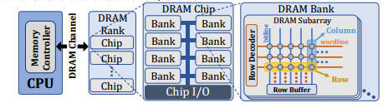
DRAM Hierarchy.
DRAM (dynamic random access memory) is organized in a hierarchy of cells, banks, ranks, and DIMMs, which are connected to one or more channels.

Slide 5
DRAM Hierarchy.
Row-Buffer Timing Side Channel
Opening a row and loading its contents into the row buffer results in a measurable latency. Even more so, repeatedly alternating accesses to two uncached memory locations will be significantly slower if these two memory locations happen to be mapped to different rows of the same bank .
we use this timing difference to identify virtual addresses whose contents lie within the same bank, and also uncover the lower 22 physical addressing bits, thereby enabling double-sided Rowhammer attacks.

Slide 6
Rowhammer
Due to the proximity of word lines in DRAMs, when a word line is activated, crosstalk effects on neighboring rows result in partial activation, which leads to increased charge leakage from cells in neighboring rows. Consequently, when a row is repeatedly opened, some cells lose enough charge before being refreshed to drop to an uncharged state, resulting in bit flips in memory.
A central requirement for triggering Rowhammer bit flips is the capability to make the memory controller open and close DRAM rows rapidly.
Notes:
执行未缓存的内存访问。触发 Rowhammer 位翻转的核心要求是能够使内存控制器快速打开和关闭 DRAM 行。为此，攻击者需要对绕过 CPU 缓存的交替 DRAM 行生成一系列内存访问。已经提出了几种绕过缓存的方法。

Slide 7
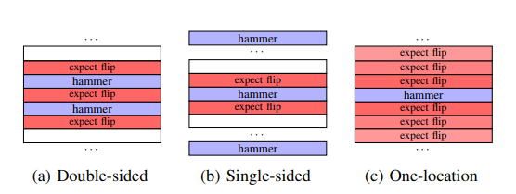
Rowhammer
Another important distinction between Rowhammer attacks is the strategy in which DRAM rows are activated
Double-sided Rowhammer
Single-sided Rowhammer.
One-location Rowhammer.
Notes:
• 手动刷新缓存行。x86 指令集提供了 CLFLUSH 指令，该指令从缓存层次结构的所有级别刷新包含其目标地址的缓存行。至关重要的是，CLFLUSH 只需要对刷新地址的读取访问权限，从而促进来自非特权用户级代码的 Rowhammer 攻击。在 ARM 平台上，在 ARMv8 之前，等效的缓存行刷新指令只能在内核模式下执行；但是，ARMv8 确实为操作系统提供了启用非特权缓存行刷新操作的选项。
• 缓存逐出。在 CLFLUSH 指令不可用的情况下（例如在浏览器中），攻击者可以强制竞争缓存集以导致缓存驱逐 [2, 19]。
• 未缓存的 DMA 内存。范德维恩等。 [61] 报告说，上述缓存逐出方法的速度不够快，无法在当代基于 ARM 的智能手机上引起位翻转。相反，他们使用 Android ION 功能将不可缓存的内存分配给非特权用户空间应用程序。
• 非临时指令。非临时加载和存储指令指示 CPU 不缓存其结果。避免缓存意味着对同一地址的后续访问绕过缓存并从内存 [50] 提供服务。

Slide 8
RAMBLEED
RAMBleed exploits a physical phenomenon in DRAM DIMMs wherein the likelihood of a Rowhammer induced bit flip depends on the values of the bits immediately above and below it.
True Cells. For cells where a one-valued bit is represented as the cell being charged.
0-1-0 0-0-0
Anti Cells. For cells where a one-valued bit is represented by an uncharged cell.
1-0-1 1-1-1
“stripe” patterns, “uniform” patterns.

Slide 9
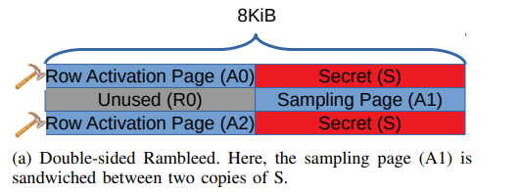
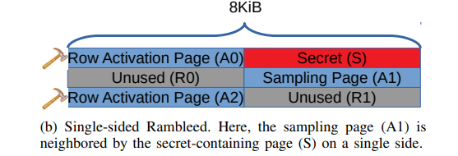
RAMBLEED
1) Initialize.
2) Hammer.
3) Observe.
Double-sided RAMBleed.***
Single Sided RAMBleed.

Slide 10
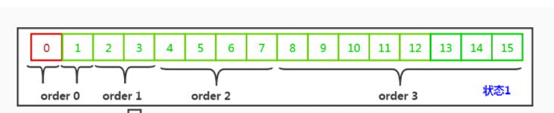
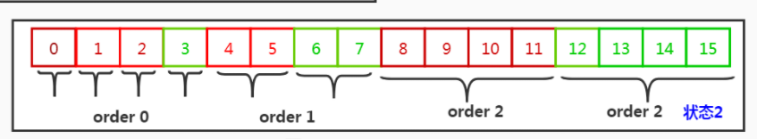
Memory massaging
Obtaining Physically Consecutive Pages
Linux Buddy Allocator.
Obtaining a Physically Consecutive 2 MiB Block.
• Phase 1: Exhausting Small Blocks.
• Phase 2: Obtaining a Consecutive 2 MiB Block.

Slide 11
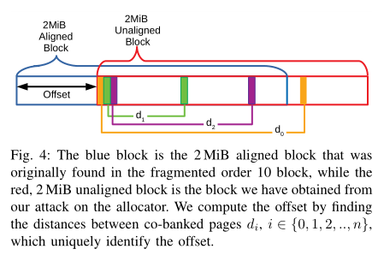
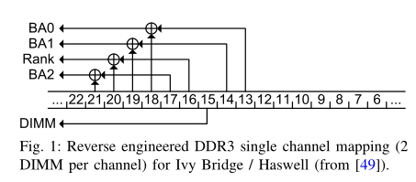
Memory massaging
While the region we obtain in the second allocation is physically consecutive, this approach does not guarantee that the obtained area will be 2 MiB-aligned in the physical memory
Thus, to use the obtained region for Rowhammer, we require an additional step to recover more information about the physical address of the obtained 2 MiB region.
Recovering Physical Addressing Bits.
Computing Offsets.
Recovering Distance Patterns.
Recovering Bit 21.

Slide 12
Memory massaging
Memory Templating
After obtaining blocks of contiguous memory, we proceed to search them for bits that can be flipped via Rowhammer.
We refer to this as the templating phase, which is performed as follows.
We first use our technique to obtain 2 MiB blocks of physically contiguous memory.
Then, we locate addresses that belong to the same bank using the method described above.
Next, we perform double-sided hammering with both 1-0-1 and 0-1-0 striped configurations.
Finally, we record the locations of these flips for later use with RAMBleed

Slide 13
Memory massaging
Placing Secrets Near Flippable Bits
“Frame Feng Shui”
exhausting most of the available memory to control the placement of the victim, we achieve the same result on Linux’s buddy allocator without memory exhaustion.
Exploiting Linux’s Buddy Allocator.
Step 1: Dummy Allocations.
Step 2: Deallocation.
Step 3: Triggering the Victim.

Slide 14
Experimental evaluation
To measure RAMBleed’s capacity as a read side channel, we measure the rate and accuracy of RAMBleed’s ability to extract bits across process boundaries and address spaces under ideal conditions and predictable victim behavior.
Hardware. We use an HP Prodesk 600 desktop running Ubuntu 18.04, featuring an i5-4570 CPU and two Axiom DDR3 4 GiB 1333 MHz non-ECC DIMMs, model number 51264Y3D3N13811, in a single-channel configuration.

Slide 15

Experimental evaluation
Memory Templating.
we found flips at a more modest rate of 41 flips per minute.
Reading Secret Bits.
our experimental code can read out the victim’s secret at a rate of 3–4 bits/second.

Slide 16
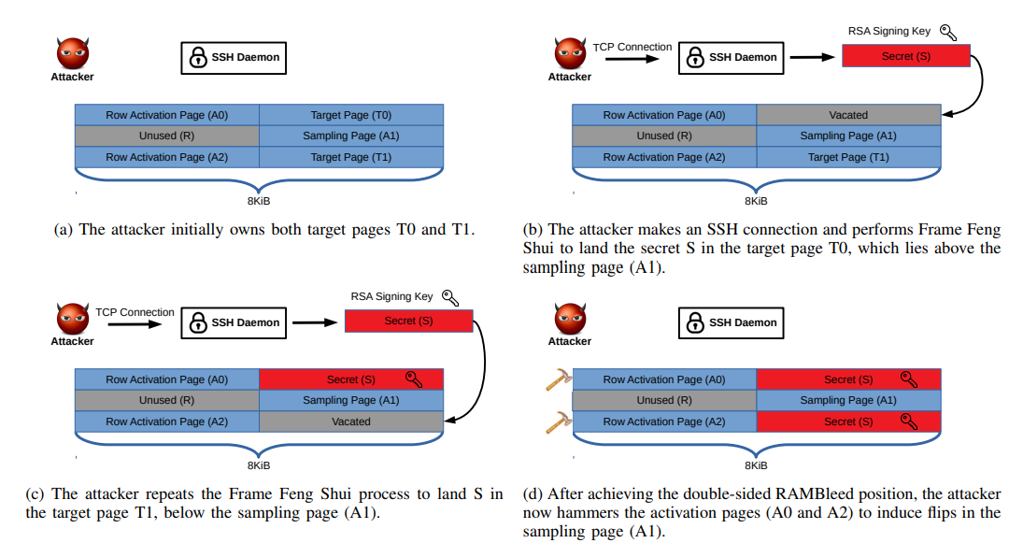
Attacking OpenSSH

Slide 17
Attacking OpenSSH
Memory Templating.
a more modest rate of 41 flips per minute
Removing Useless Bits.
not all of these bitflips are useful for key extraction.
Reading Private Key Material..
recovering 68% of the private key, or 4200 key bits, at a rate of 0.31 bits/second at an accuracy rate of 82% against OpenSSH.
Key Recovery.
we recover the entire RSA private key in about 3 minutes on a consumer laptop

Slide 18
RAMBleed on ECC Memory
Correction Mechanism.
Detecting Bit Flips.
Templating.
replace the single-bit iteration phase with a binary search over the possible locations for the bit flip.
Reading Bits.
we use the timing side channel and look for long read latencies.
successfully read bits via RAMBleed against ECC memory with a 73% accuracy at a reading rate of 0.64 bits/second in our setup.

Slide 19
MITIGATIONS
Hardware Mitigations
Targeted Row Refresh (TRR).
Increasing Refresh Intervals
Using Error Correcting Codes (ECC).
Memory Encryption
Flushing Keys from Memory
Probabilistic Memory Allocator

Slide 20
LIMITATIONS AND FUTURE WORK
RAMBleed’s primary limitation is that it requires the victim process to allocate memory for its secret in a predictable manner in order to reliably read bits of interest.
Another limitation is that our attack against OpenSSH 7.9 required the the daemon to allocate the key multiple times.
RAMBleed’s rate of reading memory is modest, toping at around 3–4 bits per second.

Slide 21
THANKS!

