Slide 1
Uncovering In-DRAM RowHammer Protection Mechanisms: A New Methodology, Custom RowHammer Patterns, and Implications
Renqiu Ouyang
2021.12.9

Slide 2
IEEE/ACM International Symposium on Microarchitecture（micro）
Hasan Hassan

Slide 3
Outline
Abstart
DRAM
RowHammer
TRR
U-TRR
RS
TRR-A
Experiment and Conclusion

Slide 4
Abstart
The RowHammer vulnerability in DRAM is a critical threat to system security. To protect against RowHammer, vendors commit to security-through-obscurity: modern DRAM chips rely on undocumented, proprietary, on-die mitigations, commonly known as Target Row Refresh (TRR).The article put forward Uncovering TRR (U-TRR), an experimental methodology to analyze in-DRAM TRR implementations. U-TRR is based on the new observation that data retention failures in DRAM enable a side channel that leaks information on how TRR refreshes potential victim rows.

Slide 5
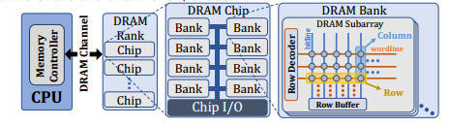
DRAM
A DRAM channel can host one or more DRAM modules, where each module consists of one or more DRAM ranks. A rank is comprised of multiple DRAM chips. A DRAM chip consists of multiple DRAM banks, which share an internal data/command bus. Within a DRAM bank, DRAM cells are organized into multiple dense two-dimensional arrays of DRAM cells called subarrays.
DRAM row within a subarray share a wordline, which is driven by a row decoder to open the row of cells to be read or written. DRAM column within a subarray share a bitline, which is used to read and write to the cells with the help of a row buffer.
Notes:
low latency and low cost per bit
DRAM vendors still push DRAM technology scaling forward to continuously shrink DRAM cells to further reduce the cost of DRAM

Slide 6
RowHammer
Modern DRAM chips suffer from disturbance errors that occur when a high number of activations (within a refresh interval) to one DRAM row unintentionally affects the values of cells in nearby rows.This phenomenon, popularly called RowHammer.
This Phenomenon stems from electromagnetic interference between circuit elements RowHammer becomes exacerbated as manufacturing process technology node size (and hence DRAM cell size) shrinks and circuit elements are placed closer together.
Notes:
现代DRAM芯片遭受干扰错误，当一个DRAM行的大量激活(在刷新间隔内)无意中影响附近行中的单元格的值时，会发生这种错误
electromagnetic interference between circuit elements 电路元件之间的电磁干扰

Slide 7
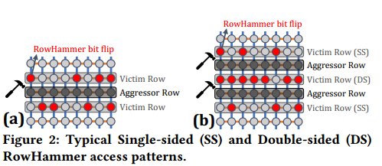
RowHammer
Aggressor row : hammered row.
Victim row : a nearby row that is affected by the hammered row, regardless of whether or not the victim row actually experiences RowHammer bit flips.

Slide 8
RowHammer
Four groups of mitigation mechanisms：
1) increasing the refresh rate to reduce the number of activations that can be performed within a refresh interval;
2)isolating sensitive data from DRAM rows that an attacker can potentially hammer;
3)keeping track of row activations and refreshing potential victim rows;
4)throttling row activations to limit the times a row can be activated within a refresh interval
Notes:
1)增加刷新速率以减少在刷新间隔内可以执行的激活数量
2)将敏感数据与攻击者可能破坏的DRAM行隔离
3)记录行激活信息并刷新潜在的victim row
4)限制行激活，以限制在刷新间隔内可以激活行的次数

Slide 9
Target Row Refresh(TRR)
The main idea of TRR is to detect an aggressor row (a row that is being rapidly activated) and refresh its victim rows (neighboring rows that are physically adjacent to the aggressor row).
The recent work shows that in certain DRAM chips, the TRR mechanism keeps track of only a few aggressor rows.Hence, an access pattern that hammers many aggressor rows can circumvent the TRR protection and induce RowHammer bit flips.

Slide 10
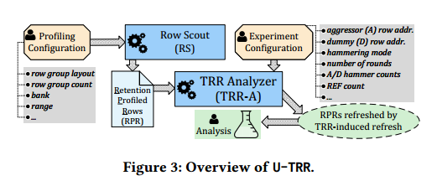
Uncovering TRR(U-TRR)
A new methodology for gaining visibility into Target Row Refresh (TRR) operations.
The two components of U-TRR: Row Scout (RS) and TRR Analyzer (TRR-A)
RS finds a set of DRAM rows that meet certain requirements as needed by TRR-A and identifies the data retention times of these rows.TRR-A uses the RS-provided rows to distinguish between TRR refreshes and regular refreshes, and thus builds an understanding of the underlying TRR mechanism.

Slide 11
Row Scout (RS)
Goal: To identify a list of useful DRAM rows and their retention times, and provide this list to TRR-A.
Requirement:
Rows with uniform retention time
Relative positions of profiled rows
Rows in specific DRAM regions
Rows with short retention times

Slide 12
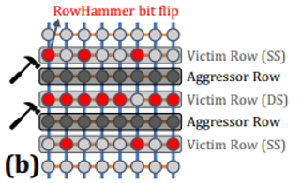
Row Scout (RS)
Requirement
Rows with uniform retention time
A TRR mechanism may refresh multiple victim rows at the same time. To examine whether or not TRR can refresh multiple victim rows at the same time, RS must provide multiple rows that have the same retention time.
Relative positions of profiled rows
The location of a victim row depends on the location of the aggressor rows that the U-TRR user specifies for an experiment. For example, for a double-sided RowHammer attack, RS must provide three rows with the same retention time that are exactly one row apart from each other. TRR-A can then analyze which of the three victim rows get refreshed by TRR when hammering the two aggressor rows that are placed between the victim rows.
Notes:
TRR机制可以同时刷新多个受害行。为了检查TRR是否可以同时刷新多个受害行，RS必须提供具有相同保留时间的多个行。
受害者行的位置取决于U-TRR用户为实验指定的攻击者行的位置。例如，对于双面RowHammer攻击，RS必须提供具有相同保留时间的三行，它们之间相隔一行。然后TRR- a可以分析当敲击放置在受害者行之间的两个攻击者行时，TRR刷新了三个受害者行中的哪一个。

Slide 13
Row Scout (RS)
Requirement
Rows in specific DRAM regions
TRR may treat rows in different parts of a DRAM chip differently by operating independently at different granularities.
Rows with short retention times
The time it takes to finish a single U-TRR experiment depends on the retention time of the rows RS finds. To reduce the overall experiment time, it is critical for RS to identify rows with short data retention times.
Notes:
TRR可以在不同的粒度上独立操作，以不同的方式处理DRAM芯片的不同部分中的行。
完成一个U-TRR实验所需的时间取决于RS发现的行保留时间。为了减少整个实验时间，RS识别数据保留时间短的行是至关重要的。

Slide 14
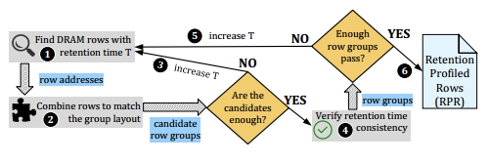
Row Scout (RS)
Operation
❶ RS scans a full rangeof DRAM rows within a DRAM bank, as specified in the profiling configuration, and collects the addresses of rows that experience retention failures if not refreshed over the time interval T.
❷ RS creates candidate row groups by combining the appropriate row addresses (with retention time T) that match the row group layout specified in the profiling configuration.
❸ If the number of candidate row groups is less than the number of row groups to find according to the profiling configuration, RS increases T by a certain amount and starts over from ❶.
Notes:
1) RS扫描DRAM银行中所有的DRAM行，在分析配置中指定，并收集如果没有在时间间隔T刷新，经历保留失败的行地址。
2) RS通过组合与分析配置中指定的行组布局相匹配的适当行地址(具有保留时间T)来创建候选行组。
3) 若候选组的数量达不到配置所需的数量，则增大T，然后从1开始

Slide 15
Row Scout (RS)
Operation
❹ RS tests each row in a candidate row group one thousand times to ensure that all rows in the candidate row group have a consistent retention time that is equal to T.
❺ If the number of candidate row groups that pass the retention time consistency test is less than the number of row groups to find according to the profiling configuration, RS increases T by a certain amount and starts over from ❶.
❻ RS provides a list of retention time-profiled rows to be used by TRR-A
Notes:
4) RS对候选行组中的每一行进行1000次测试，以确保候选行组中的所有行具有一致的保留时间，该保留时间等于T。
5) 若候选组的数量达不到配置所需的数量，则增大T，然后从1开始
6) 将候选组传入到TRR-A

Slide 16
TRR Analyzer(TRR-A)
TRR-A is a configurable and extensible component in U-TRR for analyzing TRR-induced as well as regular refresh operations. Implementing TRR-A on top of a modified version of SoftMC with DDR4 support
Requirement
Ability to hammer multiple aggressor rows with individually configurable hammer counts in a configurable order
Ability to specify dummy rows that are hammered in addition to the aggressor rows
Ability to flexibly issue REF commands
Ability to reset TRR mechanism’s internal state
Notes:
TRR-A是一个可配置和可扩展的U-TRR组件，用于分析trr诱导以及定期刷新操作。在支持DDR4的SoftMC改进版本上实现TRR-A

Slide 17
TRR Analyzer(TRR-A)
Requirement
Ability to hammer multiple aggressor rows with individually configurable hammer counts in a configurable order
To analyze the capability of TRR in detecting multiple aggressor rows, TRR-A should allow the user to specify one or more aggressor rows, their corresponding hammer counts, and the order in which to hammer the aggressor rows.
Ability to specify dummy rows that are hammered in addition to the aggressor rows
The user should be able to specify dummy rows¹ that can be hammered to divert the TRR mechanism to refresh the neighbors of a dummy row instead of victims of an aggressor row.
¹(A dummy row operates similarly to an aggressor row, but it can be implemented more efficiently in a SoftMC program since a dummy row does not need to be initialized with specific data unlike an aggressor row.)
Notes:
锤击多个攻击者行与个别可配置锤计数在一个可配置的顺序
为了分析TRR检测多个攻击者行的能力，TRR- a应该允许用户指定一个或多个攻击者行，它们对应的锤计数，以及锤击攻击者行的顺序。
除了攻击者行之外，还可以指定被锤击的虚拟行
用户应该能够指定虚拟row1，通过锤击改变TRR机制来刷新虚拟行的邻居，而不是攻击者行的受害者。
(虚拟行操作类似于攻击行，但它可以在SoftMC程序中更有效地实现，因为虚拟行不需要像攻击行那样用特定的数据进行初始化。)

Slide 18
TRR Analyzer(TRR-A)
Requirement
Ability to flexibly issue REF commands
To force the TRR mechanism to perform an additional refresh operation when desired during the experiment, TRR-A should allow flexibly issuing an any number of REF commands at arbitrary times.
Ability to reset TRR mechanism’s internal state
The TRR mechanism under study may retain its state beyond a single experiment, potentially causing the TRR mechanism to detect different rows as aggressors depending on previous experiments.
Notes:
能够灵活地发布REF命令
为了在实验过程中强制TRR机制执行额外的刷新操作，TRR- a应该允许在任意时间灵活地发出任意数量的REF命令。
能够重置TRR机制的内部状态
研究中的TRR机制可能会在单个实验之外保持其状态，可能导致TRR机制根据之前的实验检测不同的行作为攻击者。

Slide 19
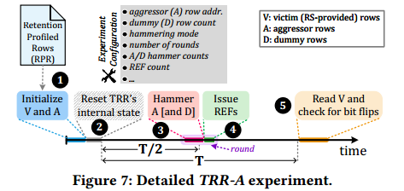
TRR Analyzer(TRR-A)
Operation
❶ Initializing rows’ data
TRR-A initializes the RS-provided rows by writing into them the same data pattern that that RS used for profiling these rows. TRR-A also initializes the aggressor rows, whose addresses are specified in the experiment configuration.
❷ Resetting internal TRR state
the operations we perform in this step make the TRR mechanism clear any internal state that is relevant to rows activated in past experiments or during ❶.
Notes:
初始化行数据
TRR-A通过将RS用于分析这些行的相同数据模式写入这些行来初始化RS提供的行。TRR-A还初始化攻击行，其地址在实验配置中指定。
重置内部TRR状态
我们在这一步中执行的操作，使TRR机制清除任何与过去实验中激活的行相关的内部状态或在注释期间。

Slide 20
TRR Analyzer(TRR-A)
Operation
❸ Hammering aggressor and dummy rows.
❹ Issuing REFs
To cause the TRR mechanism to perform TRRinduced refresh operations on the victim rows, TRR-A issues a number of REF commands.
❺Reading datas and checking for bit flips
Notes:
To cause the TRR mechanism to perform TRRinduced refresh operations on the victim rows, TRR-A issues a number of REF commands.

Slide 21
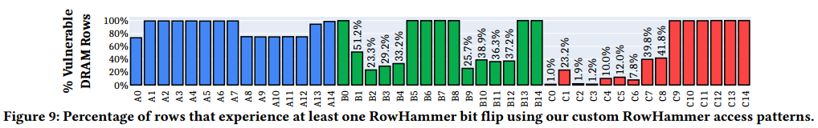
Experiment and Conclusion
Conclusion:
TRR does not provide security against RowHammer and can be easily circumvented using the new understanding provided by U-TRR

Slide 22
Thank you!

