Slide 1
Leveraging EM Side-Channel Information to Detect Row hammer Attacks
By
Joshua Felix Jwakdak
LY2021039

Slide 2
Content
Brief information of the paper (Title, Authors, Institutes, Journal or conference the paper appears in, Published date)
Problem addressed by the paper and the background
Challenges to solve the problem and existing work mentioned in the paper
Solution to the problem proposed by the authors
Experimental results and conclusion

Slide 3
Brief information of the paper
The rowhammer bug belongs to software-induced hardware faults, and has been exploited to form a wide range of powerful rowhammer attacks. Yet, how to effectively detect such attacks remains a challenging problem. In this paper, the paper proposes a novel approach named RADAR (Rowhammer Attack Detection via A Radio) that leverages certain electromagnetic (EM) signals to detect rowhammer attacks.

Slide 4
Brief information of the paper
Authors:
Zhenkai Zhang (Texas Tech University)
Zihao Zhan (Vanderbilt University)
Daniel Balasubramanian (Vanderbilt University)
Bo Li (UIUC)
Peter Volgyesi (Vanderbilt University)
Xenofon Koutsoukos (Vanderbilt University)

Slide 5
Problem addressed by the paper
In this paper, we introduce a new direction to addressing the problem of rowhammer attack detection. Specifically, we propose to leverage certain electromagnetic (EM) emanations to effectively and robustly detect rowhammer attacks. EM sidechannel information is capable of revealing much knowledge about the ongoing activity in a computing device, and it has been extensively exploited to breach confidentiality. However, it has been realized that, as a double-edged sword, such side-channel information can also be used to help build security defenses.

Slide 6
Problem addressed by the paper
Following this line, for the first time, we utilize EM sidechannel information to our advantage for rowhammer attack detection. Because EM emanations are inevitably issued during any computation and can be hardly suppressed by outside adversaries, our proposed approach can detect any potential rowhammer attacks including the extremely elusive ones that are hidden inside attacker-controlled SGX enclaves. Moreover, our detection approach does not degrade the performance or resource utilization of the system under protection.

Slide 7
Background
As a fundamental requirement for implementing security measures, memory protection prevents a process from modifying memory it does not own. However, this essential protection becomes at stake due to the discovery of a vulnerability, known as the rowhammer bug, in the underlying dynamic random-access memory (DRAM). The rowhammer bug belongs to the class of software-induced hardware faults, which makes unauthorized data modifications possible.

Slide 8
Background
The existence of the rowhammer bug has been reported in numerous DRAM chips of DDR3 and DDR4. Since its discovery, this hardware vulnerability has been continuously exploited to form a wide range of powerful rowhammer attacks. Examples of such attacks include sandbox escaping privilege escalation cryptography subversion, denial-of-service, and even confidentiality breaching. Furthermore, rowhammer attacks have been effectively demonstrated in the presence of ECC mechanism as well as in the context of only sending network packets.

Slide 9
Background
DRAM Organization:
Modern computing devices use DRAM as the main memory. For better memory bandwidth, DRAM is often partitioned into multiple channels. Each channel may be associated with multiple dual in-line memory modules (DIMMs). Each DIMM has one or more ranks (e.g., modern DIMMs can be single- /dual-/quad-/octal-rank), and each rank has multiple banks (e.g., normally there are 8 banks for DDR3 and 16 banks for DDR4).

Slide 10
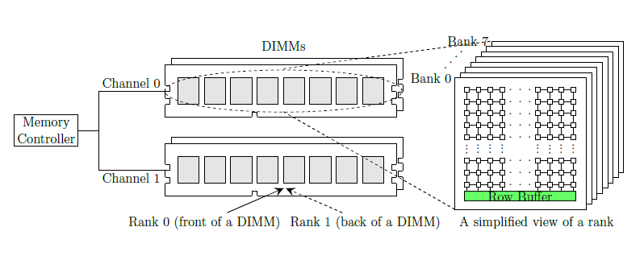
Background
As depicted in Fig. 1, each bank can be viewed as a two-dimensional array of memory words, organized in rows and columns. The size of the memory word depends on the data bus width, and decides how many cells are needed to store its content (e.g., 64 cells are needed to store a 64-bit memory word).

Slide 11
Background
Each cell consists of a capacitor and a transistor, where the capacitor is either charged or uncharged to represent a binary value1, and the transistor is used to access the capacitor. In each bank, there is also a row buffer, which can hold the contents of a single row. To access a cell, the corresponding row has to be activated first to put the contents of the row into the row buffer, and then the access is served from the row buffer. An activated row remains in the row buffer until being closed by the memory controller, and before then, consecutive accesses to that row will be served directly from the row buffer. Depending on what memory controller policy is being used, an active row can be closed due to different reasons: If the memory controller uses an open-page policy, the active row will not be closed until a different row in the same bank is accessed; and such a causal event is often called a row conflict. On the other hand, if a closed-page policy is employed, the memory controller will proactively close the row.

Slide 12
Background
The Rowhammer Bug and Hammering
As DRAM becomes denser, the capacitor in a cell becomes smaller and the voltage margin separating ‘0’ and ‘1’ becomes lower, which unfortunately have reduced the overall DRAM reliability. First thoroughly studied in, the rowhammer bug has become a well-known DRAM reliability issue: When a DRAM row is repeatedly activated and closed (namely, the row is hammered) enough times within a refresh interval, one or more bits in its physically adjacent rows can be flipped to the opposite value2. Usually, a row that is hammered is referred to as an aggressor row, and a row that has flipped bits is called a victim row.

Slide 13
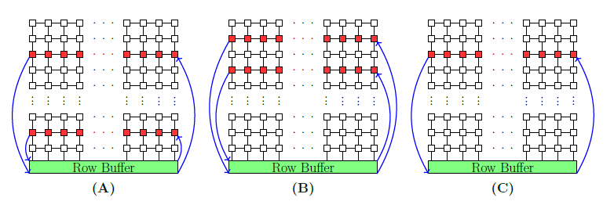
Background
Fig. 2. Three possible hammering techniques in the literature: (A) singlesided hammering; (B) double-sided hammering; and (C) one-location hammering.

Slide 14
Background
Rowhammer Attacks:
Because the rowhammer bug allows one to modify the contents of a DRAM row without explicit permission, severe security risks are posed. Since the discovery of this devastating hardware vulnerability, many powerful attack vectors have been developed by exploiting the rowhammer bug to compromise the security defenses of a system.

Slide 15
Background
Usually, a rowhammer attack consists of three basic phases:
1) Exploration phase. In the first phase, the attacker intensively hammers the DRAM and searches for exploitable bit flips. The prerequisite for performing this phase is to design approaches used to trigger the rowhammer bug on the targeted system. More details will be described below.
2) Manipulation phase. In the second phase, the attacker steers the targeted security-critical data to the vulnerable memory location that has the exploitable bit flips found in the first phase. There are several approaches developed for this specific task, including memory spraying, memory grooming, memory waylaying, and memory ambush.
3) Exploitation phase. Once the security-critical data has been placed at the vulnerable location, in the third phase, the attacker triggers the rowhammer bug again to flip the bit(s), which achieves the final compromise.

Slide 16
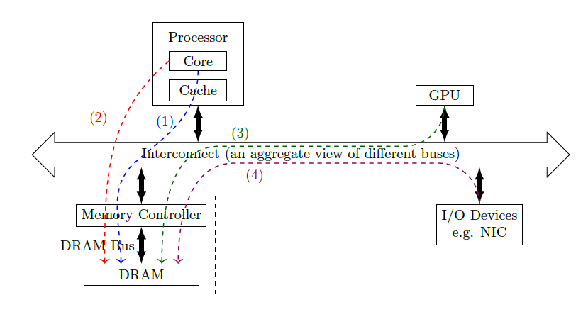
Background
Fig. 3 shows a typical computing platform, and each of the dashed lines in the figure represents a possible path taken to enable fast access to the same location in DRAM: (1) flushing or evicting CPU caches ; (2) bypassing CPU caches; (3) evicting GPU caches; and (4) maneuvering DMA buffers from I/O devices.

Slide 17
Background
EM Emanations
Because the electric current in the circuitry of a computing device varies with time, EM emanations arise. As inevitable physical side effects, EM emanations carry information about the underlying electronic activities, which can be linked with certain high-level activities such as which instructions or loops are being executed. Thus, this information leakage has been exploited to facilitate certain attacks, e.g., stealing cryptographic keys or inferring privacy, Yet, other than being exploited for side-channel attacks, EM emanations have also been used to track code execution for ensuring control-flow integrity or profiling.

Slide 18
Challenges to solve the problem and existing work mentioned in the paper
THREAT MODEL
Assume an attacker has access to a system equipped with DDR3 or DDR4 memory modules. The attacker attempts to find out whether the DRAM of the system has the rowhammer bug, and if so, the attacker also scans for exploitable bit flips for a subsequent attack. Given the very low probability that exploitable bit flips can be found in the first few trials, the attacker needs to intensively hammer the DRAM for such bit flips. In this paper, we assume that the attacker will either utilize special instructions such as clflush (namely flushing the cache) or movnti (namely bypassing the cache), or constantly evict the corresponding cache lines, to achieve either double-sided, single-sided, or one-location hammering. To circumvent simple detections, the attacker may manipulate the system to run an SGX enclave, inside which the malicious activities are performed.

Slide 19
Challenges to solve the problem and existing work mentioned in the paper
NEW DIRECTION TO ROWHAMMER DETECTION
Under the stated threat model, developing effective detection-based defense techniques against the possible rowhammer attacks remains an open research problem. In this section, we discuss why leveraging physical side-channel information, EM emanations in particular, can provide a feasible solution to this problem. As we know, to effectively and robustly detect any type of attacks, we need to discover and rely on information that has a strong correlation with these attacks but can hardly be tampered or concealed by any attacker-controllable running program. Since physical side-channel information leaks much fine-grained knowledge about system activities and can hardly be corrupted by remote adversaries in reality, we can leverage such information to help detect anomalies, including rowhammer attacks.

Slide 20
Challenges to solve the problem and existing work mentioned in the paper
FINDING HAMMERING INFORMATION IN EM SIDE-CHANNEL EMANATIONS
As mentioned in the background section, rowhammer attacks need a hammering process to tentatively trigger the rowhammer bug, and then search for exploitable bit flips. The whole hammering process consists of many hammering attempts, each of which requires a large amount of toggling the activation of aggressor row(s) within a short period of time. In the following discussion, we will call such an activation toggling as a hammering iteration. Therefore, there is a fast and nearly-regular switching behavior in rowhammer attacks in nature. As a consequence, when the three aforementioned hardware components (namely, the memory controller, memory bus, and DRAM modules) are stressed by hammering, the information about the hammering activity is very likely carried by some EM-emanated signals at certain frequencies.

Slide 21
Challenges to solve the problem and existing work mentioned in the paper
Direct EM Emanations
Given the fast switching behavior in a hammering attempt (e.g., the row buffer in a bank is repeatedly opened and closed along with discharging and charging the aggressor rows), we conjecture that there should be clear EM-emanated signals at the possible switching frequencies. Therefore, we are tempted to identify these signals directly. However, there are some challenges and concerns in measuring such direct EM emanations, even though their existence is plausible: First, the switching periods are normally in the range of one hundred to several hundreds of nanoseconds, and therefore the corresponding frequencies are in a rather low spectral range, where much noise exists due to radio stations, appliances, and other sources. Second, these signals may be very weak, and measuring such long wavelength weak signals may require a physically large antenna or a special antenna whose return loss is minimal around the frequencies of interest.

Slide 22
Challenges to solve the problem and existing work mentioned in the paper
AM-Modulated EM Emanations (amplitude modulation)
As we know, many system modules like clocks and voltage regulators intrinsically create EM-emanated periodic signals. According to the study in, some of these periodic signals will be AM-modulated by certain types of activities, and thus information about the corresponding activities can be found in those modulated signals. Moreover, such signals are relatively strong and can propagate far, which lowers the requirements for measuring them. Inspired by this study, we investigate whether it is possible to find information about hammering attempts in some of such AM-modulated signals. As an educated guess, the hammering activity most likely modulates some periodic carrier signals generated in the aforementioned three hardware components.

Slide 23
Challenges to solve the problem and existing work mentioned in the paper
Spread-Spectrum Clocking
One major difficulty in robustly detecting hammering correlated sideband patterns is created by spread spectrum clocking (SSC), which has been commonly used in electronic products like computer systems for meeting electromagnetic compatibility (EMC) regulations. EMC standards impose allowable limits on the EM-emanated signal energy at any frequency above 30 MHz, and many high-frequency clock signals in a computer system (e.g., the DRAM clock) are strong enough to violate such legal limits. To achieve EMC, SSC uses FM-modulation to vary the clock frequency over a range so that the time spent by the clock signal at a particular frequency is reduced and the energy is spread over that range of frequencies.

Slide 24
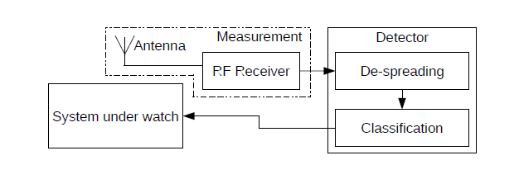
Solution to the problem proposed by the authors
ROWHAMMER ATTACK DETECTION VIA A RADIO
In this section, we propose a rowhammer attack detection system named RADAR (Rowhammer Attack Detection via A Radio), which detects potential rowhammer attacks by identifying hammering-correlated sideband patterns in the Am modulated DRAM clock signal. The diagram of the proposed RADAR system is depicted in Fig. below In the following, we describe each component of our RADAR system.

Slide 25
ROWHAMMER ATTACK DETECTION VIA A RADIO
Measurement Component
In the first step, we use a measurement device to capture the EM-emanated DRAM clock signal. As the time spent in each hammering iteration could be as low as one hundred nanoseconds (e.g., when using one-location hammering on a high-performance platform), to capture both upper and lower hammering-correlated sideband patterns, the measurement device utilizing quadrature sampling should be able to support at least 20 MHz instantaneous bandwidth. Moreover, the clock frequency of interest may be as low as 400 MHz (e.g., DDR3- 800) or as high as 1600 MHz (e.g., DDR4-3200), and thus it is more flexible to have a measurement device that can be tuned to all of the possible frequencies. Fortunately, inexpensive and reliable instruments exist. For simplicity and convenience, in our prototype, we use a software-defined radio for this task. Because a clock signal is a square wave, there is an infinite number of harmonics in the frequency domain. Here we only consider the first harmonic. If there is too much noise around the fundamental frequency, we may try to rely on some higher order harmonics.

Slide 26


ROWHAMMER ATTACK DETECTION VIA A RADIO
De-Spreading Component
As aforementioned, to robustly detect hammering-correlated sideband patterns, we need to counter the effect of SSC by de-spreading the energy in the measured clock signal. Given a clock signal whose frequency is fc, SSC uses FM-modulation to vary the clock frequency in accordance with a signal fm(t) that is generated in the SSC hardware chip but undocumented. At time t, the instantaneous frequency fi(t) of the clock signal becomes:
where K is some proportionality constant. In an analytic form, the effect of SSC is equivalent to multiplying the clock signal by a complex exponential function θ(t), which is defined as:

Slide 27
ROWHAMMER ATTACK DETECTION VIA A RADIO
Classification Component
Having the stream of samples that are processed we continuously perform FFTs to obtain a sequence of spectra. Each spectrum is treated as a feature vector that is fed into a classifier. Since the hammering-correlated sideband patterns are relatively easy to recognize, it is not hard to train an appropriate model to achieve accurate binary classification. However, if we predict there is a potential rowhammer attack as soon as certain hammering-correlated sideband patterns are identified in a single spectrum, the false positive rate may be high because similar patterns may transiently arise due to some factors like noise. Recall that a hammering attempt lasts for a period of time, usually tens of milliseconds, which means that the hammeringcorrelated sideband patterns are very likely present in each spectrum derived within that period of time. On the other hand, if some similar sideband patterns appear in a spectrum, but not due to hammering, they may disappear in the next few spectra. Therefore, we can rely on this temporal dependency to achieve more accurate classification.

Slide 28
ROWHAMMER ATTACK DETECTION VIA A RADIO
Discussion on the Use of Detection Information
When suspicious sideband patterns are recognized, the detector will notify the system under watch that a rowhammer attack may be ongoing. To this end, the detector should be connected to the system through some standard communication interface like USB, and will send notification messages when potential hammering attempts are detected. Upon receiving such a message, we may try to prevent the system from being compromised in a very simple fashion, which is to terminate all of the untrusted processes or the processes belonging to untrusted users. Although this approach can promptly thwart potential rowhammer attacks, it is overly conservative, since many non-malicious processes are also terminated. Alternatively, we may leverage the scheduling information to narrow down the list of suspicious processes (e.g., we can select the untrusted processes that were scheduled to run in the last 100 ms as suspicious ones).

Slide 29
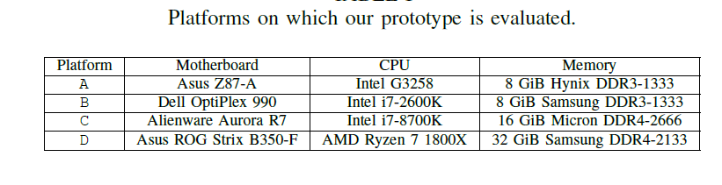
EVALUATION
A RADAR prototype was implemented to demonstrate its practicality, and have evaluated it on four platforms that are summarized in Tab. below, an attacker has various choices of hammering techniques for rowhammer attacks. We show that our approach can protect a system from all these possible techniques. Before presenting the evaluation results, we will first describe our prototype in more detail.

Slide 30
Prototype of RADAR
a software-defined radio was used, LimeSDR, to acquire the EM-emanated DRAM clock signal data. The bandwidth we need is 25 MHz, and LimeSDR can provide 61.44 MHz RF bandwidth in the frequency range of 100 kHz – 3.8 GHz [43], which is more than sufficient for our needs. A LimeSDR costs $2994.We simply use a 20 cm telescopic antenna or two pieces of 7.5 cm metal wire that can be easily placed inside the case. The de-spreading and classification components run on a dedicated computer that serves as our detector. For rapid prototyping, we use the GNU Radio framework, and implement the de-spreading functionality as a GNU radio module. The classification component is implemented under the PyTorch framework and integrated into the GNU radio using the C++ interface. We train a 3-layer CNN model with 20,000 positive examples and 20,000 negative examples. The detector is connected to the system under watch via the USB interface. Note that we need to use a crossover USB cable which has an embedded bridge controller to connect two USB hosts.

Slide 31
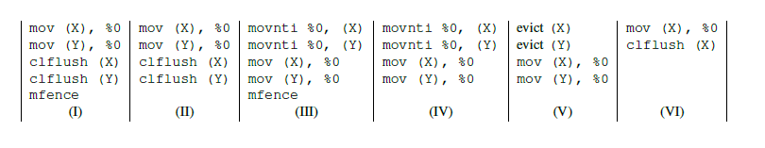
Effectiveness of RADAR
We first evaluate whether our RADAR system can effectively detect potential rowhammer attacks under simple situations, in which no memory-intensive tasks are running. The evaluation is performed in a normal working environment, where computers with the same DRAM clock frequency are present but no closer than 1.8 m (note that later we will show the distance can be as close as 0 m), and the antenna stands outside on the metal case using a magnetic mount. The effectiveness of our RADAR system is evaluated against the hammering methods illustrated in Fig. below. The first five ones (I)–(V) use two addresses to perform single-/doublesided hammering via clflush, movnti, or eviction, and the last one (VI) tests one-location hammering following the tool flipfloyd.

Slide 32
Robustness of RADAR
There are two types of noise that may affect the operation of RADAR. The first type of noise is generated internally, due to a legitimate use of the computer system which changes the power of the DRAM clock signal constantly. To create such noise, we run different applications to impose loads on the memory system. To quantify the obviousness of the sideband patterns, we measure how relatively “tall” the patterns of interest are, namely the power difference between the patterns and their neighboring frequency components.

Slide 33
CONCLUSION
In this paper, we have investigated how to leverage EM side-channel information to detect rowhammer attacks. We have found that there are distinguishable sideband patternsmcorrelated with hammering activities in the spectrum of the DRAM clock signal. Based on this observation, we have proposed and implemented RADAR, which unveils and recognizes hammering-correlated sideband patterns to help set up defenses against even elusive next-generation rowhammer attacks. The effectiveness and robustness of our RADAR have been demonstrated under different scenarios. In the future, we plan to implement the detector part of RADAR using the FPGA on the software-defined radio device.

Slide 34

Thank you

Slide 35
References
M. T. Aga, Z. B. Aweke, and T. Austin, “When Good Protections Go Bad: Exploiting Anti-DoS Measures to Accelerate Rowhammer Attacks,” in 2017 IEEE International Symposium on Hardware Oriented Security and Trust, ser. HOST ’17, 2017, pp. 8–13.
[2] D. Agrawal, B. Archambeault, J. R. Rao, and P. Rohatgi, “The EM Side-Channel(s),” in Proceedings of the 4th International Workshop on Cryptographic Hardware and Embedded Systems, ser. CHES ’02, 2002, pp. 29–45.
[3] M. Alam, H. A. Khan, M. Dey, N. Sinha, R. Callan, A. Zajic, and M. Prvulovic, “One&Done: A Single-Decryption EM-Based Attack on OpenSSL’s Constant-Time Blinded RSA,” in 27th USENIX SecuritySymposium (USENIX Security 18), 2018, pp. 585–602.
[4] Z. B. Aweke, S. F. Yitbarek, R. Qiao, R. Das, M. Hicks, Y. Oren, and T. Austin, “ANVIL: Software-Based Protection Against Next- Generation Rowhammer Attacks,” in Proceedings of the Twenty-First International Conference on Architectural Support for Programming Languages and Operating Systems, ser. ASPLOS ’16, 2016, pp. 743– 755.
[5] M. Backes, M. D¨urmuth, S. Gerling, M. Pinkal, and C. Sporleder, “Acoustic Side-channel Attacks on Printers,” in Proceedings of the 19th USENIX Conference on Security, ser. USENIX Security ’10, 2010.

