Slide 1

Neural Acceleration for General-Purpose Approximate Programs
汇报人：鲁时宇 汇报时间：12.9
Notes:
通用近似程序的神经加速
本文发表在2012年 IEEE/ACM微体系结构国际研讨会中

Slide 2
1.
Introduction
2.
Design
CONTENTS
3.
Evaluation
4.
Limitations and Directions

Slide 3
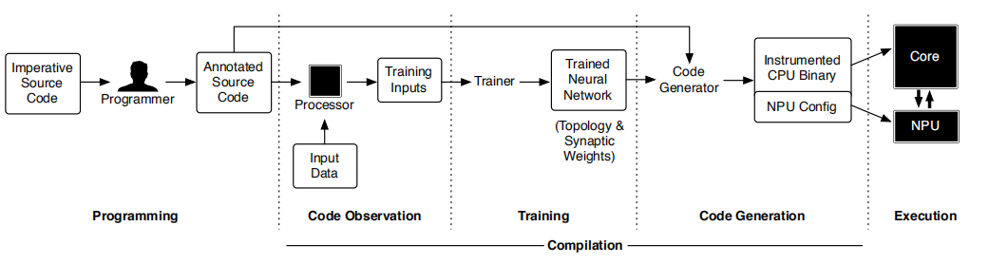
Introduction
Energy efficiency is a primary concern in computer systems. The cessation of Dennard scaling has limited recent improvements in transistor speed and energy efficiency, resulting in slowed general-purpose processor improvements. Consequently, architectural innovation has become crucial to achieve performance and efficiency gains.
Rather than contributing a new design for neural network implementation, this paper presents a new technique for harnessing hardware neural networks in general-purpose computations.

Slide 4
Introduction
Three challenges that must be solved to realize effective trainable accelerators:
A learning algorithm is required that can accurately and efficiently mimic imperative code. We find that neural networks can approximate various regions of imperative code and propose the Parrot transformation, which exploits this finding.
A language and compilation framework should be developed to transform regions of imperative code to neural network evaluations. we define a programming model and implement a compilation workflow to realize the Parrot transformation The Parrot transformation starts from regions of approximable imperative code identified by the programmer, collects training data, explores the topology space of neural networks, trains them to mimic the regions, and finally replaces the original regions of code with trained neural networks.
An architectural interface is necessary to call a neural processing unit (NPU) in place of the original code regions. The NPU we designed is tightly integrated with a speculative out-of-order
core. The low-overhead interface enables acceleration even when fine-grained regions of code are transformed. The core communicates both the neural configurations and run-time invocations to the NPU through extensions to the ISA.

Slide 5
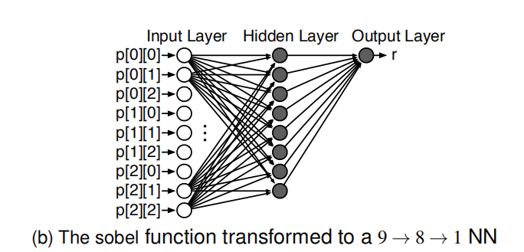
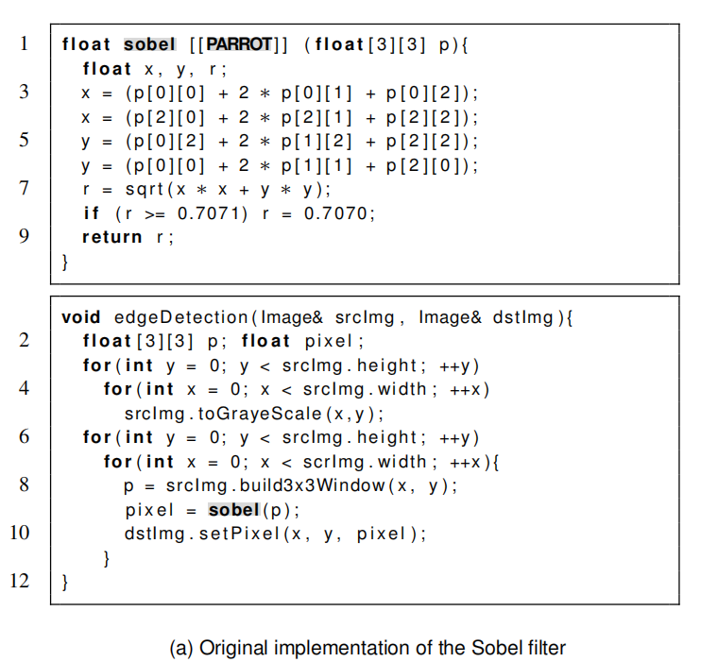
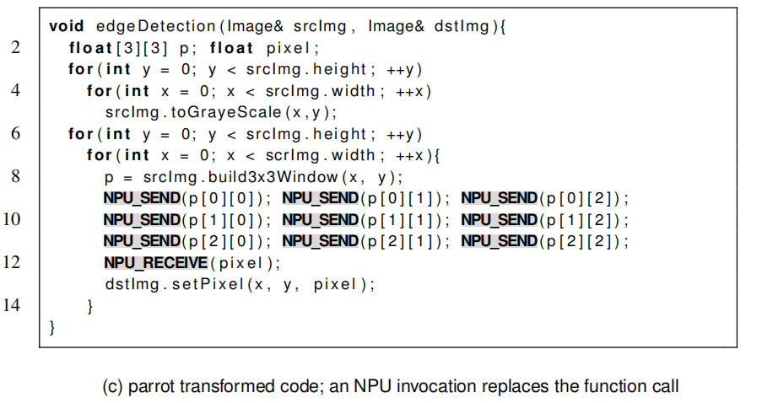
Design:code
Three stages in the transformation of an edge detection algorithm using the Sobel filter.

Slide 6
Design: Compilation
Code Observation
In the first phase, the compiler collects input–output pairs for the target code that reflect real program executions. This in-context observation allows the compiler to train the neural network on a realistic data set.
Training
The compiler uses the training data to produce a neural network that replaces the original function. To choose the topology, we use a simple search algorithm guided by the mean squared error of the neural network when tested on an unseen subset of the observed data.
Code Generation
After the training phase, the compiler generates an instrumented binary that runs on the core and invokes the NPU instead of calling the original function.

Slide 7
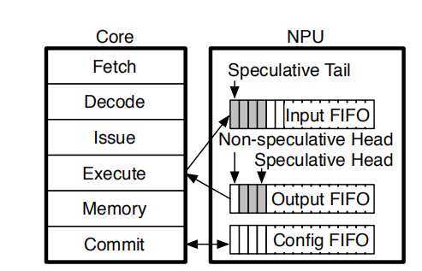
Design: NPU Acceleration
the CPU–NPU interface consists of three queues: one for
sending and retrieving the configuration, one for sending the inputs, and one for retrieving the neural network’s outputs. The ISA is extended with four instructions to access the queues. These instructions assume that the processor is equipped with a single NPU; if the architecture supports multiple NPUs or multiple stored configurations per NPU, the instructions may be parameterized with an operand that identifies the target NPU.
The NPU exposes three FIFO queues to the core. The speculative state of the FIFOs is shaded.
• enq.c %r: enqueues the value of the register r into the config FIFO.
• deq.c %r: dequeues a configuration value from the config FIFO to the register r.
• enq.d %r: enqueues the value of the register r into the input FIFO.
• deq.d %r: dequeues the head of the output FIFO to the register r.

Slide 8
Design: NPU Acceleration
Scheduling and issue.
To ensure correct communication with the NPU, the processor must issue NPU instructions in order. To accomplish this, the renaming logic implicitly considers every NPU instruction to read and write a designated “dummy” architectural register.
Speculative execution
The processor can execute enq.d and deq.d instructions speculatively. Therefore, the head pointer of the input FIFO can only be updated—and consequently the entries recycled— when: (1) the enqueue instruction commits; (2) the NPU finishes processing that input.
Interrupts
If an interrupt were to occur during an NPU invocation, the speculative state of the NPU would need to be flushed.
Context switches.
The NPU’s configuration is architectural state, so the operating system must save and restore the configuration data on a context switch.

Slide 9
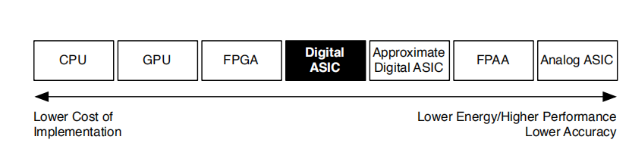
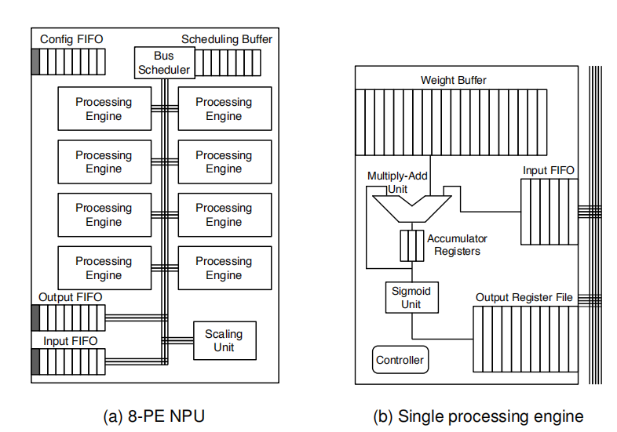
Design: Neural Unit
Design space of NPU implementations. This paper focuses on a precise digital ASIC design.
（a）The NPU stores the bus scheduling information in its circular scheduling buffer
（b） The source is either the input FIFO or the identifier of a PE along with an index into its output register file

Slide 10
Design: Neural Unit
NPU Configuration
The static NPU scheduling algorithm first assigns an order to the inputs of the neural network. This order determines
both the sequence of enq.d instructions that the CPU will send to the NPU during each invocation and the order of multiply-add operations among the NPU’s PEs.
the scheduler takes the following steps
for each layer of the neural network:
1. Assign each neuron to one of the processing engines.
2. Assign an order to the multiply-add operations considering the order assigned to the inputs of the layer.
3. Assign an order to the outputs of the layer.
4. Produce a bus schedule reflecting the order of operations.

Slide 11
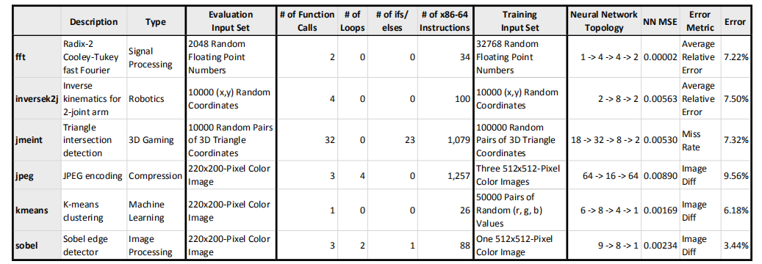
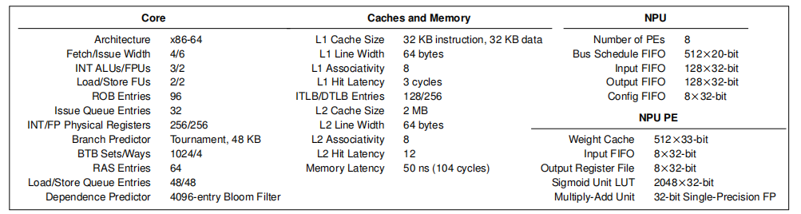
Evaluation
The benchmarks evaluated, characterization of each transformed function, 0 data, and the result of the Parrot transformation.
Microarchitectural parameters for the core, caches, memory, NPU, and each PE in the NPU.

Slide 12
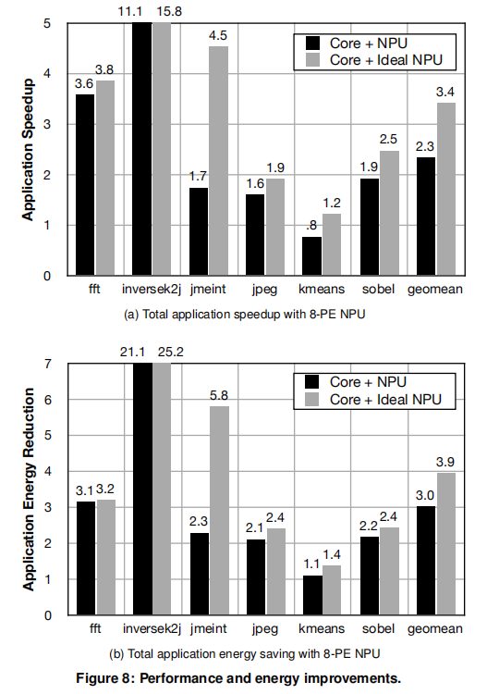
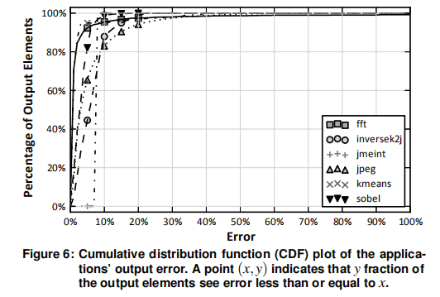
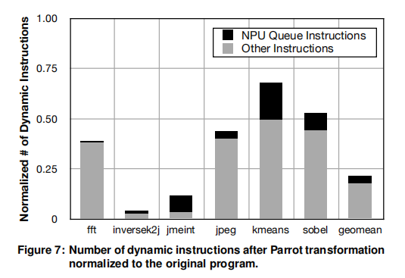
Evaluation

Slide 13
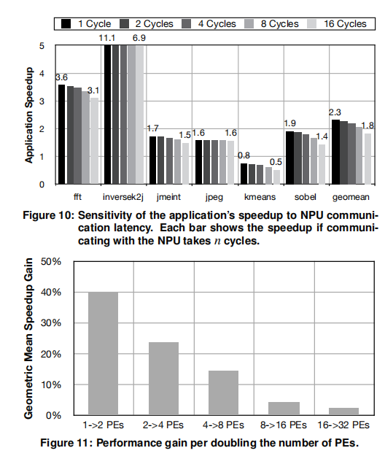
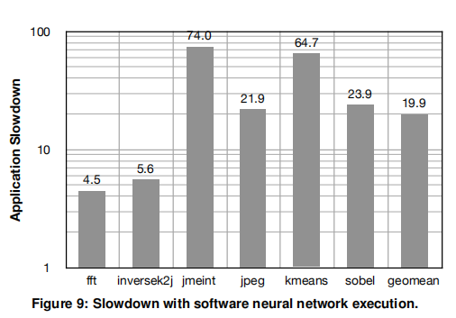
Evaluation

Slide 14
Limitations and Directions
Applicability
• The region must be hot in order to benefit from acceleration.
• The region must be approximable. the program must incorporate application-level tolerance of imprecision in the results of the candidate region.
• The region must have a bounded number of statically identifiable inputs and outputs.
Programmer effort
The Parrot transformation requires programmers to:
identify approximable code regions
provide application inputs to be used for training data collection.
Quality and error control
As long as the frequency of low-quality results is low and the application can tolerate these infrequent large errors, approximation techniques like NPUs can be effective. For this reason, future research should explore mechanisms to mitigate the frequency of such low-quality results.

Slide 15
感谢您的聆听
T H A N K Y O U

