Slide 1


CoNDA: Efficient Cache Coherence Support for Near-Data Accelerators
Amirali Boroumand
Saugata Ghose, Minesh Patel, Hasan Hassan, Brandon Lucia, Rachata Ausavarungnirun, Kevin Hsieh, Nastaran Hajinazar, Krishna Malladi, Hongzhong Zheng, Onur Mutlu
reporter：高瑛璇
id：S2110W0943
Notes:
2019发表在ISCA（体系结构顶会）

Slide 2

Outline
Introduction
Motivation
CoNDA
Architecture Support
Evaluation
Conclusion
Notes:
首先我们来大致看下这篇文章都做了什么

Slide 3
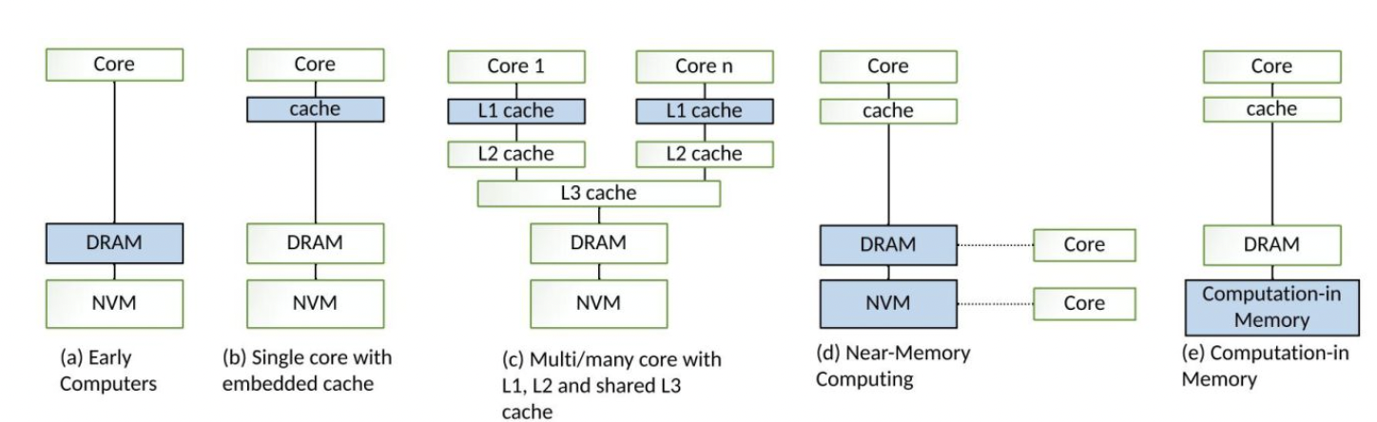
Computing system evolution
Von Neumann bottleneck！
Processing In Memory: Computing operations are performed by
computing units inside a Memory chip.
Processing Near Memory: Computing operations are performed by a separate computing chip located outside the Memory chip. The storage unit and the computing unit are independent of each other.
ASIC
Notes:
大多数现代计算系统是以传统的冯诺依曼结构为基础建立的，物理结构上包括独立的计算单元和存储单元，其在执行各种计算任务的过程中，以计算单元为主，计算单元附近有缓存，需要在存储单元和计算单元之间反复传输大量的数据
随着ai时代的到来，数据处理的量增大，这种体系结构的问题，也就是冯诺依曼瓶颈逐渐显露出来。比如ai中涉及矩阵乘法，可能有大量数据只需要计算一次，并且通常矩阵维度很大时，用指令缓存和数据缓存来存储并不适合，
那么是不是一定要将数据移动至cpu附近，d和e就是我们说的存算一体，d和e是其中两种主流的技术，降低延迟以及功耗，提升数据处理的效率
存内计算（Processing In Memory）：计算操作由位于存储芯片内部的计算单元完成，内存本身具有计算能力（使用具有计算能力的内存（例如基于忆阻器的存算一体芯片M）来完全减少数据移动，）
另外一种 近存储计算（Processing Near Memory）：计算操作由位于存储芯片外部的独立的计算芯片完成。
二者非常相似，区别在于：存储单元和计算单元是否完全独立。
我们今天主要的场景，就是缓存一致性协议的应用场景是近存储计算，

Slide 4

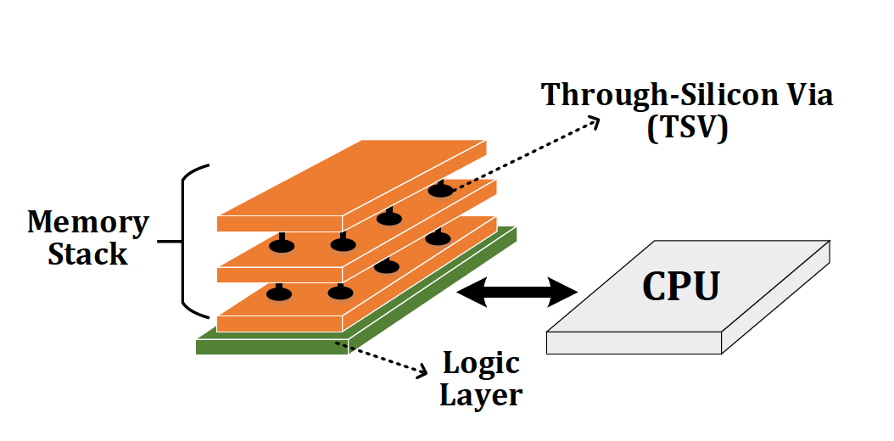
Near-Date Accelerator
Near-Data Processing (NDP)
A potential solution to reduce data movement
Idea: move computation close to data
Enabled by recent advances in 3D-stacked memory
Reduces data movement
Exploits large in-memory bandwidth
Exploits shorter access latency to memory
Notes:
我们把靠近存储单元的计算单元叫做近数据加速器NDA
NDP技术 基于3D内存堆叠技术 得以实现
左侧是Dram 其中一层逻辑层中有许多的NDA芯片
芯片和存储单元之间可以通过 tsv硅痛孔 纵向联系

Slide 5
Coherence For NDAs
Challenge: Coherence between NDAs and CPUs
(1) Large cost of off-chip communication
DRAM
CPU
L2
CPU
L1
CPU
CPU
Compute Unit
(2) NDA applications generate a large amount of off-chip data movement
NDA
ASIC
It is impractical to use traditional coherence protocols
Notes:
使用近数据加速器的挑战 是NDA和CPU的一致性。
包括两个原因:第一，nda和cpu之间的芯片外通信的成本非常高。
其次，NDA应用通常具有较差的局部性，因此产生大量的片外数据移动，从而导致大量的coherence miss。
由于这些挑战，使用传统的一致性协议进行是不切实际的，

Slide 6
Existing Coherence Mechanisms
We extensively study existing NDA coherence mechanisms and make three key observations:
These mechanisms eliminate a significant portion of NDA’s benefits
1
The majority of off-chip coherence traffic generated by these mechanisms is unnecessary
2
Much of the off-chip traffic can be eliminated if the coherence mechanism has insight into the memory accesses
3
ASIC
Notes:
研究现有的NDA一致性机制有以下三点发现
因为要维护CPU和NDA的一致性，使得NDA本身带来的好处（减少数据移动）被抵消了
按照这些机制，为了维护一致性而产生的片外流量大部分是不必要的
我们希望能设计一种机制可以通过分析具体的内存访问操作来识别 哪些为维护一致性而产生的流量是必要的

Slide 7
An Optimistic Approach
We find that an optimistic approach to coherence can address the challenges related to NDA coherence
We propose CoNDA, a coherence mechanism that lets an NDA optimistically execute an NDA kernel
Optimistic execution enables CoNDA to identify and avoid unnecessary coherence requests
CoNDA comes within 10.4% and 4.4% of performance and energy of an ideal NDA coherence mechanism
ASIC
Notes:
基于以上观察，提出了一个乐观的一致性方法来解决上述挑战。CoNDA，
乐观执行使CoNDA能够识别并避免执行不必要的一致性请求。我们的评估表明，

Slide 8
Outline
Introduction
Motivation
CoNDA
Architecture Support
Evaluation
Conclusion
Notes:
前面我们做了一些铺垫，通过NDA来减少数据在计算单元和存储单元的移动，提升数据处理的效率，降低功耗。但关键问题在于如何保证NDA和CPU对应的数据的一致性问题，作者发现现有的一致性协议几乎抹平了nda为我们带来的好处，作者借下来从两个方面阐述motivation，也就是当前的一致性协议有待改善的点

Slide 9
Application Analysis

Slide 10


Sharing Data between NDAs and CPUs
Hybrid Databases (HTAP)
Graph Processing
We find not all portions of applications benefit from NDA
1
Memory-intensive portions benefit from NDA
2
Compute-intensive or cache friendly portions should remain on the CPU
1st key observation: CPU threads often concurrently access the same region of data that NDA kernels access which leads to significant data sharing
ASIC
Notes:
在本文中，我们广泛分析了两类重要应用于NDA的应用程序:图处理框架和混合内存数据库。我们发现并非这些应用程序的全部都能从NDA中受益。
内存密集型：大量的数据移动，并且通常表现为较差的时间局部性 通常将其放到NDA处理受益于3d堆叠内存中可用的高带宽、低延迟和低能量内存访问
计算密集型：计算复杂或那些对缓存友好（利用CPU本身的缓存层次结构）的部件应该留在CPU上，以最大限度地提高性能。
first key observation：CPU线程经常同时访问NDA内核访问的数据区域，这导致了大量的数据共享

Slide 11
Shared Data Access Patterns
2nd key observation: CPU threads and NDA kernels typically do not concurrently access the same cache lines
For Connected Components application, only 5.1% of the CPU accesses collide with NDA accesses
CPU threads rarely update the same data that an NDA is actively working on
ASIC
Notes:
当CPU线程和NDA核共享相同的数据区域时，通常不会同时访问相同的缓存行。即使同时访问了，CPU线程也只是读取cache lines，也就是说cpu很少修改NDA正在工作部分的数据

Slide 12
Analysis of NDA Coherence Mechanisms

Slide 13
Analysis of Existing Coherence Mechanism
We analyze three existing coherence mechanisms:
1
Non-cacheable (NC)
Mark the NDA data as non-cacheable
2
Coarse-Grained Coherence (CG)
Get coherence permission for the entire NDA region
3
Fine-Grained Coherence (FG)
Traditional coherence protocols（e.g. MESI）
ASIC
Notes:
1、将NDA数据标记为不可缓存。不允许CPU缓存NDA正在工作的数据集
在这种情况下，我们不需要担心一致性，因为任何CPU向主存中的写入操作对于NDA来说立即可见。在CPU线程访问NDA数据的次数少的情况下工作得很好，但当CPU频繁访问NDA区域时，它的性能非常差。
2.粗粒度：每当NDA 获得发出一致性请求时，CPU 会写回所有NDA数据区域的对应的脏的缓存行，但事实上NDA不会用到那么多data，造成不必要的数据移动
3.细粒度：正常应用于多核一致性维护是没问题的，但由于NDA架构通信的成本太大，使得协议本身的弊端被放大了，弊端是并不是所有为维护一致性传送的消息都是必要的

Slide 14
Analysis of Existing Coherence Mechanisms
GMEAN
Loses a significant portion of the performance and energy benefits
Increases energy over CPU-only by 64.4% and performs 6.0% worse than CPU-only
Performs 0.4% worse than CPU-only
Poor handling of coherence eliminates much of an NDA’s performance and energy benefits
FG suffers from high amount of unnecessary off-chip coherence traffic
NC suffers from a large number of off-chip accesses from CPU threads
CG unnecessarily flushes a large amount of dirty data
Notes:
横坐标图像处理的应用，和输入的图像；纵坐标是速度的提升，以只用CPU为基准，对数据做了归一化处理。
NC（不缓存）CG（粗粒度）FG（细粒度）Idea（理想的NDA协议，为维护一致性而做的信息传递的成本为0）
为维护一致性进行的数据处理限制了NDA带来的好处。
NC：性能方面不升反降，功耗更大了，比较好理解，是禁用了cpu缓存直接访问主存的结果。
CG：把全部的和NDA共享区域的脏数据全部写回，NDA不会全部访问这些脏数据
FG：表现稍好，但相比理想的NDA还是有显著差距，证明了还是会限制NDA带来的好处，为维护一致性产生了不必要的off-chip流量

Slide 15
Motivation and Goal
Poor handling of coherence eliminates much of an NDA’s benefits
1
1
The majority of off-chip coherence traffic is unnecessary
2
2
Our goal is to design a coherence mechanism that:
3
1
Retains benefits of Ideal NDA
2
Enforces coherence with only the necessary data movement
Notes:
通过分析三种NDA一致性协议和NDA应用
我们发现他们的问题是：因为无法识别哪些一致性流量是不必要的，而降低NDA带来的好处
我们希望设计一个机制能尽可能靠近理想的NDA协议，并且识别哪些数据移动是必要的

Slide 16
Outline
Introduction
Motivation
CoNDA
Architecture Support
Evaluation
Conclusion

Slide 17
Optimistic NDA Execution
We leverage two key observations:
1
Having insight enables us to eliminate much of unnecessary coherence traffic
2
Low rate of collision for CPU threads and NDA kernels
We propose to use optimistic execution for NDAs
NDA executes the kernel:
1
Assumes it has coherence permission
2
Gains insights into memory accesses
ASIC
When execution is done:
Performs only the necessary coherence requests
Notes:
在看具体的机制之前先来了解一下：乐观的执行状态
基于一下两点观察提出
1乐观模式基于两点发现提出:希望能在维护一致性之前识别哪些操作是必要的
2并且CPU和NDA同时访问同一个缓存行的几率很低
如果NDA在乐观模式下执行：假设它的执行过程不会发生任何违反一致性的操作，执行过程中不做一致性的维护，只是跟踪内存访问操作获得insights。
当乐观模式执行完成后，对执行期间实际访问的共享数据，NDA使用insights，分析哪些访问操作违反了一致性，识别必要的一致性请求

Slide 18
High-Level Overview of Optimistic Execution Model
CPU
NDA
Time
Fits well within the context of NDA coherence:
1
CPU Thread Execution
Allows us to identify the necessary coherence traffic
Starts optimistic execution
2
Most of the time optimistic execution works → low re-execution rate
Concurrent CPU + NDA Execution
Optimistic Execution
No Coherence Request
Coherence Resolution
Commit or Re-execute
Notes:
下面是我们乐观执行模型的流程。
一个应用程序在CPU上运行，然后它发出一个调用来将一部分工作分配给NDA上执行。当NDA开始执行时，CPU继续并行执行。
NDA以乐观模式执行，它假设它总是对它使用的cache不会违反一致性，因此不做和CPU的一致性检查。这意味着在执行过程中没有off-chip的一致性请求。
当乐观执行停止时，我们使用insight来检查是否发生了任何违背一致性的情况，并执行必要的一致性请求。

Slide 19
High-Level Overview of CoNDA
We propose CoNDA, a mechanism that uses optimistic NDA execution to avoid unnecessary coherence traffic
CPU
NDA
Time
CPU Thread Execution
Offload NDA kernel
Concurrent CPU + NDA Execution
No Coherence Request
Optimistic Execution
Signature
Signature
Send signatures
Coherence Resolution
Commit or Re-execute
Notes:
因此，基于我刚才解释的乐观执行模型，我们提出了一个一致性机制。
和刚才的类似，CPU将任务卸载给NDA。NDA以乐观模式开始执行。在乐观执行期间，CoNDA使用签名跟踪所有NDA读、NDA写和CPU写的地址。当乐观模式完成后，NDA将这些签名发送给CPU, CoNDA比对这些签名来识别是否违反了一致性。
如果没检测到一致性违反，提交NDA L1缓存中所有更新的数据
如果CoNDA检测到任何一致性违反(1)NDA使所有的更新无效;(2) CPU分析签名执行必要的一致性更新（更新缓存行）;(3) NDA重新执行
如何检测是否违反一致性？发现违反之后，如何识别必要的一致性维护操作？——比对signature

Slide 20
How do we identify coherence violations?
Notes:
So now lets how we actually identify the necessary coherence request during coherence resolution

Slide 21
Necessary Coherence Requests
Coherence requests are only necessary if:
Both NDA and CPU access a cache line
At least one of them updates it
We discuss three possible interleaving of accesses to the same cache line:
1
NDA Read and CPU Write (coherence violation)
2
NDA Write and CPU Read (no violation)
3
NDA Write and CPU Write (no violation)
ASIC
Notes:
如何通过分析签名识别哪些操作违反了一致性呢：
一定有的特点：NDA和CPU访问了同一条缓存行，并且至少有一个更新（写）数据
分别讨论符合条件的三种情况

Slide 22

Identifying Coherence Violations
CPU
NDA
Time
C1. Wr Z
N1. Rd X
No coherence checks during NDA execution
C2. Rd A
N2. Wr Y
C3. Wr B
N3. Rd Z
1) NDA Read and CPU Write: violation
2) NDA Write and CPU Read : no violation
3) NDA Write and CPU Write: no violation
NDA reads old value of Z
Any Coherence Violation?
Yes. Flush Z to DRAM
Coherence checks happen at the end of NDA kernel
C4. Wr Y
N4. Rd X
C5. Rd Y
N5. Wr Y
N6. Rd Z
“C4” and “C5” are ordered before “N5”
Any Coherence Violation?
No. Commit NDA operations
C6. Wr X
Notes:
例子中，虽然CPU和NDA是并行执行，但我们默认正常的同步顺序是CPU先执行之后NDA再执行

Slide 23
Outline
Introduction
Motivation
CoNDA
Architecture Support
Evaluation
Conclusion
Notes:
Before we jump into our analysis, lets talk about …

Slide 24
CoNDA: Architecture Support
DRAM
CPU
CPU
L1
NDA Core
L1
Shared LLC
NDAReadSet
NDAReadSet
Coherence Resolution
Coherence Resolution
NDAWriteSet
CPUWriteSet
NDAWriteSet
CPUWriteSet
ASIC
Notes:
左侧cpu右侧dram
dram中有NDA core 和cpu一样都有l1缓存
并且有三个组记录内存访问信息

Slide 25
Optimistic Mode Execution
The CPU records all writes to the NDA data region in the CPUWriteSet
CPU
L1
L1
NDA Core
L1
NDA Core
NDAReadSet
Shared LLC
NDAReadSet
NDAWriteSet
Coherence Resolution
NDAWriteSet
CPUWriteSet
CPUWriteSet
Per-word dirty bit mask to mark all uncommitted data updates
ASIC
The NDAReadSet and NDAWriteSet are used to track memory accesses from NDA
Notes:
左边是cpu端，右边是NDAside。NDA以乐观模式执行时操作都在L1缓存中，并且对每个条目都有一个脏位记录数据是否提交
NDA这边：NDAreadsets，它跟踪NDA的所有读操作;一个NDAwrite set，它记录NDA的所有写操作;
CPUWriteSet记录NDA数据区域中一下两种情况(1)CPU线程在NDA乐观执行期间写入或(2)在NDA内核启动进入乐观模式之前，在CPU缓存中有脏数据。

Slide 26
Coherence Resolution
CPUWriteSet
NDAReadSet
Conflict
CPU
L1
NDA Core
L1
NDAReadSet
Shared LLC
NDAReadSet
Coherence Resolution
NDAWriteSet
Coherence Resolution
CPUWriteSet
CPUWriteSet
If conflicts happens:
The CPU flushes the dirty cache lines that match addresses in the NDAReadSet
If no conflicts:
Any clean cache lines in the CPU that match an address in the NDAWriteSet are invalidated
NDA invalidates all uncommitted cache lines
ASIC
Signatures are erased and NDA restarts execution
NDA commits data updates
Notes:
之后，当乐观执行完成时，NDAReadSet和NDAWriteset两套签名都被发送回CPU端的coherence resolution。然后计算NDAReadSet和CPUWriteSet的交集，以确定两个签名中是否存在相同地址。这里是检测是否有一致性违反的操作
无冲突:如果没有匹配，意味着没有一致性违反。那么提交nda缓存中的数据
通过签名识别必要的一致性更新操作
如果存在匹配，说明违反了一致性。在这种情况下，为此，CPU将所有与NDAReadSet中地址匹配的脏cache line刷新到DRAM（nesserary的一致性操作）

Slide 27
Outline
Introduction
Motivation
CoNDA
Architecture Support
Evaluation
Conclusion
Notes:
Before we jump into our analysis, lets talk about …

Slide 28
Evaluation Methodology
Simulator
Gem5 full system simulator
System Configuration:
CPU
16 cores, 8-wide, 2GHz frequency
L1 I/D cache: 64 kB private, 4-way associative, 64 B block
L2 cache: 2 MB shared, 8-way associative, 64 B blocks
Cache Coherence Protocol: MESI
NDA
16 cores, 1-wide, 2GHz frequency
L1 I/D cache: 64 kB private, 4-way associative, 64 B Block
Cache coherence protocol: MESI
3D-stacked Memory
One 4GB Cube, 16 Vaults per cube

Slide 29
Applications
Ligra
Lightweight multithreaded graph processing
We used three Ligra graph applications
PageRank (PR)
Radii
Connected Components (CC)
Real-world Input graphs:
Enron
arXiV
Gnutella25
Hybrid Database (HTAP)
In-house prototype of an in-memory database
Capable of running both transactional and analytical queries on the same database (HTAP workload)
32K transactions, 128/256 analytical queries
Notes:
我们研究了两类非常适合NDA的应用程序，评估了来自Ligra(多线程图像处理)的三种图像处理应用，还评估了支持HTAP工作负载的内部内存数据库(IMDB)原型

Slide 30
Speedup
66.0%
GMEAN
FG loses a significant portion of Ideal-NDA’s improvement
NDA-only eliminates 82.2% of Ideal-NDA’s improvement
CG and NC eliminate the entire performance benefit of Ideal-NDA execution
CoNDA consistently retains most of Ideal-NDA’s benefits, coming within 10.4% of the Ideal-NDA performance
Notes:
速度方面
横坐标分别是图像处理和数据库应用，最右侧是平均值，同样以只用cpu为标准做归一化。
不缓存和粗粒度不考虑了
细粒度一执行协议表现不是很好
CoNDA本文的方法相比只用CPU提升了66%，和理想的NDA协议之差10.4%

Slide 31
Memory System Energy
GMEAN
FG loses a significant portion of benefits because of a large number of off-chip coherence messages
CoNDA significantly reduces energy consumption and comes within 4.4% of Ideal-NDA
Notes:
功耗方面还是来看平均值

Slide 32
Outline
Introduction
Motivation
CoNDA
Architecture Support
Evaluation
Conclusion
Notes:
Before we jump into our analysis, lets talk about …

Slide 33
Conclusion
Coherence is a major system challenge for NDA
Efficient handling of coherence is critical to retain NDA benefits
We extensively analyze NDA applications and existing coherence mechanisms. Major Observations:
There is a significant amount of data sharing between CPU threads and NDAs
A majority of off-chip coherence traffic is unnecessary
A significant portion of off-chip traffic can be eliminated if the mechanism has insight into NDA memory accesses
We propose CoNDA, a mechanism that uses optimistic NDA execution to avoid unnecessary coherence traffic
CoNDA comes within 10.4% and 4.4% of performance and energy of an ideal NDA coherence mechanism
Notes:
一致性是NDA的主要系统挑战。有效地处理一致性对于保留NDA的好处至关重要
我们分析了NDA的应用和现有的一致性机制。主要观察:在CPU线程和NDA之间有大量的数据共享，大部分片外的一致性流量是不必要的
如果一致性机制有深入了解NDA内存访问，可以消除很大一部分片外的流量。
CoNDA的性能和功耗分别和理想NDA一致性机制相差10.4%和4.4%

Slide 34



CoNDA: Efficient Cache Coherence Support for Near-Data Accelerators
Amirali Boroumand
Saugata Ghose, Minesh Patel, Hasan Hassan, Brandon Lucia, Rachata Ausavarungnirun, Kevin Hsieh, Nastaran Hajinazar, Krishna Malladi, Hongzhong Zheng, Onur Mutlu

