Slide 1

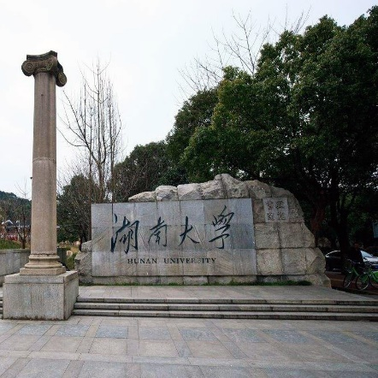
Using Memory Errors to Attack a Virtual Machine
Sudhakar Govindavajhala
Andrew W. Appel
Princeton University
Reporter：Yaohao Huang
Notes:
亮亮图文旗舰店 亮亮图文旗舰店
https://liangliangtuwen.tmall.com

Slide 2

目录
CONTENTS
01
02
03
04
05
Introduction
Attack Method
Analysis
Physical Fault Injection
Countermesure and Conclusion

Slide 3
Introduction
01

Slide 4

Introduction
Softmemory errors can lead to serious security vulnerabilities in Java and .NET virtual machines, or in any system that relies on type-checking of untrusted programs as a protection mechanism.
软内存错误可能会导致Java和.NET虚拟机中的严重安全漏洞，或者任何依赖不可信程序的类型检查作为保护机制的系统中的安全漏洞
Sending to the JVM a Java program that is designed so that almost any mem-ory error in its address space will allow it to take control
of the JVM.
向JVM发送一个Java程序，该程序的设计使其地址空间中的几乎任何内存错误都将允许它控制JVM。
Notes:
引言部分就是简述一下这篇论文做的工作，以及对几个重要名词的解释。首先是

Slide 5
Introduction
什么是软内存错误？
内存错误根据其原因可分为硬错误和软错误。硬错误是由于硬件的损坏或缺陷造成的，因此数据总是不正确的，此类错误是无法纠正的；软错误是随机出现的，例如在内存附近突然出现电子干扰等因素，可能造成内存软错误的出现。操作系统或程序访问内存地址不在当前物理内存中，而在磁盘上的页面文件内的情况。
Notes:
Java 程序被javac工具编译为.class字节 码文件之后，我们执行java命令，该class文件便被JVM的Class Loader加载

Slide 6
Introduction
什么是类型检查？
类型检查是JVM字节校验器的部分功能。作为一种保护机制允许可信和不可信程序之间更紧密的耦合：可以使用面向对象的共享内存接口，而不是跨地址空间的消息传递和远程过程调用。
Notes:
Java 程序被javac工具编译为.class字节 码文件之后，我们执行java命令，该class文件便被JVM的Class Loader加载

Slide 7
Introduction
攻击实现的条件
JVM允许运行通过了类型检查的不受信任的代码
JVM采用链接时检查而不是运行时检查
内存翻转会使程序读回不同的字块
PC机很少提供奇偶校验和纠错码
Notes:
Java 程序被javac工具编译为.class字节 码文件之后，我们执行java命令，该class文件便被JVM的Class Loader加载

Slide 8
Attack Method
02

Slide 9
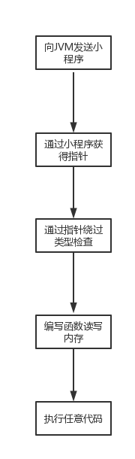
Attack Method
Java中并没有指针的概念，但声明一个类的对象时其作用相当于声明了一个对应类的指针变量
两个指向同一位置的指针，其中一个自身类型与内容类型不同

Slide 10
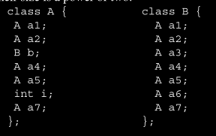
Attack Method
小程序组成：
小程序的组成十分简单。由一个A类对象和许多个B类对象填满堆空间。所有的B类对象都被赋值为A对象的地址x
Our attack applet is quite simple. First, it fills the heap with many objects of class B and one object of class A.All the fields of all the B objects are initialized to point to the unique A object, which sits at addressx.
Classes A and B are defined so that, including the object header, their size is a power of two
A类和B类组成，单位A类和B类所占的内存空间大小是相等的,且是2的幂。

Slide 11
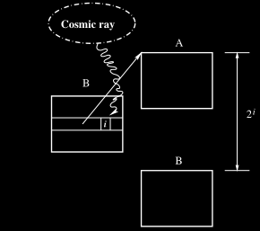
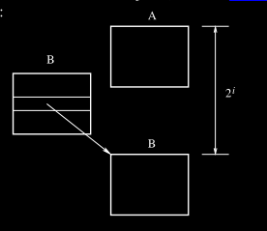
Attack Method
小程序被送到JVM后，开始等待内存出现错误。
此时，我们假设某个B类对象的某个字块的第i位发生翻转。
并且2^i大于单位A类或者B类所占内存的大小。

Slide 12
Attack Method
此时该字块的内容发生改变。
变为x异或2^i。
因此该字块本身是A类的对象，但却很有可能指向一个B类对象的基址。
Suppose a cosmic ray flips theith bit of some word in a B object.
If 2^i is larger than the object size, then x⊕2^i is likely to point to the base of a B object (⊕is the exclusive-or
operator)

Slide 13
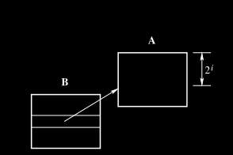

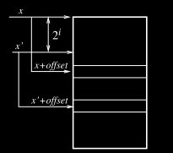
Attack Method
如果2^i小于单位类的内存大小。
此时我们假设一个A类变量p，包含x 。
当程序将p的B类字段引用到一个B类变量s：
On the otherhand, suppose2iis smaller than the object size; then the mutated field points within the A object:
此时s的取值就会出现漏洞
它会认为自己的取值是x+offset
但实际上是x+offset+2^i
这个地址大概率存放的是一个A类对象。
The applet dereferencesp.b; it thinks it’s fetching a field of type B, but it’s really fetching a field of type A

Slide 14
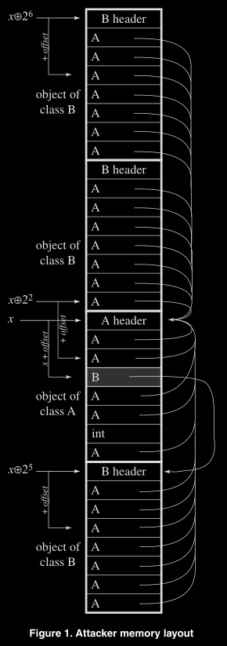

Attack Method
示例：
假设对象B384的a6字段的某个字块发生翻转。我们用一个A类变量r来获取这个字段的内容：
Now suppose that in one of the many B objects, one of the bits in one of the fields has been traversed by a cosmic ray, and flips — for example, bit 5 of fielda6of record b384. We fetch this field into a pointer variablerof type A
跟其他的A类对象一样，B384.a6包含有p的内容，也就是地址x。
右图描述了当i=2、5、6时，q对应的内容。

Slide 15
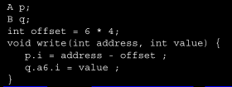
Attack Method
在获得了p、q两个变量之后，就能绕过类型检查：
上面代码中的offset与之前提到的不同
这里的offset指的是A类对象中i字段离基址的偏移量
第一条语句将address-offset写入q.a6
第二条语句将value写入到离q.a6指向地址带有offset偏移量的地方
因此整个程序实现了将value写到address的功能。
进而实现运行任意代码的目的。
The valueoffsetis the offset of the fieldifrom the
base of an A object. This procedure type-checks. The
fieldsiof typeA and a6 of typeB from their bases. Suppose that through our attack,p and q contain the same address. The first statement writesad-dress - offsetat the fieldq.a6. The second statement writes value at an offset ofoffsetfromq.a6.Thus the procedure writesvalueatoffset + (address - off-set) = address.。

Slide 16
Analysis
03

Slide 17
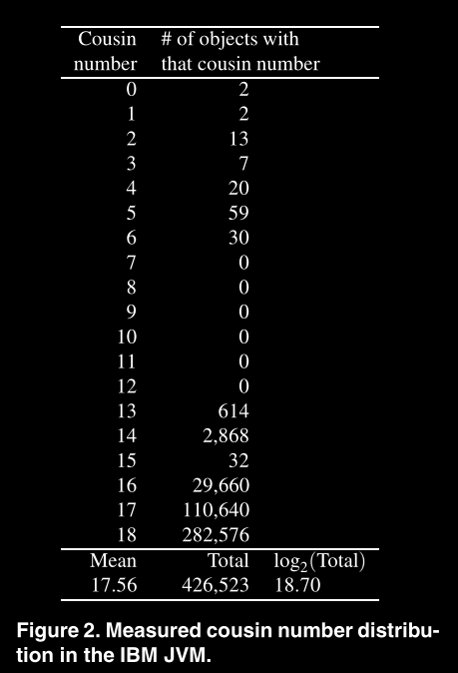
Analysis
性能分析
首先需要定义一些变量：
P：计算机物理内存的字节数
M：程序数据空间的字节数
s: 单位对象中含有的字块数，w=log2（字块大小）
h：单位对象中对象头占有的字块数
那么对象数量则为N=M/(s*（2^w）).
称地址只有一位不同的两个对象为表亲
令x的表亲数目中类B的数量为C(x）
假设对象大小和数目为2的幂并且在内存中连续存在
显然C（x）=log2N
虽然这只是理想条件下的预测值，但论文中提到一台IBM的商业JVM的实验证明了log2N是一个非常好的预测值

Slide 18

Analysis
数据分析
假设字块大小是4，对象大小是1024,32位指针值结构如下：
那么第10位到第27位发生翻转会使指针指向某个B类对象的基址
2到9位发生翻转会使指针指向对象里，加上offset之后指针会指向A类对象中附近的A类或者指向邻近的B类。这些指针不会指向类头，因此可能会导致JVM崩溃。
同时也无法利用特别高位的位，这会使指针指向内存堆外。

Slide 19
Analysis
数据分析
假设K是可利用的单位错误数
那么K=C(x) +log2s;其中C(x)来自高位翻转的利用，log2s来自中位翻转的利用。
K可以用来评价这个攻击的效率
在上述假设中K值为26（18+8）

Slide 20

Analysis
数据分析
对于每一个含有x的A类，每个K中的位发生翻转都是一次成功的利用。于是最终物理内存中可利用的位数的占比为：
由KN(s-h)/8P 展开得来，其中K是可利用的位数，N(s-h)是包含x的A类指针数。

Slide 21
Physical Fault Injection
04

Slide 22
Physical Fault Injection
软内存错误是实现本攻击的必要条件，要人为的对内存造成软错误，有如下几种方式。

Slide 23
Physical Fault Injection
Alpha particles：
Alpha particles are helium nuclei that are typically
formed as a byproduct of radioactive decay of heavy
elements. Obtaining an alpha-particle source from
a scientific supply house might not be too difficult,
or one could obtain a weak source by taking apart a
smoke detector. However, alpha particles don’t pen-
etrate even a millimeter of plastic very well; histor-
ically, when alpha particles have been a significant
source of memory errors it has been when radioac-
tive sources have contaminated the chip packaging
material itself. Alpha particles might be used to at-
tack a computer in the form factor of a credit card,
but anything thicker should be resistant.

Slide 24
Physical Fault Injection
Beta rays：
Beta raysare high-energy electrons. They interact suf-
ficiently strongly with plastic and metal packaging
material that beta rays resulting from decay of radioactive nuclei would not be useful to an attacker.

Slide 25
Physical Fault Injection
X rays：
X-rays or other high-energy photons might penetrate the
packaging material, but interact weakly with DRAM
circuitry – they simply don’t have enough energy
per particle. A dentist’s X-ray or an airport baggage
scanner would be very unlikely to induce memory
errors. A “hard” (very high energy) X-ray source
might possibly do the job

Slide 26
Physical Fault Injection
High-energy protons and neutrons：
High-energy protons and neutrons,such as those pro-
duced by large particle accelerators, are similar to
those cosmic rays that penetrate the atmosphere, and
interact similarly with DRAM chips. Such accelera-
tors are often used to test the resistance of electronic
components to cosmic radiation, especially compo-
nents to be used on aircraft and spacecraft. Few
attackers — indeed, few nation-states — have ac-
cess to such accelerators. However, an Americium-
Beryllium source (such as is used in oil explo-
ration) produces neutrons that could very likely in-
duce memory errors. Access to such sources is
regulated; an attacker could gain access by purchas-
ing a small oil-drilling company, or by becoming em-
ployed at such a company.

Slide 27
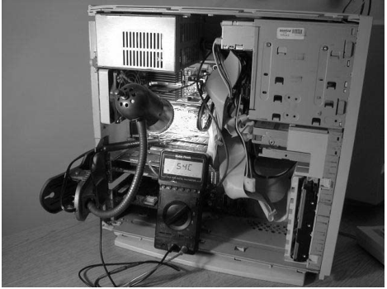
Physical Fault Injection
Infrared radiation：
Infrared radiation produces heat, and it is well known that electronic components become unreliable at high temperatures .We induced memory errors in a desktop PC by opening the box and shining light on the memory chips. We used a clip-on lamp with a flexible gooseneck, equipped with a 50-watt spotlight bulb.

Slide 28
Countermesure and Conclusion
05

Slide 29
Countermesure and Conclusion
Multiple-bit errors：
ECC memory can detect all 1-bit
and 2-bit errors. The probability that a bit flips in the
memory should be extremely small. Otherwise, we may
have bit flips in the control space of the applet, and hence
the applet may crash. For the adversary to successfully
take over the virtual machine, the adversary should create
a multiple bit error without creating 1-bit and 2-bit errors.
If single-bit errors are rare and uniformly randomly dis-
tributed, then the likelihood of a 3-bit error without ECC
detecting any 2-bit or 1-bit errors is vanishingly small.
However, ECC itself cannot provide a complete defense.
Notes:
ECC是对本攻击方法的一种有效而明显的防御方式，但是典型的ECC是设计用来防止自然发生的故障的。因此，对于本文提出的这种协同攻击，还需要额外考虑一些因素。ECC可以检测所有的1位和2位错误，如果发生多位翻转，可能会导致攻击小程序发生崩溃。

Slide 30
Countermesure and Conclusion
Total datapath coverage：
Our attack works regardless of where on the datapath the error occurs. If there is a bus between processor and memory that is not coveredby error detection, then the attacker can attempt to induce
errors in that bus. It is not sufficient to apply ECC just within the memory subsystem. Only a few high-end x86-compatible processors handle ECC on the processor chip.

Slide 31
Countermesure and Conclusion
Logging：
To defend against attacks by heat or other means of in-
ducing errors, the logging system must be able to react to
a substantial increase in the number of errors. If several
errors are detected in a short period, it would be wise to
assume that the system is under attack, and to shut down
— or at least to disable untrustedsoftware that mightcon-
tain implementations of our attack.

Slide 32
Countermesure and Conclusion
Conclusion:
Allowing the attacker to choose the program to be run alters many of the assumptions under which error-protection mechanisms are designed. Virtual machines that use static checking for protection can be vulnerable to attacks that exploit soft memory errors. The best defense is the use of hardware error-detection and correction (ECC), with software logging of errors and appropriate response to unusual patterns of errors

