Slide 1
SIMDRAM: An End-to-End Framework for Bit-Serial SIMD Computing in DRAM
Nastaran Hajinazar^{1,2},Geraldo F. Oliveira¹ , Sven Gregorio¹ , Joao Ferreira¹ , Nika Mansouri Ghiasi¹ , Minesh Patel¹ ,Mohammed Alser¹ , Saugata Ghose³ , Juan Gómez–Luna¹ , Onur Mutlu¹
¹ETH Zürich, ²Simon Fraser University, ³University of Illinois at Urbana–Champaign
ASPLOS ’21, April 19-23, 2021, Virtual, USA
Prensented by:张梦豪
S211000834

Slide 2
Executive Summary
Motivation:
Existing processing-using-DRAM proposals either mostly focus on basic bitwise operations and aren't flexible or require significant changes to the DRAM subarray
Observation:
Shifts can often be eliminated by changing the data-layout, Ambit and RowClone already implement sufficient primitives
Goals:
A framework that aids the adoption of processing-using-DRAM by efficiently implementing complex operations and providing the flexibility to support new desired operations
Idea:
Built up complex operations from basic bitwise primitives by offloading scheduling to a separate SIMDRAM control unit
Evaluation:
Very low area cost (0.2% of a modern CPU)
Throughput analysis shows that SIMDRAM outperforms both CPUs/GPUs by 88x/ 5.8x respectively
257x/31x/2.6x more energy efficient than CPU/GPU/Ambit

Slide 3
Outline
1. Processing-using-DRAM
2. Background
3. SIMDRAM
Processing-using-DRAM Substrate
SIMDRAM Framework
4. System Integration
5. Evaluation
6. Conclusion

Slide 4

Data Movement Bottleneck
Data movement is a major bottleneck
More than 60% of the total system energy
is spent on data movement
Computing Unit
(CPU, GPU, FPGA, Accelerators)
Main Memory
(DRAM)
Memory
channel
Bandwidth-limited and power-hungry memory channel
Notes:
1. Processing-using-DRAM

Slide 5
Problem
Data Movement between memory and CPU is slow and inefficient
Modern applications can be very data intensive, doing computations on large amounts of data can be very slow.
A lot of computation involves applying data-parallel operations to large amounts of data.
Traditional SIMD speeds up processing in the CPU, but memory movement overhead still exists.
Existing Processing-using-DRAM proposals mostly support bitwise operations. Real-world kernels are more complicated, chaining these primitives can be the bottleneck.

Slide 6
Processing-using-Memory (PuM)
PuM: Exploits analog operation principles of the memory circuitry to perform computation
Ambit, an Accelerator-in-Memory for bulk bitwise operations. (the first)
Leverages the large internal bandwidth and parallelism available inside the memory arrays
Simple logical operations (e.g., AND, OR, XOR)
More complex operations (e.g., addition, multiplication)

Slide 7

Inside a DRAM Chip
Bitline
Wordline
Subarray
(2D Array of DRAM Cells)
DRAM Cells
Wordline
Access
Transistor
Bitline
Sense Amplifiers
Row Buffer
Storage
Capacitor
DRAM Bank
DRAM Chips
DRAM Module
Notes:
2. Background

Slide 8
Ambit: Subarray Organization
Regular
row decoder
Data rows
1
1
1
1
1
1
1
1
1
1
1
1
1
1
Control rows
0
0
0
0
0
0
0
0
0
0
0
0
0
0
Compute
row decoder
Address A
Compute rows
Sense amplifiers
DRAM subarray

Slide 9
Goal
SIMDRAM: An end-to-end processing-using-DRAM framework that provides the programming interface, the ISA, and the hardware support for:
Efficiently computing complex operations in DRAM
Providing the ability to implement arbitrary operations as required
Using an in-DRAM massively-parallel SIMD substrate that requires minimal changes to DRAM architecture
Notes:
3. SIMDRAM

Slide 10
SIMDRAM: PuM Substrate
SIMDRAM framework is built around a DRAM substrate that enables two techniques:
(1) Vertical data layout
(2) Majority-based computation
most significant bit (MSB)
C_{out}= AB + AC_{in} + BC_{in}
A
MAJ
Row Decoder
4-bit element size
B
C_{out}
C_{in}
least significant bit (LSB)
Pros compared to the conventional horizontal layout:
Implicit shift operation
Massive parallelism
Pros compared to AND/OR/NOT-based computation:
Higher performance
Higher throughput
Lower energy consumption

Slide 11





SIMDRAM Framework
User Input
Step 1: Generate
MAJ logic
Step 2: Generate
sequence of
DRAM commands
SIMDRAM Output
Desired operation
New SIMDRAM $μ$Program
ACT/PRE
ACT/PRE
ACT/PRE
ACT/ACT/PRE
done
$$μProgram$$
$$μProgram$$
MAJ
Main memory
AND/OR/NOT logic
MAJ/NOT logic
bbop_new
New SIMDRAM
instruction
ISA
$μ$Program
User Input
Step 3: Execution according to $μ$Program
SIMDRAM Output
SIMDRAM-enabled application
Instruction result
in memory
foo () {
bbop_new
}
ACT/PRE
ACT/PRE
ACT/PRE
ACT/PRE/PRE
done
ACT/PRE
Control Unit
$μ$Program
Memory Controller
Notes:
SIMDRAM Framework

Slide 12

Step 1: Naive MAJ/NOT Implementation
A
A
MAJ
C
B
C
output is “1” only when A = B = “1”
B
0
A
A
MAJ
C
B
C
output is “0” only when A = B = “0”
B
1
A
0
MAJ
B
A
Part 1
B
C_{out}
MAJ
C_{out}
MAJ
MAJ
1
C_{in}
1
0
C_{in}
Naively converting AND/OR/NOT-implementation to MAJ/NOT-implementation leads to an unoptimized circuit

Slide 13
Step 1: Efficient MAJ/NOT Implementation
Greedy
optimization
algorithm
0
MAJ
A
MAJ
A
B
Part 2
B
C_{out}
MAJ
1
MAJ
C_{out}
1
MAJ
C_{in}
0
C_{in}
Step 1 generates an optimized
MAJ/NOT-implementation of the desired operation

Slide 14
Step 2: µProgram Generation
µProgram: A series of microarchitectural operations (e.g., ACT/PRE) that SIMDRAM uses to execute SIMDRAM operation in DRAM
Goal of Step 2: To generate the µProgram that executes the desired SIMDRAM operation in DRAM
Allocate DRAM rows to the operands
Generate µProgram

Slide 15


Step 3: µProgram Execution
SIMDRAM control unit: handles the execution of the µProgram at runtime
Upon receiving a bbop instruction, the control unit:
Loads the µProgram corresponding to SIMDRAM operation
Issues the sequence of DRAM commands (ACT/PRE) stored in the µProgram to SIMDRAM subarrays to perform the in-DRAM operation
User Input
Step 3: Execution according to $μ$Program
SIMDRAM Output
SIMDRAM-enabled application
Instruction result
in memory
foo () {
bbop_new
}
ACT/PRE
ACT/PRE
ACT/PRE
ACT/ACT/PRE
done
ACT/PRE
Control Unit
$μ$Program
Memory Controller
18

Slide 16











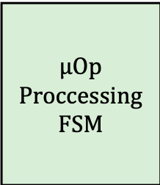









SIMDRAM control unit:
7
is_zero
Loop
Counter
6
decrement
size
1
From
CPU
bbop
FIFO
shift
amount
$μ$Register
Addressing Unit
dst, src_1, src_2, n
$μ$Program
Scratchpad
reg dst.
$μ$Op Proccessing
FSM
2
bbop_op
reg src.
+1
$μ$Op Memory
$μ$Register File
$μ$Op 62
…
…
$μ$Op 0
$μ$Op 63
$μ$PC
/
…
$μ$Op 0
$μ$Op 62
…
$μ$Op 0
$μ$Op 63
$μ$Op 1
branch
target
4
$μ$Op 62
…
$μ$Op 0
$μ$Op 63
$μ$Op 63
$μ$Op
3
1024
16
To Memory
Controller
1024
$μ$Program
5
From $μ$Program
Memory
AAP/AP
Notes:
Set index of Scratchpad to bbop operand (?)
Write number of iterations into loop counter (= data elements / DRAM row size)
uProg is loaded from Scratchpad into μOp Memory
The Program can be executed one μOp at a time
μOp is fetched from μOp memory, indexed by the μPC
Which μRegisters are needed?
B0-B17 → uReg Addressing Unit generates DRAM addresses
B18-B31 → The uReg File provides values
uOp Processing FSM executes the uOp
If done loop counter is decremented
base source and destination addresses are shifted
resets μPC
if loop counter = 0 next bbop is executed

Slide 17
Transposing Data
SIMDRAM operates on vertically-laid-out data
Other system components expect data to be laid out horizontally
Challenging to share data between SIMDRAM and CPU
Notes:
4. System Integration

Slide 18
Transposition Unit
Transforms the data layout from horizontal to vertical, and vice versa
Last–Level Cache
Object Tracker (OT)
Horizontal → Vertical
Transpose
Vertical → Horizontal
Transpose
Transpose Buffer
Transposition Unit
Transpose Buffer
Store Unit
Fetch Unit
Memory Controller

Slide 19
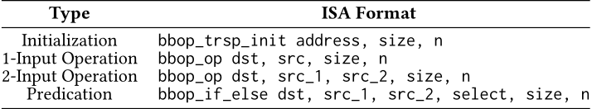
Programming interface
ISA
C Code
Two envisioned ways to use the API:
Manually where the programmer directly writes SIMDRAM primitives.
bbop_trsp_init(A, size, elem_size)...
Automatically using compiler optimizations
Future work

Slide 20
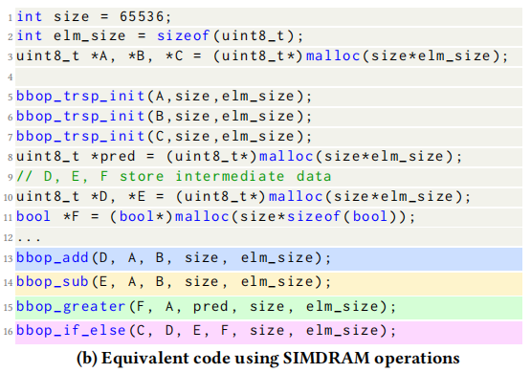
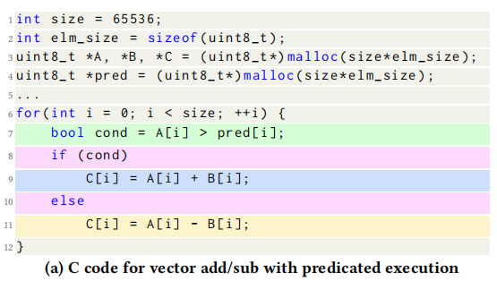
Programming interface

Slide 21
More in the Paper
Efficiently transposing data
Programming interface
Handling page faults, address translation, coherence, and interrupts
Handling limited subarray size
Security implications
Limitations of our framework

Slide 22
Methodology: Experimental Setup
Simulator: gem5
Baselines:
A multi-core CPU (Intel Skylake)
A high-end GPU (NVidia Titan V)
Ambit: a state-of-the-art in-memory computing mechanism
Evaluated SIMDRAM configurations (all using a DDR4_2400_x64 device):
1-bank: SIMDRAM exploits 65’536 SIMD lanes (an 8 kB row buffer)
4-banks: SIMDRAM exploits 262’144 SIMD lanes
16-banks: SIMDRAM exploits 1’048’576 SIMD lanes
Notes:
5. Evaluation

Slide 23
Methodology: Workloads
Evaluated:
16 complex in-DRAM operations:
Absolute - Predication
Addition/Subtraction - ReLU
BitCount - AND-/OR-/XOR-Reduction
Equality/ Greater/Greater Equal - Division/Multiplication
7 real-world applications
BitWeaving (databases) - LeNET (neural networks)
TPH-H (databases) - VGG-13/VGG-16 (neural networks)
kNN (machine learning) - Brightness (graphics)

Slide 24
Throughput Analysis
Average normalized throughput across all 16 SIMDRAM operations
SIMDRAM significantly outperforms
all state-of-the-art baselines for a wide range of operations

Slide 25
Energy Analysis
Average normalized energy efficiency across all 16 SIMDRAM operations
SIMDRAM is more energy-efficient than
all state-of-the-art baselines for a wide range of operations

Slide 26
Real-World Applications
Average speedup across 7 real-world applications
SIMDRAM effectively and efficiently accelerates
many commonly-used real-world applications

Slide 27
More in the Paper
Evaluation:
Reliability
Data transposition overhead
Area overhead
Comparison to in-cache computing
And more …

Slide 28
Conclusion
SIMDRAM: An end-to-end processing-using-DRAM framework that provides the programming interface, the ISA, and the hardware support for:
Efficiently computing complex operations
Providing the ability to implement arbitrary operations as required
Using a massively-parallel in-DRAM SIMD substrate
Key Results: SIMDRAM provides:
88x and 5.8x the throughput and 257x and 31x the energy efficiency of a baseline CPU and a high-end GPU, respectively, for 16 in-DRAM operations
21x and 2.1x the performance of the CPU and GPU for seven real-world applications
Conclusion: SIMDRAM is a promising PuM framework
Can ease the adoption of processing-using-DRAM architectures
Improve the performance and efficiency of processing-using-DRAM architectures
Notes:
6. Conclusion

Slide 29
Thank you
Prensented by:张梦豪
S211000834

